Slide 1
Machine Learning Model

Slide 2
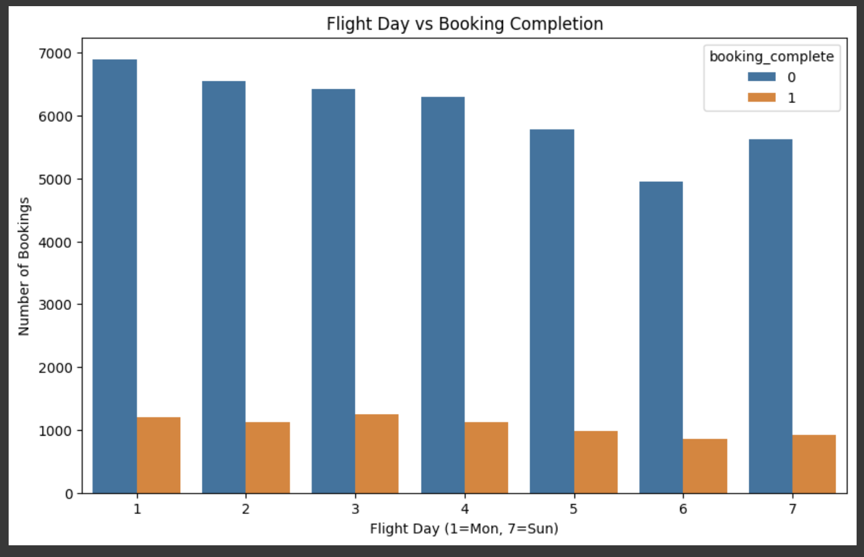
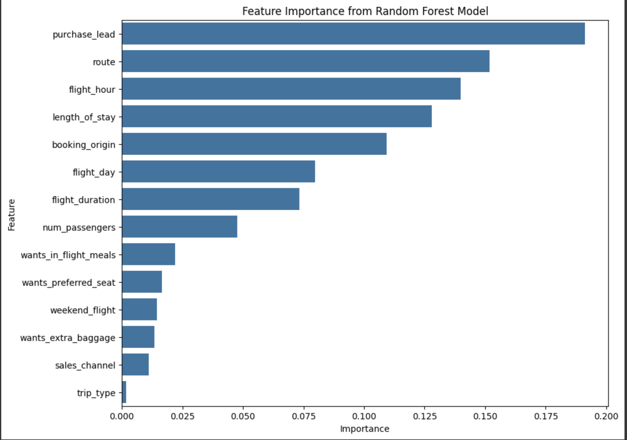
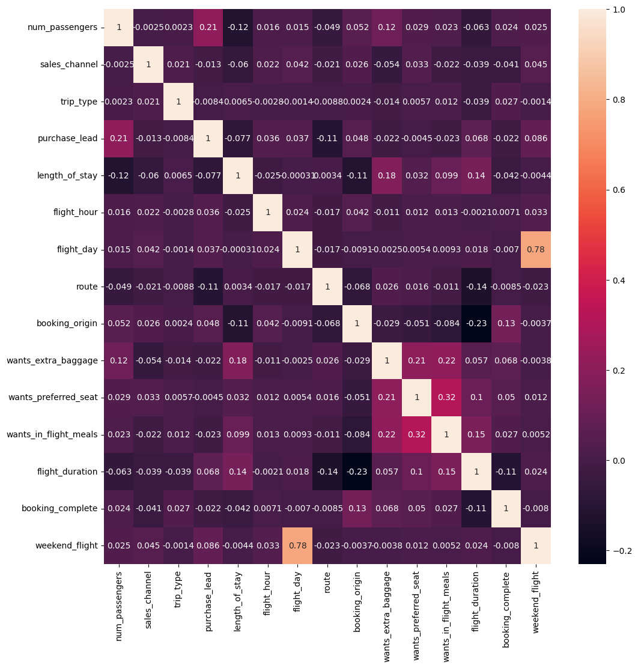
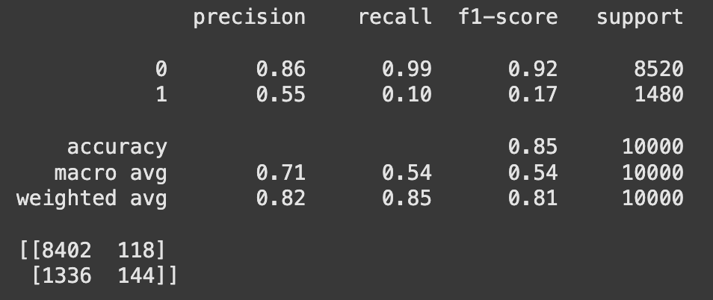
Data Exploration & Preparation: Explored customer booking data, cleaned missing values, applied feature engineering (e.g., weekend flag for flight day), and used one-hot encoding for categorical variables.
Model Training & Evaluation: Trained a RandomForest Calssifier to predict bookings, performed cross-validation, and evaluated using accuracy, precision, recall, and feature importance analysis.
Key Insights & Findings: Booking likelihood is influenced by factors like flight day (weekend vs. weekday), device type, and customer income. The model achieved 86% accuracy, with feature importance visualized for better interpretability.

