Slide 1
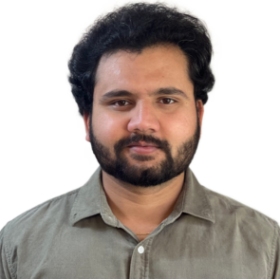


Vamshi
Solution Architecture
0449122842
yathinvamshi05@gmail.com
Overview
About me
Designed, implemented, and maintained AWS/Azure cloud infrastructure in alignment with
security, compliance, and performance requirements.
Proficient in managing AWS IAM, including permissions provisioning and role
assignments for Groups and team members..
Implementing best practices by using AWS, including identity management, authentication management, access management, and auditing. Implemented centralised identity management using AWS IAM Identity Center, enforced strong password policies, and ensured temporary access with break-glass IAM accounts
Demonstrated understanding of Docker fundamentals and Kubernetes basics, including container creation, deployment, and scaling, defining Docker files and building Docker images, to support modern DevOps practices
Graduated with a strong foundation in DevOps principles and a passion for streamlining software development processes. Seeking an entry-level cloud consultant position to apply my skills in automation, continuous integration/continuous deployment (CI/CD), and infrastructure management to contribute to an innovative IT team.
EDUCATION
TORRENS UNIVERSITY
Adelaide 2023
SKILLS
Master of Information Technology
Cloud Platform: AWS and Azure
CI/CD: AWS DevOps, Code Commit, Code Build, Code Deploy
Containers: Docker and Kubernetes
Version Control : GIT
Platforms: Windows, Linux
Web Technologies: HTML, CSS
UI designing Tool: Adobe XD
JAWAHARLAL NEHRU UNIVESITY
India 2019
Bachelor of Computer Science & engineering
Work Experience
Help Desk Agent
Probe Private Limited
Nov 2022 – Mar 2023
Serving as the initial point of contact for customers seeking technical assistance via phone or email. Promptly acknowledging and addressing incoming technical queries and issues.
Conducting remote troubleshooting using diagnostic techniques and relevant questions. Utilizing remote access tools to identify and resolve technical issues efficiently.
Providing accurate and detailed information on IT products or services to customers. Ensuring customers are well-informed about the functionalities and features of relevant products
Liaising with other internal areas to provide required information to the customers.
Documenting and Distributing clear, concise and appropriate support material to customers as required.
Achievements
Developed personal Portfolio using HTML, CSS, JavaScript: https://github.com/Vamshiyathin/portfolio
Achieved apprenticeship certification from developing a web application from DEFENCE (INDIA)
AWS Solution Architecture(Associate)Inprogress.
Customer Support
Andrash Private Limited
May 2020– Present
Providing front-line customer support, addressing inquiries and resolving queries.
Proficient in handling POS.
Establishing strong rapport with customers through clear and effective communication..
Assisting in documenting processes and improving support workflows..
Supervising and supporting junior to maximize quality of service and performance.
Tel: +61 0449122842 Email:yathinvamshi05@gmail.com 1

