Slide 1

Room Utilization Analysis for Reed Mews
Evaluating Occupancy Data to Optimize Space Utilization
VAMSI MUDILA
Notes:
Good afternoon, everyone. My name is Vamsi Mudila, and I am here to present the findings from my analysis of room utilization at Reed Mews.
This presentation will cover the key findings from the data analysis, the approach and tools used, recommendations on whether additional rooms are required, and a scalable solution for continuous monitoring of room usage.
Let’s begin with the objectives of this project.

Slide 2
Objectives
Main Goals:
Analyse current room occupancy for ground and first floors.
Provide empirical evidence on space adequacy.
Offer recommendations for optimal usage and future expansion.
Propose a scalable, real-time monitoring framework.
Notes:
The primary goal of this project is to evaluate the current utilization of rooms at Reed Mews and provide empirical evidence for making decisions regarding additional rooms.
Specifically, we aim to measure room utilization levels, identify trends and anomalies in usage, and provide actionable recommendations to optimize the existing space.
Finally, I propose a scalable solution for ongoing monitoring and predictive analysis to help with future planning.

Slide 3
Key Findings: Room Utilization Metrics
Room | Avg Utilization | Peak Utilization
G01 Occ St | 48.45% | 100%
G02 Occ St | 20.83% | 100%
G03 Occ St | 39.44% | 100%
G04 Occ St | 33.51% | 100%
G05 Occ St | 36.56% | 100%
G06 Occ St | 35.56% | 100%
G07 Occ St | 39.01% | 100%
G08 Occ St | 30.40% | 100%
G09 Occ St | 40.50% | 100%
G10 Occ St | 44.77% | 100%
Ground Floor Highlights:
Average Utilization: 48.45% (Room G01) to 20.83% (Room G02).
Peak Utilization: 100% across all rooms during certain time periods.
First Floor Highlights:
Average Utilization: 42.28% (Unit 11) to 28.11% (Room 1.03).
Peak Utilization: 100% across all rooms.
Trends:
Peak Hours: 10 AM - 3 PM.
Least Used Day: Friday.
Room | Avg Utilization | Peak Utilization
1.01 Occ St | 33.65% | 100%
1.02 Occ St | 36.42% | 100%
1.03 Occ St | 28.11% | 100%
1.04 Occ St | 36.35% | 100%
1.05 Occ St | 33.79% | 100%
Unit 11 On | 42.28% | 100%
Unit 12 On | 29.93% | 100%
Unit 13 On | 41.89% | 100%
Unit 14 On | 32.25% | 100%
Notes:
After analysing the data, here are the key findings for the ground and first floors.
On the ground floor, average utilization ranges from 48.45% for Room G01 to 20.83% for Room G02, with all rooms reaching 100% peak utilization at certain times.
Similarly, on the first floor, average utilization varies between 42.28% for Unit 11 and 28.11% for Room 1.03, with peak utilization again reaching 100%.In terms of trends, the busiest times are between 10 AM and 3 PM, while Fridays show the least utilization across both floors.
These findings indicate that the space is heavily used during specific times, but there are opportunities for better scheduling to reduce overcrowding.

Slide 4
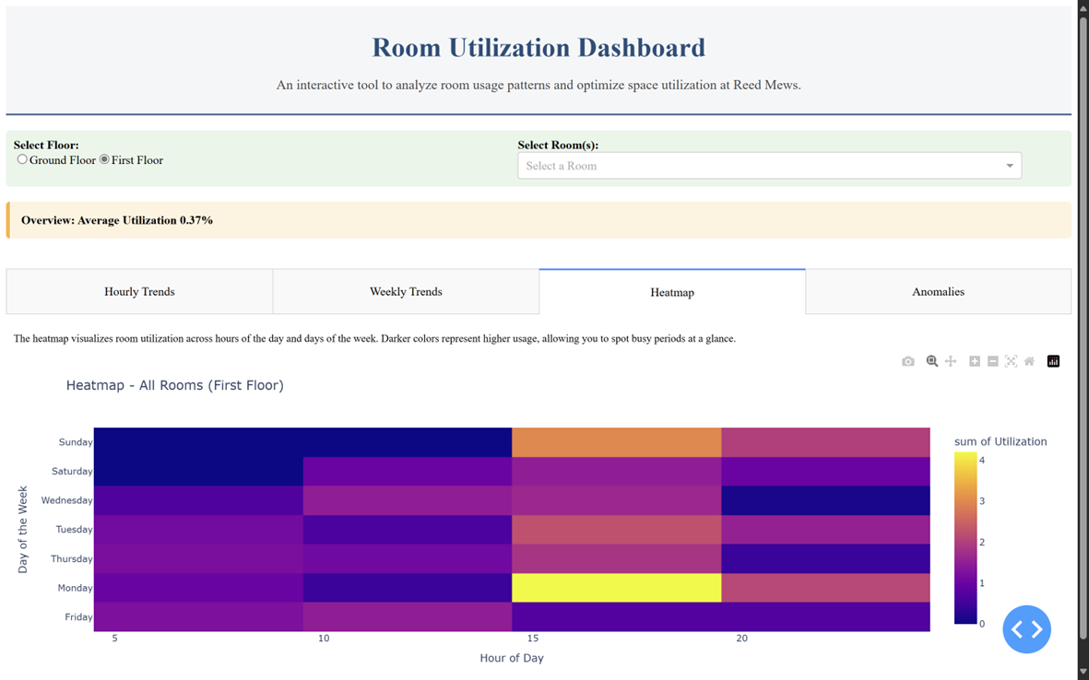
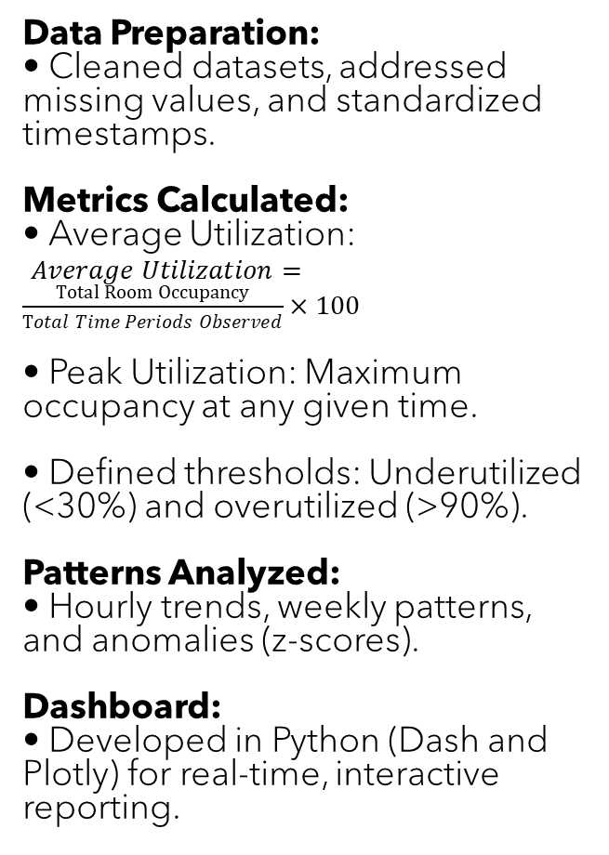
Approach and Methodology
Data Preparation:
Cleaned datasets, addressed missing values, and standardized timestamps.
Metrics Calculated:
Average Utilization:
$Average Utilization=\frac{Total Room Occupancy}{Total Time Periods Observed}×100$
Peak Utilization: Maximum occupancy at any given time.
Defined thresholds: Underutilized (<30%) and overutilized (>90%).
Patterns Analyzed:
Hourly trends, weekly patterns, and anomalies (z-scores).
Dashboard:
Developed in Python (Dash and Plotly) for real-time, interactive reporting.
Notes:
Now, let me walk you through the approach used for this analysis.
First, I prepared the data by cleaning it to remove duplicates, addressing missing values, and standardizing timestamps for time-series analysis.
Metrics like average utilization and peak utilization were calculated, with thresholds set to identify underutilized rooms—those below 30% utilization—and overutilized rooms—those above 90%.Patterns were analysed using hourly and weekly trends, while anomalies were detected using statistical z-scores.
Finally, I developed an interactive dashboard using Python, Dash, and Plotly to visualize the data and insights in real time.

Slide 5
Recommendations
Redistribute Activities:
Increase flexible use of underutilized rooms (e.g., G02, Room 1.03).
Optimize Peak Hours:
Shift activities from 10 AM - 3 PM to early morning or late evening.
Investigate Anomalies:
Address scheduling inefficiencies causing unusual spikes.
No Immediate Need for 9 Additional Rooms:
Current space, if optimized, is sufficient for existing needs.
Implement a Smart Booking System:
Dynamic scheduling based on room usage trends.
Notes:
Based on the analysis, here are my recommendations:
Redistribute activities to underutilized rooms, such as G02 on the ground floor and Room 1.03 on the first floor, to balance usage.
Shift activities during peak hours, which are 10 AM to 3 PM, to less utilized periods in the early morning or evening.
Investigate anomalies that may be caused by scheduling inefficiencies or unexpected events.
Finally, there is no immediate need for the nine additional rooms. Optimizing the existing space through better scheduling and a dynamic booking system should suffice for the current demand.

Slide 6
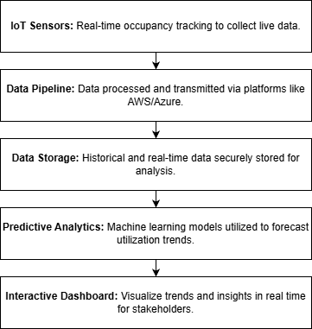
Scalable Solution Proposal
Data Model Design:
Rooms Table: Room ID, Floor, Capacity.
Occupancy Table: Room ID, Timestamp, Occupancy Count.
Anomalies Table: Room ID, Timestamp, Anomaly Score.
Features:
Real-Time Monitoring: IoT sensors for live occupancy tracking.
Historical Storage: AWS/Azure for secure data storage.
Predictive Analytics: Machine learning models for trend forecasting.
Notes:
In this slide, I’ll present the scalable solution proposal, focusing on its data model, core features, and workflow.
Workflow: The diagram illustrates how these components work together. Data flows from IoT sensors into a data pipeline, which processes it and stores it securely in a cloud environment. The stored data is then analyzed using machine learning algorithms to identify patterns, and the results are visualized in an interactive dashboard built using Dash and Plotly.
Transition: "This solution is designed to be scalable, cost-effective, and future-proof, ensuring that Reed Mews can make informed decisions about room utilization efficiently.

Slide 7
Technical Justification
Why Python?
Unified Ecosystem: Data cleaning (Pandas), analysis (NumPy), and visualization (Plotly).
Cost-Effective: Open-source and widely supported.
Scalable: Integrates seamlessly with cloud platforms for future needs.
Future Enhancements:
IoT-Integrated Sensors for live data.
Cloud-Hosted Dashboards for accessibility.
Predictive Analytics for long-term planning.
Notes:
This project was implemented entirely in Python, leveraging its powerful ecosystem for data analysis, visualization, and scalability.
Dash and Plotly were chosen for their ability to create interactive, user-friendly dashboards.
Pandas and NumPy were used for efficient data preprocessing and aggregation, while Seaborn and Matplotlib aided in exploratory visualizations.
For future scalability, cloud platforms like AWS or Azure are recommended to handle real-time data ingestion and predictive analytics.
Using Python ensured a streamlined, cost-effective, and scalable solution tailored to the Estates team’s needs.

Slide 8
Conclusion
Key Takeaways:
Current space is sufficient with optimal scheduling.
Implement recommended changes to redistribute and optimize usage.
Adopt a scalable data model for real-time and predictive insights.
Next Steps:
Deploy the smart booking system.
Begin monitoring with the proposed data model.
Review utilization metrics in 6 months.
Notes:
To conclude, this analysis demonstrates that the current space at Reed Mews is sufficient if scheduling is optimized and underutilized rooms are better utilized.
Implementing the proposed scalable solution will enable real-time monitoring and provide predictive insights for proactive decision-making.
Next steps include deploying a smart booking system, monitoring utilization metrics with the proposed data model, and reviewing results after six months.

Slide 9
Thank you
VAMSI MUDILA
vamsi.mudila@gmail.com
Notes:
Thank you for your attention. I’m happy to answer any questions you may have.

