Slide 1

AI for Music Recommendation and Generation
Team Details:
D. Pavan (22101A010045)
A. Gowri Shankar (22101A010003)
K. Anish (22101A010006)
Vaibhav Tripathi (22101A010185)

Slide 2
AGENDA-REVIEW (05.05.2024)
Abstract
Introduction
Problem Statement
Objectives
Literature Survey
Limitations of Existing System
Workflow of the Proposed System
Methodology
Result and Discussion
Conclusion
Future Scope
References

Slide 3
ABSTRACT
This presentation introduces a music recommendation and playlist creation system driven by AI. It uses sensory traits and genre categories to suggest new music based on shared characteristics. Through K Means clustering, songs are grouped based on their sound features, allowing for tailored playlists that match the user's musical tastes. By analyzing detailed music attributes like instrumentals, danceability, energy, mood, and tempo, the system offers personalized recommendations and interactive playlists based on the user's listening history. This ensures a customized listening experience for each user.

Slide 4
INTRODUCTION
Our system looks at detailed music features like instruments, how easy it is to dance to, its energy, mood, and speed, going beyond just genres. By understanding these aspects, it makes personalized suggestions that fit each user's taste. It sorts songs into groups based on how they sound using smart methods like K Means clustering, making special playlists. Also, it changes according to what users like and what they're doing, making playlists that match the mood. This presentation talks about how technology and music come together to give us amazing music experiences in the digital world. Come along as we discover how AI can change how we enjoy music.

Slide 5
PROBLEM STATEMENT
39. AI for Music Recommendation and Playlist Generation
Methods Utilized:
We use AI to make playlists, looking at how songs sound and what genre they are. We use K Means clustering to group songs accurately. Also, we adjust settings to make sure the grouping is just right, so the music suggestions are good. This method gives users a customized listening experience that matches what they like.

Slide 6
OBJECTIVES
Personalization: Make AI that suggests music based on what each person likes and how they've listened before.
Content Understanding: Use AI to understand music, like its mood or style, to give better suggestions.
Real-time Adaptation: Make AI that changes suggestions instantly based on what you do, so it always fits what you want.
Enhanced User Engagement: Use AI to keep people interested by giving them music they really like and making new music just for them.
Contextual Relevance: Use AI to think about things like what time it is, where you are, and who you're with when suggesting or making music, to make it fit better.

Slide 7
LITERATURE SURVEY
 | Paper Title | Journal / Conference details | Methods Proposed | Datasets Used | Limitations
1. | ARTIFICIAL INTELLIGENCE, MUSIC RECOMMENDATION, AND THE CURATION OF CULTURE(2021) | Policy Report | Collaborative Filtering, Content-based Filtering | Million Song Dataset | Limited to existing user data, may not capture emerging trends.
2. | Explainability in music recommender systems (2021) | Journal Paper | Hybrid recommendation approach combining lyrics and audio content analysis | Million Song Dataset | Limited to songs with available lyrics and audio features
3. | Music Recommendation Using Content-Based Filtering and Collaborative Filtering with Data Fusion Approach (2023) | Research Paper | Fusion of content-based and collaborative filtering approaches | lastfm.csv | Limited scalability for large-scale recommendation systems
4. | Music Recommendation Based on Emotional Cues (2015) | International Conference on Music Information Retrieval | Incorporation of emotional cues for music recommendation |  | Limited emotional annotation of music tracks
5. | Combining Collaborative Filtering and Sentiment Analysis for Music Recommendation (2013) | IEEE International Conference on Big Data | Integration of sentiment analysis with collaborative filtering |  | Limited availability of sentiment-tagged music data

Slide 8
LIMITATIONS OF EXISTING SYSTEM
Here is a condensed list of the limitations from the literature survey table:
Limited to existing user data, may not capture emerging trends.
Limited to songs with available lyrics and audio features
Limited scalability for large-scale recommendation systems
Limited emotional annotation of music tracks
Limited availability of sentiment-tagged music data

Slide 9
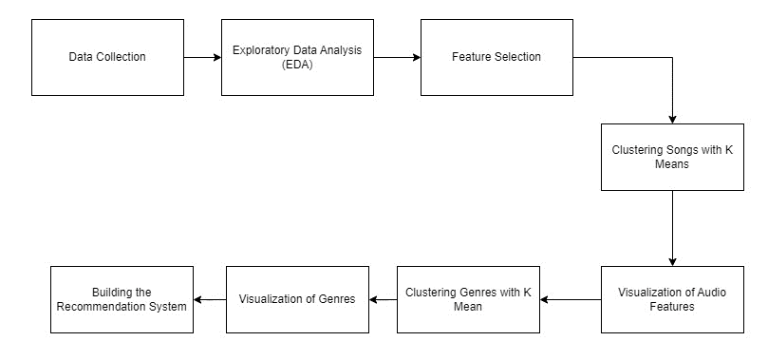
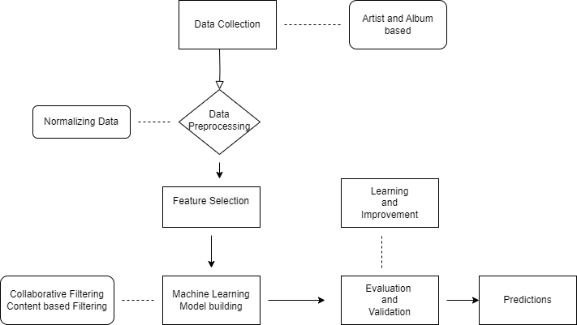
WORKFLOW OF PROPOSED SYSTEM
workflow diagram for AI Music Recommendation and Generation System.

Slide 10
METHODOLOGY
Data Acquisition
Read Data:
data.csv: Main dataset containing track details.
data_by_genres.csv: Genre-specific information.
data_by_year.csv: Annual music features.
Columns in Use:
Valence, Year, Acousticness, Danceability, Energy, etc.
Data Preprocessing
Standardization
Employed StandardScaler to normalize feature scales.
Dimensionality Reduction:
Applied PCA (Principal Component Analysis) for initial feature reduction.
Utilized TSNE (T-Distributed Stochastic Neighbor Embedding) for visualization and further dimension exploration.

Slide 11
METHODOLOGY
Model Building
Clustering with K-Means:
Utilized the K-Means algorithm to group songs into clusters based on features.
Determined optimal cluster count via the elbow method using Euclidean distances.
Evaluation and Iteration
Model Assessment: Evaluated model using silhouette scores to understand the efficacy of the clustering.
Iterative Improvement: Adjusted preprocessing and clustering parameters to optimize the recommendations.
Tools and Libraries Used
Python Libraries: Pandas for data manipulation, Matplotlib for plotting, Scikit-learn for model building.
Environment: Colab provided an interactive environment for coding and visualization.

Slide 12
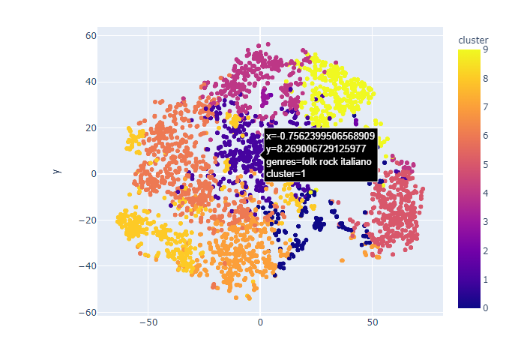
RESULT & DISCUSSION
s
Clustering genres with k-means
K-means clustering is used to divide the genres in this dataset into ten clusters based on the numerical audio features of each genres. This t-Distributed Stochastic Neighbor Embedding (t-SNE) is used to reduce dimensionaility of the genre data and visualize it in a two-dimensional space.

Slide 13
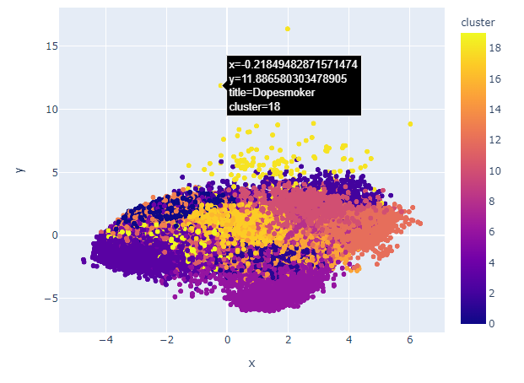
RESULT & DISCUSSION
Clustering song with k-means
This uses PCA to reduce dimensionality and Plotly Express to clusters in a two-dimensional space after K-means clustering is applied to the song data and cluster labels are assigned to each song.

Slide 14
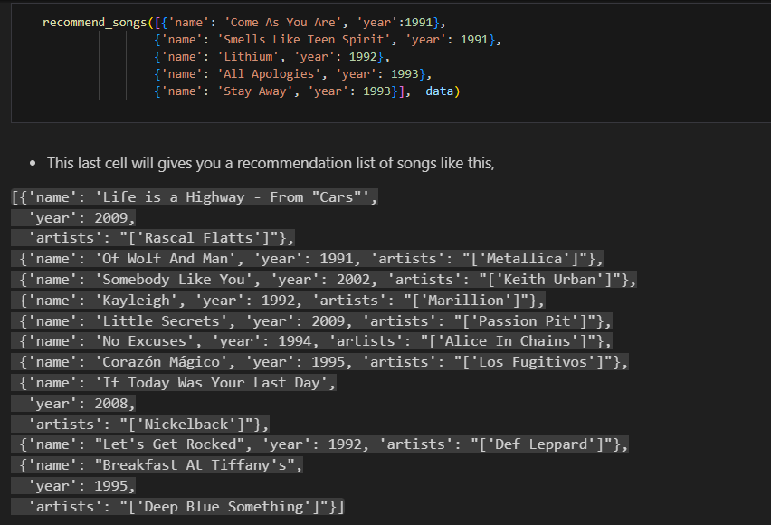
RESULT & DISCUSSION

Slide 15
RESULT & DISCUSSION
Output:
It is evident from the analysis and visualizations that comparable song types are clustered together, and that comparable genres also contain data points that are positioned close to one another.
Songs within related genres will sound similar and originate from similar eras. Similarly, genres will sound similar. By using the data points of the songs a user has listened to, we may leverage this concept to create a recommendation system that suggests songs based on adjacent data points.
Suggested Songs:
A list of songs is provided by the system, together with information about the artists, albums, and years of release.
recommend_song, whose input is a list of dictionaries, most likely containing song data.
Based on user preferences, the function most likely generates song recommendations.

Slide 16
CONCLUSION
The AI-based system for creating playlists and recommending music seems promising. It uses sensory features and music genres to find similarities between songs and suggest music based on common traits. The system also uses K Means clustering to group songs based on how they sound. However, it might struggle to capture all the unique aspects of music creation, which could affect how well it works. To improve, the system could consider user feedback, use better machine learning techniques, and refine how it recommends music. This could help make the music listening experience more personalized and varied for users in the future.

Slide 17
FUTURE SCOPE
The AI-based music recommendation and playlist creation model have a bright future. To make it even better, we can add sentiment analysis to suggest music based on how users feel. Using advanced machine learning like GANs and VAEs could help create more diverse music, appealing to more people. It would also help to use real-time data to keep up with current music trends and what users like. Adding social features would let users share and find music together, making the experience more fun and interactive. By doing these things, the model can become a great music platform that not only suggests personalized music but also helps people make music and connect with others.

Slide 18
REFERENCES
1. Born, G., Morris, J., Diaz, F., & Anderson, A. (2021). Artificial intelligence, music recommendation, and the curation of culture.
2. Afchar, D., Melchiorre, A., Schedl, M., Hennequin, R., Epure, E., & Moussallam, M. (2022). Explainability in music recommender systems. AI Magazine, 43(2), 190-208.
3. Li, J., & Li, S. (2011). Music Recommendation Using Content-Based Filtering and Collaborative Filtering with Data Fusion Approach. *International Conference on Advanced Data Mining and Applications.*
4. Kim, S., & Lee, J. H. (2015). Music Recommendation Based on Emotional Cues. *International Conference on Music Information Retrieval.*
5. Lian, J., & Gou, L. (2013). Combining Collaborative Filtering and Sentiment Analysis for Music Recommendation. *IEEE International Conference on Big Data.*

Slide 19


