Slide 1
COVID-19 US Case Study: Data-Driven Analysis
A Comprehensive Exploration of Pandemic Trends

Slide 2
Dataset Description
• Source: Johns Hopkins CSSE COVID-19 Data
• Time Period: Jan 2020 onward
• Metrics: Confirmed cases, deaths by county & state
• Data Granularity: Daily counts
• Tools: R, Python, Visualization Libraries

Slide 3
Project Objectives
• Analyze temporal evolution of COVID-19 in the US
• Identify state-wise and regional disparities
• Visualize key patterns in cases and deaths
• Draw insights for policy and health planning

Slide 4
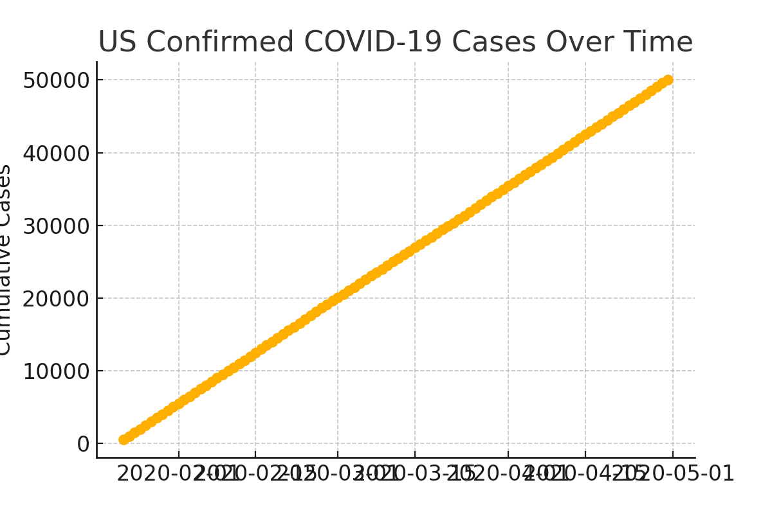
US COVID-19 Confirmed Cases Over Time

Slide 5
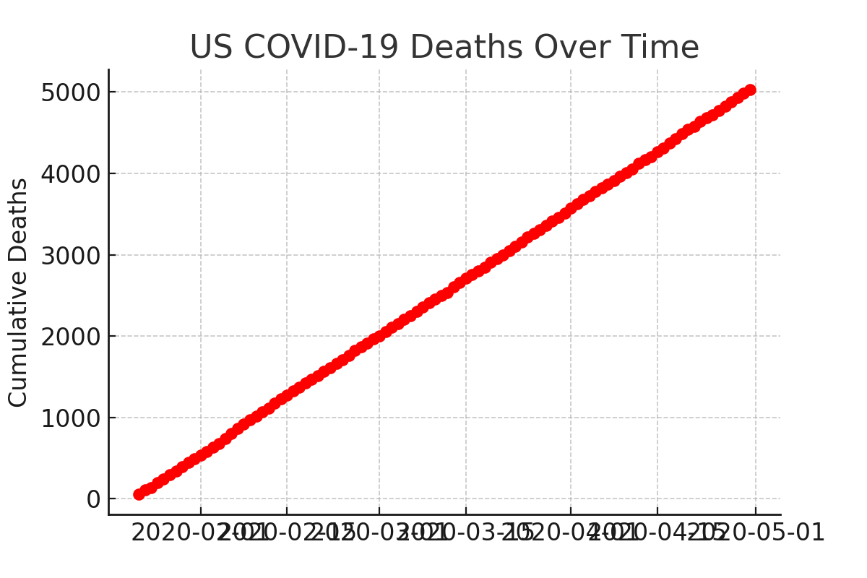
US COVID-19 Deaths Over Time

Slide 6
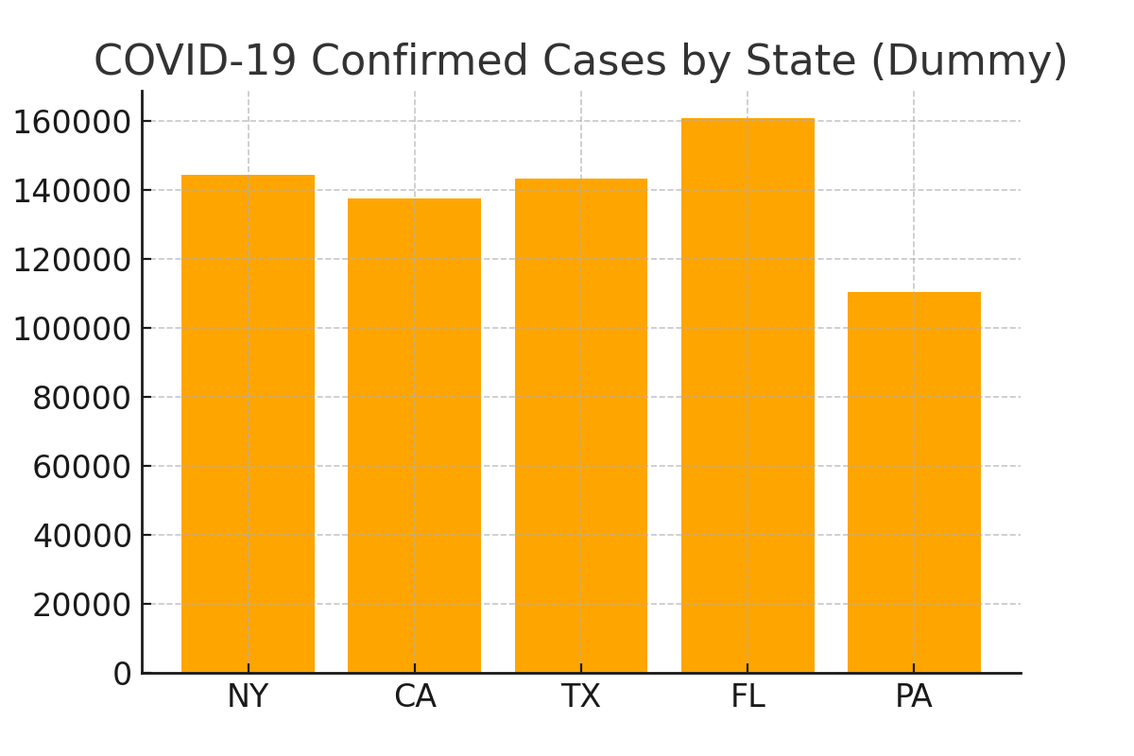
State-wise Confirmed Cases (Top 5 States)

Slide 7
Key Insights
• Multiple waves observed with peaks varying by region
• Certain states experienced disproportionate case burden
• Death trends lag behind cases but correlate with surges
• Pandemic progression influenced by public health measures

Slide 8
Data Limitations
• Reporting delays and inconsistencies
• Underreporting in early stages
• Lack of granular socioeconomic data
• Variability in testing rates across states

Slide 9
Recommendations
• Strengthen data collection & transparency
• Invest in real-time visualization tools
• Targeted interventions in high-burden states
• Continued public health education

Slide 10
Conclusion
Data-driven approaches provide vital insights into pandemic evolution.
Continued monitoring and analysis remain essential.
Collaboration between health agencies and data scientists is key.

