Slide 1

EDGE DETECTION USING PYNQ-Z2 BOARD
Subtitle: FPGA-Based Real-Time Edge Detection Using Custom Sobel Filter IP on PYNQ-Z2.
EEC51806 – PROJECT PHASE 1
Guide: Dr. M. Rajmohan
Presented By:
P. Vamsi Krishna (22119006)
M. Durga Siva Krishna (22119019)
U. Bhavani Shankar (22119018)

Slide 2
ABSTRACT:
Designed and implemented real-time edge detection on FPGA using the Sobel filter.
Utilized hardware IP cores for efficient horizontal and vertical edge computation.
Live image frames are captured, filtered via DMA, and edges are extracted using gradient magnitude.
Achieved substantial acceleration and low resource usage compared to software-only methods.
Developed with Vivado 2018.3 and validated on the PYNQ-Z2 board.
Results show suitability for embedded, scalable, high-performance vision solutions.

Slide 3
INTRODUCTION:
The project focuses on real-time edge detection using the Sobel filter.
Edge detection highlights boundaries in images where there is a sharp change in intensity, helping to identify shapes and features.
A Pynq-Z2 FPGA board is used to accelerate computation by implementing Sobel X and Sobel Y filters in hardware.
The hardware design provides significant speedup compared to software processing, enabling efficient image processing for real-world applications such as forensics, medical imaging, robotics, and autonomous systems.

Slide 4
LITERATURE REVIEW
Title / Publication | Merits / Advantages | Implication For My Project
Sobel Edge Detection Using FPGA – International Journal of Advanced Information Science and Technology. Published: (IJAIST), Vol. 2, No. 11, Nov 2013. | FPGA implementation provides high speed and low power edge detection compared to software execution. Binary image conversion reduces complexity since no square root calculation is required. | Enables real-time image processing for applications like surveillance, robotics, or medical imaging. Simplifies hardware design, but may cause loss of edge details in some images.
Efficient Edge Detection on Low-Cost FPGAs. Jamie Schiel & Dr. Andrew Bainbridge-Smith. Department of Mechatronic Engineering & Department of Electrical and Computer Engineering. University of Canterbury, New Zealand. Published: 2015 | Proposed a new FPGA-based edge detection architecture optimized for low-cost devices. Achieved 28% increase in speed compared to previous designs. Reduced area usage by 4.4%, lowering cost and power. Utilized Sobel kernels (separable, no multiplications required). | Demonstrates that low-cost FPGAs can handle real-time edge detection for UAVs and embedded systems. Provides a scalable method suitable for other FPGA families (e.g., Xilinx).

Slide 5
Title / Publication | Merits / Advantages | Implication For My Project
FPGA Implementation for Real Time Sobel Edge Detector Block Using 3-Line Buffers. Proceedings of 25th The IIER International Conference, Kuala Lumpur, Malaysia, 2nd May 2015, Authors: Ronnie O. Serfa Juan, Chan Su Park, Hi Seok Kim, Hyeong Woo Cha | Efficient real-time edge detection using Sobel operator on FPGA. Pipelined method increases speed. Reduces memory usage via 3-line buffer. Achieved high max frequency (238.687 MHz). | Provides baseline for implementing Sobel edge detection on FPGA PYNQ board. Shows importance of buffer optimization (can adapt 3-line buffer idea for memory efficiency). Highlights FPGA’s suitability for high-speed image processing tasks.
FPGA-based Low-power Sobel Edge Detection System. IRJMETS, Vol.05, Issue 04, April 2023. | Achieves high accuracy in edge detection. Provides real-time performance suitable for robotics, surveillance, and autonomous vehicles. Uses Sobel + Canny combination. | Supports my project goal of real-time edge detection on FPGA PYNQ board. low-power design, Portable systems. Demonstrates adaptability to noisy images, making my design more reliable.

Slide 6
PROBLEM STATEMENT:
Problem: Software-only edge detection is slow for real-time video/image processing.
Gap: Need a high-speed, parallel solution.
Solution: FPGA hardware acceleration with Sobel filters + DMA.
Impact: Real-time performance for vision applications (robots, surveillance, medical imaging, etc.).

Slide 7
OBJECTIVE:
Project Objective | Relevant SDG(s) | SDG Goal Description
Design real-time edge detection on FPGA | SDG 9: Industry, Innovation, and Infrastructure | Promote inclusive and sustainable industrialization and foster innovation
Ensure energy-efficient hardware image processing | SDG 7: Affordable and Clean Energy | Ensure access to affordable, reliable, sustainable and modern energy for all
Apply embedded vision for urban safety and smart infrastructure | SDG 11: Sustainable Cities and Communities | Make cities inclusive, safe, resilient and sustainable
Use open/hands-on tech for education and research | SDG 4: Quality Education | Ensure inclusive and equitable quality education and promote lifelong learning

Slide 8
Implementation of Sobel Steps:
Design and implement a block-based hardware system using Vivado IP Integrator.
Integrate Sobel X and Y filters using custom IP (Intellectual Property) blocks in the PL (Programmable Logic).
Use dual DMA channels (axi_dma_x, axi_dma_y) to transfer image data between DDR and Sobel IPs.
Capture grayscale images using OpenCV and process them using the hardware pipeline.
Display Sobel X, Sobel Y, and gradient outputs on an HDMI monitor.

Slide 9
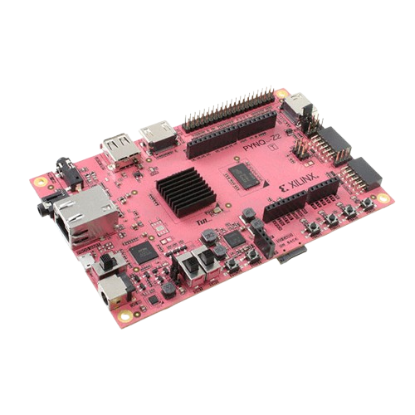
PYNQ
PYNQ™ is an open-source project from AMD® that makes it easier to use Adaptive Computing platforms.
Using the Python language, Jupyter notebooks, and the huge ecosystem of Python libraries, designers can exploit the benefits of programmable logic and microprocessors to build more capable and exciting electronic systems.
PYNQ can be used to create high performance applications with:
Parallel hardware execution
High frame-rate video processing
Hardware accelerated algorithms
Real-time signal processing

Slide 10
Board Overview
The PYNQ-Z2 board is built around the ZYNQ XC7Z020-1CLG400C device, which integrates the following key components:
Dual-core ARM Cortex-A9 processor (650 MHz).
512MB DDR3 memory for the processor subsystem.
Extensive I/O interfaces: 2 Pmod ports (for peripheral modules), HDMI input/output, Arduino and Raspberry Pi connectors, USB 2.0, Gigabit Ethernet, audio deck (I2S DAC), switches, push-buttons, and programmable LEDs.
Programmable from JTAG, Quad-SPI flash, and MicroSD card.

Slide 11
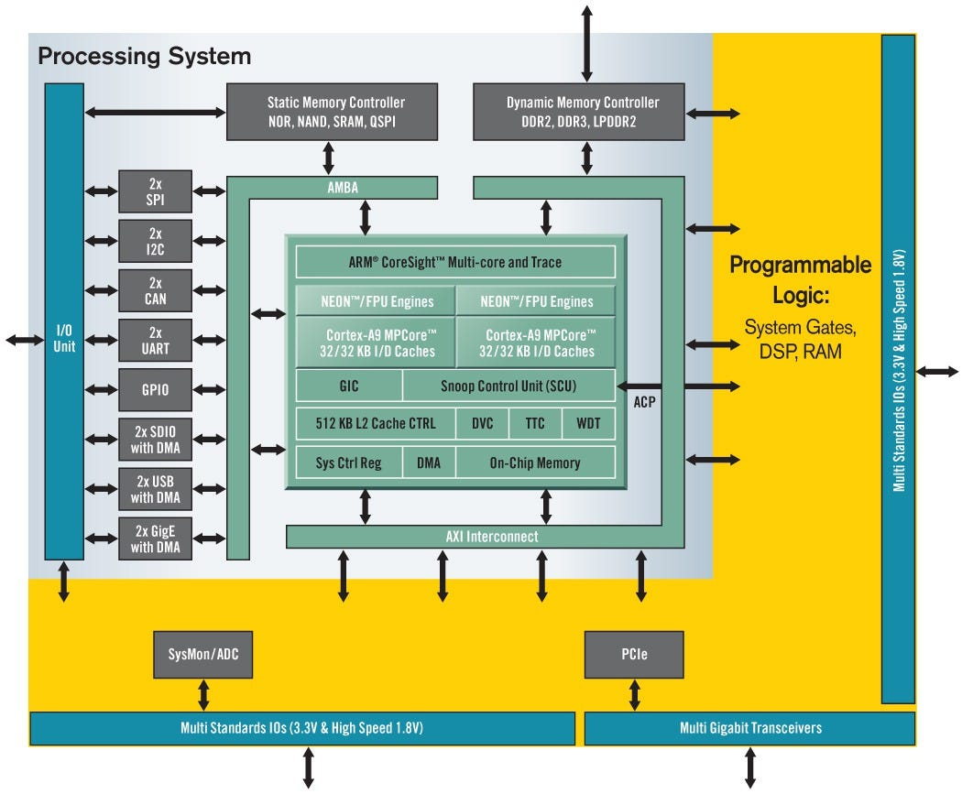
PYNQ ARCHITECTURE

Slide 12
Processing System (PS) and Programmable Logic (PL)
Processing System (PS):
The PS module contains the dual-core ARM Cortex-A9 processor.
It manages DDR3 memory, handles standard peripherals like USB, Ethernet, SD card, UART, SPI, I2C, and operates the software side of applications.
Programmable Logic (PL):
The PL section is essentially an Artix-7 class FPGA, offering extensive custom hardware acceleration capabilities.
It implements custom logic circuits, hardware accelerators, signal processing, or parallel execution features, all programmable and accessible via Python APIs when using PYNQ.
The PL can interface directly to I/O (such as LEDs, switches, HDMI, Pmod ports), offering high-performance, low-latency control and hardware-level speed.

Slide 13
PS-PL Integration
The PS and PL are tightly integrated and communicate via high-bandwidth AXI interfaces (Advanced eXtensible Interface).
Software running on the ARM processor in the PS can dynamically configure logic functions in the PL, enabling on-the-fly hardware acceleration and adaptable embedded system architectures.
The PYNQ-Z2 board leverages the synergy between a conventional processor (PS) and programmable hardware (PL) for flexible, powerful embedded system applications, all accessible using Python.

Slide 14
Tools & Libraries:
Libraries: cv2, PIL, scipy.nd image, PYNQ
Hardware: PYNQ-Z2 FPGA Board, Camera module, External monitor
Software: Vivado, Python

Slide 15
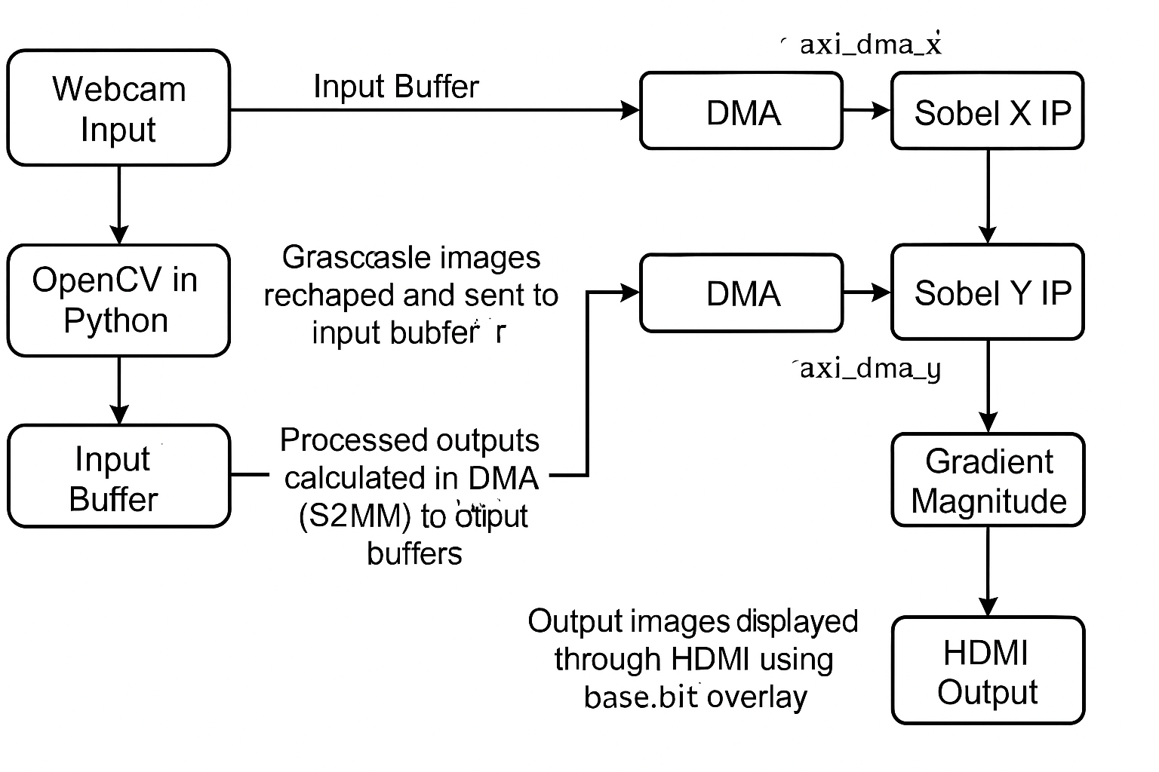
FLOW CHART:

Slide 16
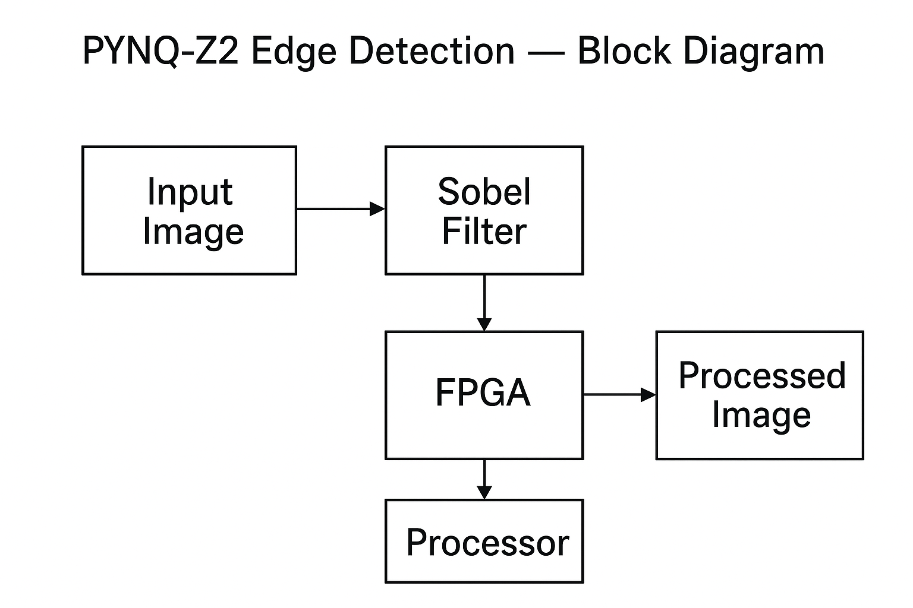
BLOCK DIAGRAM:

Slide 17
Sobel Working Principle :
The project uses a Pynq-Z2 board with a webcam as input and HDMI monitor as output.
Captured images are first converted to grayscale and then processed using Sobel filters.
Two custom hardware IPs (Sobel X and Sobel Y) compute gradients in vertical and horizontal directions simultaneously.
Both run in parallel for high-speed convolution.
The filtered image data is transferred between Processing System (PS) and Programmable Logic (PL) using AXI DMA.
The gradient magnitude is calculated as:
G = \sqrt{(Sobel_x)^2 + (Sobel_y)^2}
Processed edge-detected images are then displayed on the monitor via HDMI.

Slide 18
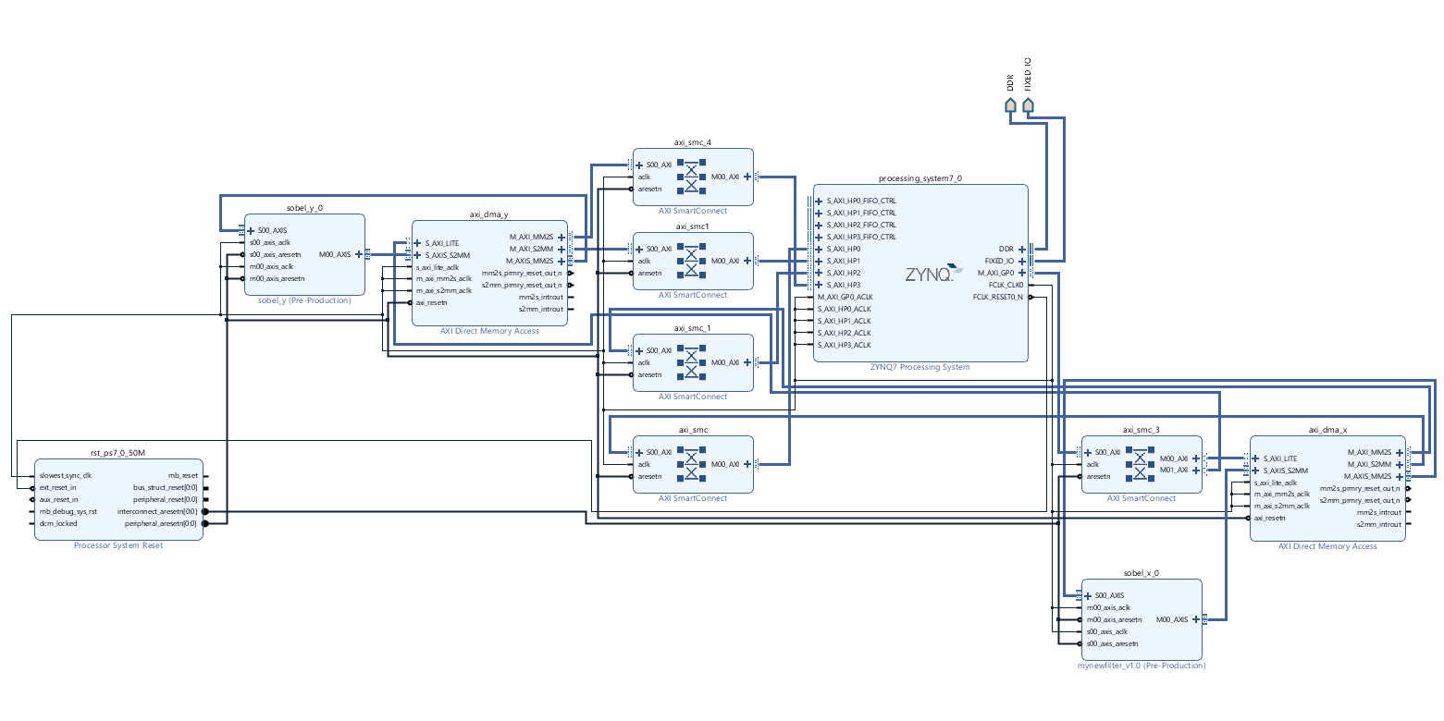
Schematic Diagram:

Slide 19
Block Explanation:
1. Processing System (ZYNQ7 Processing System)
This is the ARM Cortex-A9 CPU and other processing resources inside the PYNQ (Zynq SoC).
Manages software tasks, memory, and controls the hardware accelerators.
Interfaces with DDR memory and peripherals like HDMI.
2. sobel_x_0 and sobel_y_0 (Custom IP Blocks)
These are custom hardware IPs that implement the Sobel filter in the X-direction and Y-direction.
They receive pixel data (via AXI-Stream), perform convolution with Sobel kernels, and output edge values.
Together, they calculate the gradient in both directions for edge detection.
3. axi_dma_x and axi_dma_y (AXI Direct Memory Access)
DMA blocks transfer data between DDR memory ↔ Sobel IP blocks.
S2MM (Stream to Memory-Mapped): moves processed data (from Sobel filters) back to memory.
MM2S (Memory-Mapped to Stream): sends input image data from memory to Sobel filters.
This avoids CPU overhead and speeds up real-time processing.

Slide 20
Block Explanation:
4. AXI SmartConnect (axi_smc_*)
These blocks handle interconnections between multiple AXI masters (DMA, PS, Sobel IPs) and slaves (memory, peripherals).
Basically, they act like AXI crossbars/routers to ensure smooth communication between all blocks.
5. mynewfilter_v1_0 (Custom Filter IP – Pre-Production)
Another custom IP block you added.
Likely for combining Sobel X & Y results (e.g., computing gradient magnitude or thresholding).
Outputs the final edge-detected image.
6. Processor System Reset (rst_ps7_0_50M)
Handles reset signals across the entire design.
Ensures all IPs and interconnects start in a known state when the system powers up or resets.
7. DDR and Fixed IO
Connections to the external DDR memory and fixed I/O pins (like HDMI, UART, etc.).
Used to store images and transfer them between software and hardware accelerators.

Slide 21
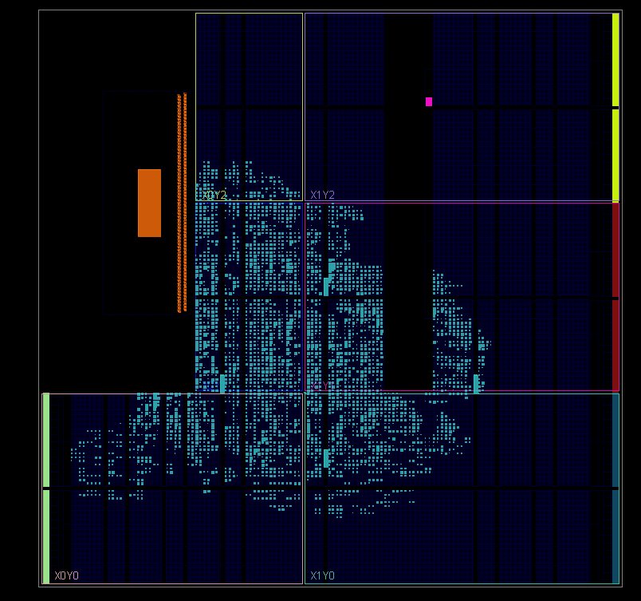
Synthesis Result:
The coloured blocks represent areas used for logic (LUTs), flip-flops, DSP slices, and other FPGA resources consumed by your custom modules, DMA, and processing system interconnects.
Most activity clusters in the central region, indicating that Sobel X and Y IP cores, memory interfaces, and control logic are efficiently packed.
The sparse or unmarked regions show unused FPGA fabric, confirming your design uses only a fraction of available resources, which is typical for a proof-of-concept or phase 1 block-level implementation.
The clear structure and lack of congestion demonstrate a successful place-and-route process, suggesting your block design achieved timing closure and is ready for hardware programming and further testing.

Slide 22
Conclusion
The proposed tasks of the project were:
Integrating Webcam with the board to get input images.
Implementing Sobel Filter (both x and y) and combining the outputs to obtain gradient for edge detection in HW.

Slide 23
REFERENCES:
[1] Vani, P., Ramesh, K., and Priya, S., “Designing SOBEL Edge Detection Using VLSI on FPGA,” International Journal of Embedded Systems and Applications, vol. 10, no. 2, pp. 145–152, 2022.
[2] Zhang, Y., Lee, H., and Chen, M., “Design and Implementation of Image Edge Detection Algorithm Based on FPGA,” Journal of Real-Time Image Processing, vol. 15, no. 1, pp. 78 89, 2022.
[3] Sharma, A., and Patel, R., “Implementation of SOBEL Edge Detection on FPGA,” International Journal of Computer Trends and Technology (IJCTT), vol. 30, no. 5, pp. 112 118, 2022.
[4] Xilinx Application Note XAPP890, “Sobel Filter in Zynq via Vivado HLS,” Xilinx Technical Documentation Series, 2022.
[5] Thomas, L., and Verma, S., “Model-based Design of a High-Throughput Canny on Zynq,” Emerging Technologies in Advanced Signal Research (ETASR), vol. 5, no. 3, pp. 201–215, 2024.
[6] Khan, M., Ali, R., and Das, P., “FPGA Implementation of Sobel Edge Detection,” EAI Transactions on Industrial Electronics, vol. 12, no. 4, pp. 305–320, 2024.
[7] Iyer, N., and Mukherjee, S., “A Novel Sobel Edge Detection Accelerator,” Journal of Reconfigurable Architectures and Systems, vol. 8, no. 2, pp. 95–107, 2022.

Slide 24
Result and Discussions:
Aspect | Result/Observation | Discussion/Significance
Processing Speed | < 1 ms per frame (hardware) | Achieves real-time edge detection for video/image applications.
Resource Utilization | < 20% LUTs, FFs, BRAM, DSP on FPGA | Design is efficient and scalable for larger tasks.
Power Consumption | ~1.7 W on-chip | Suitable for portable and embedded systems.
Output Accuracy | Hardware closely matches software Sobel results | Confirms correctness of VHDL implementation.
Speedup vs. Software | >200x faster than software implementation | Hardware acceleration provides a major performance advantage.

Slide 25
Project Progress
Month 1 | Week 1 | Tasks Completed Selected project title: "Edge Detection using FPGA PYNQ Board“ and Title Discuss With Guide.
 | Week 2 | Collected and reviewed literature papers on FPGA image processing and edge detection algorithms (Sobel, Prewitt, Canny). And Selected The Sobel Filter Process.
 | Week 3 | Understood basics of PYNQ board architecture. And FPGA toolchain (Vivado, Jupyter Notebooks).
 | Week 4 | Finalized problem statement. And wrote initial project plan.
Month 2 | Week 1 & 2 | Collected necessary hardware/software tools (PYNQ board setup, Python libraries, Vivado installation).
 | Week 3 & 4 | Designing FPGA hardware block for edge detection (Sobel filter) using Vivado.

Slide 26
Future Work
In the current work, 2 overlays are being used, our own custom overlay for image processing, and the base overlay for output display on monitor. Work can be done to integrate the elements required for HDMI output from the base overlay into our custom designed overlay to avoid calling multiple overlay instances. Secondly, while the Sobel x,y speedup factor is over 200, the total time in hardware is still comparable to software since the gradient calculation is done in SW, which takes 1.2 seconds. To retain the HW advantage, gradient calculation needs to be implemented in the HW too.

Slide 27
THANK YOU

Slide 28
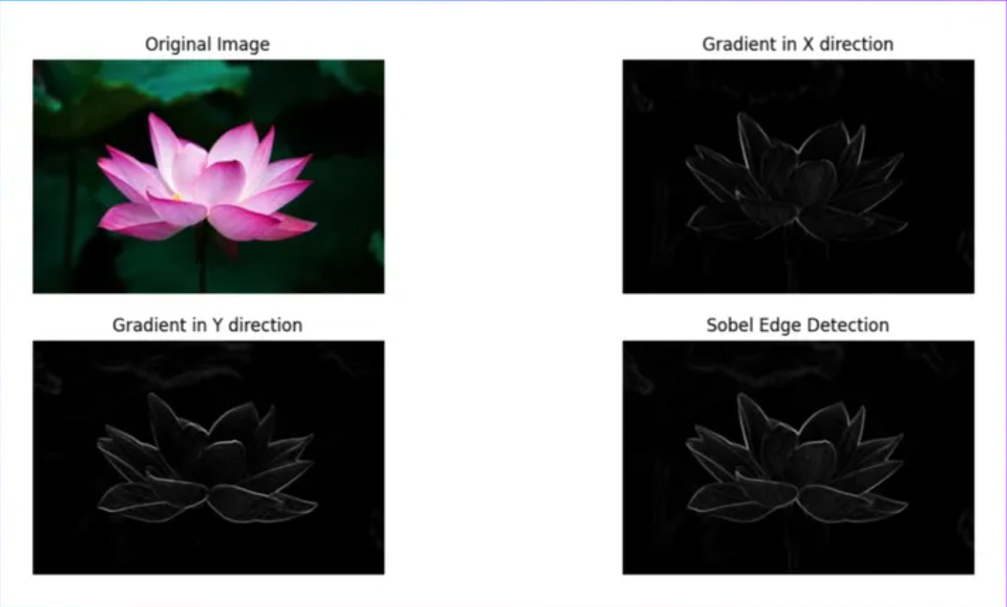
Sample Output:

Slide 29
Phase 1: Core Implementation & Demonstration
Phase 2: Optimization & Future Enhancements
Implement real-time image edge detection using Sobel filters on the Pynq-Z2 FPGA board.
Design and develop VHDL-based hardware IPs (Sobel X and Sobel Y) with AXI-Stream compatibility.
Integrate the IPs into Vivado block design with DMA, AXI Smart Connect, and PS–PL interfaces.
Webcam input is processed through custom VHDL-based IP cores and displayed on an HDMI monitor.
The design achieves over 200× speedup compared to software execution.
Optimize the system by moving gradient magnitude computation from software to hardware.

