Slide 1
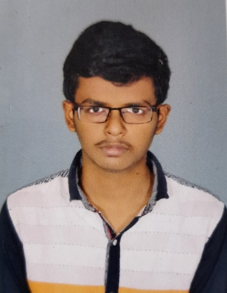

POLISETTY BALA VAMSI GUPTA
Analyst/Software Engineer
Bachelor of Technology (2018 – 2022)
Computer Science and Engineering
Skills Java 11
Spring Boot, MVC
Spring Security
Spring Cloud
MEAN Stack
Angular
MongoDB
Database
No SQL database – MongoDB
Web Technologies
HTML5 & CSS3
Javascript
Typescript
Tools
Github
Maven
Postman
VS Code
AddOns
Communications
Team Management
Chennai
POLISETTY.BALA-VAMSI-GUPTA@CAPGEMINI.COM
+91 9381358140
A4
Hands on experience in creating microservices with Spring boot, Spring Security, Spring Cloud API Gateway, Eureka server
Hands on experience in creating single page web application in Angular Latest Version.
Hands on experience in connecting MongoDB with Spring Boot and Angular
Java Microservice Development knowledge using Spring boot and spring cloud framework
Experience in creating unit testing using Junit
Implementation of RabbitMQ
Always ready to improve my skills by learning new technologies.
Flight Booking System Application
Completed end to end case study of Flight Booking System Application using Full stack with Angular.
In Case Study, implemented Spring Boot Micro Services, Frontend with Angular 13, using Angular CLI for creating a user-friendly UI and Backend with Mongo Compass.
Implemented unit testing using Junit Testing.
Completed AWS Certified Cloud Practitioner.
Completed Agile Software Development.
Check out my work on GitHub

