Slide 1














Social Media Website With Theme Customization
Team Number: 19 Team Members:
201CV170
201EC269
201ME320
PARSAPU KAMAL RAJ VAMSI KRISHNA MANDEM
GEETHA SRIDHAR MATTA

Slide 2
Outline
Intro (Project Preview)
Project Setup & Plugins
CSS General Styles and CSS Variables
Navigation Styles
Responsive Design | CSS Media Queries
Sidebar Menu Items Toggle Functionality in JavaScript
Filter messages using JavaScript
Modal Open and Close Functionality using JavaScript
Font Size Customization using JavaScript
Primary Color Theme Customization using JavaScript
Background Theme Color Customization using JavaScript

Slide 3
INTRODUCTION
Social Media plays a crucial role in the creation as well as the exchange of content. However, apart from this, the Social Media platform aims to serve and fulfill its core objectives along with the objectives of the business or the brand using social media as a tool to market their brand
The First and the Foremost aim of Social Media like any other media tool is to Educate Society. One of the most important objectives of any media tool is to take on the initiative to educate our society as a whole, to build our society up, and spread awareness.
●
We'll use modern CSS features like CSS Variables, CSS Grid, CSS Flexbox, and CSS
Units like rem, vw, and vh to achieve a Responsive Design
I will walk you through creating the markup for the navigation bar, sidebar and
notifications popup, stories, create post section, feeds or posts, messages, and friend
requests.

Slide 4
Objectives
Our main Objective is to create a website which gives better user experience to users. This website is a Responsive Social Media Website With Theme Customization Using HTML CSS & JavaScript.
A responsive website means the website’s design responds to different screen sizes across a variety of devices.
What a website looks like on a desktop computer won’t be the same for a mobile device. It is also referred to as a mobile-friendly website. Depending on the width and orientation of your device’s screen, a responsive website will flow and respond accordingly.
Decreased loading times:Smaller images optimized for mobile devices means your site will load faster on mobile devices.

Slide 5
System Design
Design Goals
Navigation Bar Markup
Main and Left (Profile and Sidebar Menus and Notification Popup) Markup
Main and Left (Profile and Sidebar Menus and Notification Popup) Styles
Stories and Create Post Markup
Stories and Create Post Styles
Feeds/Posts Markup
Messages and Friend Request Markup
Messages and Friend Request Styles
Theme Customization Modal Markup
Theme Customization Modal Styles

Slide 6
Requirements Analysis (add slides as required)
Functional Requirements
Profile
Navigation Bar Markup
Sidebar Menus
Notification Popup
Stories , Feeds and Create Post
Messages and Friend Request

Slide 7
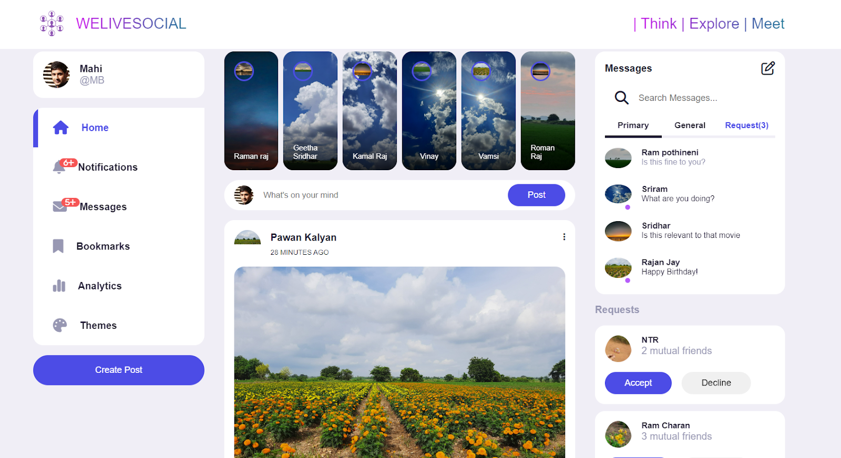
System Architecture :

Slide 8
Detailed Design Methodologies (as applicable)
Main and Left (Profile and Sidebar Menus and Notification Popup) Markup
Main and Left (Profile and Sidebar Menus and Notification Popup) Styles
Stories and Create Post Markup
Stories and Create Post Styles
Feeds/Posts Markup
Feeds/Posts Styles
Messages and Friend Request Markup
Messages and Friend Request Styles
Theme Customization Modal Markup
Theme Customization Modal Styles
Responsive Design | CSS Media Queries
Sidebar Menu Items Toggle Functionality in JavaScript
Filter messages using JavaScript
Modal Open and Close Functionality using JavaScript
Font Size Customization using JavaScript
Primary Color Theme Customization using JavaScript
Background Theme Color Customization using JavaScript

Slide 9
Any Relevant Information (optional)
You only need to take a look at the success of Amazon to see just how much people love to shop online. In the modern day, thousands of people do their shopping on their mobile device. If you run an online store and your website isn’t mobile friendly, you could be missing out on thousands of dollars in revenue. A mobile site is one that makes more money
Facebook. You’ve probably heard of it. YouTube. You’ve probably heard of that too.Social media sites bring millions of people to their mobile devices,. That’s free traffic you can take advantage of, IF your site’s built to attract mobile users.Responsive design is the answer.

Slide 10
Work Plan
Learning modern features of CSS and Javascript.
Need to implement CSS(add more styles) and javascript(make it more appropriate).
Change some orientations of webpage information and make it handy to user in both computer and phone.

Slide 11
Conclusion
People are attracted by Webpage which are more attractive and very easy to use and it should be very handy to them.
As this is a social media webpage and information gathering and sharing is done on mostly in mobile also it is carried by almost every person and to grab the attention of these people also this webpage is needed to be manipulated to work on the mobile too that is making it compatible to mobile devices also.
So, we need to make the designed webpage to a responsive webpage and add more modern features to it.

Slide 12
Individual Contribution
201CV170 | PARSAPU KAMAL RAJ | : CSS
201EC269 | VAMSI KRISHNA MANDEM | : JAVASCRIPT
201ME320 | GEETHA SRIDHAR MATTA | : HTML

Slide 13
References
https://www.w3schools.com/htmL/html_css.asp
https://www.w3schools.com/htmL/html5_video.asp
https://websitesetup.org/website-coding-html-css/
https://www.youtube.com/watch?v=oNSX21dh6kw
https://www.youtube.com/watch?v=zF6VSky4SIc

