Slide 1
Does L+S Beat Either Band Alone?
Surface-water mapping and change detection with NISAR L- and S-band GCOV over the Bihar Ganga floodplain, monsoon 2026
Team Drishya
InGARSS 2026 Young Professionals Hackathon, Phase 1
Notes:
Team Drishya. Our question: with NISAR imaging the same place at the same moment at two radar frequencies, is a water map from both bands measurably better than one from either band alone?

Slide 2
Problem and Objective
Map surface water and its change (stable water, new water, water loss) over the full NISAR frame around Bihar’s Ganga floodplain (25.5° N, 86.5° E) during the 2026 monsoon
Do it three ways, using only NISAR L2 GCOV data: L-band only, S-band only and L+S combined
Core question: does combining L- and S-band measurably beat either band alone?
Fair comparison: one algorithm, one set of training pixels and one post-processing chain; only the input features change
Every claim validated against independent Sentinel-2 data, with confidence intervals
Notes:
Fairness is what makes the answer credible: the three maps differ only in their input features.

Slide 3
Study Area and Data
 | L-band (NASA / ASF) | S-band (ISRO / Bhoonidhi)
Product | L2 GCOV, PROVISIONAL (calibrated) | L2 GCOV, PROVISIONAL (12 Sep: urgent-response only)
Mode and polarizations | 40+5 MHz, HH/HV, 10 m | 37 MHz, HH/HV, 10 m
Joint L+S dates (UTC) | 14 Jul, 12 Sep, 18 Oct 2026 | 14 Jul, 12 Sep, 18 Oct 2026 (none before 14 Jul)
Looks per 20 m pixel | about 19 | about 64
Polarimetry pass | 14 Sep descending, quad-pol | 14 Sep descending, compact-pol
Frame: ascending track 98, frame 14, about 250 × 250 km; common 20 m grid in UTM 45N (EPSG:32645)
Supporting layers: Copernicus GLO-30 HAND and slope, ESA WorldCover 2021, JRC Global Surface Water
Reference: Sentinel-2 L2A MNDWI on 18 Oct (same UTC day) and 13 Sep (5.4 h after the peak pass)
Notes:
No S-band GCOV exists before 14 July 2026, so 14 July is the first date where both bands imaged the floodplain together; it is our low-water baseline.

Slide 4
Methodology: Water Mapping
Preprocess
HH, HV backscatter averaged to 20 m; invalid samples masked
Threshold
Split-based Kittler–Illingworth on 5 km bimodal tiles
Train
Common pixels: dark (water) or bright (land) in both bands
Classify
Gaussian class models, EM prior, per-pixel P(water)
Clean up
HAND > 15 m or slope > 10° masked; 0.4 ha minimum unit
Feature sets: L = [L-HH, L-HV]; S = [S-HH, S-HV]; L+S = all four channels (Bayesian likelihood fusion)
Identical algorithm, settings, training pixels, clean-up and validation pixels for every feature set
References: naive L AND S and L OR S; equal-information control = L-band at 40 m (about 4× the looks)
Uncertain zone: 0.2 < P(water) < 0.8
Notes:
The control answers the obvious objection that L+S simply has more data: S-band at 20 m has about 3.4 times the looks of L-band, so we give L-band about four times the looks by averaging to 40 m.

Slide 5
Change Detection and Validation
Change detection
Post-classification comparison of the per-date maps
Classes: stable water, new water, water loss, stable land
Per-pixel confidence: P(gain) = P2 × (1 − P1)
New water outside JRC persistent water (≥ 75%) = potential temporary surface inundation
Gain: 14 Jul → 12 Sep; loss: 12 Sep → 18 Oct
Validation
Reference: Sentinel-2 L2A MNDWI > 0, clouds masked with SCL
18 Oct: 36,400 km² clear; 13 Sep: 21,900 km² clear
Every map scored on identical pixels
F1, precision, recall, IoU; 95% CIs from a 5 km block bootstrap
McNemar tests; error-adjusted areas (Olofsson et al. 2014)
Notes:
The block bootstrap resamples 5 km blocks rather than pixels, so spatial autocorrelation does not make the confidence intervals falsely narrow.

Slide 6
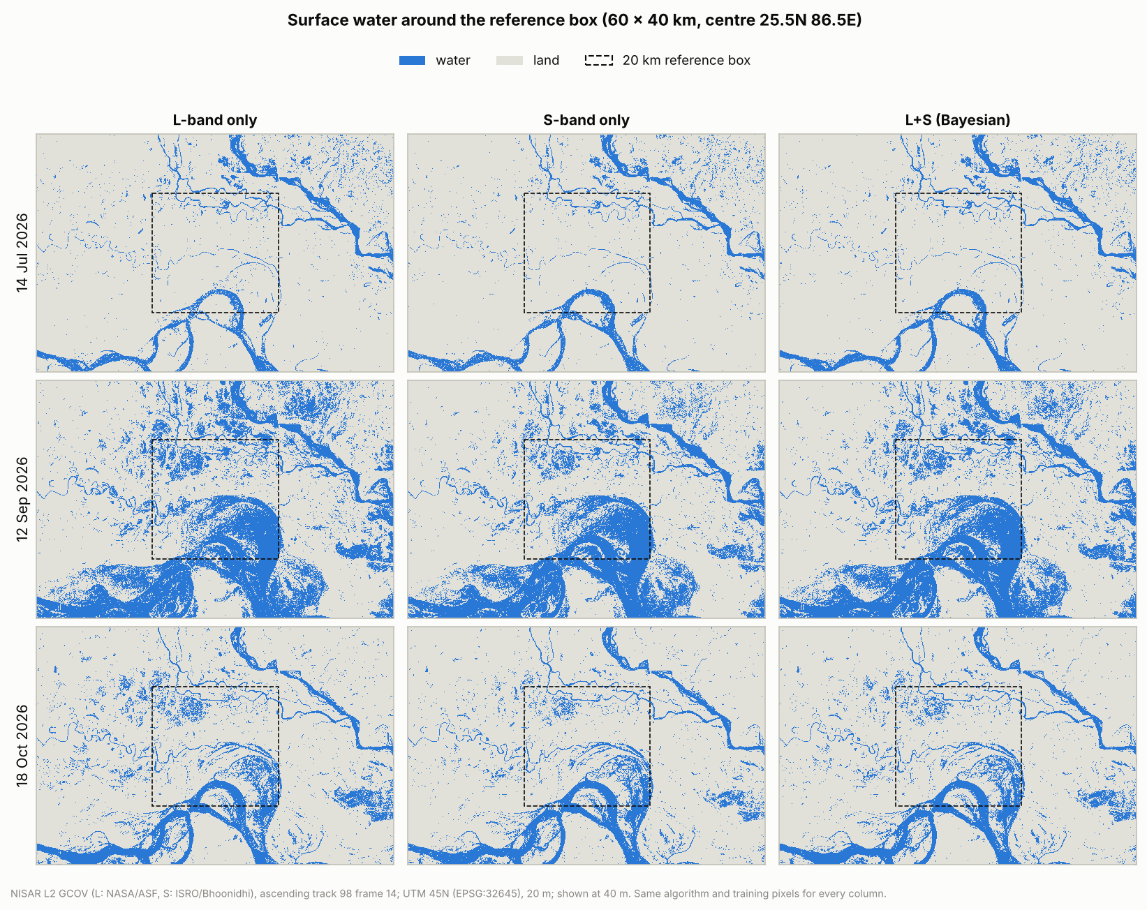
Results: Surface-Water Maps
14 Jul: channels near low water; 2,866 km² mapped with L+S
12 Sep: the Kosi–Ganga floodplain fills; 5,630 km²
18 Oct: receding; L 2,759, S 2,374, L+S 2,464 km²
L-band maps the most water, S-band the least
Error-adjusted areas agree across methods: about 6,000 km² at the peak, 2,700 km² on 18 Oct
Notes:
The big rivers look the same in every column; the differences are at the margins: shallow water, wet fields and the floodplain edges.

Slide 7
Results: Accuracy against Sentinel-2
L+S is the most accurate of six maps on both dates
18 Oct: F1 0.698 (95% CI 0.674–0.719) vs 0.671 (L) and 0.672 (S)
12 Sep: F1 0.799 (0.777–0.817) vs 0.752 (L) and 0.774 (S)
L-band with 4× the looks scores lowest
Notes:
Two dates, the same answer: the fused map has the highest F1 on 18 October and at the 12 September peak.

Slide 8
Added Value of Combining L- and S-band
Gains over each band have 95% CIs that exclude zero: +0.027 [+0.022, +0.033] and +0.046 [+0.041, +0.052] vs L; +0.026 and +0.024 vs S
Complementary errors: L finds more water but also more false water; S is more precise but misses water; fusion keeps both strengths
Not just more data: L-band with 4× the looks is worse
Band choice changes the flood estimate: new water 4,501 km² (L) vs 3,616 km² (S)
Notes:
McNemar tests: p below 0.001 for L+S versus each single band on both dates.

Slide 9
Where Does Fusion Help?
Largest gain just above the floodplain: HAND 1–3 m, F1 0.666 vs 0.625 (L) and 0.643 (S)
L leads on cropland and sandbars, so “S-band fixes sandbars” is not supported
S leads on grass and wetland
L+S matches or beats the better band in nearly every class
Notes:
One planned hypothesis did not hold: we expected S-band to clean up dry sandbars that look like water at L-band, but on sandbars S-band is the weaker band. The fused map is still the best there.

Slide 10
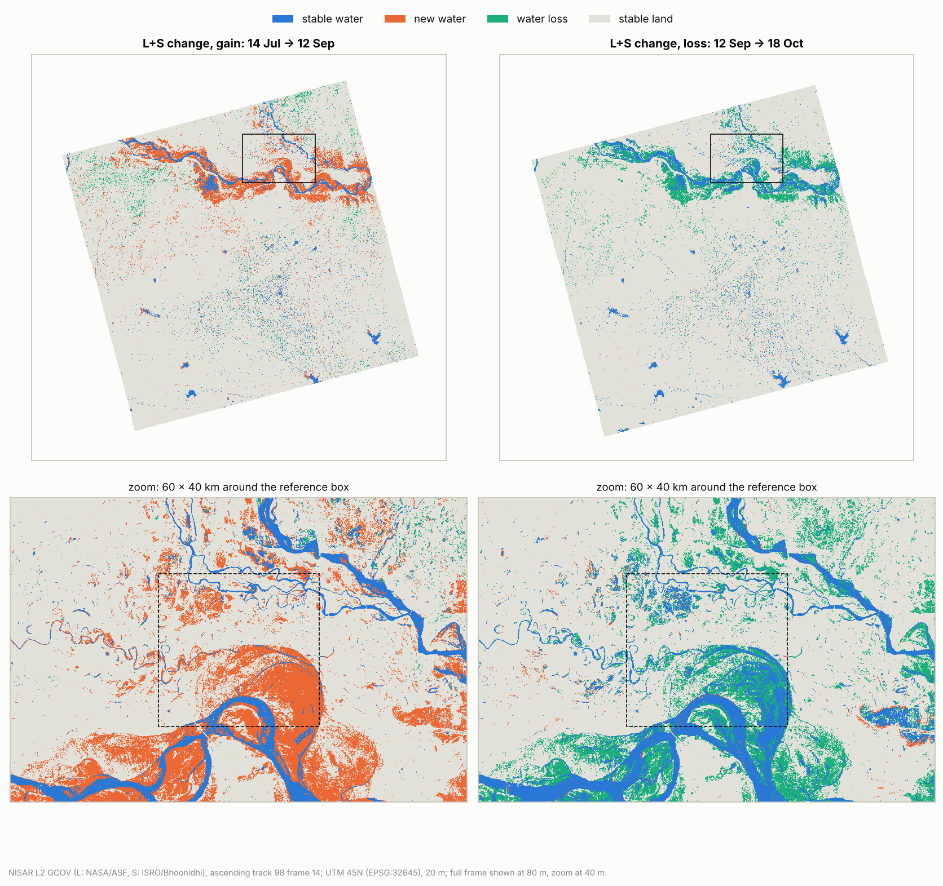
Results: Gain and Recession (L+S)
Gain, 14 Jul → 12 Sep: 3,774 km² of new water, 3,758 km² of it outside persistent water
80% on cropland (3,038 km²); 79% within 1 m of the nearest drainage
Loss, 12 Sep → 18 Oct: 3,273 km² receded; 2,266 km² stayed water
Notes:
We call it new water, not flood, because we have no independent flood record to confirm it.

Slide 11
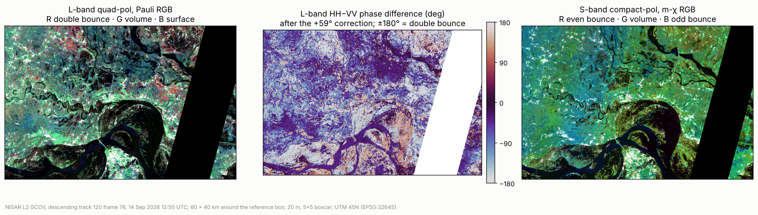
Polarimetry (14 Sep, Descending)
L-band quad-pol: Pauli decomposition and HH–VV phase difference
59° phase calibration correction, sign verified: open water −20°, double bounce +167°
6.1% of the window shows double bounce: candidate flooded vegetation
S-band compact-pol m-χ separates rivers, vegetation and settlements
Notes:
For the GCOV HHVV term the documented 59 degree correction has to be applied with the opposite sign to the known-issues note; we checked it on open water and on bright double-bounce targets.

Slide 12
Limitations and Future Work
Limitations
Optical reference misses water under vegetation; the 18 Oct image is 19 h before the pass; 13 Sep is only 31% clear
S-band only from 14 Jul; 12 Sep S-band is urgent-response; ISRO’s sample-shift flag covers 36% of the S swath
20 Jun (L-band only) excluded: dry pre-monsoon fields look like water
No banding correction; one frame and track
Future work
Explain the 0.4 dB S−L offset inside the sample-shift flag, by land cover
Incidence-angle banding correction; more dates (31 Aug, 6 Oct)
Labelled sample points for cloudy dates and flooded vegetation
Polarimetric features inside the classifier

Slide 13
Conclusions
Yes: combining L- and S-band measurably improves NISAR surface-water mapping
F1 gains of +0.024 to +0.046 over the single bands, significant on both validated dates
The gain comes from the second frequency, not from extra looks
2026 monsoon: 3,774 km² of new water between 14 Jul and 12 Sep, mostly cropland in the low floodplain; 3,273 km² receded by 18 Oct
Fully reproducible: github.com/Vamsi12345-eng/INGARSS (one command per step)
Thank you! Team Drishya

