Slide 1
Gopavarapu Vamsi
Final Project
3/21/2024 Annual Review

Slide 2
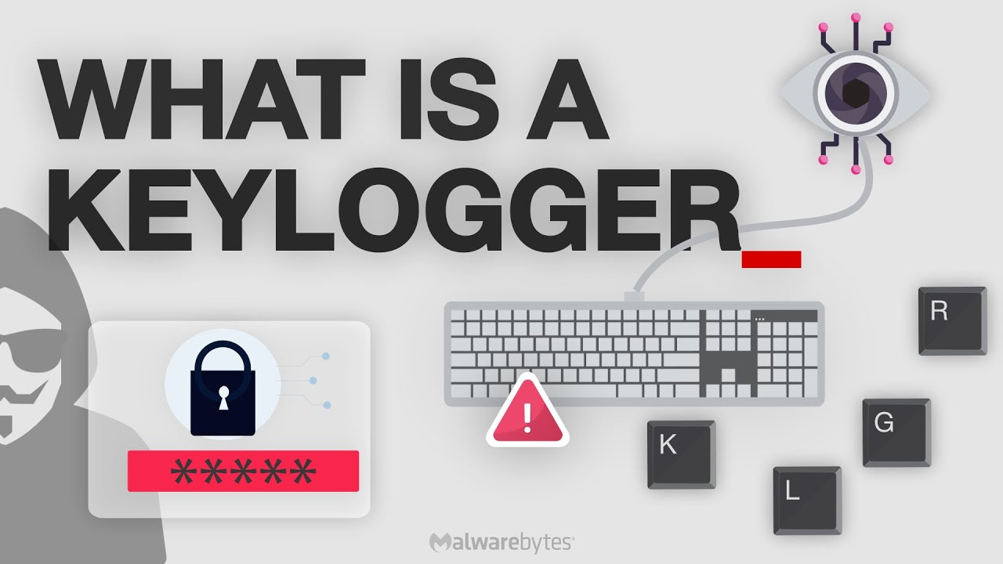
KEYLOGGER & Security
3/21/2024 Annual Review

Slide 3
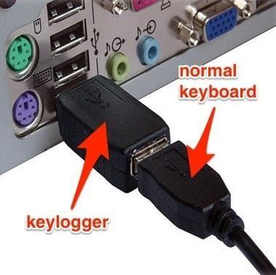
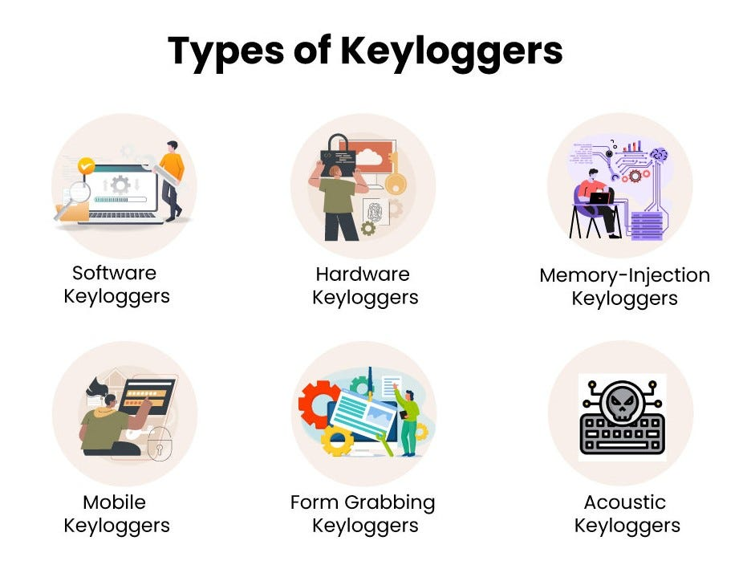

AGENDA
To know about the keylogger like what is it, how it works, its type and etc. and to secure ourselves from hacking our credentials.
A keylogger, sometimes called a keystroke logger, is a type of surveillance technology used to monitor and record each keystroke on a specific device, such as a computer or smartphone.
This keylogger can be a software or a hardware.
3/21/2024 Annual Review

Slide 4

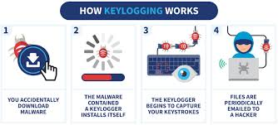
PROBLEM STATEMENT
How the keylogger program works?
What is phishing?
How do we secure ourselves from phishing?
3/21/2024 Annual Review

Slide 5

PROJECT OVERVIEW
Run the keylogger program in a python idle.
It opens a GUI screen with start and stop buttons.
When we click start, all the keystrokes that are typed from our keyboard are recorded into an external file until we click the stop button.
3/21/2024 Annual Review

Slide 6

WHO ARE THE END USERS?
There are two end users for this program.
The first one is IT workers. They use this keylogger to monitor the sites and logins of the employees working in an organisation.
The second one are hackers. They use this program to know about the bank credentials, secured passwords etc of the people.
3/21/2024 Annual Review

Slide 7

YOUR SOLUTION AND ITS VALUE PROPOSITION
3/21/2024 Annual Review

Slide 8

THE WOW IN YOUR SOLUTION
3/21/2024 Annual Review
8

Slide 9
MODELLING
Teams cam add wireframes
3/21/2024 Annual Review
9

Slide 10
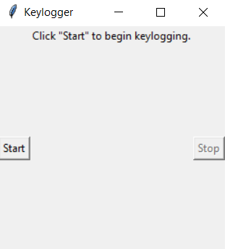
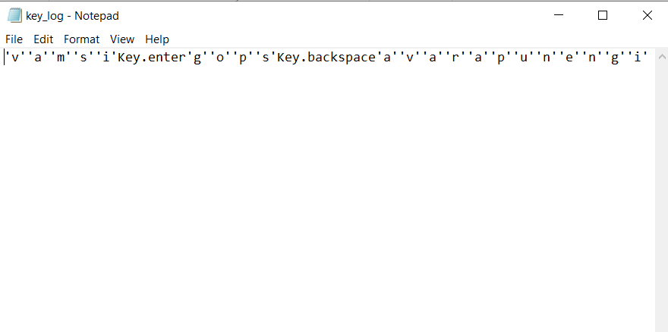
RESULTS
3/21/2024 Annual Review
10

