Slide 1
FITPRO
Vamsi Krishna Mannepalli

Slide 2
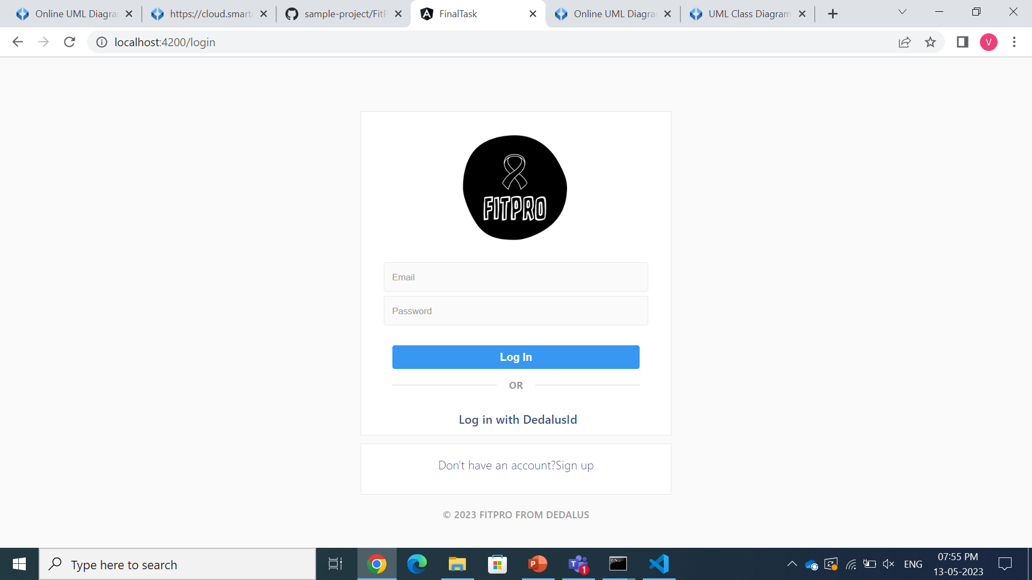
LOGIN PAGE
The user's email and password are entered on the page, and a connection to the JSON file is created.
The entered information is compared and checked within the JSON file.
The user can choose to register and enter the details if they are brand-new and haven't done so already.
If the user type "admin" is present in the user details, the admin page is opened; otherwise, the user page is displayed.

Slide 3
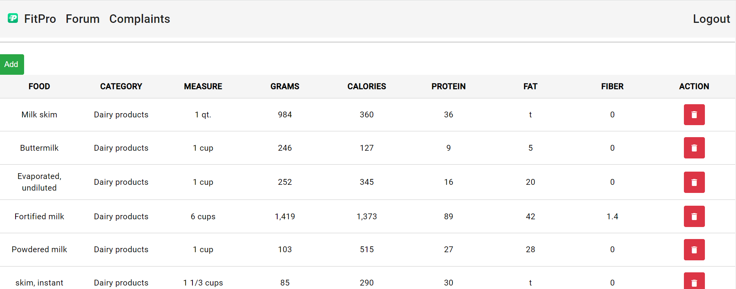
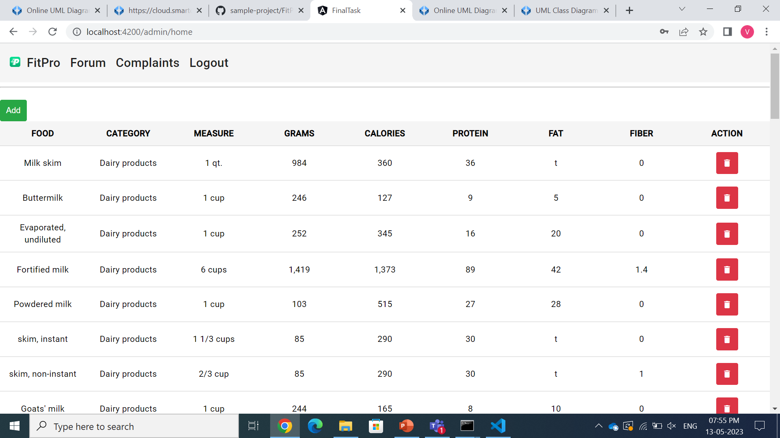
ADMIN INTERFACE
To add and remove products from the list of products in the JSON file, the admin has a simple interface.
The item will also be permanently removed from the JSON file if the admin chooses to remove any item from the list.
The administrator can delete the product as well as search for it.

Slide 4
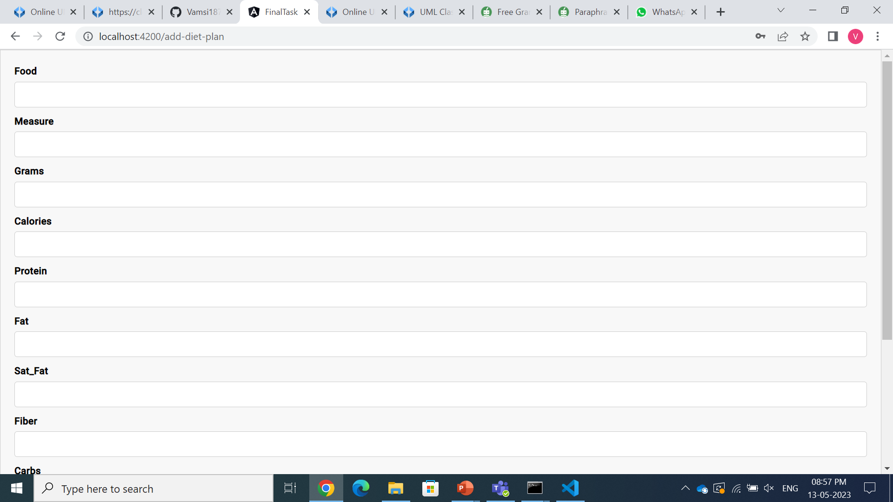
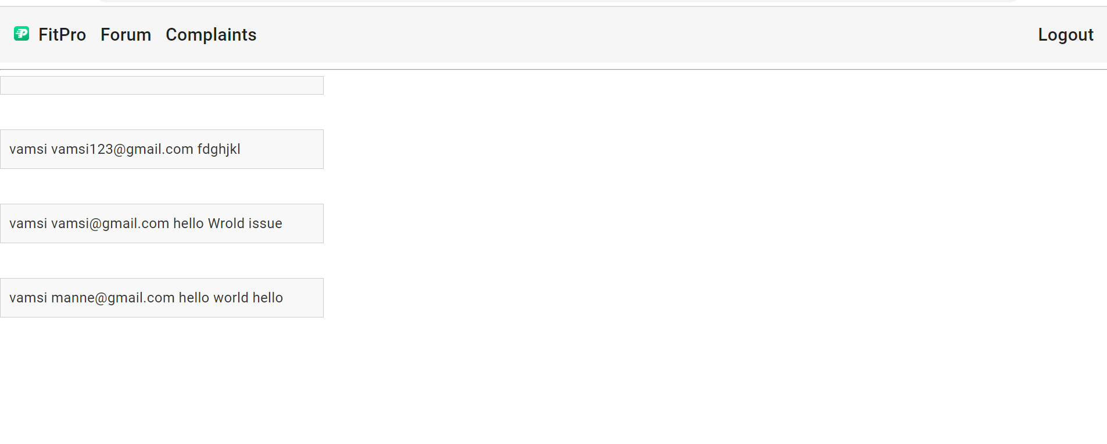
ADMIN FEATURES
A wish list item can be added by an administrator, and the list will be updated as a result.
Until the administrator again decides to delete it as well, the addition will be displayed on the total list.
A drop-down box in the category list causes an error that can prevent it from being added to the required category. And even admin can check all the complaints raised by users

Slide 5
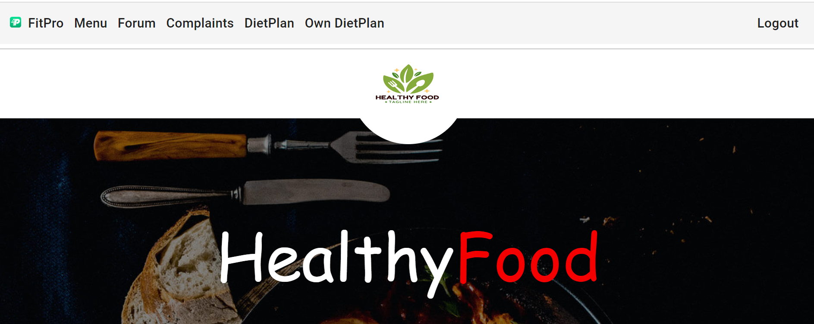
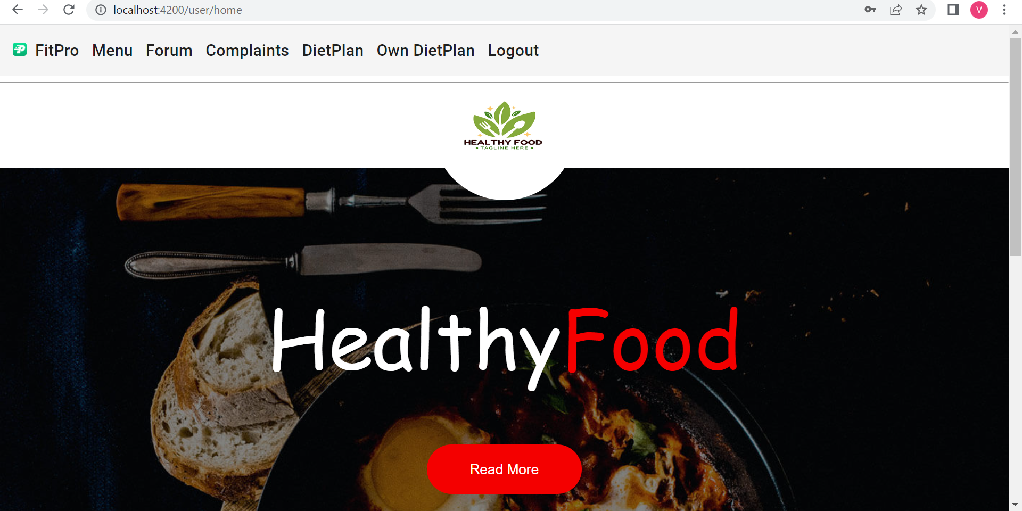
USER INTERFACE
After Logging In User will get displayed home page content and a header part which consists of 1. Menu 2. Forum 3. Complaints 4. Own-Diet-Plan

Slide 6
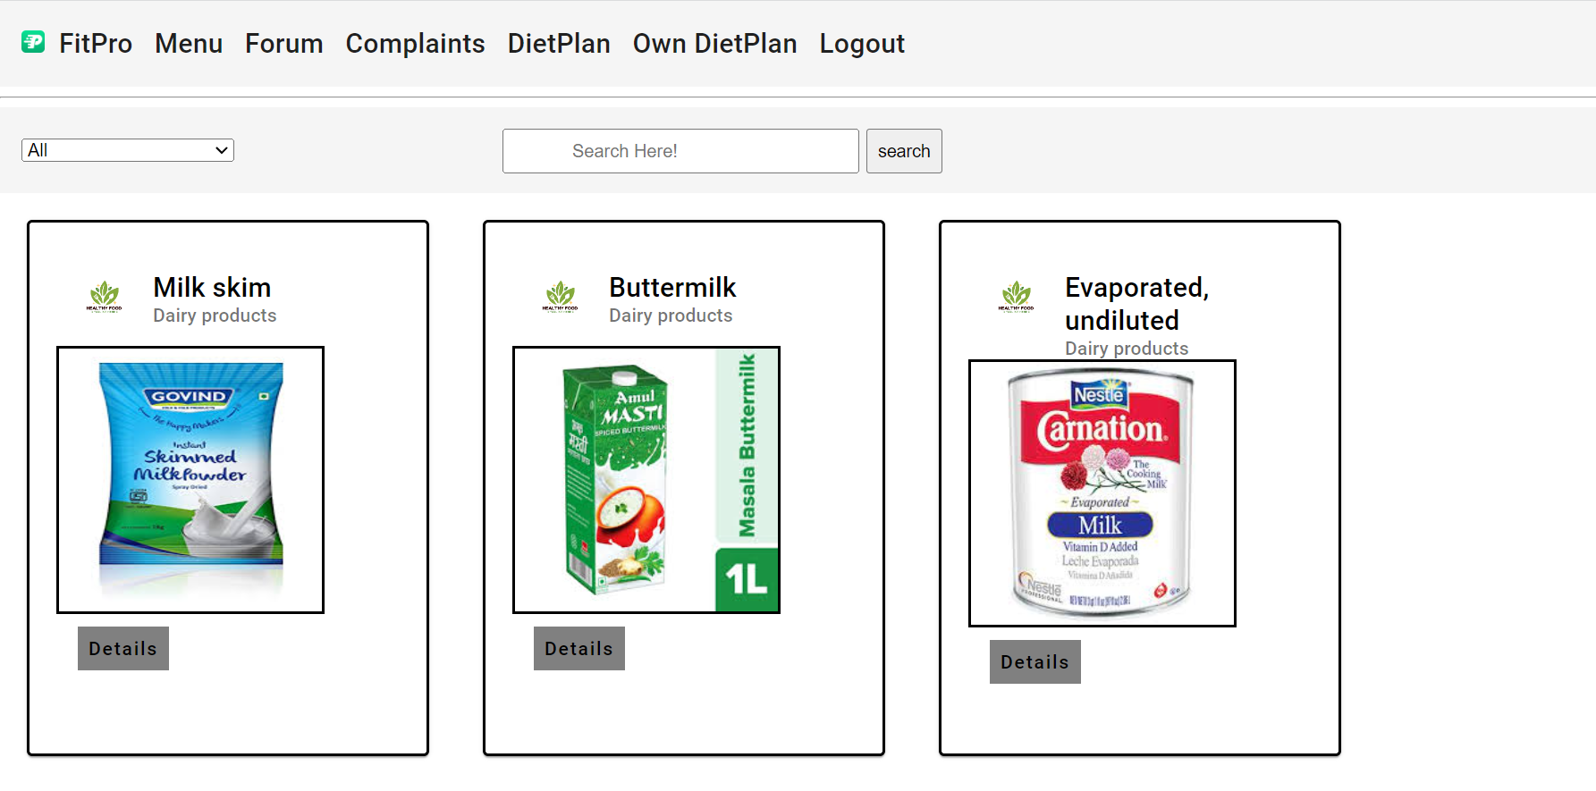
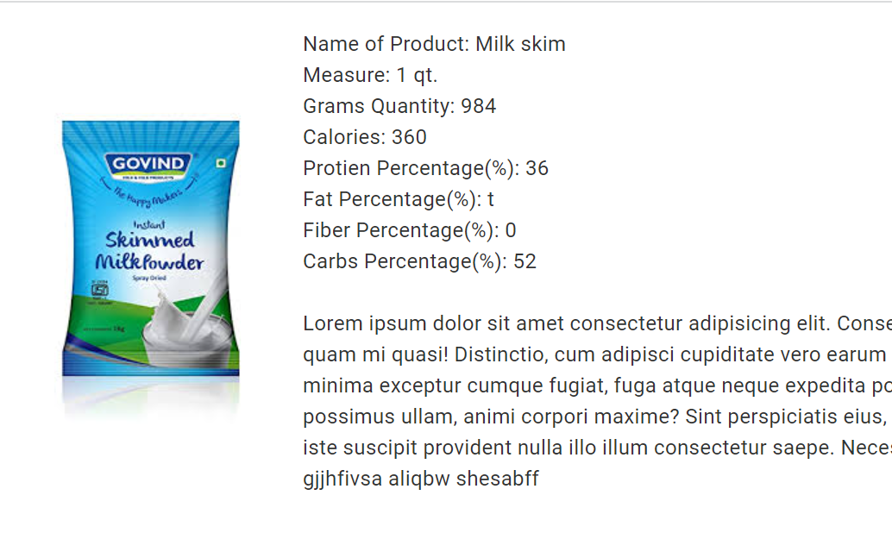
PRODUCTS
The user has a variety of features, including a page that lists the items available and their nutritional values, and after clicking the details button user can seen the entire description

Slide 7
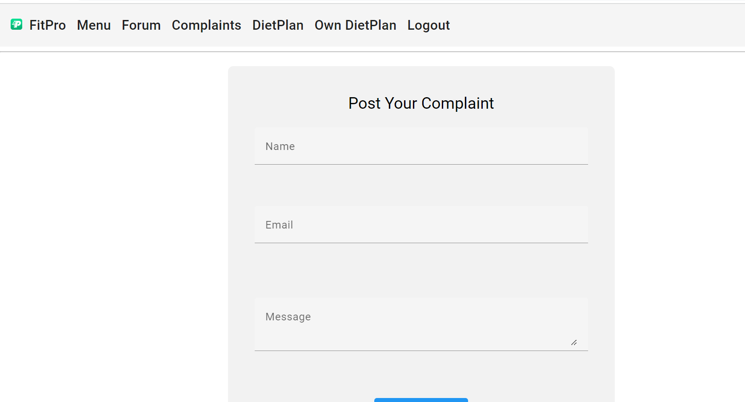
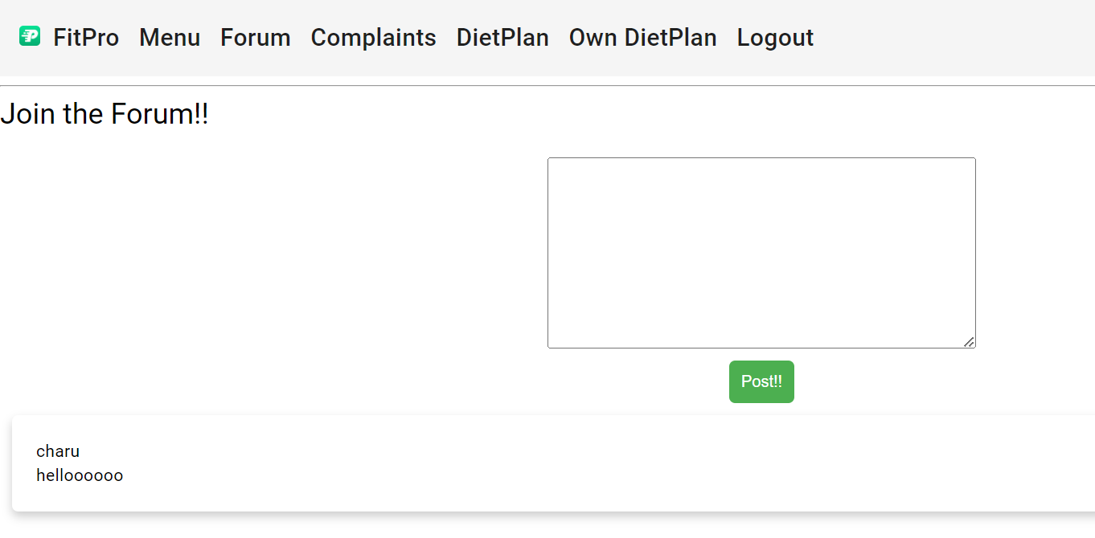
FORUMS & COMPLAITS
A discussion forum is created where users can send their opinions and have discussion on it in a public forum.
The users can see the opinions of others as well.
And the complaint page where user can raise a complaint regarding products

Slide 8
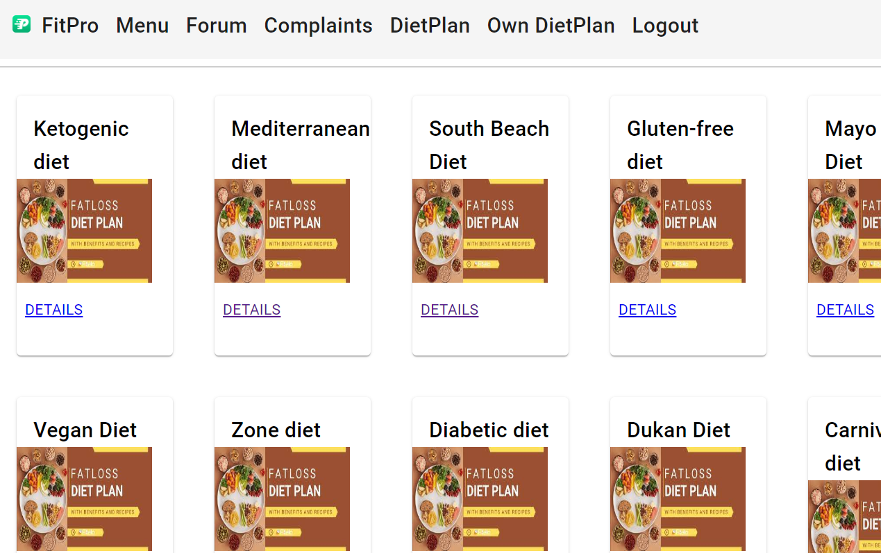
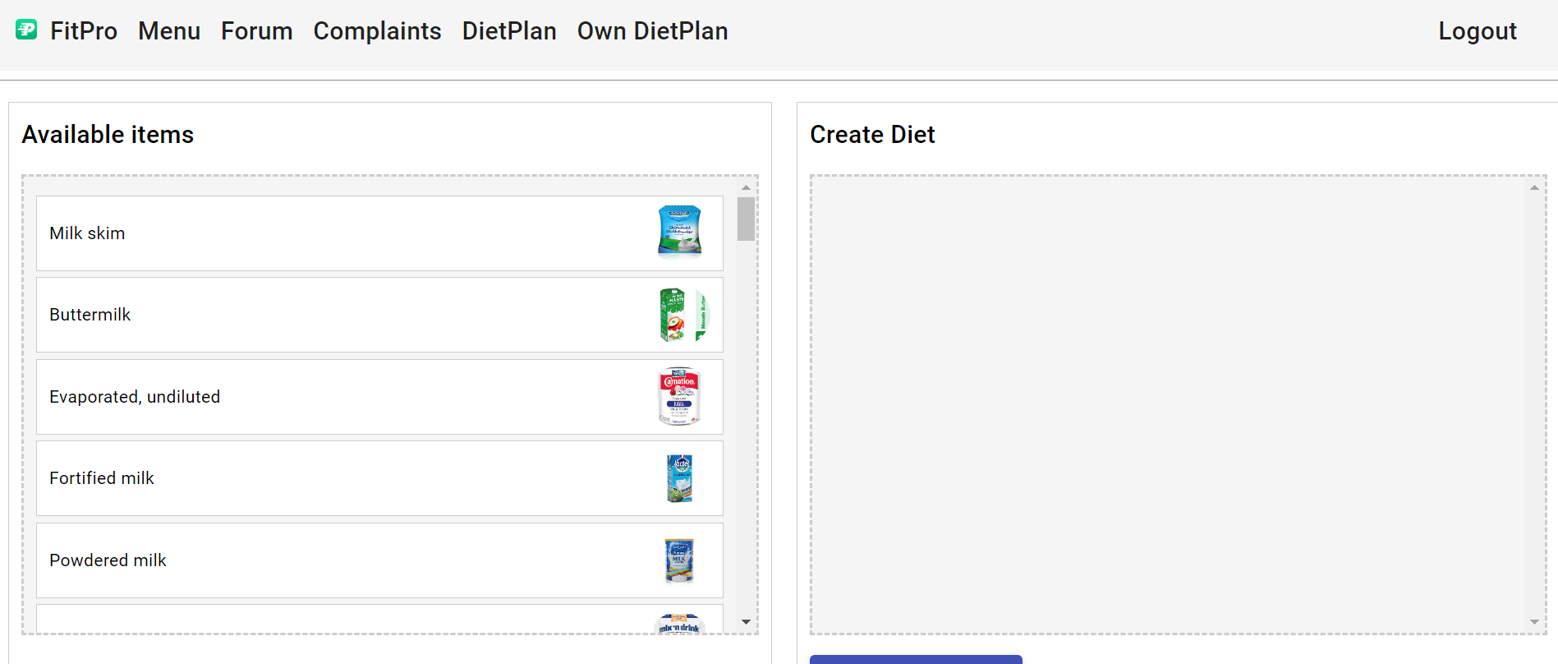
DIETPLANS/OWN DIET PLAN
There are 10 types of diets mentioned. All the 10 types of details and their benefits are stored in the JSON file. The details are displayed and the benefits of the diets are displayed
The user can input different types of food products from different categories and sum up all to get a required amount of calories basing which he can create his own diet

Slide 9
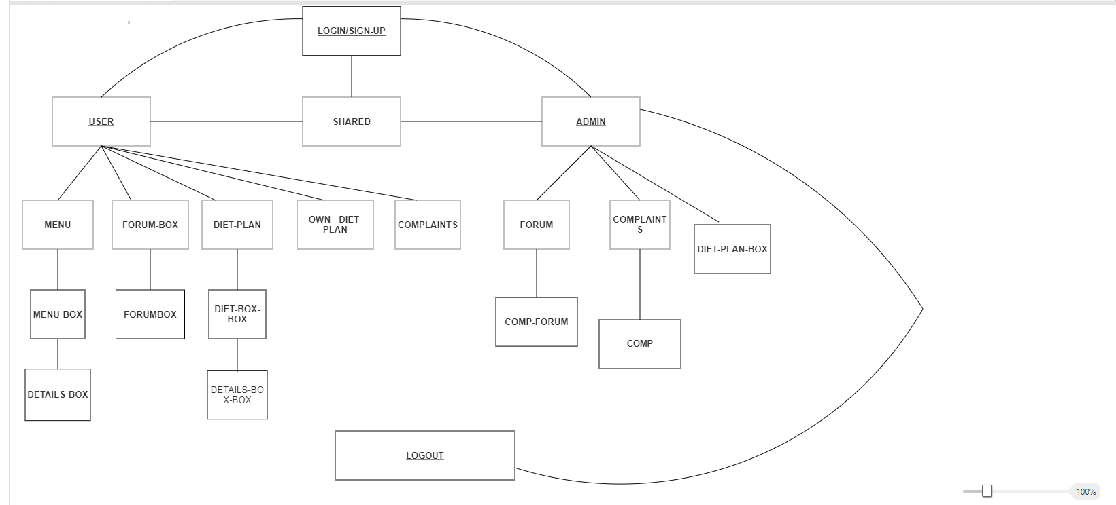
WORKFLOW

Slide 10
Thank you
Vamsi Krishna Mannepalli vamsi.mannepalli@dedalus.com

