Slide 1

Superproductive
AI Agent
IIT Jodhpur — Software Engineering Project

Slide 2
Purpose of the App
Aggregate tasks from Outlook, Teams, Loop
AI-based prioritization
Natural-language task queries
Improve productivity with automation

Slide 3
System Architecture
3-Tier Layered Architecture
React Frontend + FastAPI Backend
JSON → PostgreSQL-ready Data Layer

Slide 4
Key Features
Multi-source task extraction
AI-powered prioritization
Chat-based task understanding
Task insights dashboard

Slide 5
Data flow
Extract → Prioritize → Filter → Chat → Insights
JSON-based storage (POC) → DB ready architecture

Slide 6
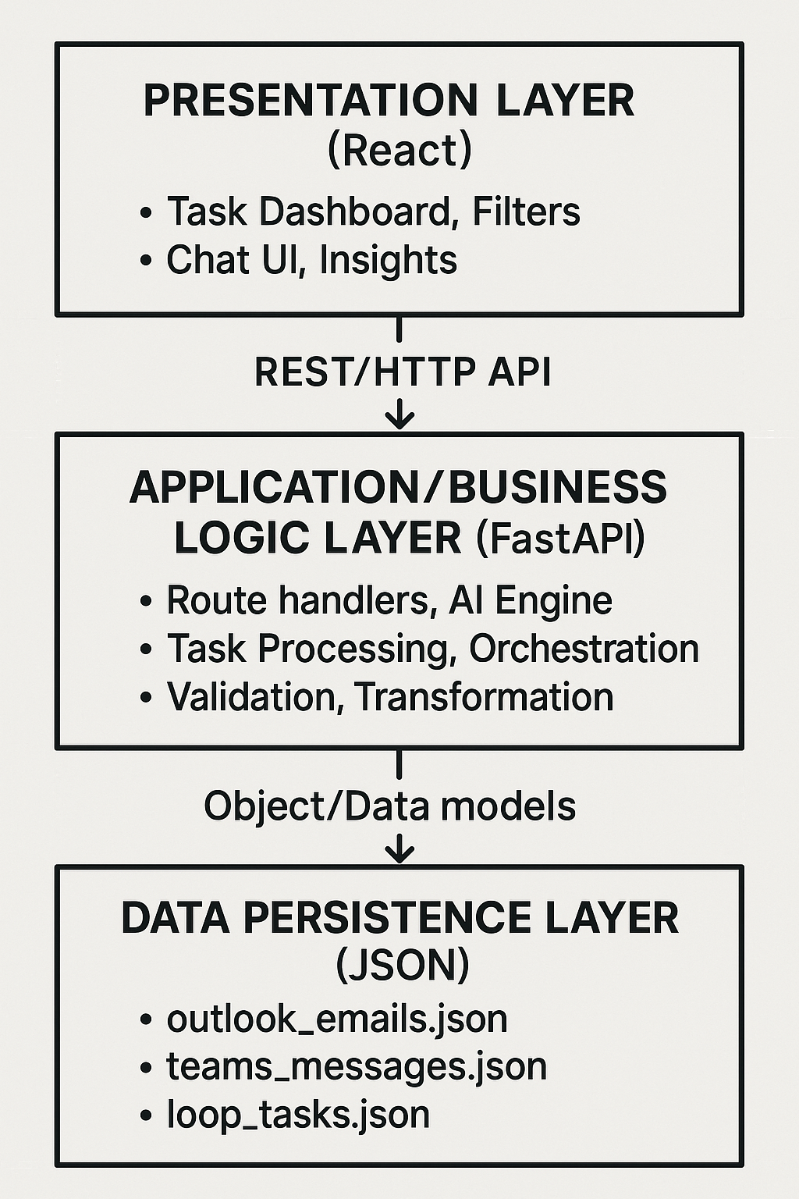

Slide 7
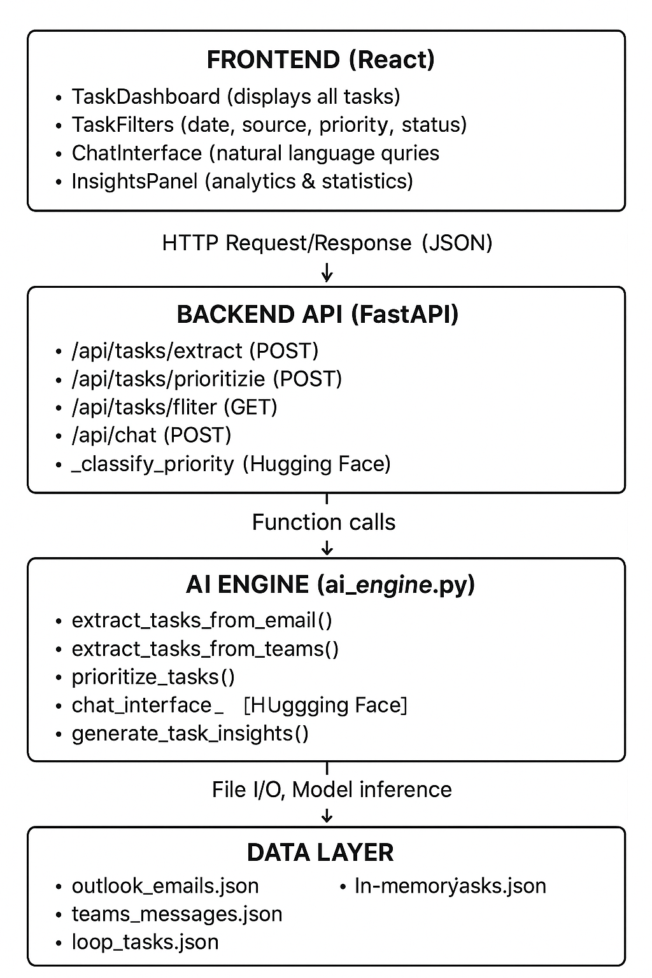

Slide 8
Quality Attributes Achieved
Scalability: Stateless backend, horizontal scaling
Maintainability: SOLID, modular, clean code
Reliability: Graceful fallback handling

Slide 9
Tech Stack
Frontend: React + TailwindCSS
Backend: FastAPI
AI: Hugging Face Offline Models
Storage: JSON (POC), scalable to SQL/NoSQL

Slide 10
Future Enhancements
Can be Scaled to enterprise level app
Integration with productivity apps for live data and scalable database
Can migrate to Microservices based architecture for vertical scaling
Implement Real time feedback and notification to automate task.

Slide 11
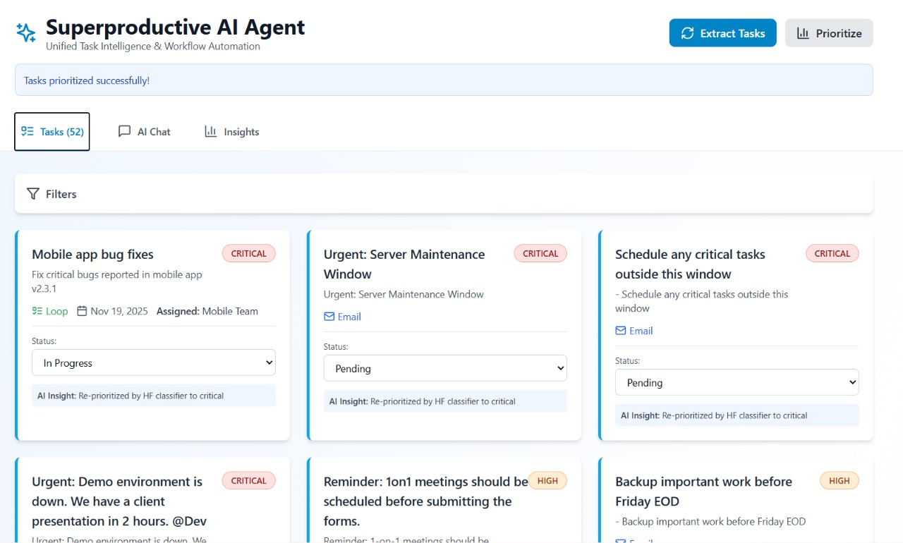
UI of working App

Slide 12
Conclusion
Superproductive AI Agent is scalable, reliable, and production-ready
POC demonstrates clean engineering, modularity, and intelligent automation.

