Slide 1
Salary And Compensation Analysis Though Excel Data Modeling
STUDENT NAME: VAMSI P S
REGISTER NO: 312214554/372C8539A1EDE4487E14EE932FF67EC6
DEPARTMENT: B.COM (COMPUTER APPLICATION)
COLLEGE: ST THOMAS COLLEGE OF ARTS AND SCIENCE

Slide 2
PROJECT TITLE
Salary And Compensation Analysis Though Excel Data Modeling

Slide 3


AGENDA
Problem Statement
Project Overview
End Users
Our Solution and Proposition
Dataset Description
Modelling Approach
Results and Discussion
Conclusion
3/21/2024 Annual Review

Slide 4

PROBLEM STATEMENT
Benchmarking:
Assess our compensation structure against industry standards and regional benchmarks.
Equity Analysis:
Evaluate internal pay equity across different roles, departments, and experience levels.
Trend Analysis:
Identify historical trends in salary adjustments and compensation changes.
Forecasting:
Predict future compensation needs based on current data trends and business growth projections.

Slide 5

PROJECT OVERVIEW
.
Data Collection: Consolidation of salary, demographic, performance, and market data.
Data Analysis: Examination of salary structures, compensation equity, and benchmarking against industry standards.
Data Modeling: Application of Excel functions and tools to analyze and visualize data.Reporting: Presentation of findings and recommendations to inform strategic compensation decisions.

Slide 6

WHO ARE THE END USERS?
1. Human Resources (HR) Team
2. Compensation and Benefits Specialists
3. Finance Department
4. Senior Management and Executives
5. Line Managers

Slide 7

OUR SOLUTION AND ITS VALUE PROPOSITION
Our Solution:
Integrated Data Model: Our solution consolidates all relevant compensation data—salaries, bonuses, benefits—into a single, comprehensive Excel model. This integration allows for a holistic view and seamless analysis.
Value Proposition:
Enhanced Decision-Making: By providing clear, actionable insights, our solution empowers HR and management teams to make well-informed decisions regarding salary adjustments, compensation policies, and budget planning.

Slide 8
Dataset Description
➤ Employee KAGGLE
➤ 26-Features
➤ 9-Features
➤ Emp Id- Number
➤ Name Text
➤ Emp- Type
➤ Current Employee Rating- Number
➤ Gender- Male Female

Slide 9

THE "WOW" IN OUR SOLUTION
•=IFS(Z8>=5,"VERY HIGH",Z8>=4,"HIGH",Z8>=3,"MED",TRUE,"LOW")
3/21/2024 Annual Review
9

Slide 10
MODELLING
Data Collection:
Gather Relevant Data:
Employee Data: Names, job titles, departments, levels, locations, etc.
Compensation Data: Base salary, bonuses, stock options, benefits, etc.
Benchmark Data: Industry salary data, geographic salary differentials, etc.
Import Data into Excel:
Use Excel’s import features to bring in data from various sources like CSV files, databases, or direct entry.
2. Data Organization :
Create a Clean Data Structure:
Sheets: Organize data into different sheets if necessary (e.g., Employee Data, Compensation Data, Benchmark Data).
Tables: Use Excel Tables (Insert > Table) to structure data, which makes it easier to manipulate and analyze.
10

Slide 11
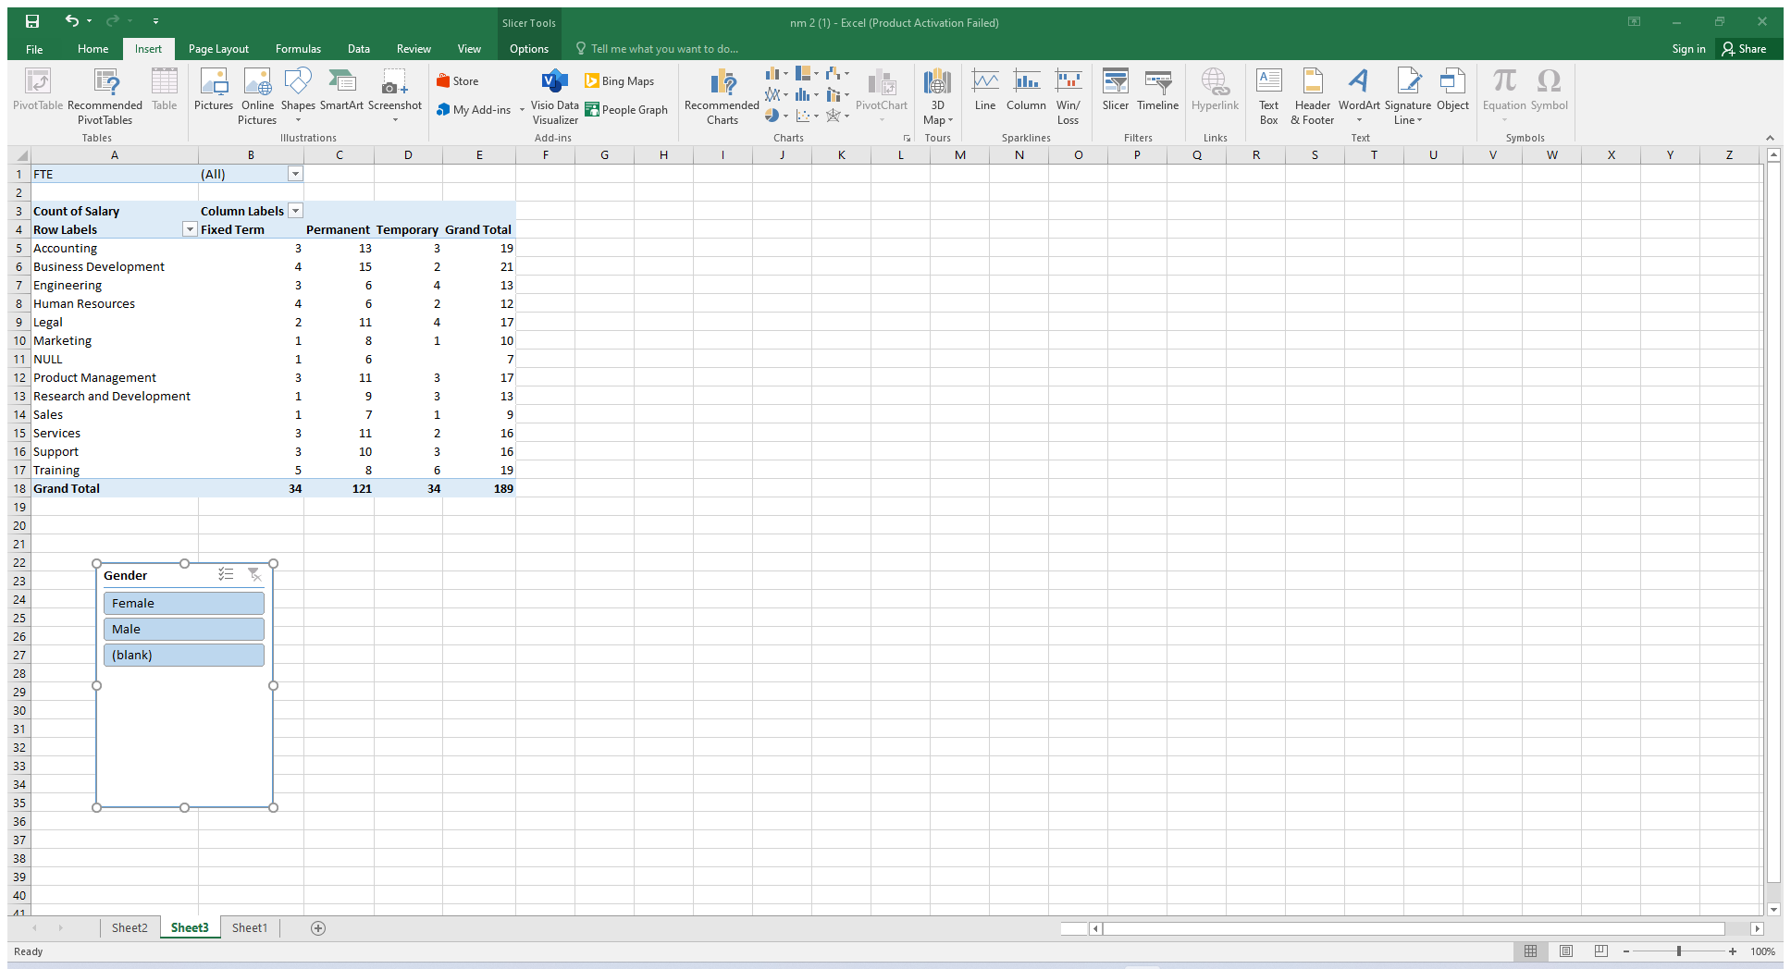
RESULTS
11

Slide 12
RESULTS
12

Slide 13
conclusion
➤In conclusion, the salary and compensation analysis through Excel data modeling provides a comprehensive understanding of compensation structures and trends within an organization. By leveraging Excel's powerful data analysis tools, we can identify key patterns and insights, such as salary distribution, compensation disparities, and the impact of various factors like experience, education, and job role on overall pay. This analysis not only helps in making informed decisions regarding pay equity and competitive compensation strategies but also aids in budgeting and forecasting future compensation needs. Ultimately, using Excel for this purpose enables organizations to align their compensation practices with industry standards, improve employee satisfaction, and support strategic HR planning.

