Slide 1

N.B.K.R. INSTITUTE OF SCIENCE AND TECHNOLOGY (AUTONOMOUS)
Affiliated to JNTUA, Ananthapuramu & Accredited by NAAC with ‘A’ Grade
Courses Accredited by NBA Under Tier-I | Vidyanagar, Tirupathi Dist., A.P., India - 524413
BYTEXL PROJECT
Title: HelpHub - A-Z Home Services
Team Members:
K.Mohith (24KB1A05V9) (Team Leader)
D.Vamsikrishna (24KB1A05C6)
K.Rajesh (24KB1A05S8)
B.Hajarath Babu (24KB1A0571)
B.Vijay Kumar (24KB1A0555)

Slide 2
Index
1
Introduction
6
Architecture
2
Problem Statement
7
User Roles
3
Project Structure
8
Booking Lifecycle
4
Modules
9
Features and Demo
5
Requirements
10
References

Slide 3
Introduction
Booking everyday home services such as cleaning, plumbing and electrical work is often unorganized and informal.
HelpHub is a full-stack web platform for booking A-Z home services.
Customers book services, workers claim and complete jobs, and admins monitor everything.
Built with React, Express and MySQL, with JWT-secured, role-based access.
3
user roles
4
booking stages

Slide 4




Problem Statement
Finding trusted workers for everyday home services is slow and unorganized.
Customers have no single place to compare services, starting prices and booking progress.
Workers have no simple way to find and claim unassigned service requests.
Admins lack a central dashboard to assign workers and track completed work and revenue.

Slide 5



Project Structure
HelpHub/
├── backend/
│ ├── config/db.js
│ ├── create-admin.js
│ └── server.js
├── database/
│ ├── az_home_services.sql
│ └── seed_services.sql
└── frontend/
└── src/
├── components/
├── pages/
├── services/api.js
└── App.jsx
backend
Express REST API, MySQL connection and the admin-creation script.
database
SQL schema for az_home_services plus sample service catalog.
frontend
React UI: pages, components and an API client (api.js).

Slide 6
Modules of HelpHub
Module | Description
User Authentication | Register and log in with bcrypt hashes and JWT tokens.
Service Catalog | Browse and search services by name or category.
Booking Management | Customers create, view and cancel their bookings.
Worker Module | Maintain a profile, claim requests, update job status.
Admin Dashboard | View enrollments, assign workers, track revenue.
Access Control | Backend role checks protect every sensitive endpoint.

Slide 7
Requirements
Software requirements
Hardware requirements
Frontend: React with Vite, HTML, CSS, JavaScript
Backend: Node.js and Express.js
Database: MySQL (XAMPP and phpMyAdmin)
Security: bcrypt password hashes, JWT
Tools: Visual Studio Code, Git, npm
Computer or laptop
Internet connection
Modern web browser

Slide 8


System Architecture
REST + JWT
SQL queries
React Frontend
Express API
MySQL Database
Vite dev server
localhost:5173
Node.js server
localhost:5001
az_home_services
via XAMPP
The React app calls the API through services/api.js and sends Authorization: Bearer <token>.
Express validates the JWT and the user’s role before running any protected route.
MySQL stores accounts, services and bookings; booking prices are saved at booking time.

Slide 9


User Roles
Customer
Worker
Admin
Registers and signs in
Searches services and books a future date/time
Views own bookings; cancels pending or confirmed ones
Maintains a basic profile
Claims unassigned pending requests
Moves jobs to in progress and completed
Created from the terminal (npm run create-admin)
Views enrollments and assigns workers
Tracks live booking and revenue totals

Slide 10

Booking Lifecycle
pending
confirmed
in_progress
completed
Customer may cancel while the booking is pending or confirmed. A worker can only advance their own booking, one step at a time.
One claim only
Privacy
Price lock
Only one available worker can claim an unassigned request.
The service address is shown only after a worker accepts.
Price is copied from the service at booking time, so later changes don’t affect it.

Slide 11
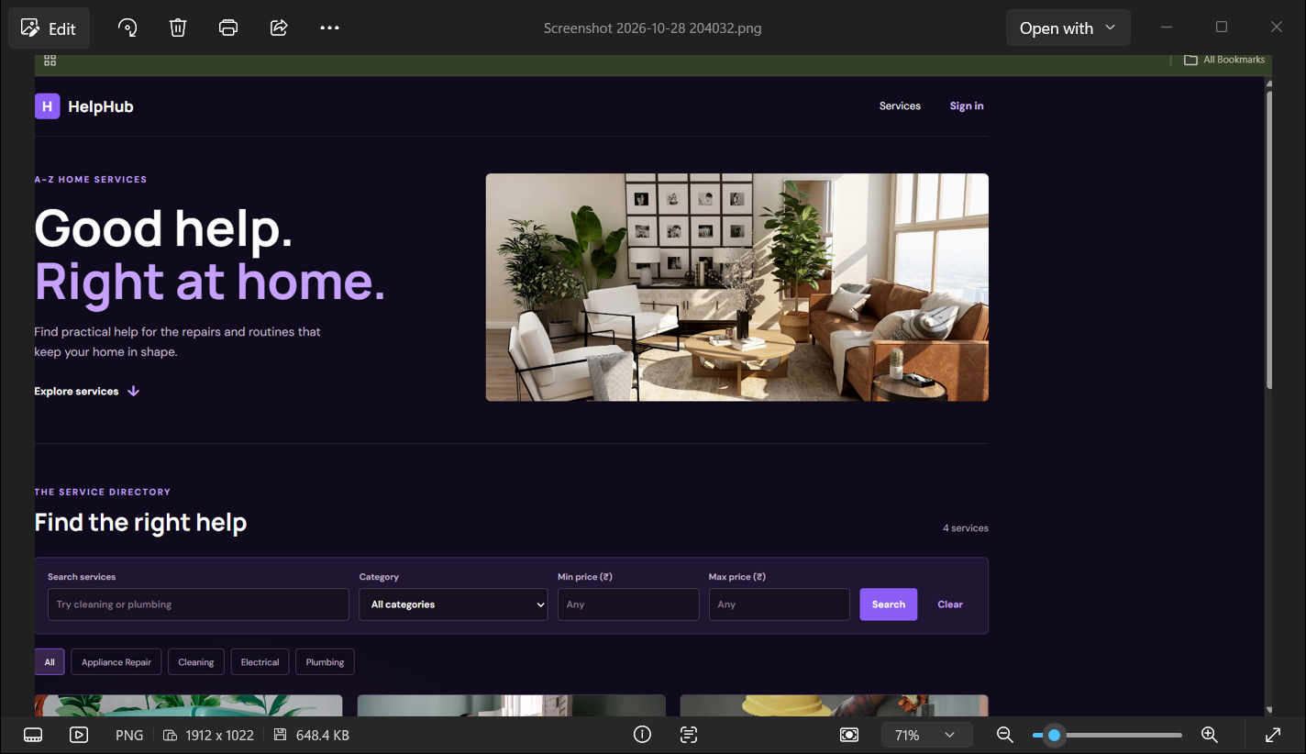
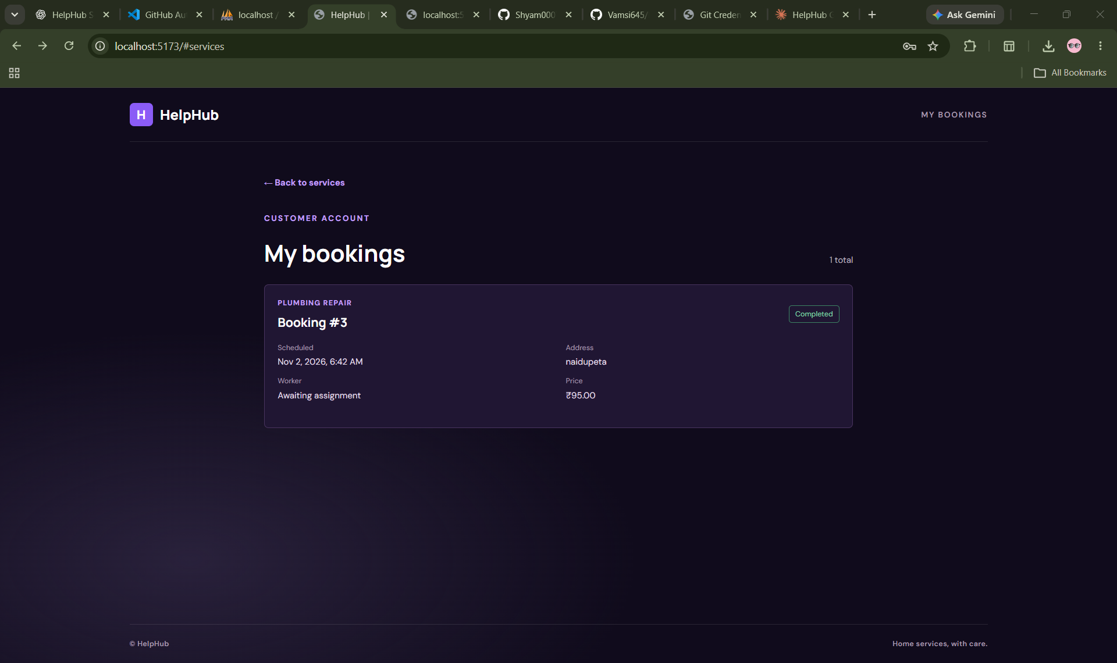
Screenshots
Add screenshot: Home / Services page
Add screenshot: Admin dashboard

Slide 12
Key Features and Conclusion
Secure login with bcrypt and JWT
Conclusion
Searchable service catalog
HelpHub brings customers, workers and admins onto one platform for A-Z home services. It simplifies booking, job assignment and progress tracking, with secure, role-based access end to end.
Customer booking and cancellation
Worker job claiming and status updates
Admin assignment and revenue dashboard
Role-based API protection

Slide 13
References
1. React Documentation — react.dev
2. Vite Documentation — vite.dev
3. Node.js Documentation — nodejs.org
4. Express.js Documentation — expressjs.com
5. MySQL Documentation — dev.mysql.com/doc
6. JWT Introduction — jwt.io
7. Project Repository — github.com/Vamsi645/HelpHub

Slide 14
Thank You
Questions and Suggestions?
We welcome your questions, feedback and suggestions regarding HelpHub.

