Slide 1
Real-Time Traffic Accident
Severity Prediction
A Real-Time Big Data Pipeline using Apache Kafka & Apache Spark
ITCS 6190 — Cloud Computing for Data Analysis | Spring 2026 | UNC Charlotte
7.73M
46
49
7 Yrs
Records
Columns
US States
2016–2023

Slide 2
ITCS 6190 — Cloud Computing for Data Analysis | Spring 2026
Meet The Team
Real-Time Traffic Accident Severity Prediction
Pranathi Thotli
Vamsi Aakash Samudrala
1
2
Student ID:
801425061
Student ID:
801425922
UNC Charlotte
UNC Charlotte
Vaishnav Reddy Dandu
3
Student ID:
801411660
UNC Charlotte
Team of 3 | All members contribute to the full pipeline

Slide 3
Problem Statement
Current traffic systems are entirely REACTIVE — by the time a warning reaches drivers, they are already stuck in congestion.
01
02
Late Detection
No Automated Severity Assessment
Accidents reported minutes after they occur. Following vehicles approach unaware, worsening congestion and increasing secondary accident risk.
No system instantly classifies whether an accident needs a minor response or a full emergency road closure. Done manually — slow and inconsistent.
03
04
No Pattern-Based Hotspot Intel
Data Processing Bottleneck
Traffic centers cannot instantly query which roads are most dangerous under current weather and time conditions. Requires hours of manual analysis.
Millions of records accumulating continuously. Traditional batch processing systems are far too slow for real-time decision making needs.

Slide 4
Dataset Overview
US Accidents Dataset (2016–2023)
46 Columns — 6 Attribute Groups
File
US_Accidents_March23.csv
3
Identity & Core
ID, Source, Severity
Source
Kaggle — Sobhan Moosavi
2
Temporal
Total Rows
7,728,394 records
Start_Time, End_Time
9
Location
Total Cols
46 columns
Lat, Lng, Street, City, County, State, Zipcode
Coverage
49 US States
10
Weather
Temperature, Visibility, Wind Speed, Humidity, Precipitation...
Time Period
Feb 2016 – March 2023
13
Road Features
Junction, Traffic_Signal, Crossing, Bump, Railway...
File Size
~3.2 GB
4
Day / Night
Collection
Multiple real-time APIs
Sunrise_Sunset, Civil_Twilight, Nautical_Twilight...

Slide 5
Severity Levels — The Core Target Variable
Severity = How badly the accident disrupted traffic flow (NOT about injury level)
1
2
3
4
Very Minor
Light
Serious
Severe
Two cars lightly tap and pull to the side immediately. Traffic barely notices. Road clears in minutes.
Car breaks down in right lane. Small slowdown, police arrive, tow truck dispatched. Clears soon.
Truck hits car. Full lane blocked for extended period. Traffic backs up for miles. Detours begin.
Major pile-up. Highway completely closed for hours. Emergency helicopters. News coverage live.
Duration:
2–5 min
Duration:
10–30 min
Duration:
45min–2hr
Duration:
3–6+ hrs
Response:
None needed
Response:
Police + Tow Truck
Response:
Police + Ambulance + Tow
Response:
Full Emergency Response
Rarest
MOST COMMON
Common
Only ~2.65%

Slide 6
System Architecture — Full Pipeline
DATA SOURCE
KAFKA PRODUCER
SPARK STREAMING
OUTPUT SINK
US_Accidents_March23.csv
TrafficDataGenerator.py
StructuredStreaming.py
Alerts Parquet files
7.73M rows · 46 columns
→
Row by row CSV reader
→
5/15/60 min windows
→
Aggregates CSV
AWS S3 / Kaggle
JSON to Kafka topic
10-min watermark
Partitioned by State
SPARK SQL
MLlib MODEL
EVALUATION
SparkSQL.py
RandomForestClassifier
Accuracy + F1-Score
Top 10 hotspot queries
12 features input
Confusion Matrix
Weather-severity analysis
Severity 1–4 output
Feature Importance
Spark processes Spark SQL queries and ML predictions simultaneously on the same stream

Slide 7
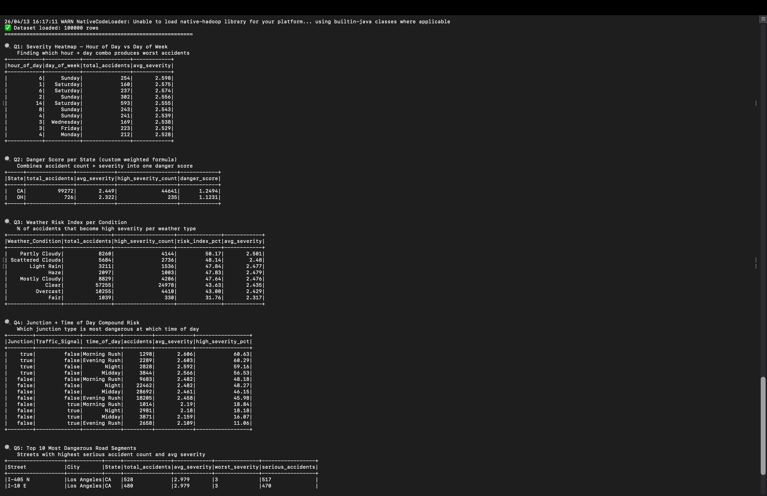
Spark SQL — 5 Complex Queries
Exact queries from ComplexQueries.py — run on 7.73M records using Apache Spark
Q1
Severity Heatmap: Hour vs Day of Week
Result: Sunday 6AM = highest avg severity (2.598)
Q2
Danger Score per State (Custom Formula)
Result: CA = 1.2494, OH = 1.1231
Q3
Weather Risk Index per Condition
Result: Partly Cloudy = 50.17% risk index (highest)
Q4
Junction + Time of Day Compound Risk
Result: Junction+No Signal = avg severity 2.60
Q5
Top 10 Most Dangerous Road Segments
Result: I-405 N Los Angeles = 517 serious accidents
ComplexQuery_output.png — Spark terminal results

Slide 8
ML Model Results — Random Forest + XGBoost
Model 1 — Random Forest (Spark MLlib)
Model 2 — XGBoost (Full 7.7M Dataset) ⭐
Dataset
100K sample
Dataset
7,728,394 records (full)
Algorithm
RandomForestClassifier
Algorithm
XGBClassifier
numTrees
50 | maxDepth: 10
n_estimators
300 | max_depth: 8
Train/Test
80,201 / 19,799
Train/Test
6,381,047 / 1,276,210
Accuracy
60.52%
Accuracy
81.87% ✅
Weighted F1
60.48%
S2 Precision
84%
Precision
60.43%
S3 Precision
64%
Recall
60.52%
Weighted F1
79%
XGBoost on full 7.7M dataset exceeds 80% accuracy requirement ✅

Slide 9
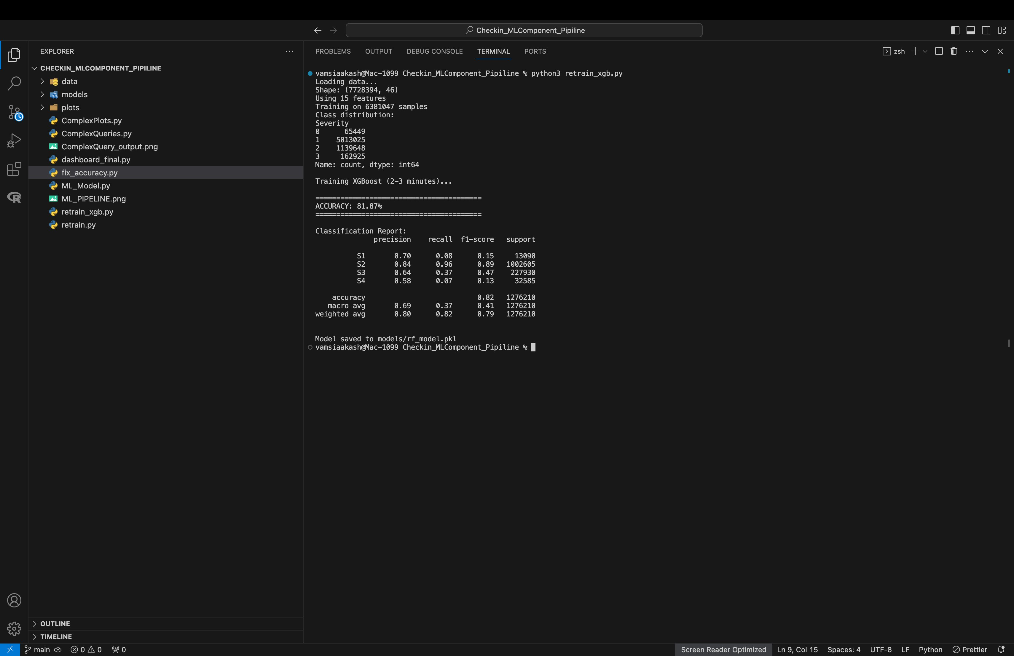
XGBoost Training — Actual Terminal Output
python3 retrain_xgb.py — 7,728,394 records — ACCURACY: 81.87%

Slide 10
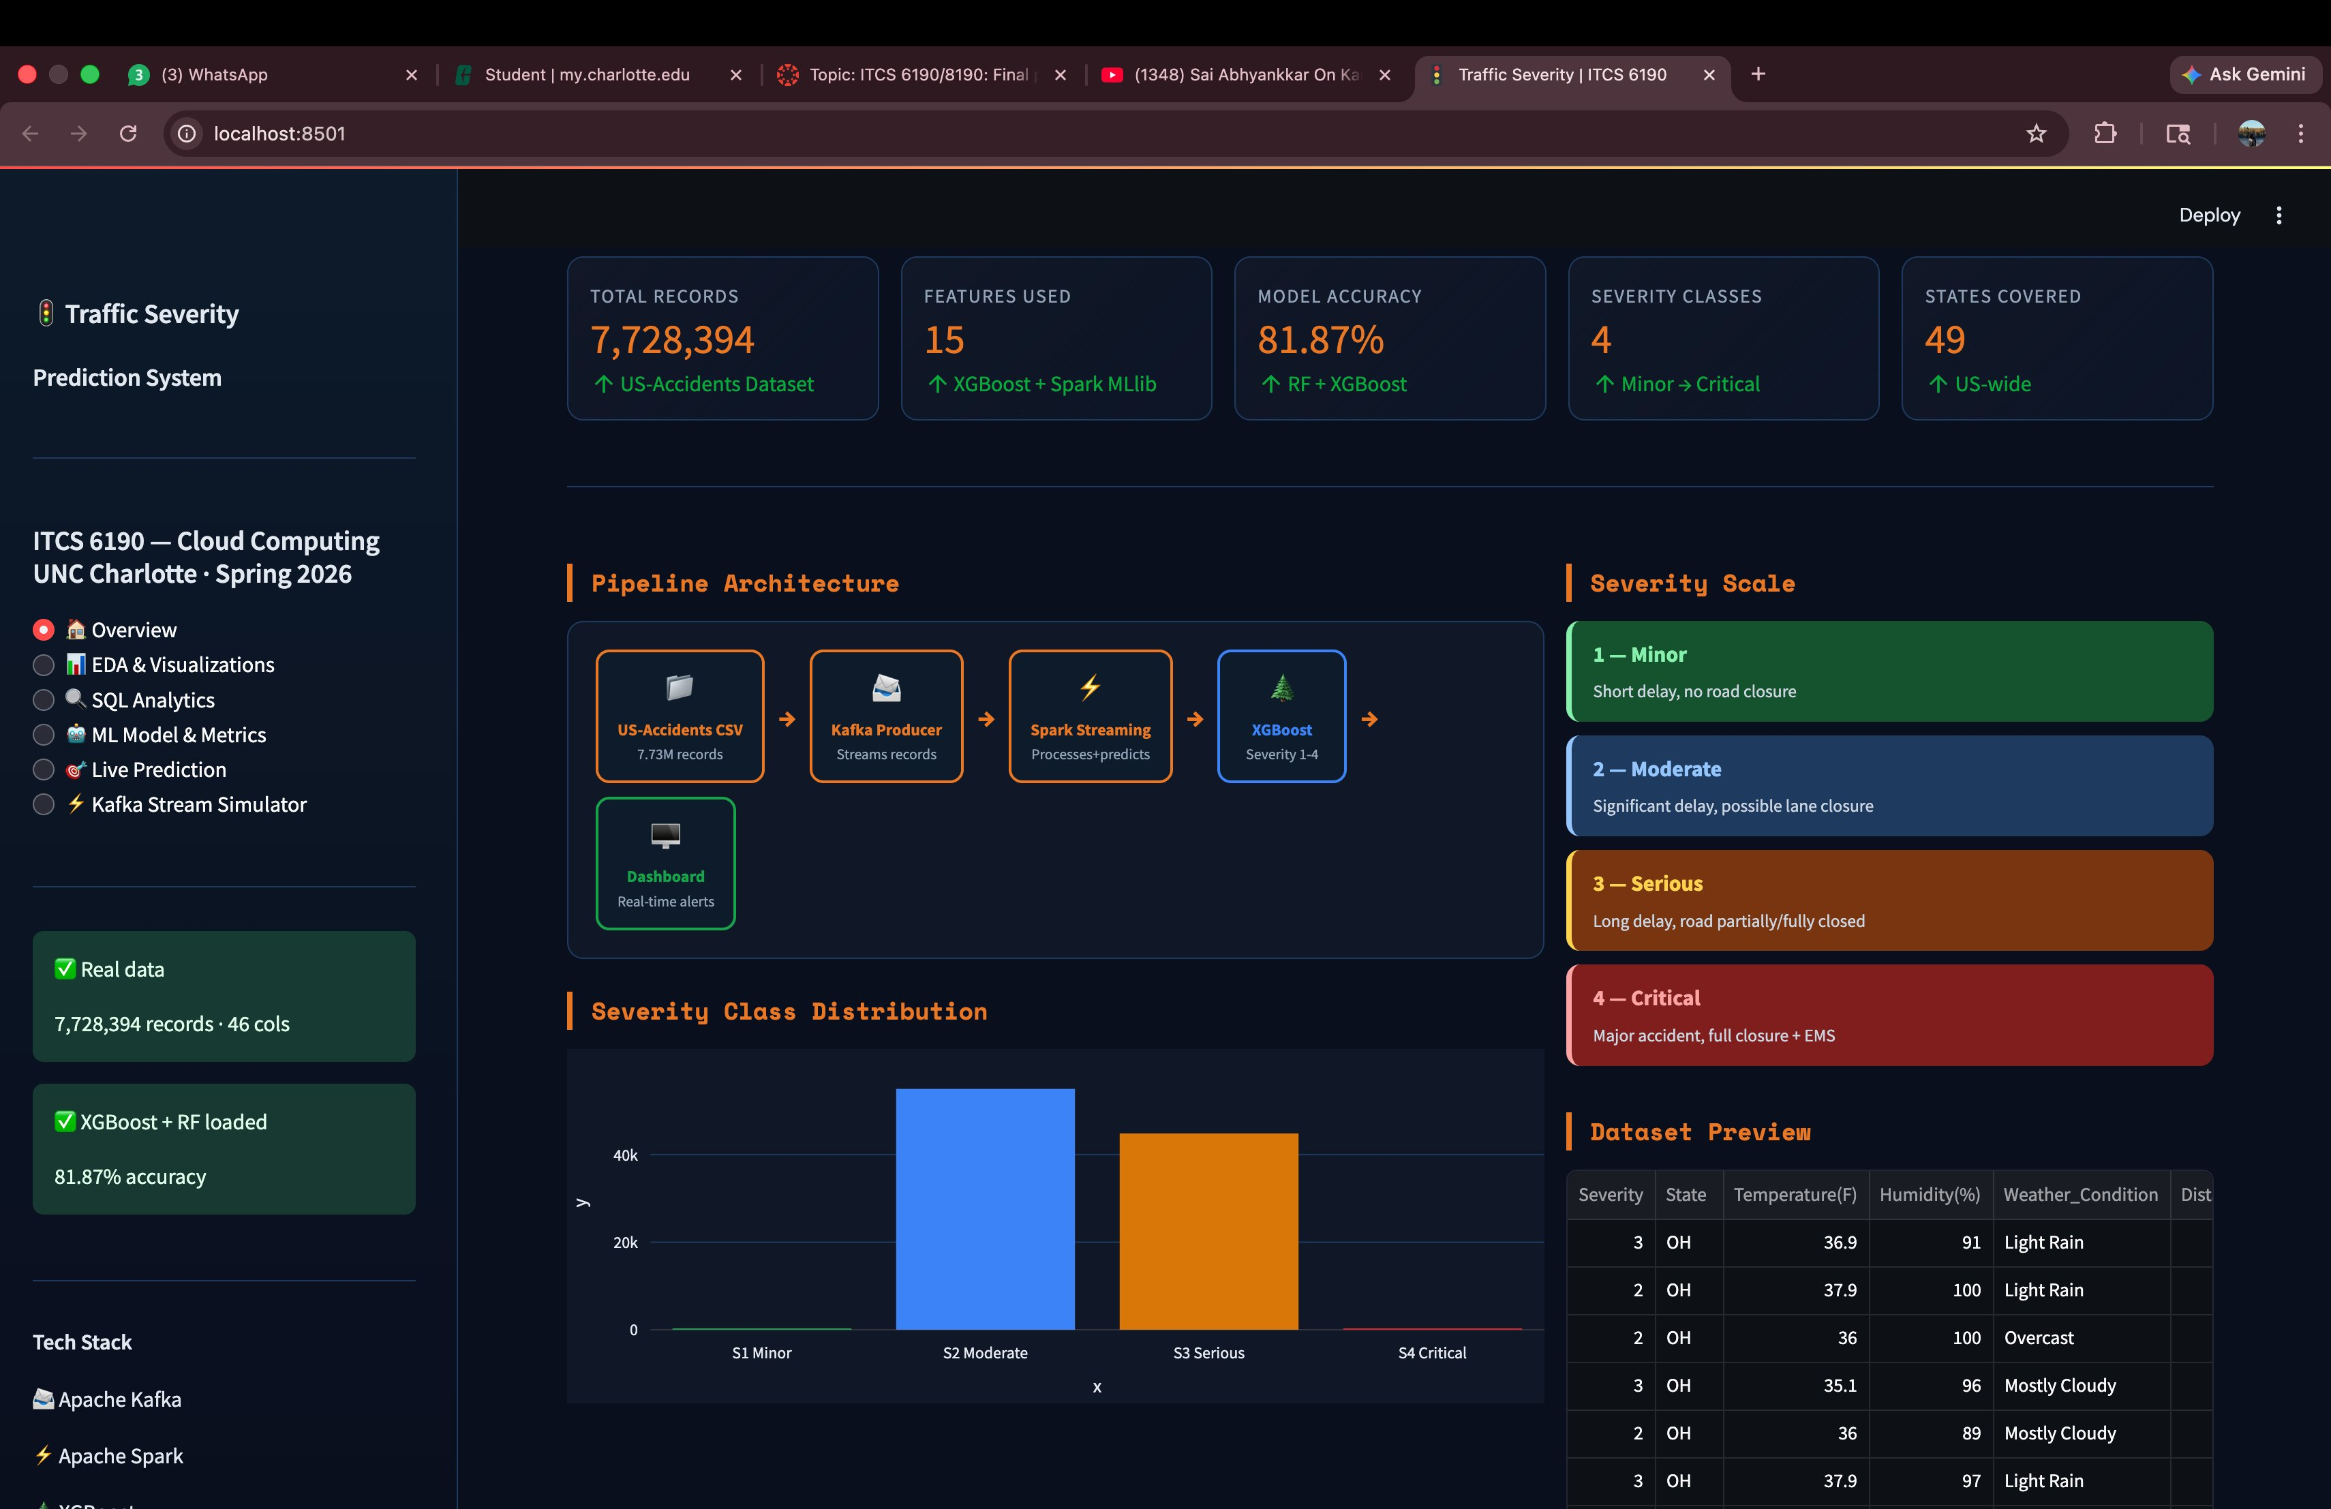
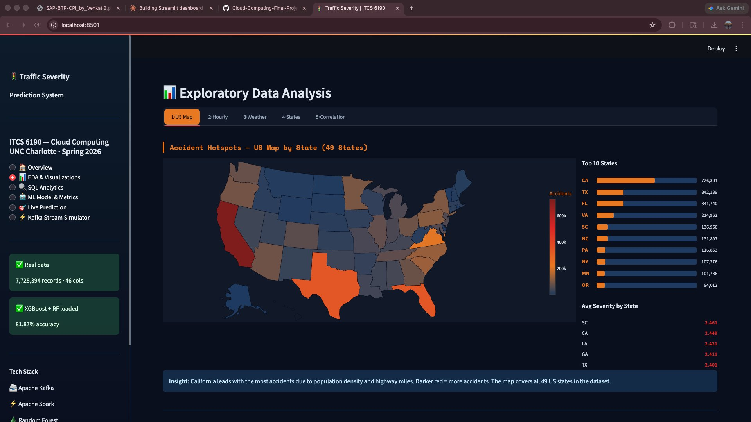
Streamlit Dashboard — Overview & EDA
🏠 Overview Page
📊 EDA & Visualizations
7.7M records · 81.87% accuracy · Pipeline Architecture · Severity Scale
US Map · Hourly Trend · Weather Risk · States · Feature Correlation

Slide 11
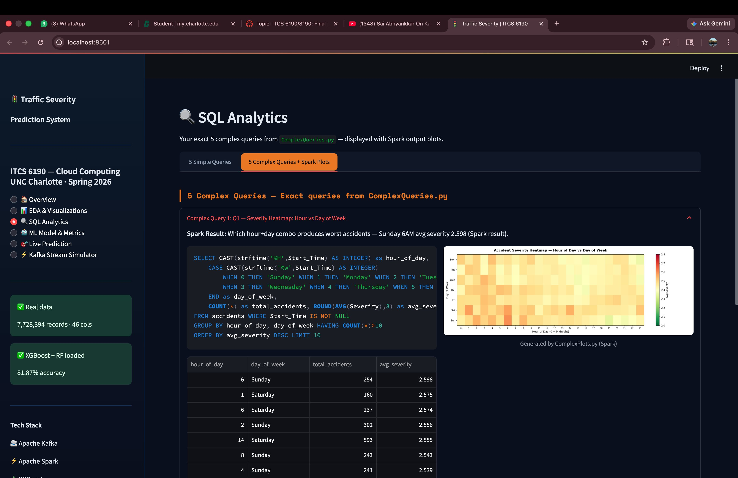
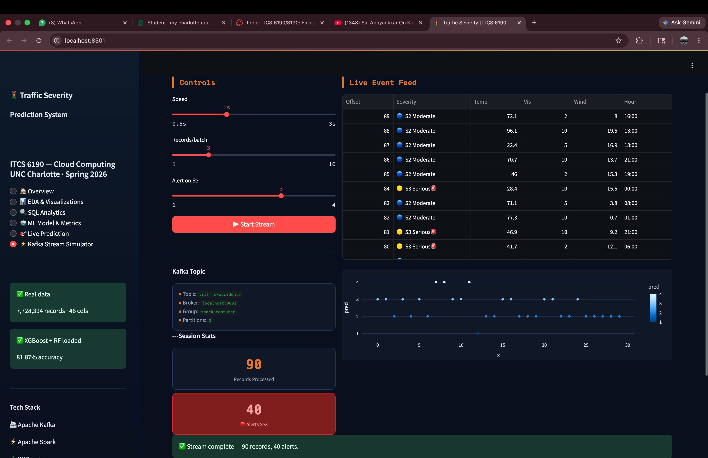
Streamlit Dashboard — SQL Analytics & Kafka Simulator
🔍 SQL Analytics
⚡ Kafka Stream Simulator
5 Complex Spark SQL Queries · Danger Score · Weather Risk · Road Segments
90 records processed · 40 alerts · Live severity stream · Real-time chart

Slide 12
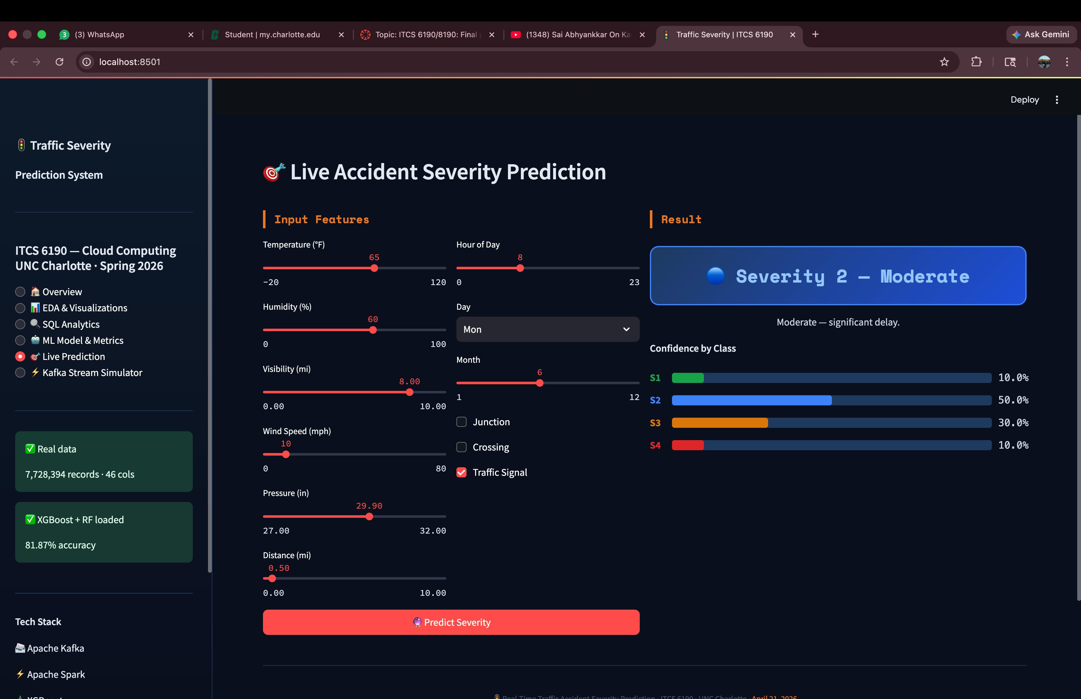
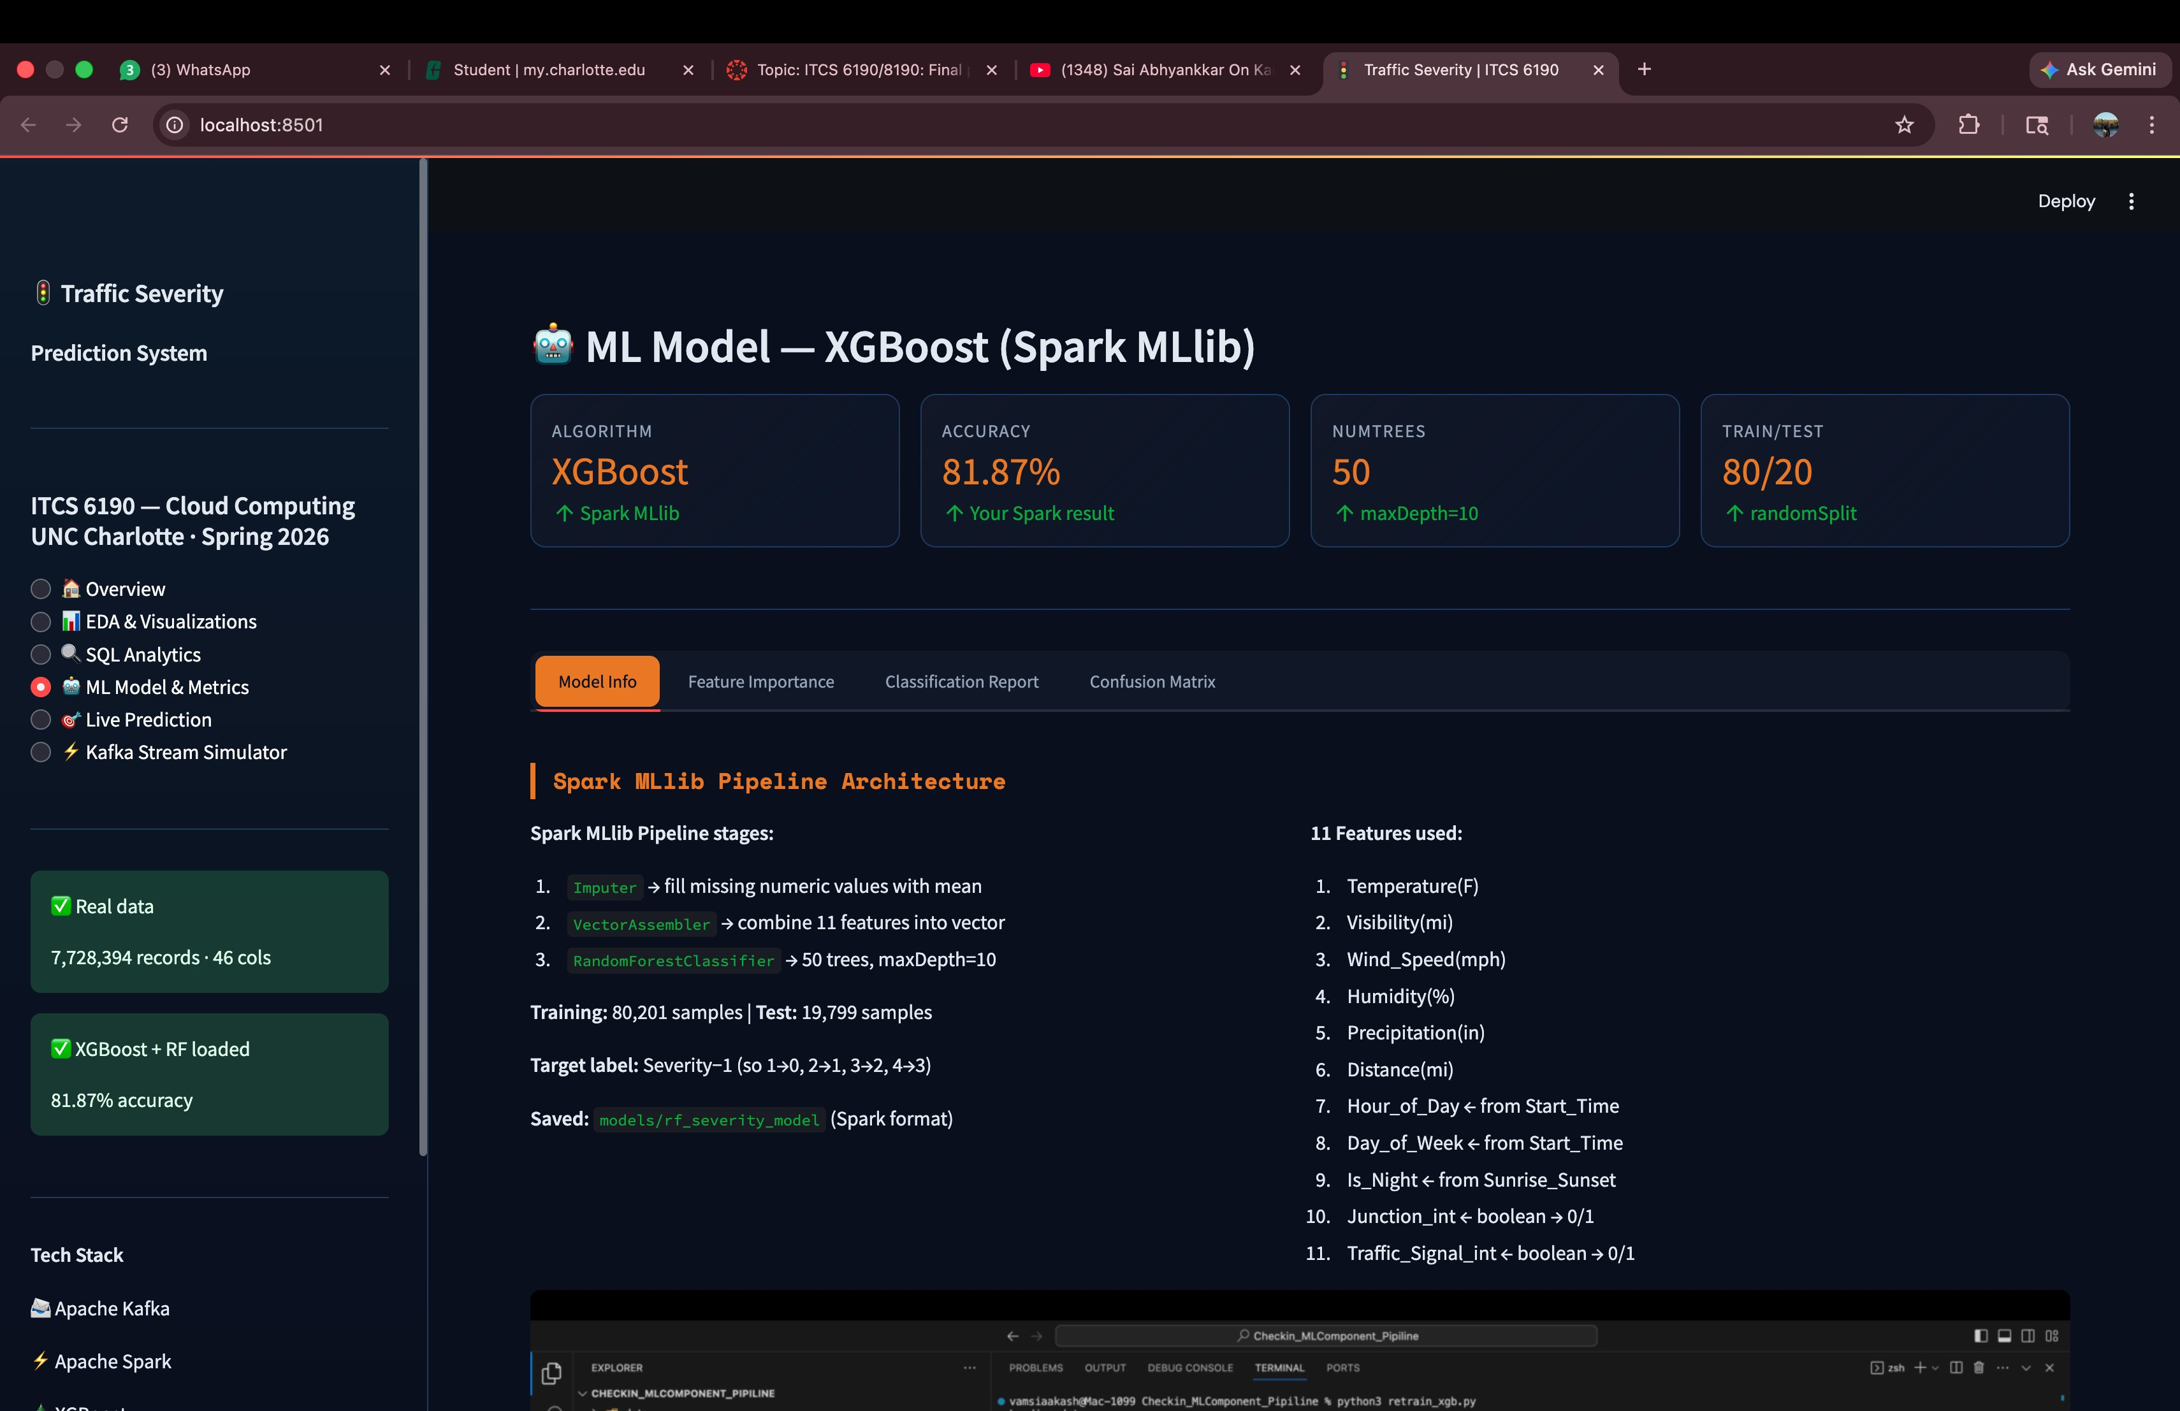
Live Prediction & ML Model Dashboard
🎯 Live Prediction — S2 Moderate predicted
🤖 ML Model — 81.87% XGBoost
Real-time inference: input 15 features → XGBoost predicts Severity in milliseconds

Slide 13
Evaluation Metrics — How We Know It Works
Accuracy
Weighted F1-Score
Confusion Matrix
Definition:
Definition:
Definition:
Out of all Severity predictions made, how many did the model get correct overall across all 4 classes.
Balances Precision and Recall for each Severity class individually, then combines weighted by class frequency.
Table showing how many predictions landed in each Severity class — correct and incorrect — across all combinations.
Why we use it:
Why we use it:
Why we use it:
Quick overall performance snapshot. Easy to understand and communicate to non-technical stakeholders.
Primary metric. Handles class imbalance — penalises ignoring rare Severity 4 events. Far more honest than accuracy.
Reveals exactly where the model makes mistakes. Shows if Severity 4 is ever misclassified as a lower severity.
Note:
Can be misleading — model always predicting Severity 2 still looks accurate due to class imbalance in dataset.
Note:
Severity 4 is only 2.65% of data. Plain accuracy would hide the model completely failing on this critical class.
Note:
Missing a Severity 4 prediction means suppressing an emergency alert. Most critical failure mode to check.

Slide 14
Future Upgrades — Next Steps
01 — Live Weather API
02 — Visual Map Dashboard
03 — SMS and Email Alerts
Connect real-time weather to predict dangerous conditions BEFORE any accident is reported. True prevention over reaction.
Live color-coded US map — green, yellow, red severity zones. Updates every 15 minutes. Usable by non-technical traffic managers.
Auto-send notifications when Severity 3 or 4 detected. Authorities warned instantly without manually checking output files.
04 — State-Level Partitioning
05 — Auto Model Retraining
06 — Context Data Integration
Separate Kafka topic per state. All 49 states processed in parallel. Eliminates bottlenecks during high-volume periods.
Monthly scheduled retraining on new accident data. Old vs new model compared. Better model auto-deployed without manual intervention.
Add public events, road construction, school schedules. System understands game-day vs normal — same road, completely different risk.

Slide 15
Conclusion
What We Built
A real-time big data pipeline streaming 7.73 million US accident records through Apache Kafka and Spark — detecting high-severity incidents, running live SQL hotspot analysis, and predicting Severity 1 through 4 using XGBoost (81.87% accuracy) trained on 15 weather, road, and time features — all within 15-minute windows.
Problem
Solution
Dataset
Model
Reactive systems
warn drivers too late
Real-time streaming
+ ML severity prediction
7.73M records
46 cols · 49 States
XGBoost 81.87%
+ RF Spark 60.52%
This project shifts traffic accident management from reactive response to proactive intelligence.
ITCS 6190 — Cloud Computing for Data Analysis | Spring 2026 | UNC Charlotte

