Slide 1
Predicting Gender Based on Voice
CS419 M Course Project
https://github.com/VamsiGaraga/CS419M_Project

Slide 2
Overview
Task Description
Dataset Employed
Models Employed
Data Augmentation
Results and Analysis
Sources of Code (SOC) & Original Code (OC)

Slide 3
Task Description

Slide 4
Our task involves:
Making predictions of Gender based on a dataset consisting of 20 voice features (including properties of quantiles, fundamental and dominant frequencies etc).
Employing various classifier models to fit the data and comparing their accuracy.
Analysing the effect of data augmentation (through addition of gaussian noise) on the performance of the various models.
Task Description
Dataset Employed
Models Employed
Data Augmentation
Results/
Analysis
SOC & OC

Slide 5
Dataset Employed

Slide 6
We have used the Kaggle Dataset ‘voice.csv’ which consists of 3169 data points, each in turn consisting of 20 features.
The male voices have label = 0 while female voices have label = 1. The mean of the “label” column is 0.5, indicating that the dataset consists of 50% male and 50% female voices.
The data is normalised along each feature by subtracting the mean from each datapoint and dividing by the standard deviation.
Train Dataset to Test Dataset split is 70:30.
Task Description
Dataset Employed
Models Employed
Data Augmentation
Results/
Analysis
SOC & OC

Slide 7
Models Employed
SVM Classifier
Logistic Regression
Neural Network
K-Neighbors Classifier
Random Forest Classifier

Slide 8
Logistic Regression
Utilized the LogisticRegression function from the linear_model class of the sklearn module.
L2 regularization is employed with regularization strength of 1.
The maximum number of iterations is set to 1000.
Task Description
Dataset Employed
Models Employed
Data Augmentation
Results/
Analysis
SOC & OC

Slide 9
SVM
Utilized the SVC function from the svm class of the sklearn module.
The implementation is based on libsvm and only suitable for small datasets.
The kernel used is RBF.
A squared L2 penalty is applied with strength 1.
Task Description
Dataset Employed
Models Employed
Data Augmentation
Results/
Analysis
SOC & OC

Slide 10
Neural Network
Utilized the MLPClassifier function from the neural_network class of the sklearn module.
A simple neural network with 1 hidden layer consisting of 100 neurons is used.
The solver used is the stochastic gradient based Adam optimizer.
The maximum number of iterations is set to 1000.
Task Description
Dataset Employed
Models Employed
Data Augmentation
Results/
Analysis
SOC & OC

Slide 11
K Neighbours
Utilized the KNeighborsClassifier function from the neighbors class of the sklearn module.
The argmax of the classes of the 5 nearest neighbors is taken to predict the class of a new testpoint.
The euclidean distance in the feature space is used to find the nearest neighbors.
Task Description
Dataset Employed
Models Employed
Data Augmentation
Results/
Analysis
SOC & OC

Slide 12
Random Forest
Utilized the GradientBoostingClassifier function from the ensemble class of the sklearn module.
The number of boosting stages used is 100.
In each stage, a single regression tree is fit on the negative gradient of the binomial deviance loss function.
Task Description
Dataset Employed
Models Employed
Data Augmentation
Results/
Analysis
SOC & OC

Slide 13
Data Augmentation

Slide 14
To test and analyse the performance of the models against noise, we concatenated the original data corrupted by gaussian noise (zero mean normal distribution with std = 0.008), to the original data.
Hence, the new train dataset consists of a total of 4436 datarows (2 * 0.7 * 3169)- 2218 original data rows and 2218 noise corrupted datarows.
All of the models were trained from scratch using the newly formed train dataset, and their accuracies were evaluated on the test dataset (which is the same as the one before).
Task Description
Dataset Employed
Models Employed
Data Augmentation
Results/
Analysis
SOC & OC

Slide 15
Results and Analysis

Slide 16
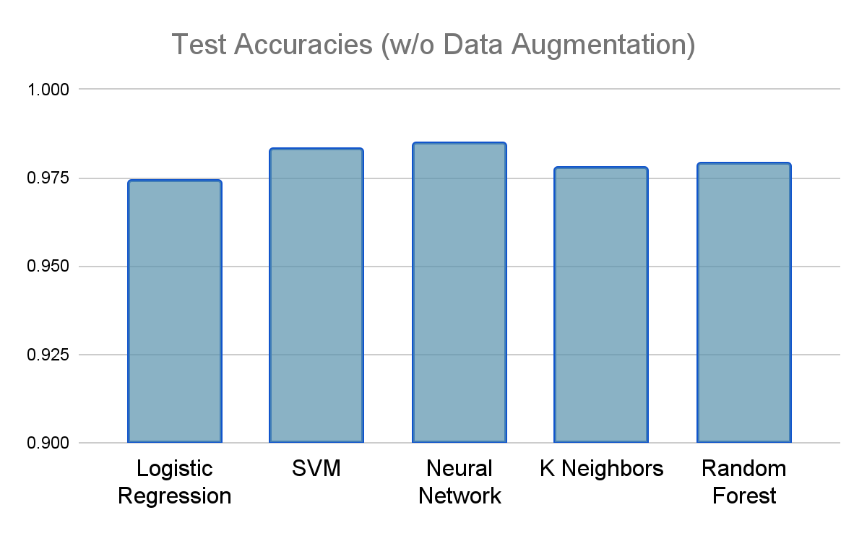
The test accuracies for the models when there is no data augmentation in the training set are as follows:
Logistic Regression - 0.974
SVM - 0.983
Neural Network - 0.985
K Neighbors - 0.978
Random Forest - 0.979

Slide 17
Analysis of Results (w/o Data Augmentation)
It is observed that even a simple neural network with just one hidden layer performs the best among all the models.
The SVM test accuracy closely follows that of the neural network.
The Random Forest and K neighbors classifiers have a similar performance that is observably worse than the ones mentioned above.
The simple Logistic Regression classifier performs the worst by a visible margin.
Task Description
Dataset Employed
Models Employed
Data Augmentation
Results/ Analysis
SOC & OC

Slide 18
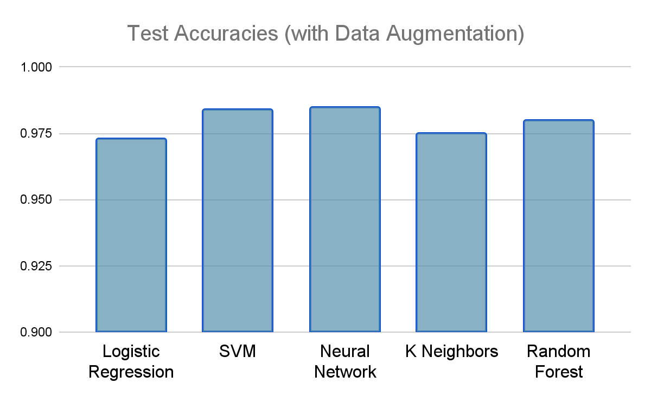
The test accuracies for the models when we have data augmentation in the training set are as follows:
Logistic Regression - 0.973
SVM - 0.984
Neural Network - 0.985
K Neighbors - 0.975
Random Forest - 0.980

Slide 19
Analysis of Results (w/o Data Augmentation)
It is observed that the neural network, very closely followed by the SVM, performs the best among all the models.
The Random Forest classifier performs observably worse than the above two.
The simple Logistic Regression classifier, closely followed by the K neighbors classifier, performs the worst by a visible margin.
Task Description
Dataset Employed
Models Employed
Data Augmentation
Results/ Analysis
SOC & OC

Slide 20
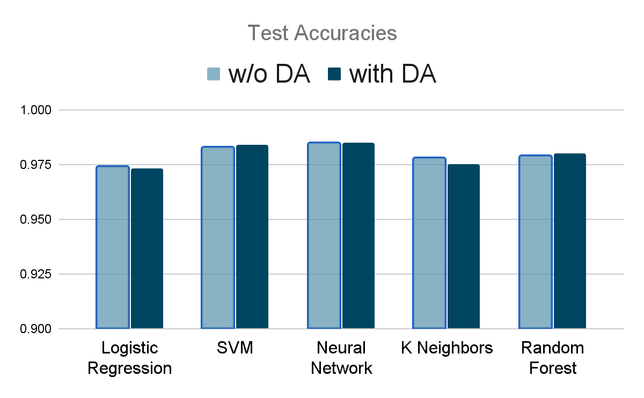
It is observed that the neural network accuracy remains almost unchanged on data augmentation, while that of Logistic Regression decreases slightly.
The accuracies of SVM and Random Forest increase slightly with data augmentation.
The K neighbors accuracy decreases somewhat substantially with augmentation.
We can thus safely conclude that data augmentation is, at the very least, not a very effective means of improvement for our task.
Comparison of Results with and without Data Augmentation

Slide 21
Sources of Code (SOC) & Original Code (OC)
Code is completely written by us, didn’t use any source code

Slide 22
The Team
180070017 - Devak Sinha
180070020 - Garaga VVS Krishna Vamsi
180070068 - Yash Sanjeev
18D070011 - Harshit Shrivastava
190070042 - Parin Senta

Slide 23
Contribution
Yash Sanjeev | Code for data normalization and SVM Report : Section 1, 2
Garaga V V S Krishna Vamsi | Rest of the code
Devak Sinha | Report : Section 5 PPT
Harshit Shrivastava | Report : Section 3, 4
Parin Senta | PPT

