Slide 1
ORGANISATION NAME:SNIST PROBLEM STATEMENT :Sentiment Analysis From Text Feedback. Description : Web portals like Bhuvan get vast amount of feedback from the users. To go through all the feedbacks can be a tedious job. Develop software to categorize opinions expressed in feedback forums. This can be utilized for feedback management system. The software must provide the following output. 1) Classification of individual comments/reviews. 2) Determining overall rating based on individual comments/reviews. The Multi-Domain Sentiment Dataset contains product reviews taken from Amazon.com from many product types (domains). TEAM NAME: Team Algos TEAM LEADER NAME : D.Vikas

Slide 2
IDEA/APPROACH:
Multi-Class Text Classification with Scikit-Learn
The problem is supervised text classification problem, and our goal is to investigate which supervised machine learning methods are best suited to solve it.
Given a new complaint comes in, we want to assign it to one of categories. The classifier makes the assumption that each new complaint is assigned to one and only one category.

Slide 3
TECHNOLOGY STACK
Initially, we have used nltk and TEXTBLOB for tokenizing and TextProcessing .
PANDAS For data analysis.
NUMPY For arrays and matrices.
FLASK For deploying our ntlk model on to a web application.
MYSQL For Database.
SCKIT-LEARN For Naïve Bayes Algorithm.

Slide 4
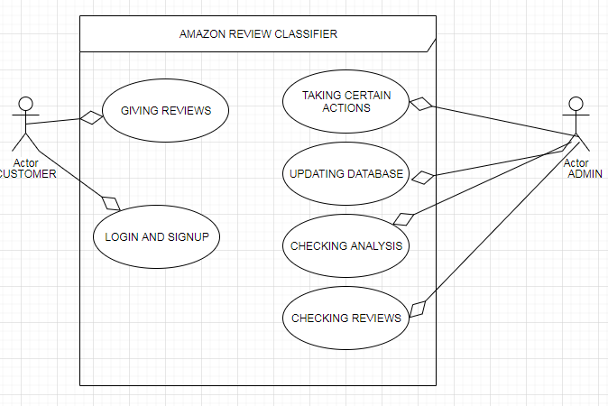
USECASE DIAGRAMS

Slide 5
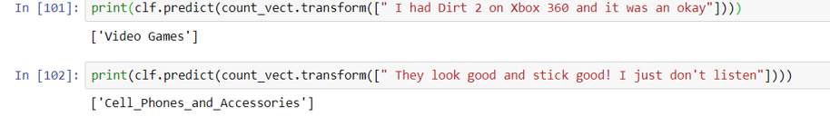
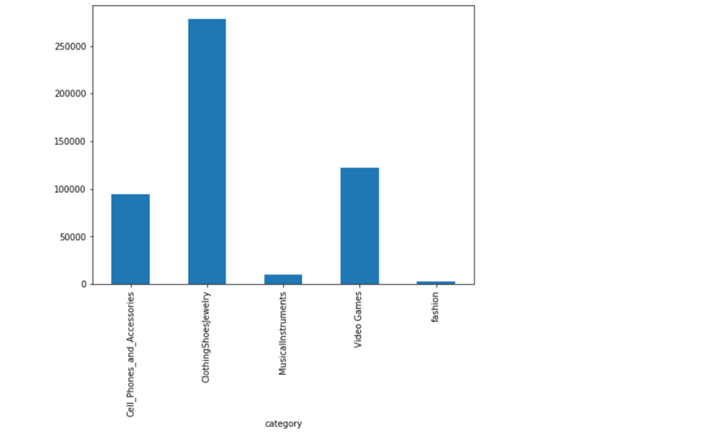
INPUT AND OUTPUT SCREENSHOTS

Slide 6
