Slide 1

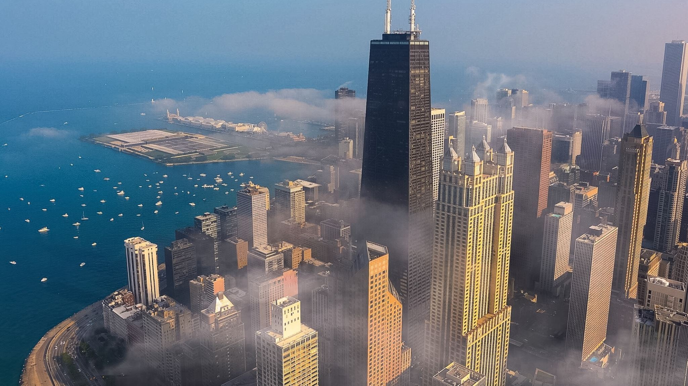
Chicago Crime analysis
Team Jalebi
Sahaja- spedda3@uic.edu, github - Sahajareddyp
Raj- rkapad5@uic.edu, github - rkap5423
Vamsi- vmunju2@uic.edu, github - VamsiMunjuluri
Github project repository link- https://github.com/CS418/group-project-jalebi

Slide 2
Problem
What time of day is the safest? Which day of the week? What are the most common crimes? Those are just some of the questions we explored.
With crime on the rise in the city, it’s important to understand for students and all residents alike where extra precautions must be taken when traveling, as well as when it should be done

Slide 3
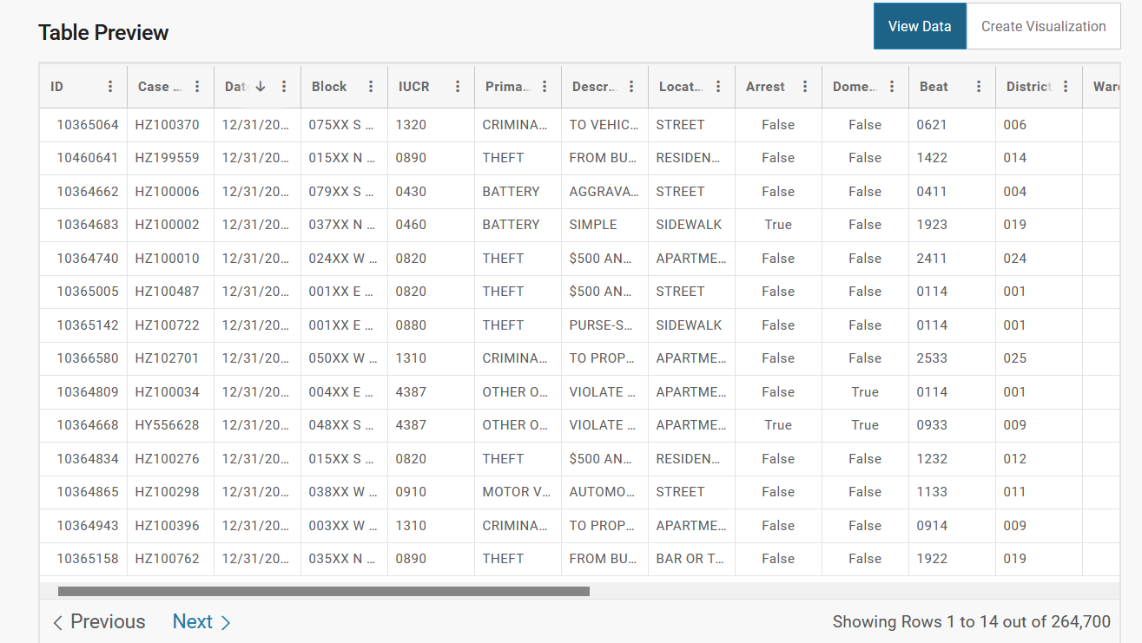
Data
All data required is publicly accessible and located at https://data.cityofchicago.org/browse?category=Public+Safety
It can be quickly accessed as a CSV file or through an API
Depending on the year, each dataset contains roughly between 250,000-300,000 rows of reported crimes
Each row contains various pieces of information about every reported crime, including location, timestamp, type, etc.
We focus on 2022 data, contains Jan-Present

Slide 4
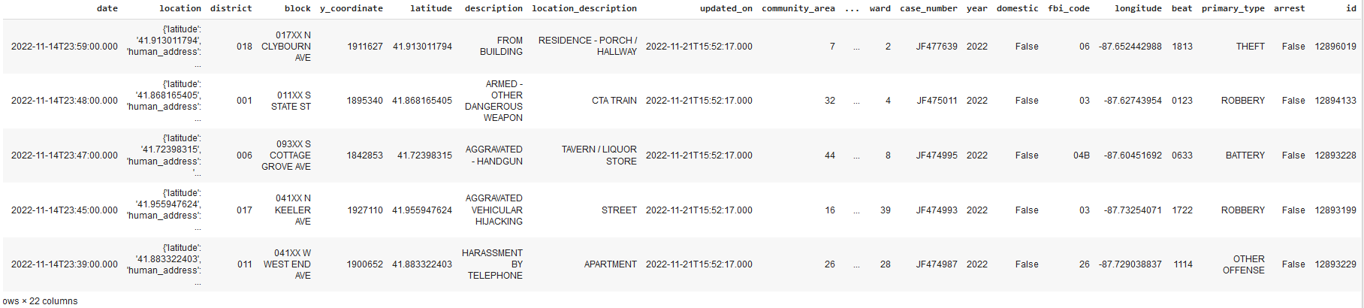

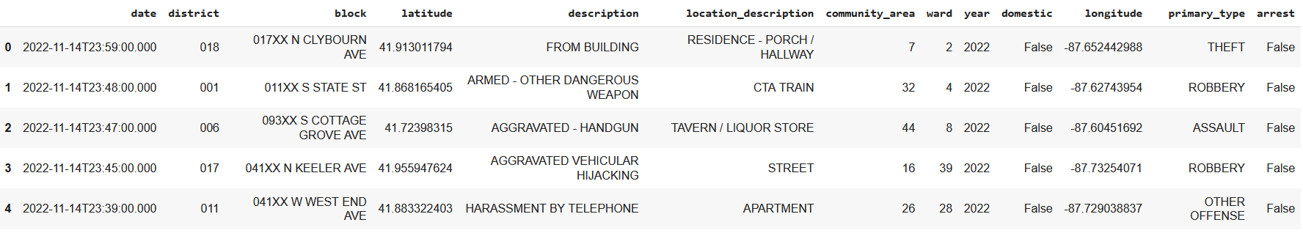
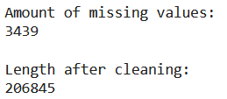
Cleaning
Dropped unnecessary primary key columns such as case number, FBI code, etc
Combined many similar crime types such as assault and battery, sex offense and sexual assault, etc.

Slide 5
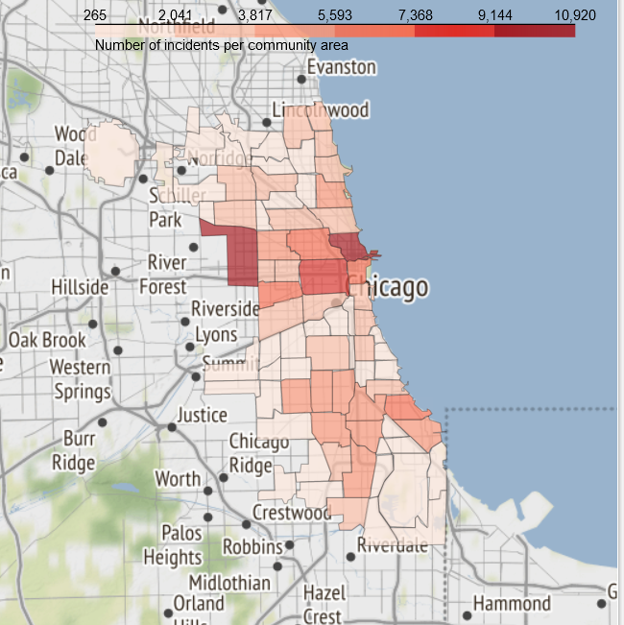
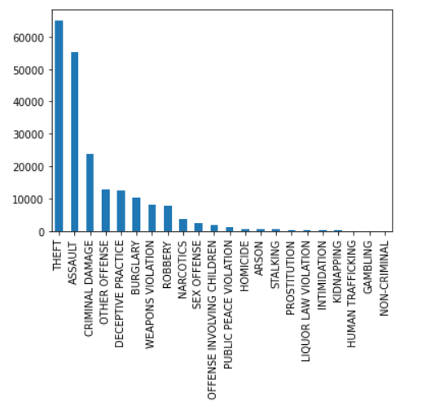
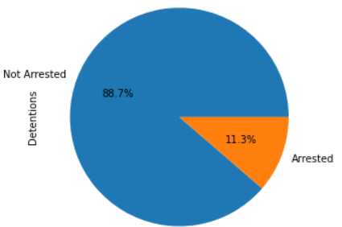
Exploratory data analysis
More crime happens in central and southern Chicago
Theft and assault are the most common crimes
Most detentions did not result in arrests

Slide 6
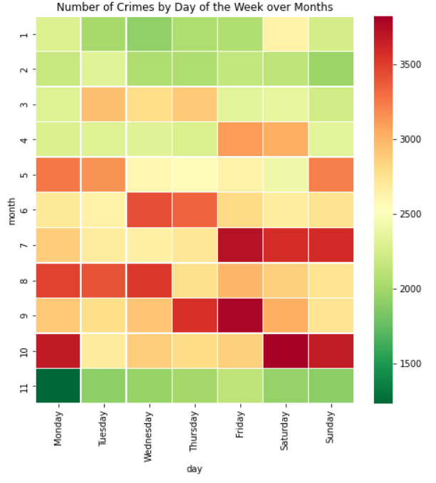
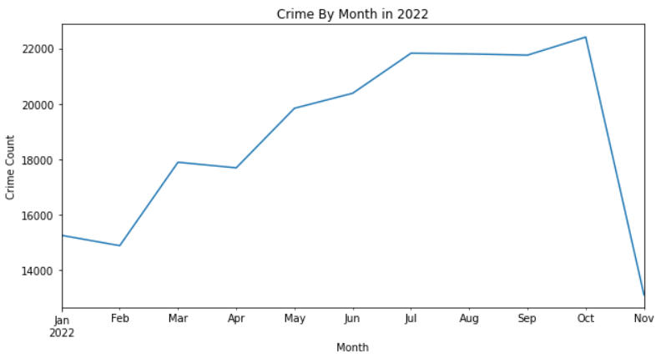
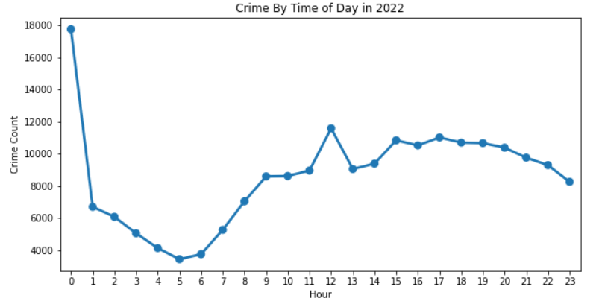
Exploratory data analysis
Late summer and fall are the most crime heavy months
Afternoon hours are the most crime heavy, along with midnight
Weekends in July, October seem to be the most dangerous

Slide 7
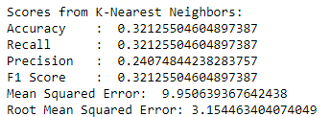
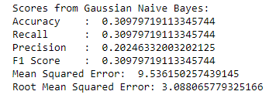
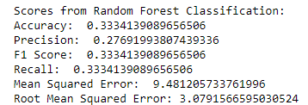
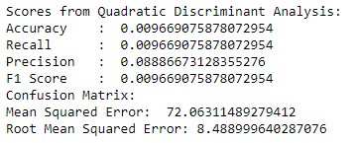
ML Analyses
Random Forest Classifier
K-Nearest Neighbors
Gaussian Naive Bayes
Quadratic Discriminant Analysis
We see that Random Forest has outperformed other models and gave better RMSE score than other ML analysis methods when it comes to predicting the crime based on address and time.

Slide 8
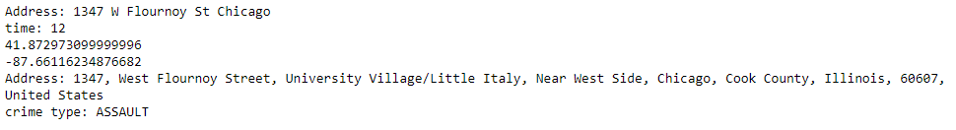
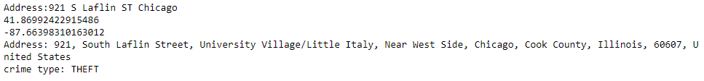
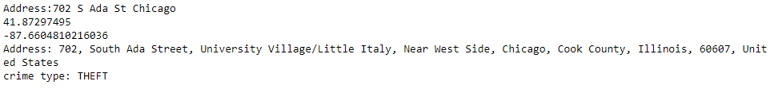
RESULTS(feW PREDICTIONS FROM THE MODELS)
Random Forest Classifier
K-Nearest Neighbors
Gaussian Naive Bayes

Slide 9
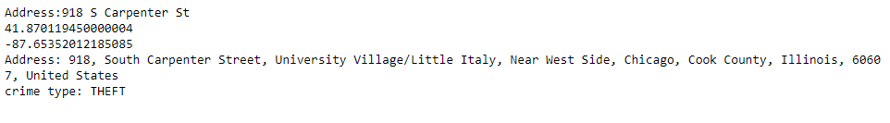
RESULTS(FEW PREDICTIONS FROM THE MODELS)
Quadratic Discriminant Analysis

Slide 10
Lessons learned
Crime is most prevalent in unexpected areas, such as near the Loop.
Nighttime is often safer than daytime.
Summer and fall are more dangerous.
We also learnt to predict the type of Crime that might take place in an area at a particular time period.
Essentially, many assumptions most people have about Chicago crime actually aren’t true.

Slide 11
Teamwork
Raj
Data cleaning
Heatmap of Day vs Month
Random Forest analysis ML Model
Quadratic Discriminant Analysis
Sahaja
Folium Map Visualization on Crime Rate in an area
Line Plot of Months vs Counts
Point Plot on Crime vs Time of Day
Gaussian Naïve Bayes ML Model
Vamsi
Bar Graph on Type of Crime vs Total Crimes
Pie Chart on Arrests and Detentions
K nearest neighbors ML model

Slide 12
References
https://data.cityofchicago.org/Public-Safety/Crimes-2022/9hwr-2zxp/data
https://pandas.pydata.org/docs/reference/index.html
https://scikit-learn.org/stable/modules/classes.html#module-sklearn.metrics
https://seaborn.pydata.org/api.html
https://aircconline.com/ijdms/V9N4/9417ijdms01.pdf
T. Almanie, R. Mirza, and E. Lor, "Crime Prediction Based on Crime Types and Using Spatial and Temporal Criminal Hotspots," International Journal of Data Mining & Knowledge Management Process, vol. 5, pp. 01-19, 2015.
D. K. Tayal, A. Jain, S. Arora, S. Agarwal, T. Gupta, and N. Tyagi, "Crime detection and criminal identification in India using data mining techniques," Ai & Society, vol. 30, pp. 117-127, 2014.

