Slide 1

Vel Tech Rangarajan Dr. Sagunthala R&D Institute of Science and Technology
School of Computing
Department of Computer Science and Engineering
10211CS224 / FULL STACK APPLICATION DEVELOPMENT (JAVA)
PROJECT REVIEW : MILESTONE PROJECT – 2
Date: 18-04-2026
Web Application For Ticket Booking of an Internal Department Event
SDG: SDG 9 – Industry, Innovation and Infrastructure
Presented By:
V DEVANANDA SAI – VTU24623 – Reg.No.23UECS0914
Courses Handling Faculty:
Dr./Mrs. AMU - Assistant Professor(SG)

Slide 2
INTRODUCTION
Background of the Problem: Traditional event booking systems are often manual or lack proper validation, leading to overbooking, errors, and inefficient management of event registrations.
Why this Project is Important: This project provides an automated and user-friendly ticket booking system that ensures accurate data handling, prevents overbooking, and improves user experience.
Real-World Relevance: Online ticket booking systems are widely used in colleges, organizations, and events to simplify registration, manage attendees, and provide instant confirmations.
Brief Overview of the System: The application is a React JS-based web system that allows users to view event details and book tickets online, with real-time validation, booking confirmation, and automatic update of available tickets.
1
2
3
4
5
6
7
8
9

Slide 3
PROBLEM STATEMENT
In many educational institutions, event ticket booking is often handled manually or through basic systems that lack proper validation and real-time updates. This can lead to issues such as overbooking, incorrect data entry, and confusion among participants. Users may not have clear visibility of available tickets, and organizers may struggle to manage registrations efficiently. Traditional methods also require more time and effort, reducing overall productivity and user satisfaction.
As the number of events and participants increases, there is a growing need for a reliable and automated booking system. Therefore, it is essential to develop a system that can provide accurate event details, validate user inputs, and update ticket availability dynamically. The proposed React JS-based Event Ticket Booking System aims to address these challenges by offering a user-friendly platform for viewing event information and booking tickets efficiently with proper validation and real-time updates.
1
2
3
4
5
6
7
8
9

Slide 4
OBJECTIVE(S)
1
To design and develop a web-based event ticket booking system that allows users to view event details and book tickets easily.
To implement a validation mechanism that ensures correct user inputs and prevents booking more tickets than available.
2
3
4
5
6
7
8
9

Slide 5
PROPOSED SYSTEM
The proposed system is a React JS-based Event Ticket Booking application that allows users to view event details and book tickets through a simple web interface. • The system provides clear information about the event, including name, date, venue, ticket price, and available tickets. • Users can enter their details and book tickets easily using an interactive booking form. • The application includes validation to ensure all inputs are correct and prevents booking more tickets than available. • After successful booking, the available ticket count is automatically updated. • The system displays a confirmation message along with booking summary details for the user. • This approach eliminates errors and inefficiencies found in manual booking systems. • The user-friendly interface makes the booking process simple, fast, and reliable. • Compared to traditional methods, this system ensures better accuracy, improved management, and enhanced user experience.
1
2
3
4
5
6
7
8
9

Slide 6
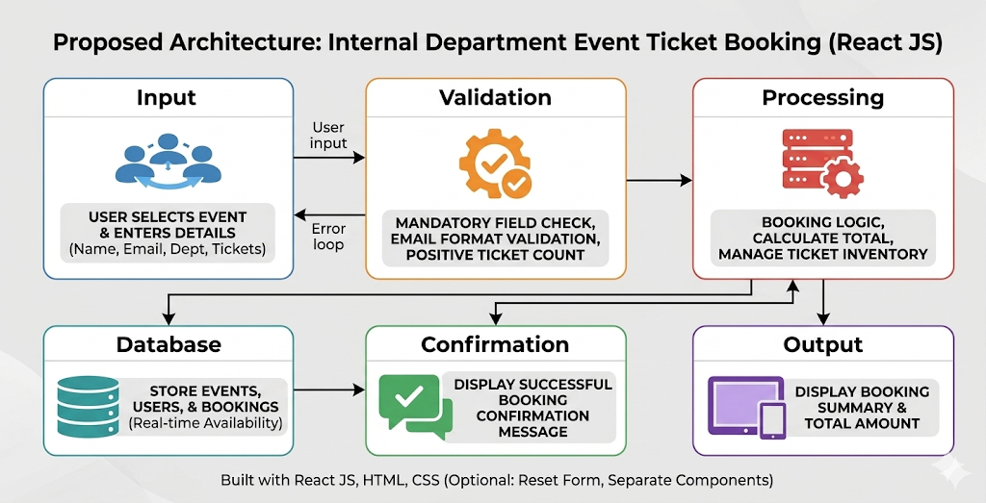
PROPOSED SYSTEM ARCHITECTURE
1
2
3
4
5
6
7
8
9

Slide 7
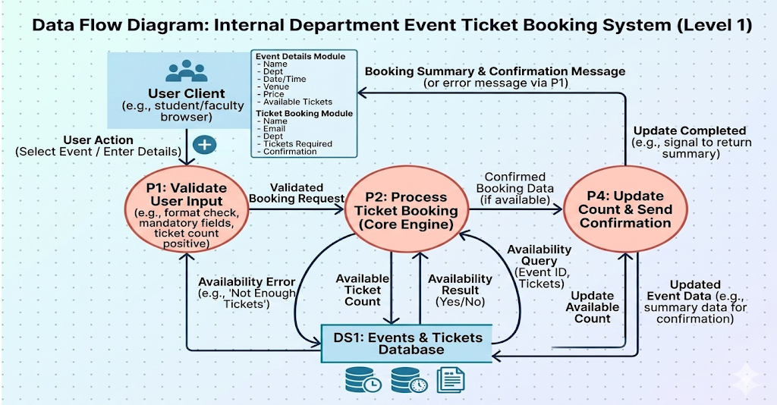
WORKFLOW
1
2
3
4
5
6
7
8
9

Slide 8
TECHNOLOGIES USED
Frontend: HTML, CSS, React JS
Backend: Node.js (for handling requests and connecting frontend with database)
Database: SQLite
Tools: Visual Studio Code, Node.js, npm
Hardware/Software Requirements: A computer/laptop with minimum 4GB RAM, modern web browser (like Google Chrome), and internet connection for development and running the application.
1
2
3
4
5
6
7
8
9

Slide 9
MODULE DESCRIPTION
Module 1: Event Details Module Handles displaying event information such as event name, department, date and time, venue, ticket price, and available tickets through the user interface. It allows users to easily view all necessary event details before booking.
Module 2: Ticket Booking Module Manages the ticket booking process by allowing users to enter their details like name, email, department, and number of tickets. It also validates inputs and prevents booking more tickets than available.
Module 3: Server & API Handling Handles communication between the React frontend and backend, processes booking requests, and ensures proper data flow between the application and the database.
Module 4: Database Management Uses SQLite to store and retrieve booking details such as user information, number of tickets booked, and updates available ticket count to maintain data consistency.
1
2
3
4
5
6
7
8
9

Slide 10
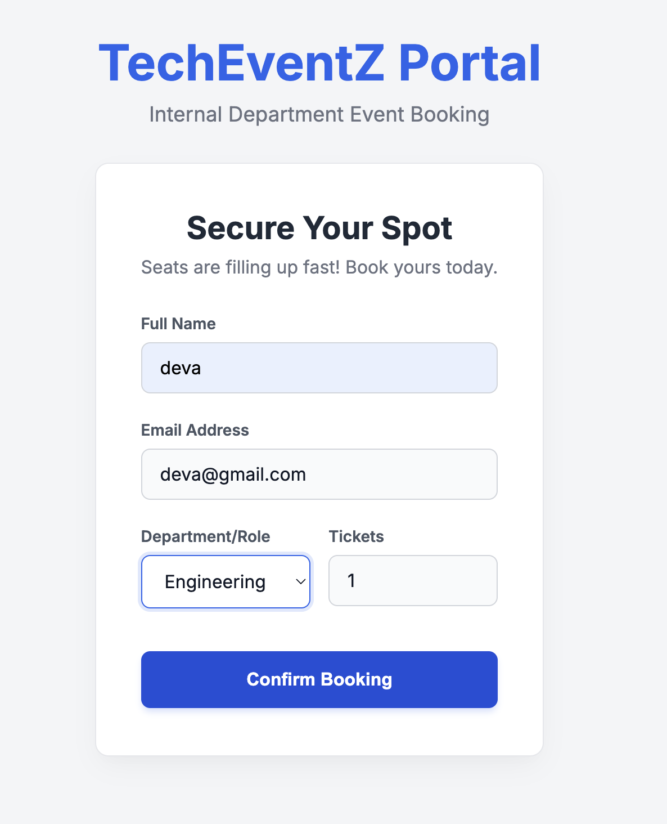
IMPLEMENTATION SCREENSHOTS
1
2
3
4
5
6
7
8
9

Slide 11
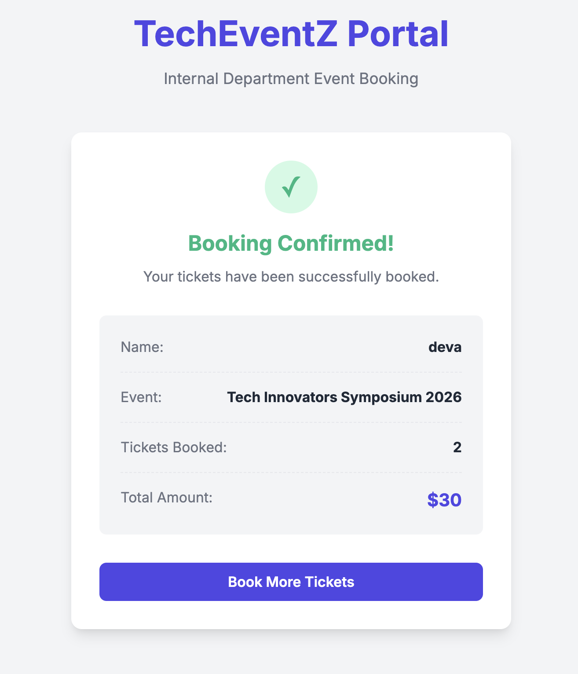
IMPLEMENTATION SCREENSHOTS
1
2
3
4
5
6
7
8(A)
9

Slide 12
IMPLEMENTATION SCREENSHOTS
1
2
3
4
5
6
7
8(C)
9

Slide 13
ADVANTAGES & LIMITATIONS
Advantages: • Provides a simple and user-friendly interface for booking tickets online. • Prevents overbooking through proper validation and real-time ticket availability updates. • Ensures accurate data storage and retrieval using SQLite. • Reduces manual effort and improves efficiency in managing event registrations.
Limitations: • Limited scalability as SQLite is not ideal for large-scale or multi-user high-traffic systems. • Requires internet and server setup for full functionality. • Basic UI may not provide advanced features like payment integration or notifications. • Limited real-time capabilities compared to fully synchronized multi-user systems.
1
2
3
4
5
6
7
8
9

Slide 14
Thank you

