Slide 1
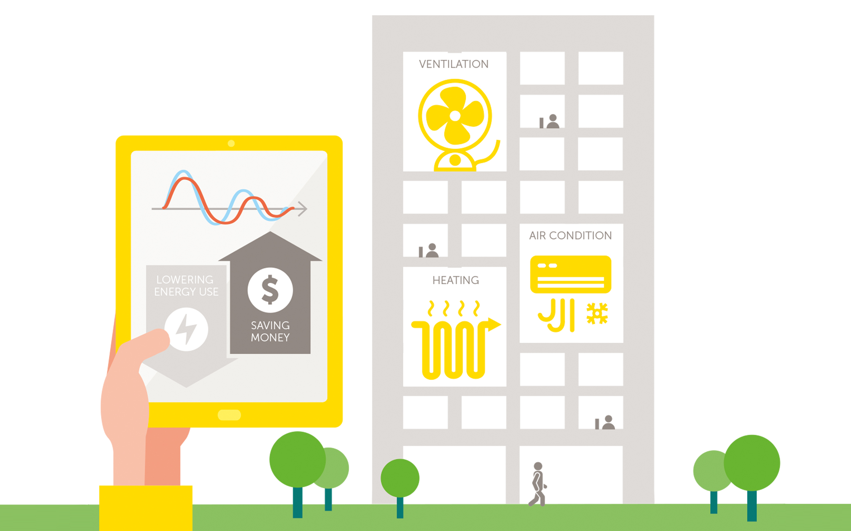
Intelligent Energy Management:
ML-Based Building Consumption Predictions
SRM INSTITUTE OF SCIENCE AND TECHNOLOGY

Slide 2
Why is Energy Management Important?
Rising Energy Consumption
Global energy demand is expected to increase by 50% by 2050 (IEA Report).
Buildings account for ~40% of total energy consumption worldwide.
Sustainability & Cost Reduction
High energy costs put a financial burden on industries and households.
Governments and corporations are setting carbon neutrality goals (e.g., India’s Net Zero by 2070).
The Need for Intelligent Management
Traditional energy management uses fixed schedules and manual monitoring.
These approaches lack adaptability to changing consumption patterns.
Smart energy systems use real-time monitoring and predictions to optimize energy usage.
How Does Machine Learning Help?
Predict Energy Demand
ML models analyze historical data (e.g., past energy consumption, weather, occupancy).
Helps predict future electricity usage trends in buildings.
Enables proactive measures to avoid energy shortages or overloads.
Optimize Resource Allocation
Machine Learning adjusts power usage based on real-time data.
Example: If ML predicts low occupancy, it can reduce HVAC usage automatically.
Smart Grids: Distribute electricity more efficiently, reducing power wastage.
Reduce Waste & Improve Efficiency
Identifies energy leaks, inefficiencies, and unusual consumption patterns.
Suggests energy-saving actions (e.g., lowering cooling load, turning off unused devices).
Helps in automated decision-making for sustainable energy consumption.
Intelligent Energy Management:
ML-Based Building Consumption Predictions
SRM INSTITUTE OF SCIENCE AND TECHNOLOGY

Slide 3
Objectives of Your Project
Develop an ML-Based Energy Consumption Prediction Model
Build a data-driven model to predict future energy consumption trends.
Use machine learning algorithms such as KNN, ARIMA, or LSTM to analyze patterns.
Improve forecasting accuracy using historical energy data and real-time inputs.
Analyze Real-Time Building Energy Data
Integrate IoT sensors and smart meters to collect real-time data.
Monitor key parameters such as: ✅ HVAC usage (Heating, Ventilation, and Air Conditioning) ✅ Lighting patterns ✅ Occupancy levels
Identify energy wastage & abnormal consumption patterns.
Optimize Energy Usage Patterns
Reduce energy overuse during peak hours by adjusting power distribution.
Implement dynamic scheduling of appliances based on demand prediction.
Utilize AI-driven automation for better load management in smart buildings.
Improve Sustainability & Reduce Costs
Lower electricity bills by reducing unnecessary energy consumption.
Reduce carbon footprint by optimizing energy efficiency.
Assist industries and households in adopting sustainable energy practices.

Slide 4
Machine Learning Approach
ML Techniques Used: Time Series Forecasting: (For predicting future energy demand)
LSTM (Long Short-Term Memory) : LSTM is a type of recurrent neural network (RNN) that retains long-term dependencies in time-series data. It uses memory cells and gates (forget, input, and output gates) to control information flow, making it effective for energy consumption trends over time.
ARIMA (AutoRegressive Integrated Moving Average) : ARIMA is a statistical model that predicts future values based on past observations by using autoregression (AR), differencing (I), and moving averages (MA).It works well for stable, linear trends in energy data but may struggle with highly fluctuating patterns.
XGBoost (Extreme Gradient Boosting): XGBoost is a decision tree-based ensemble method that improves predictions by iteratively correcting errors from previous models. It efficiently handles missing values, nonlinear relationships, and feature interactions, making it ideal for complex energy consumption forecasting.
Regression Models: (For estimating energy consumption based on input features)
Linear Regression – Basic model for consumption trends.
Random Forest Regression – Captures nonlinear relationships in energy usage.
Clustering Techniques: (For grouping similar consumption behaviors)
K-Means Clustering – Identifies usage patterns among buildings.

Slide 5
Dataset & Features
🔹 Dataset Source:
Public Datasets: Kaggle, UCI Repository, Smart Meter Data.
Real-world Data: Smart Grid Sensor Readings, IoT-based Building Data.
🔹 Key Features Considered: ✅ Time Factors: Time of day, weekday vs. weekend. ✅ Weather Conditions: Temperature, humidity. ✅ Building Usage: Occupancy, number of active devices. ✅ Energy Consumption Patterns: Electricity usage per hour/day/month. ✅ HVAC Usage: Heating & cooling energy demand.
🔹 Data Processing Steps:
Handling missing values (mean/median imputation).
Feature scaling (StandardScaler, MinMaxScaler).
One-hot encoding categorical variables (e.g., seasons).

Slide 6
Model Implementation
🔹 Tools & Libraries Used: ✅ Python – Main language. ✅ Scikit-Learn & TensorFlow – ML & deep learning. ✅ Pandas & NumPy – Data handling. ✅ Matplotlib & Seaborn – Data visualization.
🔹 Model Selection & Tuning:
Hyperparameter Tuning: Grid Search, Random Search.
Cross-validation: K-Fold technique for model robustness.

Slide 7
Model Implementation
Tools & Libraries Used
To develop an efficient and scalable energy consumption prediction model, the following tools were utilized:
✅ Python – The primary programming language for ML development. ✅ Scikit-Learn – Used for machine learning models, preprocessing, and evaluation metrics. ✅ TensorFlow – Applied for deep learning models like LSTM (Long Short-Term Memory). ✅ Pandas – Helps with data loading, cleaning, and manipulation. ✅ NumPy – Optimizes numerical computations for handling large datasets. ✅ Matplotlib & Seaborn – Used for data visualization and exploratory data analysis (EDA).
Model Selection & Tuning:
Hyperparameter Tuning 📊
Machine learning models require tuning of parameters like learning rate, number of estimators, depth of decision trees, etc. to improve performance.
Two major tuning methods used: ✅ Grid Search – Tries all possible parameter combinations exhaustively. ✅ Random Search – Randomly selects parameter values, optimizing faster than Grid Search.

Slide 8
Prediction Accuracy Metrics
To evaluate model performance, we used three key metrics:
1. RMSE (Root Mean Square Error)
Measures the average magnitude of prediction errors.
Lower RMSE = Better accuracy.
2. MAE (Mean Absolute Error)
Represents the absolute difference between actual and predicted values.
Lower MAE = More precise predictions.
3. R² Score (Coefficient of Determination)
Evaluates how well the model explains variance in energy consumption.
Higher R² (closer to 1) = Better fit.
Example Interpretation:
RMSE = 5.2 kWh → On average, predictions deviate by 5.2 kWh.
MAE = 3.1 kWh → Typical error per prediction is 3.1 kWh.
R² Score = 0.92 → 92% of the energy consumption variation is explained by our model.

Slide 9
Case Study / Real-World Applications
Where Can This ML Model Be Applied?
1. Smart Buildings (Optimizing Energy Consumption in Real Time)
HVAC Optimization – Adjusts heating, ventilation, and air conditioning based on occupancy to reduce energy wastage.
Lighting Control – Uses sensors and ML algorithms to turn lights on/off based on room occupancy.
Smart Metering – Collects real-time energy consumption data to provide accurate billing and efficiency insights.
2. Renewable Energy Management (Maximizing Solar & Wind Energy Efficiency)
Solar & Wind Forecasting – ML predicts power generation based on weather conditions to improve energy distribution.
Smart Grid Optimization – AI helps in energy storage and distribution, ensuring a stable power supply.
Demand Response Systems – ML balances energy supply and demand by predicting usage patterns.
Feature | Smart Buildings | Traditional Buildings
Energy Management | Uses AI & IoT to monitor and optimize energy consumption in real-time | Manual control, leading to inefficiencies and energy wastage
HVAC Optimization | Automated heating/cooling based on occupancy & weather | Fixed schedules, often overcooling or overheating
Lighting Control | Smart lighting systems adjust brightness based on occupancy | Lights stay on unnecessarily, wasting power
Predictive Maintenance | AI detects potential failures before they occur | Reactive approach – maintenance happens after breakdowns
Electricity Cost Savings | Reduces bills by 20-30% using ML predictions | Higher bills due to inefficient energy usage

Slide 10
Conclusion & Future Scope
🔹 Key Takeaways 💡
✅ Machine Learning enables intelligent energy predictions – reducing inefficiencies and enhancing decision-making. ✅ Helps in cost reduction & sustainability – optimizing power usage lowers electricity bills and reduces CO₂ emissions. ✅ Optimized energy usage benefits multiple sectors – including smart cities, industries, and renewable energy projects.
🔹 Future Enhancements
✅ 1. IoT Integration – Real-time Sensor Monitoring
Smart sensors will provide real-time energy consumption data.
IoT + ML will enable instant energy optimizations based on conditions.
Example: Amazon Web Services (AWS) uses IoT and AI to reduce server energy consumption by 25%.
✅ 2. Reinforcement Learning – Adaptive Energy Control
ML models will self-learn & adapt to changing energy usage patterns over time.
AI can automatically adjust HVAC, lighting, and power storage for optimal efficiency.
Example: Deep Reinforcement Learning reduced energy wastage in HVAC systems by 35% in test buildings.

