Slide 1

CSA1402-Compiler Design
Technical Presentation Cross Compilers
Presented By:
V.Vamsidhar Reddy (192365029)

Slide 2
Introduction:
A Cross Compiler is a specialized compiler that executes on a host system but generates executable machine code for a different target system or processor architecture.
Cross compilation separates the development environment from the execution environment, allowing software to be developed on powerful computers while being deployed on resource-constrained hardware.
Popular cross-compilers such as GNU GCC (ARM GCC), Clang/LLVM, AVR-GCC, and MinGW are widely used because they enable developers to compile software on a host computer and generate optimized executables for different target architectures, ensuring portability, efficient development, and support for embedded systems.

Slide 3
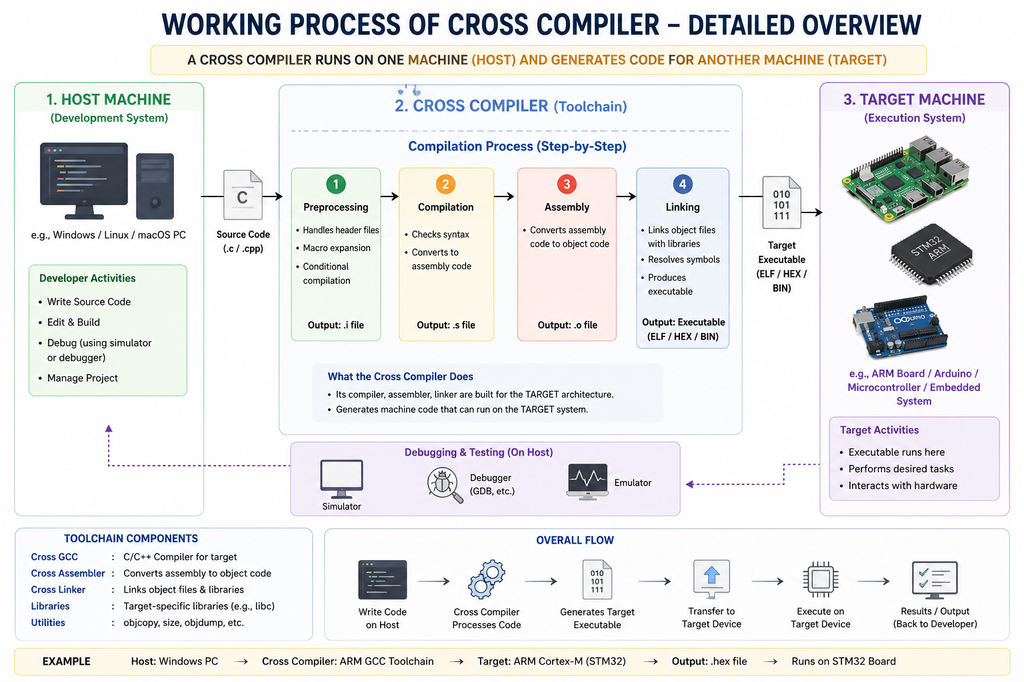
Working Process

Slide 4
widely used cross compilers
Cross Compiler | Target Architecture | Common Applications
GNU ARM GCC (arm-none-eabi-gcc) | ARM Cortex-M, ARM Cortex-A | Embedded systems, IoT, STM32, Raspberry Pi Pico
AVR-GCC | AVR Microcontrollers | Arduino Uno, ATmega328P, embedded firmware
Clang/LLVM | ARM, x86, RISC-V, MIPS, PowerPC | Cross-platform software, operating systems, embedded development
MIPS GCC | MIPS Processors | Routers, networking devices, embedded Linux
RISC-V GCC | RISC-V Processors | Open-source processors, research, IoT devices
MinGW (Minimalist GNU for Windows) | Windows (PE format) | Building Windows applications from Linux or other platforms
Android NDK (LLVM/Clang) | ARM, ARM64, x86, x86_64 | Native Android application development
PowerPC GCC | PowerPC Architecture | Automotive systems, aerospace, industrial controllers

Slide 5
Cross Compiler vs Native Compiler
Features | Cross Compiler | Native Compiler
Host & Target | Different | Same
Output Code | Different Architecture | Same Architecture
Main Use | Embedded Systems, IoT | Desktop Applications,Web Applications
Portability | High | Limited
Example | ARM GCC | GCC ,IDLE,Nodejs

Slide 6
Advantages
Platform Independence: Enables software to be developed on one system and executed on different hardware architectures without modifying the source code.
Efficient Development: Allows developers to use powerful host systems with advanced debugging, testing, and build tools, significantly reducing development time.
Essential for Embedded Systems: Makes it possible to develop applications for resource-constrained devices such as microcontrollers, IoT devices, automotive systems, and robotics.
Disadvantages
Complex Toolchain Configuration: Setting up and maintaining cross-compilation environments requires careful configuration of compilers, libraries, and target-specific dependencies.
Difficult Debugging: Errors that occur on the target hardware can be challenging to identify and reproduce because the development and execution environments differ.
Architecture-Specific Compatibility Issues: Differences in processor architecture, memory layout, and operating systems may lead to compatibility and optimization challenges.

Slide 7
:
Evolution of Cross Compiler
Early Computing (1960s–1970s): Cross compilers were introduced to develop software for hardware that lacked sufficient memory and processing power to compile programs locally.
Embedded Systems Era (1980s–1990s): They became essential for programming microcontrollers, embedded devices, and real-time systems, enabling efficient firmware development.
Modern Development (2000s–Present): Cross compilers now support diverse architectures such as ARM, RISC-V, x86, and MIPS, playing a critical role in IoT, automotive, mobile devices, robotics, and cloud-based software development.

Slide 8
Thank You

