Slide 1

Cloud-Native Grocery Delivery System with Intelligent Budget Guardian
CNAD Project Review-2
23/09/2026
Team Members K. Vamsidhar – 2420030341 Sri Ram – 2420030192 Nitesh Thammu – 2420030590
 | Under the Guidance of P. Srilatha Associate Professor, Department of Computer Science and Engineering, KLH CSE Bowrampet Campus

Slide 2
Outline of Project Work
Focus
Introduction
Literature Survey
Challenges
Research Objectives
Conclusion & Future Work
References
Publications Details

Slide 3
Problem Statement
Online grocery platforms focus on browsing, cart management, ordering, payment, and delivery, with little support for spending control.
Users often overspend because there is no real-time visibility into cumulative cart cost while shopping.
Grocery budgets are usually tracked manually or through separate apps, disconnected from the actual shopping flow.
Existing platforms rarely suggest cheaper alternatives, so cost-effective purchasing decisions are left entirely to the user.
A cloud-native system is needed that integrates grocery delivery with proactive, real-time budget management.

Slide 4
Objectives
Develop a cloud-native platform for grocery browsing, cart management, ordering, and secure payment.
Allow users to set a personal grocery budget before or during shopping.
Monitor cart spending in real time as items are added or removed.
Alert users proactively as spending approaches or exceeds the set budget.
Recommend cheaper or comparable alternatives to support cost-effective purchasing decisions.
Ensure the system is scalable and reliable using a cloud-native microservices architecture.

Slide 5
Literature Survey
Area | Existing Focus | Gap Relevant to This Project
Grocery E-Commerce Platforms | Provide browsing, cart, ordering, payment, and delivery tracking. | Budget management is not integrated into the shopping flow.
Personal Budgeting Apps | Track expenses manually or via bank/SMS import, separate from purchases. | No real-time link to what is currently in a live shopping cart.
Price Comparison Tools | Compare prices for a product across sellers or stores. | Comparisons happen outside the cart, adding friction during checkout.
Cloud-Native E-Commerce Systems | Centralized, scalable data and processing for multiple users. | Needs an integrated, real-time budget-guardian service within the platform.

Slide 6
Problem Gap Identification
The project combines grocery delivery, real-time spend tracking, alerts, and smart suggestions in one workflow.
Monitoring spend as items are added lets users course-correct before checkout, not after.
Budget guidance is not a fixed alert; it also considers category-wise limits, price-per-unit, and past purchase patterns.
A microservices architecture separates user, catalog, cart, budget guardian, order, payment, and notification concerns into manageable services.
The cloud-native approach supports centralized data storage, event-driven communication via Kafka, and independent scaling of each service.

Slide 7
Innovation, Creativity, and Novelty
Predictive Budget Pacing: Estimate when the budget will run out based on shopping frequency and cart trends.
Smart Alternative Ranking: Rank cheaper substitutes by price-per-unit, category fit, and purchase history.
Category-Wise Budgets: Let users allocate budget across categories like produce, dairy, and snacks.
Event-Driven Architecture: Stream cart changes via Kafka for instant budget checks and alerts.
Spend Analytics Dashboard: Visualize spend trends, budget vs. actual, and savings from accepted suggestions.

Slide 8
Feasibility and Project Plan
Technical feasibility: React, Java Spring Boot, PostgreSQL/MySQL, Redis, Apache Kafka, REST APIs, Docker, and Kubernetes deployment.
Operational feasibility: supports everyday grocery shoppers through budget-aware cart, order, and payment services.
Scalability: cloud-native microservices on Kubernetes allow each service to scale independently under load.
Expected outcome: reduced overspending, smarter purchasing decisions, and a scalable, reliable grocery delivery platform.
1
2
3
4
5
6
7
Requirements
Problem + users
Catalog
Product & pricing data
Budget Guardian
Real-time spend tracking
Services
Backend + APIs
UI & Alerts
Cart UI + notifications
Testing
Integration + evaluation
Deployment
K8s + final demo

Slide 9
Problem Definition
Existing online grocery platforms focus mainly on product browsing, cart management, ordering, payment, and delivery.
Users have limited real-time visibility of their total spending while shopping.
Budget tracking is often manual or handled through separate applications.
Existing platforms provide limited support for cheaper product alternatives and cost-effective decisions.
Therefore, a cloud-native grocery platform with an integrated Intelligent Budget Guardian is required to provide real-time budget monitoring and proactive spending guidance.

Slide 10
Requirements
User Authentication: Secure user registration and login.
Product Catalog: Browse and search grocery products with pricing information.
Cart Management: Add, remove, and update products while tracking the cart total.
Budget Guardian: Set a personal budget and monitor spending in real time.
Alerts & Suggestions: Notify users when they approach/exceed their budget and suggest cheaper alternatives.
Order & Payment: Place, track orders, and support secure payments.
Cloud-Native Architecture: Use microservices, REST APIs, Docker, Kubernetes, and event-driven communication for scalability and reliability
Monitoring & Deployment: Support CI/CD and monitoring using the project technologies specified in the abstract.

Slide 11
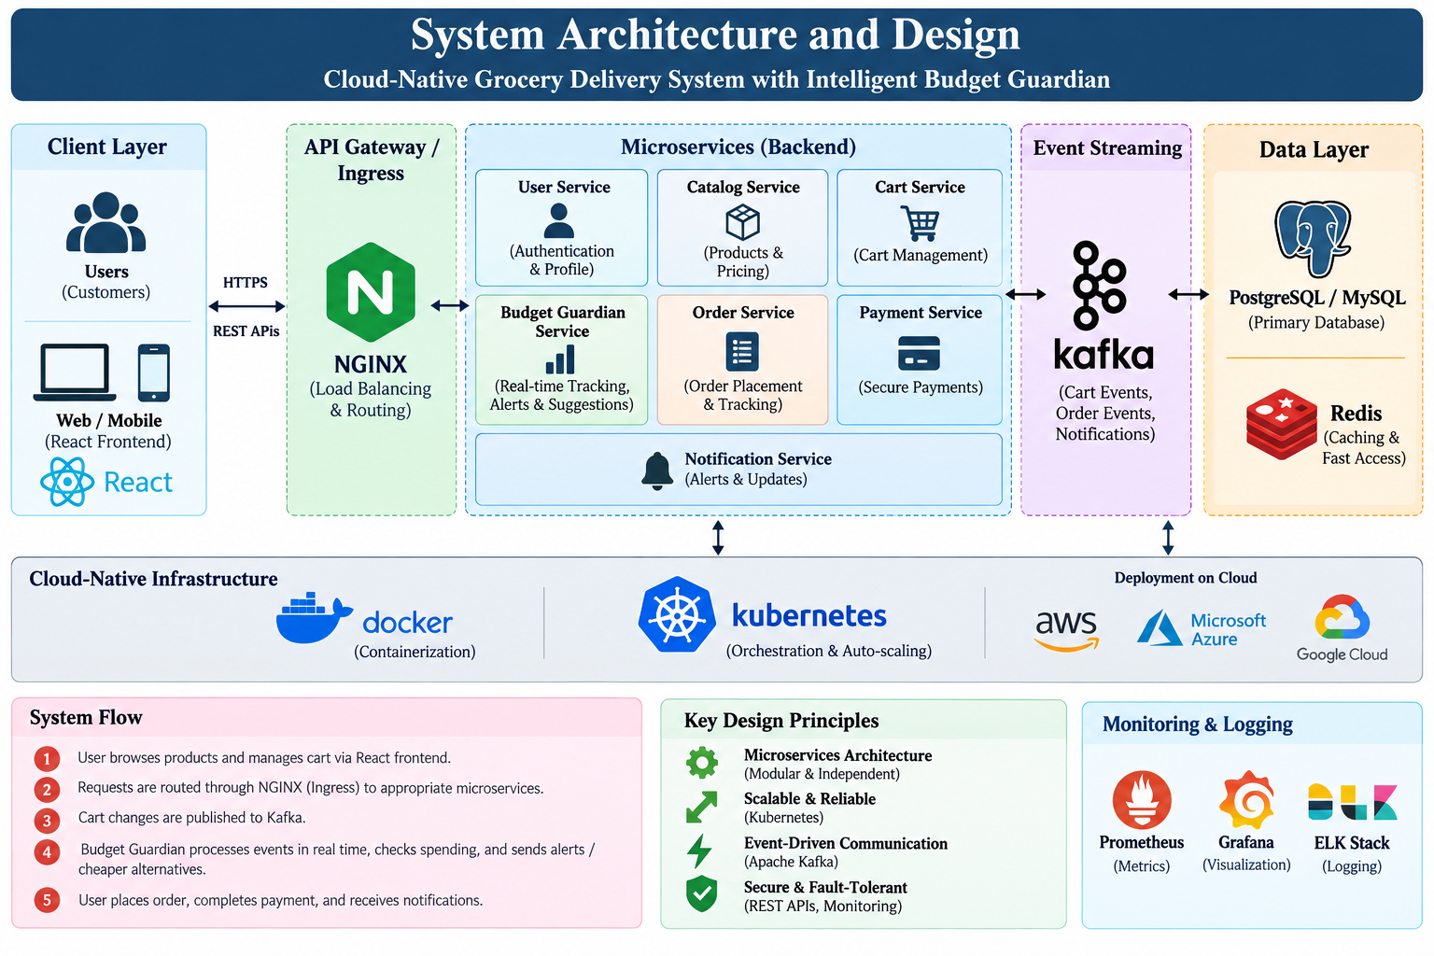
System Architecture and Design

Slide 12
Module Wise Description
User Management: Authentication and profile management.
Product Catalog: Product browsing, search, categories, and pricing.
Cart Management: Add/remove items and real-time cart calculation.
Budget Guardian: Budget setting, spend tracking, alerts, and cheaper alternatives.
Order Management: Order placement and tracking.
Payment: Secure payment processing.
Notification: Budget alerts and order updates.
Event Communication: Kafka-based real-time event processing.
Data Management: PostgreSQL/MySQL for storage and Redis for caching.
Deployment & Monitoring: Docker, Kubernetes, Prometheus, Grafana, and ELK Stack.

