Slide 1

COVID-19 / Public Health Data Visualization Dashboard
DATA SCIENCE (24AD3107) Project Review-
18th Sept 2026-8:10 am
 | Under the Guidance of Mrs. B. Prathusha Assistant Professor, Department of Computer Science and Engineering, KLH CSE Bowrampet Campus
Team Members • D Sri Ram (2420030192) • K Vamsidhar (2420030341) • G Suvin Sai (2420030115)

Slide 2
Outline of Project Work
Focus
Introduction
Literature Survey
Challenges
Research Objectives
Conclusion & Future Work
References
Publications Details

Slide 3
Problem Statement
Background & Public Health Context
Unprecedented Data Volume: COVID-19 resulted in massive, high-velocity epidemiological data generated globally across multiple public health jurisdictions.
Crucial Need for Transparency: Public health authorities, researchers, and citizens urgently need clear, intuitive tracking of infection spread, recovery velocity, and mortality trends.
Interconnected Indicators: Understanding pandemic severity requires simultaneously examining testing volumes, confirmed cases, active infection ratios, and vaccination coverage.
Key Challenges in Existing Approaches
Data Inconsistencies & Quality Noise: Public datasets suffer from missing values, reporting backlogs, retroactive updates, and disparate regional data schemas.
Fragmented & Siloed Metrics: Vaccination metrics, testing capacity, and mortality figures are often reported in isolation without multi-attribute correlation.
Static Reports & High Cognitive Load: Traditional static tables and non-interactive graphs lack dynamic temporal/regional filters, hindering in-depth exploratory discovery.

Slide 4
Objectives
Primary objective:
To build an end-to-end data science analytical framework and interactive web dashboard that transforms complex, multi-source COVID-19 public health datasets into actionable visual insights through robust preprocessing, exploratory analysis, and spatiotemporal progression modeling
1. Data Preprocessing & Cleaning Pipeline
• Handle missing values, duplicate entries, and inconsistent regional records.
• Standardize date formats and harmonize heterogeneous public health data schemas.
• Implement 7-day rolling window smoothing to eliminate artificial weekend reporting dips.
2. Exploratory Data Analysis & Statistical Profiling
• Compute epidemiological metrics: Case Fatality Rate (CFR), Recovery Rate, and Positivity Ratio.
• Analyze data distributions and identify statistical variances across waves.
• Examine multi-indicator correlations between testing rates, cases, and vaccination coverage.

Slide 5
3. Spatiotemporal & Progression Analytics
• Construct longitudinal time-series models to evaluate infection surges across pandemic waves.
• Develop geographical choropleth maps for cross-country and regional spread comparisons.
• Analyze regional vaccination rollout velocity and corresponding reduction in mortality.
4. Interactive Dashboard Architecture & Delivery
• Build a reactive, web-based UI with interactive filters (region, custom date range, waves).
• Integrate multi-tiered visual widgets: trendlines, regional bar charts, and KPI cards.
• Provide accessible, data-driven visual interpretation without replacing medical guidance.

Slide 6
Literature Survey
Authors | Title of the Paper | Methodology | Inferences | Limitation/Future work
Dong et al | An Interactive Web-Based Dashboard to Track COVID-19 in Real Time | Collected COVID-19 data from multiple sources, including official health organizations. Integrated and standardized the data to track confirmed cases and deaths across locations. | Interactive dashboards can make large-scale COVID-19 data easier to understand. Combining data from multiple sources provides a more accessible view of pandemic progression. | Depended on the availability and accuracy of data from different sources.
Ivanković, D., Barbazza, E., et al. [2] (JMIR Public Health & Surveillance, 2021) | Features of Public Health Dashboards for COVID-19: A Systematic Review | • Systematic evaluation of 158 global COVID-19 dashboards across 53 countries. • Evaluated analytical depth, visual types, and interactivity features. | • Effective dashboards must balance clinical metrics with operational data (testing, vaccination). • Dynamic user filtering & time-series comparisons substantially improve data comprehension. | • Identified widespread presence of static charts, poor mobile optimization, and lack of automated exploratory data analysis (EDA) pipelines.
Mathieu, E., Ritchie, H., et al. [3] (Nature Human Behaviour, 2021) | A global database of COVID-19 vaccinations (Our World in Data) | • Standardized multi-source metadata schema. • 7-day rolling average time-series smoothing. • Per-capita metric normalization across 218 territories. | • Harmonizing vaccination metrics with infection & mortality curves is essential to measure public health intervention efficacy. • Normalization is crucial for fair regional comparison. | • Discrepancies in jurisdictional reporting standards. • Absence of integrated, user-driven interactive exploratory dashboard for sub-regional drill-down.

Slide 7
Problem Gap Identification
Gap 1: Disconnected Indicator Analysis & Siloed Platforms
• Existing Scenario: Most public portals report infection statistics, testing numbers, and vaccination rollouts in disjointed sections.
• Identified Gap: Lack of unified cross-indicator analytics—specifically examining how testing volume and vaccination coverage directly relate to infection curves and case fatality rates in a single interface
Gap 2: Unprocessed Noise & Reporting Anomalies
• Existing Scenario: Public health datasets frequently experience batch backlog updates, negative corrections, and weekend reporting lags.
• Identified Gap: Raw data visualization without automated preprocessing leads to misleading artificial spikes, confusing non-expert users and distorting actual epidemiological trends.
Gap 3: Rigid Interfaces & Limited Interactivity
• Existing Scenario: Many existing systems offer pre-rendered, static infographics or fixed, non-customizable date windows.
• Identified Gap: Inability for users to dynamically apply custom date sliders, isolate specific pandemic waves, or conduct side-by-side comparative analyses across custom-selected regions.

Slide 8
Innovation, Creativity, and Novelty
1. End-to-End Data Science Pipeline Integration
• Seamlessly couples automated data ingestion and cleaning with real-time exploratory data visualization.
• Automates missing value handling, schema alignment, and 7-day rolling window smoothing to eliminate reporting artifacts.
• Bridges the gap between raw data science scripts and interactive end-user web applications.
2. Synchronized Multi-Indicator Analytical Engine
• Enables simultaneous side-by-side exploration of vaccination milestones, testing rates, infection surges, and mortality curves.
• Dynamic computation of crucial health ratios (CFR, Recovery Rate, Positivity Rate, Per-Capita comparisons).
• Provides a holistic epidemiological perspective rather than isolated single-attribute graphs.

Slide 9
Innovation, Creativity, and Novelty
3. Dual-Level Spatiotemporal Filtering Architecture
• Interactive multi-tier geographic filtering: Global, Continental, National, and Sub-Regional views.
• Custom temporal scoping: Interactive date range sliders and epidemic wave segmentation presets.
• Empowers users to contrast trajectories of different regions during identical pandemic phases.
4. Explainable Visual Storytelling & Ethical Scoping
• Rich interactive components: Choropleth heatmaps, dual-axis time-series, comparative bars, and KPI cards.
• Designed for diverse audiences: intuitive for general citizens while providing statistical depth for analysts.
• Built-in contextual summaries and clear disclaimers clarifying analytical boundaries.

Slide 10
Feasibility and Project Plan
TIMELINE CHART FOR EACH PHASE OF YOUR PROJECT SHOULD BE THERE AFTER EXPLANATION
Technical Feasibility
• Tech Stack: Python, Pandas, NumPy for data processing.
• Visualization: Plotly, Seaborn, Matplotlib, Streamlit/Dash.
• Performance: Mature, optimized libraries handle large datasets efficiently on consumer hardware.
Operational Feasibility
• Data Sources: Open public health repositories (OWID, JHU CSSE, WHO, COVID19-India).
• Accessibility: Web-based GUI accessible via any modern browser with zero client-side setup.
• User-Centric: Intuitive controls suitable for both technical analysts and general public.
Economic Feasibility
• Open-Source: 100% free and open-source software stack with zero licensing fees.
• Zero Infrastructure Cost: Executable locally on student PCs and deployable on free cloud tiers.

Slide 11
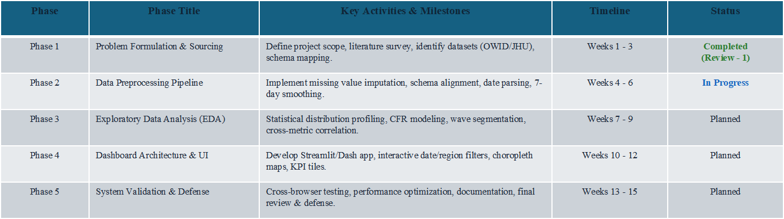
Feasibility and Project Plan

