Slide 1
CRICKET ANALYTICS
A Snowflake Data Engineering Case Study
From nested JSON scorecards to a production-style star schema — Landing → Raw → Clean → Consumption
Project Documentation & Presentation

Slide 2
01 · THE PROJECT
What Was the Project?
An end-to-end Snowflake pipeline that turns raw, deeply-nested cricket match JSON files into a clean, query-ready analytical warehouse — built across four progressively refined layers.
33+
match JSON files ingested
LAND
Stage raw JSON files as received
5
RAW
Parse JSON into OBJECT / VARIANT / ARRAY
nested JSON levels flattened
CLEAN
Flatten into match, player & delivery tables
2
CONSUMPTION
Star schema: facts + dimensions for BI
fact tables in the final model
3

Slide 3
02 · MOTIVATION
Why This Project? The Business Requirement
The main purpose is to turn raw match data into useful insights for teams, analysts, broadcasters, and cricket fans.
They may want to analyze:
Player performance — runs, wickets, strike rate, economy, boundaries, etc.
Team performance — wins/losses, run rate, batting and bowling performance.
Venue analysis — which venues favor batting or bowling.
Toss impact — whether winning the toss and choosing to bat/bowl first affects the result.
Match trends — how scoring and wickets change over different overs.
Head-to-head analysis — how one team performs against another.
Player comparison — identify top-performing batters and bowlers.
Historical trends — compare performance across matches, series, seasons, or years.
For example:
"If a team is playing at a particular venue, analysts can look at historical data to understand whether teams generally perform better batting first or chasing."
1
3
4
4

Slide 4
03 · DOMAIN CHOICE
Why Are We Analyzing Cricket Data?
Realistic complexity
5 nested levels (match→innings→overs→deliveries→extras/wickets) stress-tests semi-structured data handling.
“A stand-in for any nested, high-volume, event-style dataset.”
Rich analytical questions
Supports both aggregate (team/venue trends) and granular (ball-by-ball) analysis — justifying two fact tables.
High volume, low cost
The pipeline patterns built here — semi-structured parsing, multi-level flattening, incremental orchestration — transfer directly to IoT logs, clickstreams, and transaction feeds.
Thousands of free match files give real scale to test performance & incremental loading.
Relatable & demo-friendly
Widely followed sport — resulting metrics are intuitive for any audience.
5

Slide 5
04 · ARCHITECTURE
Pipeline Architecture: Four Layers
LANDING
RAW
CLEAN
CONSUMPTION
Stage + JSON file format
MATCH_RAW_TBL
(meta / info / innings)
Match · Player · Delivery
(LATERAL FLATTEN)
Star Schema
(facts + dimensions)
Each layer has exactly one job — isolating concerns makes the pipeline easy to debug, reprocess, and extend without touching source data.
Plus: Snowflake Streams + Tasks automate the refresh end-to-end — no manual re-run needed as new files land.
6

Slide 6
04 · ARCHITECTURE
Landing & Raw Layers
LANDING
RAW
Internal Snowflake stage (@my_stg) holds raw JSON files exactly as received
MATCH_RAW_TBL stores META (object), INFO (variant), INNINGS (array) per file
Named file format with STRIP_OUTER_ARRAY = TRUE unwraps the outer JSON array
COPY INTO captures file lineage: filename, row number, content hash, load timestamp
~2,000+ files uploaded via SnowSQL (impractical via the web UI at this volume)
ON_ERROR = CONTINUE — one bad file never blocks the rest of the load
7

Slide 7
04 · ARCHITECTURE
Clean Layer: Three Business Tables
MATCH_DETAIL_CLEAN
PLAYER_CLEAN_TBL
DELIVERY_CLEAN_TBL
One row / match
One row / player-team-match
One row / ball bowled
Event, date, teams, venue, toss, result, winner
Flattened from nested PLAYERS object
Bowler, batter, runs, extras, wickets
Built from the raw layer using colon path notation (info:city::text) and chained LATERAL FLATTEN calls to explode nested arrays into rows — see next slide.
8

Slide 8
05 · KEY TECHNIQUE
What Are LATERAL and FLATTEN?
FLATTEN
FLATTEN takes an ARRAY or OBJECT and converts each item into a separate row. It is a table function that works on tables
from raw.match_raw_tbl m,
lateral flatten(input => m.innings) i,
lateral flatten(input => i.value:overs) o,
lateral flatten(input => o.value:deliveries) d,
lateral flatten(input => d.value:extras,
outer => True) e,
lateral flatten(input => d.value:wickets,
outer => True) w
LATERAL
LATERAL allows FLATTEN to work separately for each row of the previous table.
Delivery 1 → [Pizza, Burger]
Delivery 2 → [Rice]
Delivery 3 → [Chicken, Coke]
By using the LATERAL function it will be like this –
Delivery 1 → Pizza
Delivery 1 → Burger
Delivery 2 → Rice
It helps to get all the rows and don't lose rows that have nothing to explode
5 chained flattens: innings → overs → deliveries → extras / wickets — one row out per ball bowled.
9

Slide 9
06 · AUTOMATION
Automating the Refresh: Streams & Tasks
1
2
3
4
5
Root Task
3 Streams
Clean Tasks
Dimension Tasks
Fact Tasks
LOAD_JSON_TO_RAW runs every 10 min, loads new files from the stage
APPEND_ONLY streams track new raw rows independently, per consumer
Gated by SYSTEM$STREAM_HAS_DATA — only run (and cost compute) when needed
Use MINUS to insert only genuinely new team/player/venue rows
Resolve surrogate keys and aggregate deliveries up to match grain
Result: a self-orchestrating pipeline — the warehouse refreshes itself as new match files land, with no manual re-run.
10

Slide 10
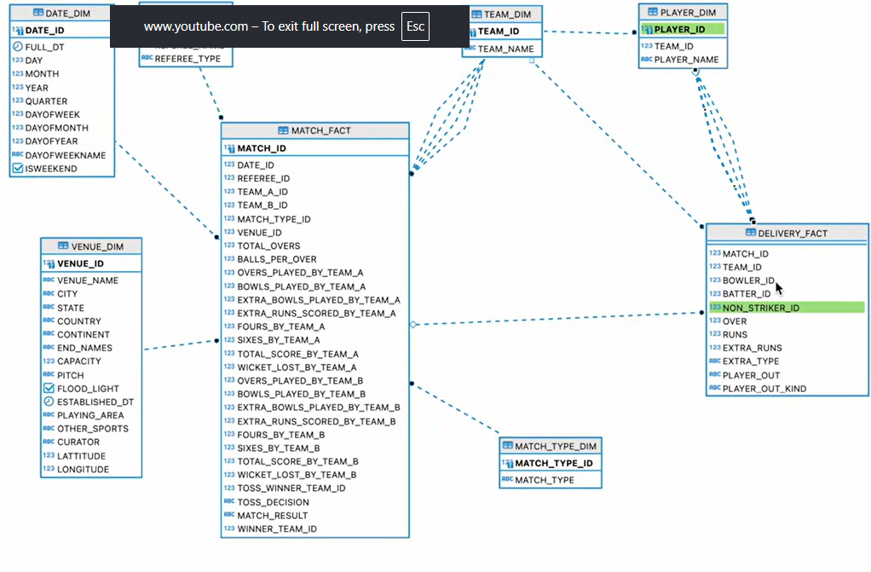
07 · DATA MODEL
The Data Model: A Star Schema
11

Slide 11
07 · DATA MODEL
Two Fact Tables, Two Grains
MATCH_FACT
DELIVERY_FACT
Grain: one row per match
Grain: one row per ball bowled
Resolves date, both teams, match type, venue, toss & winner to dimension keys
Resolves match, team, bowler, batter, non-striker to surrogate keys
Side-by-side team measures: overs, balls, extras, fours, sixes, total score, wickets
Captures over, runs, extras, extra type, dismissed player & dismissal kind
Answers “who won, by how much, where” cheaply — no ball-level scan needed
Answers granular questions — strike rate, economy, batter-vs-bowler match-ups
12

Slide 12
08 · CHALLENGES
Challenges Faced (1/2)
!
Deep nesting
!
Silent row drops
5-level JSON required chaining multiple LATERAL FLATTEN calls and tracking VALUE/PATH/KEY at each step.
A plain FLATTEN drops deliveries with no extras/wicket — fixed with outer => True.
!
Spelling error propagation
!
NULL city handling
MATACH_RESULT had to be tracked consistently rather than renamed mid-pipeline.
Source NULL city vs. dimension's 'NA' default could silently drop matches from a join.
13

Slide 13
08 · CHALLENGES
Challenges Faced (2/2)
!
Stream already consumed
!
Inner joins drop valid matches
Dimension tasks were gated on a stream the delivery task had already drained — they silently stopped running.
Tied/no-result matches (WINNER = 'NA') were excluded by inner joins to TEAM_DIM.
!
Hard-coded match format
!
No duplicate protection
50 overs / 6 balls assumed ODI rules — breaks for T20 and Test matches.
Append-only INSERTs need explicit de-dup (LEFT JOIN ... IS NULL or hash-key MERGE) to handle re-runs.
14

Slide 14
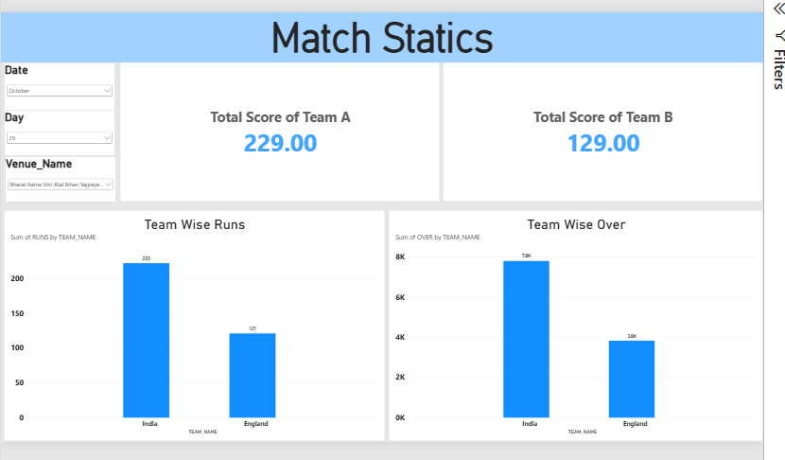
09 · Power BI Report

