Slide 1

Department of CSE(Data Science)
Viral Mutation Classification using
DNABERT-2 and LSTM
Batch no- 26:
D. Vamsi Krishna
G. Samba Siva Rao
D. Ajay Kumar Reddy
Guide:
Mrs. K. Aravinda
(Asst. Professor)
Dept. of CSD

Slide 2
Contents
Abstract
Problem Statement
Literature Review
Existing Design
Proposed Design

Slide 3
Abstract
This research analyzes the comparative performance of DNABERT versus a joint BERT-LSTM solution in identifying mutations within viral genomes using data from the NCBI Viruses database. The hybrid DNABERT-2-LSTM integration captures contextual features and long-range dependencies, achieving improved accuracy in mutation classification tasks.
The study demonstrates that NLP-based deep learning models are superior to classical methods, with the hybrid model providing reliable frameworks for genomic analysis across diverse viral mutation patterns and advancing public health preparedness.

Slide 4
Problem Statement
Traditional alignment-based bioinformatics methods fail to reliably distinguish wildtype from mutated viral sequences, especially due to
Limited labeled data.
Complex long-range mutation patterns.
Rapid viral evolution.
Urgent public health needs.
These challenges create a critical gap between real-time mutation detection required for timely vaccine design and outbreak response.

Slide 5
Literature Review
Year | Author | Model | Key Focus | Gap
2025 | Proposed work | DNABERT-2 + LSTM | Viral mutation classification | Addresses existing gaps
2023 | Ma et al. | Transformer + Mamba2 | Long genomic sequences | Increased model complexity
2023 | Zhou et al. | DNABERT-S | Metagenomic classification | No mutation-level analysis
2022 | Zhang et al. | DNABERT | Viral genome classification | No evolution modeling
2022 | Lee at al. | DNABERT + Contrastive Learning | Representation learning | No temporal dependency
2022 | Kumar et al. | DNABERT | Disease mutation analysis | Not tested on viral data
2021 | Wu et al. | DNABERT | Cancer mutation detection | Dataset-specific results

Slide 6
Existing Work
Contribution of Base Paper: iEnhancer-BERT (Luo et al., 2022)
Key Approach:
Transfer learning framework using DNABERT, a DNA-language model pre-trained on the human genome.
Hybrid architecture combining BERT for contextual feature extraction and CNN for classification.
Utilizes features from all Transformer layers instead of only the final [CLS] token.
Employs a two-stage classification framework for enhancer identification and strength prediction.
Strengths:
Effectively captures long-range dependencies in DNA sequences.
Outperforms traditional ML and CNN-based enhancer prediction models.
Leverages biological prior knowledge through genome-level pre-training.
Limitations:
Operates on fixed-length (200 bp) sequences, ignoring variable-length enhancers.
CNN limits modeling of long-term sequential dependencies.
Not designed for mutation-level or viral genome analysis.

Slide 7
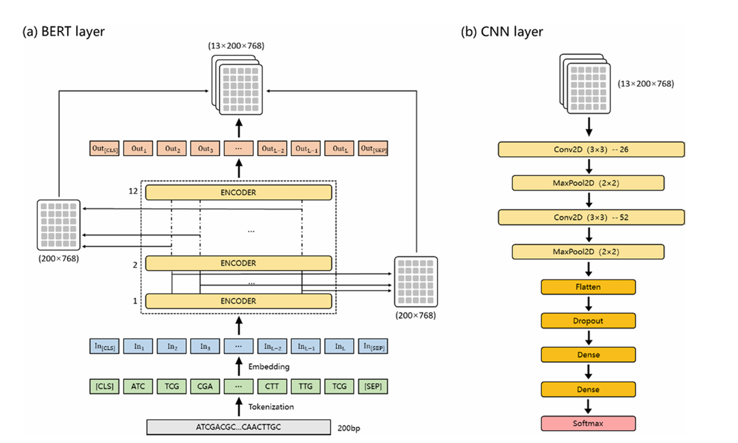
Existing Model Design

Slide 8
Proposed Work
Proposed Methodology:DNABERT-2 + LSTM based Viral Mutation Classification (Present Work)
Key Approach:
Hybrid deep learning framework combining DNABERT-2 for contextual DNA representation and LSTM for sequential dependency modeling.
DNA sequences are tokenized using k-mer encoding and passed to DNABERT-2 for feature extraction.
Contextual embeddings are fed into an LSTM layer to capture long-range mutation patterns.
Final classification is performed using a fully connected neural network.
Strengths:
Effectively models both global context (via DNABERT-2) and temporal dependencies (via LSTM).
Better suited for mutation-level analysis compared to CNN-based approaches.
Improved robustness for viral genome classification tasks.
Expected Improvements over Base Paper:
Replaces CNN with LSTM to overcome long-range dependency limitations.
Focuses on viral mutation detection, not limited to enhancer prediction.
More adaptable to evolving genomic sequences.

Slide 9
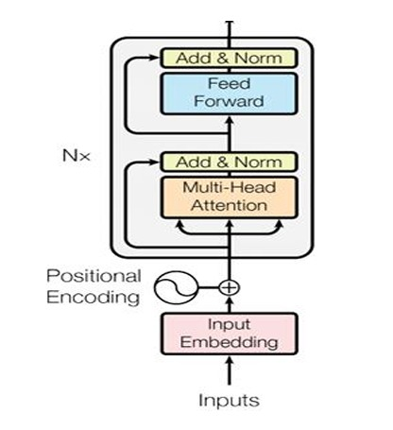
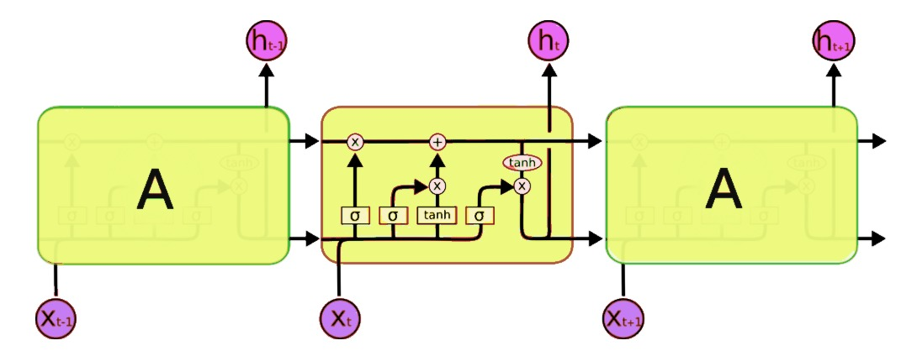
Proposed Model Design

Slide 10
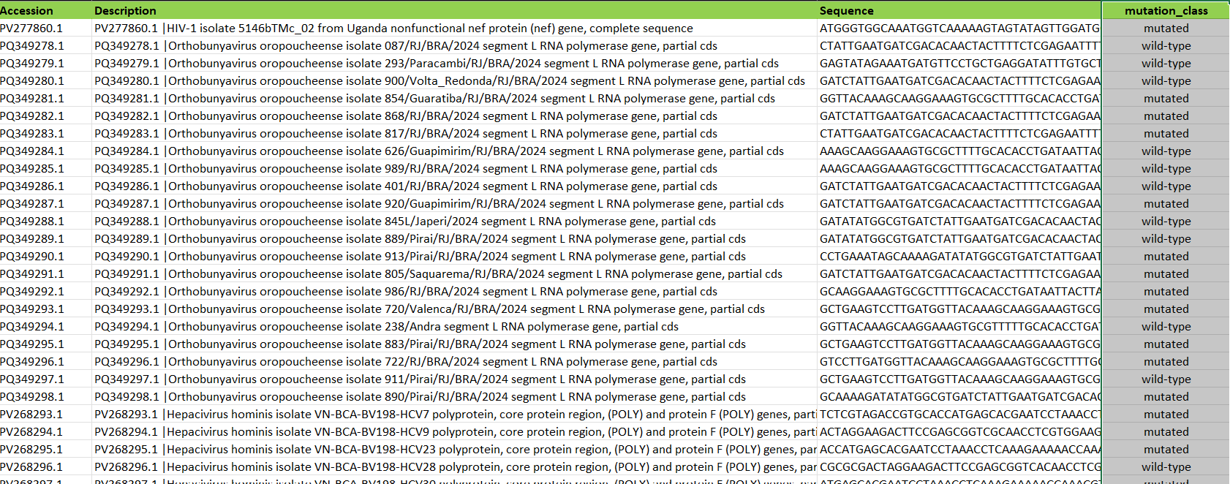
Dataset

Slide 11
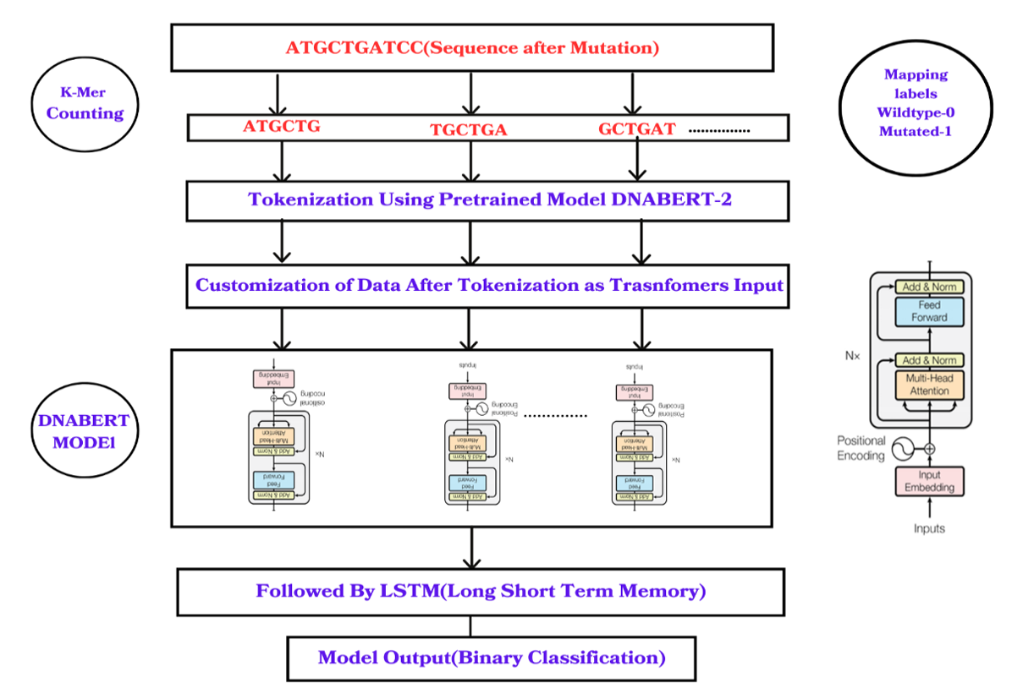
Architecture

Slide 12
Thank You

