Slide 1
HR Community Connect
A personalized community reach

Slide 2
Objective:
Build an mobile app for personalized community connect application. Where we will be able to connect with our community members, send them alerts, news, trigger safety related alerts, recording of maintenance payments etc.
Solution:
A customized chat based application that gets text, images from user and make it available to remaining users in the community using rest services.

Slide 3
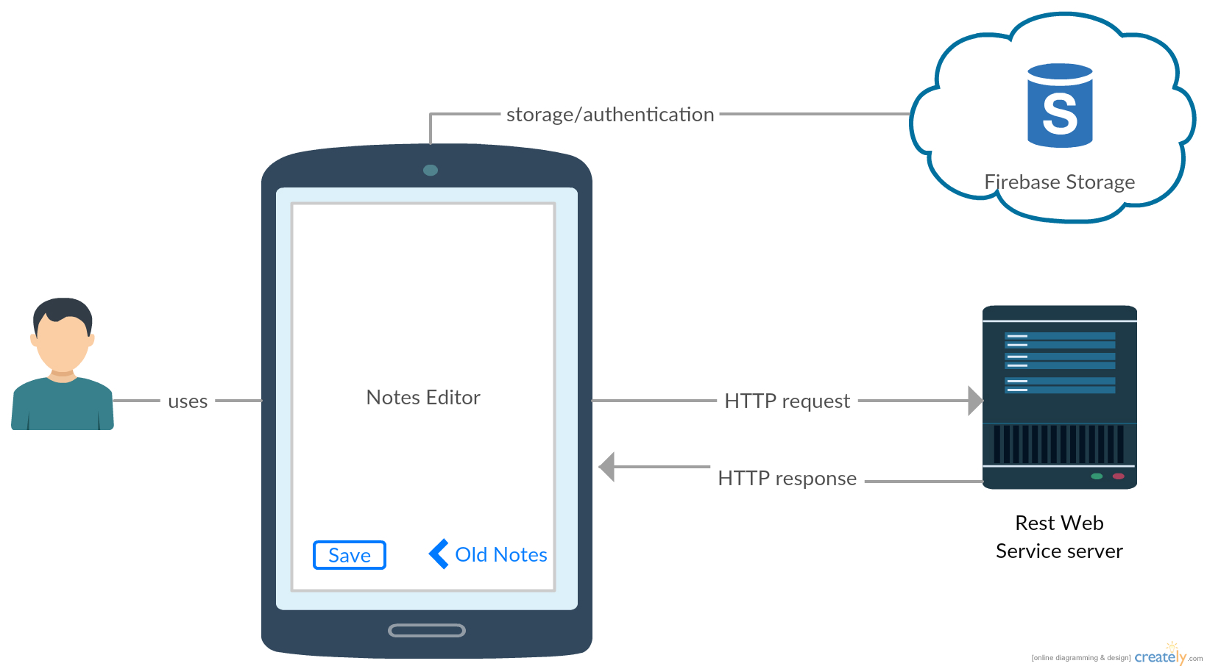
Architecture Design

Slide 4
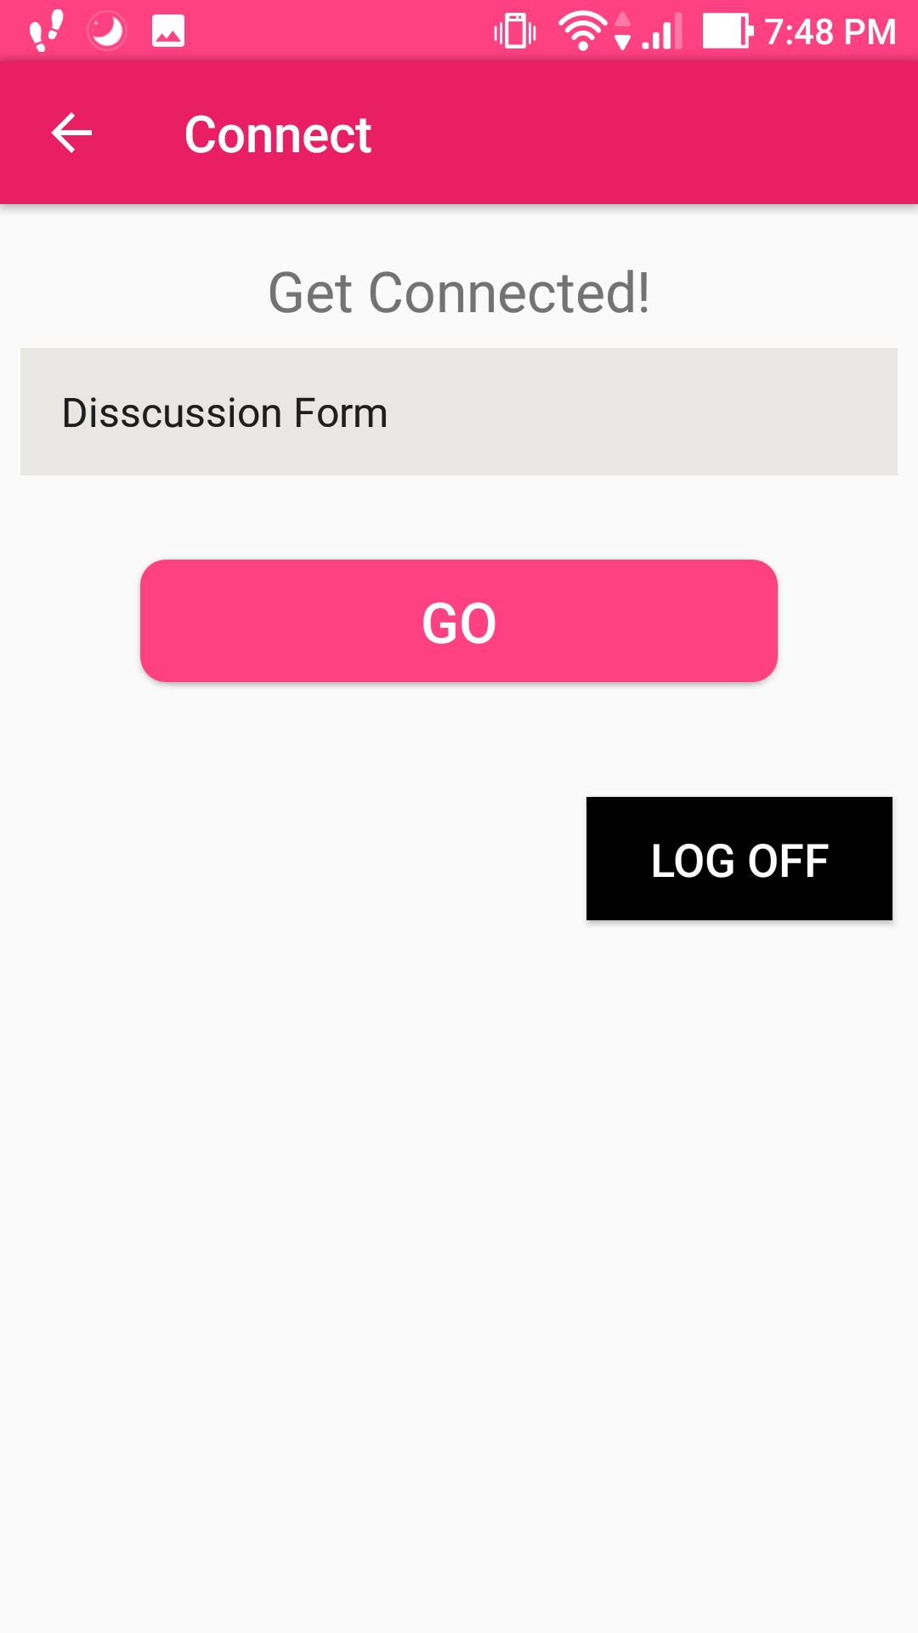
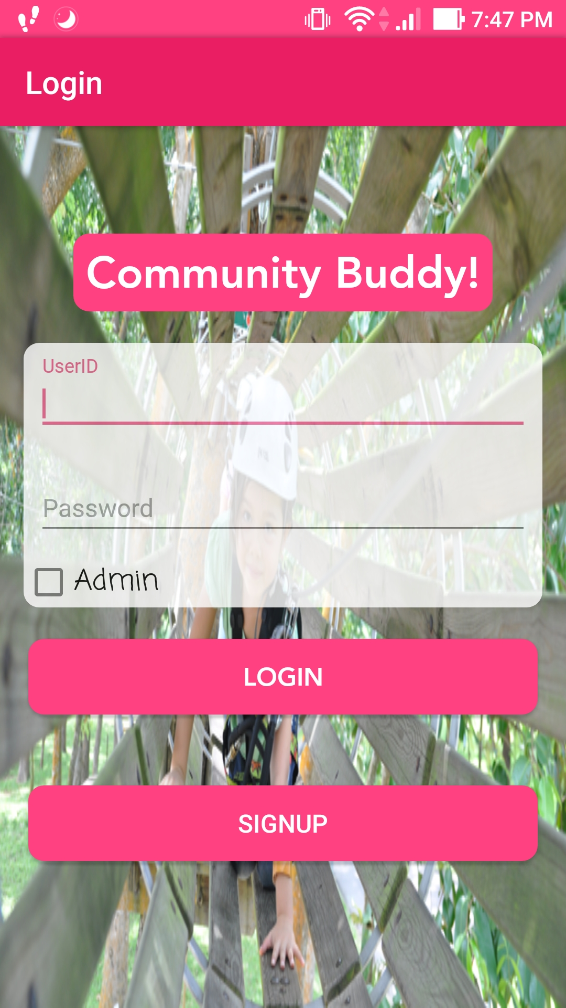
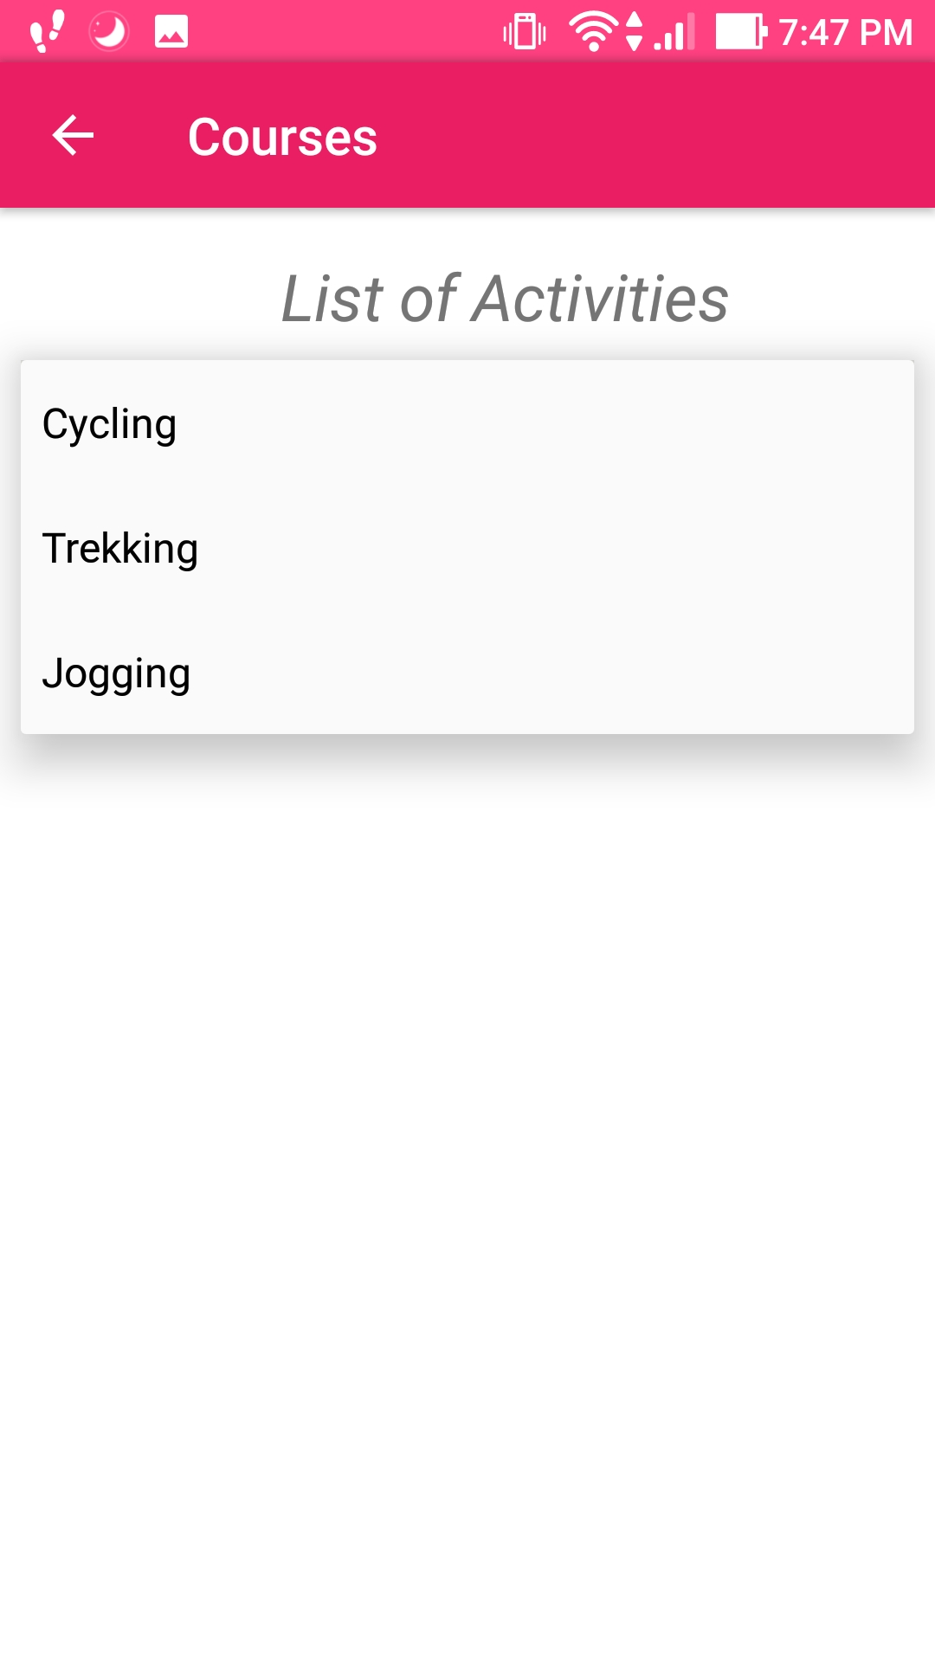
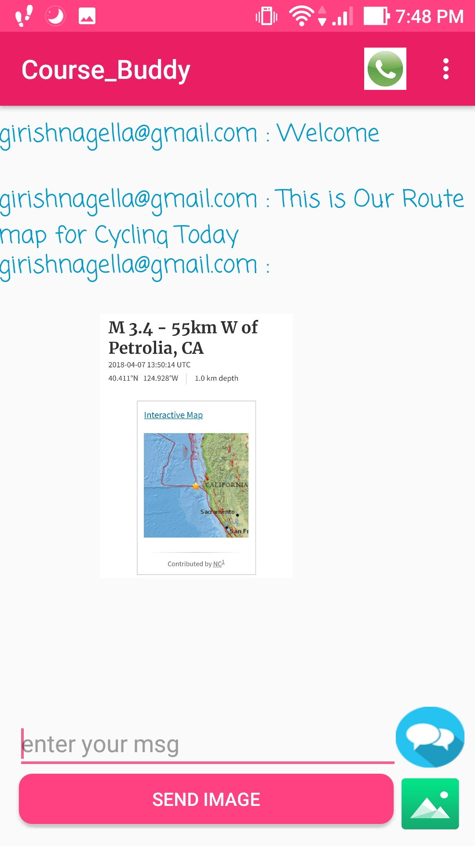
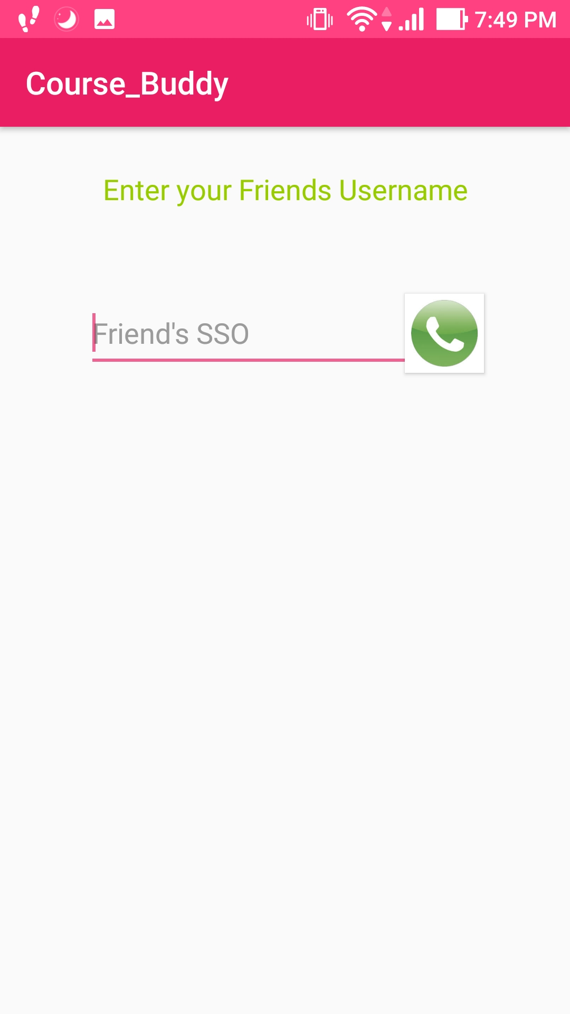
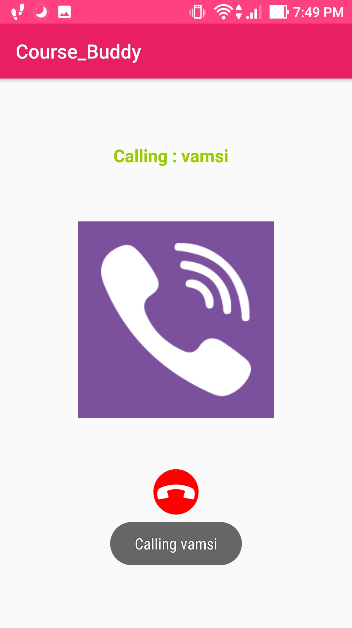
Application Life Cycle

Slide 5
Approach: This Android app keeps users engaged and updated with latest required information, alerts, info about payments, safety alerts and keep the community members updated about the application.

