Slide 1
WordPress XXE Vulnerability
CVE 2021-29447

Slide 2
Topics
What is WordPress??
XXE Attack
WordPress Vulnerability??
Demo

Slide 3

What is WordPress??
WordPress is a free and open-source content management system written in PHP and paired with a MySQL or MariaDB database. Features include a plugin architecture and a template system, referred to within WordPress as Themes.
Matt Mullenweg and Mike Little
https://kinsta.com/knowledgebase/what-is-wordpress/
2003
https://rockcontent.com/blog/wordpress/

Slide 4
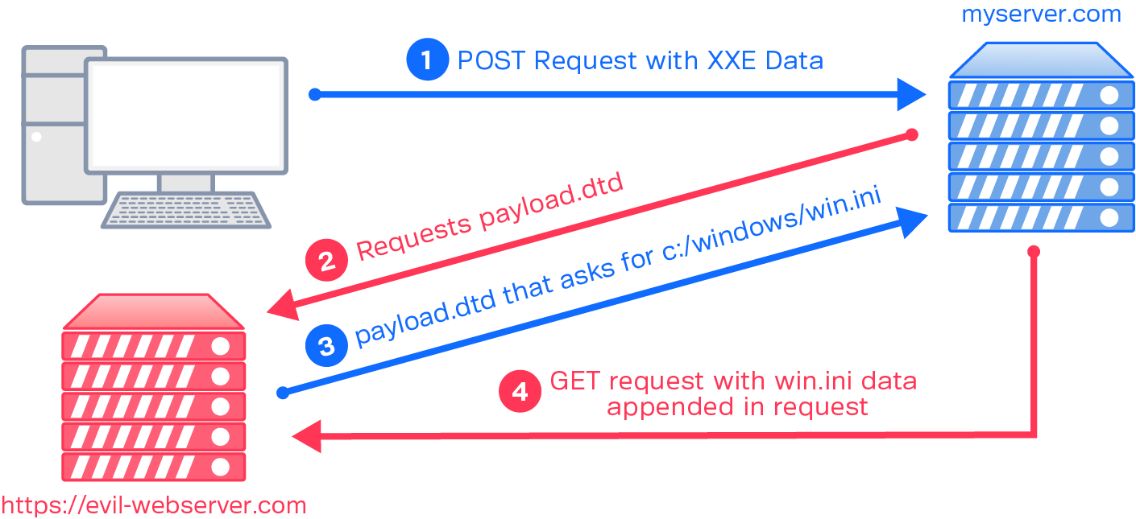
XXE Attack??
XML external entity injection (also known as XXE) is a web security vulnerability that allows an attacker to interfere with an application's processing of XML data. It often allows an attacker to view files on the application server filesystem, and to interact with any back-end or external systems that the application itself can access.
An attacker can escalate an XXE attack to compromise the underlying server or other back-end infrastructure, by leveraging the XXE vulnerability to perform server-side request forgery (SSRF) attacks.
https://portswigger.net/web-security/xxe
https://www.synack.com/blog/a-deep-dive-into-xxe-injection/

Slide 5
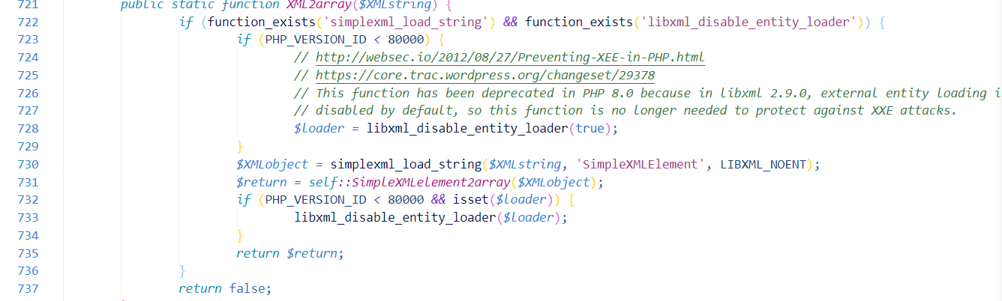
WordPress Vulnerability??
WordPress versions 5.7, 5.6.2, 5.6.1, 5.6, 5.0.11 are affected to XML eXternal Entity vulnerability where an authenticated user with the ability to upload files in the Media Library can upload a malicious WAVE file that could lead to remote arbitrary file disclosure and server-side request forgery (SSRF).
WordPress uses ID3 library to parse information about an audio file uploaded in the Media Library that was vulnerable to XXE, but what is getID3 library, and why WordPress use it?
https://blog.wpsec.com/wordpress-xxe-in-media-library-cve-2021-29447/
iXML tag

Slide 6

Demo

