Slide 1
EXPLORATORY DATA ANALYSIS ON
ATTRITION DATA SET
EXPLORATORY DATA ANALYSIS ON
ATTRITION DATA SET
By: (Group -7)
Abhirup Sarkar
David Jose Paliakkara
Gadivemula VamsiTej

Slide 2
EDA PROCESSES
Business Understanding
Data Understanding
Data Exploration and pre-processing
Univariate Analysis
Bivariate Analysis
Multivariate Analysis
Data visualization
Feature Selection
Notes:
This slide contains the editable pieces that were used to build infographic sample
Icons – Eye, PC

Slide 3
TOP 5 VARIABLES HAVING MAXIMUM CORRELATION WITH ATTRITION
AGE
OVERTIME
MONTHLY INCOME
BUSINESS TRAVEL
JOB INVOLVEMENT

Slide 4
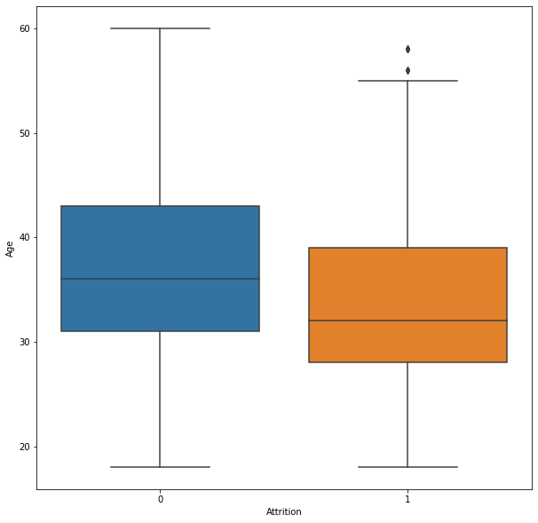
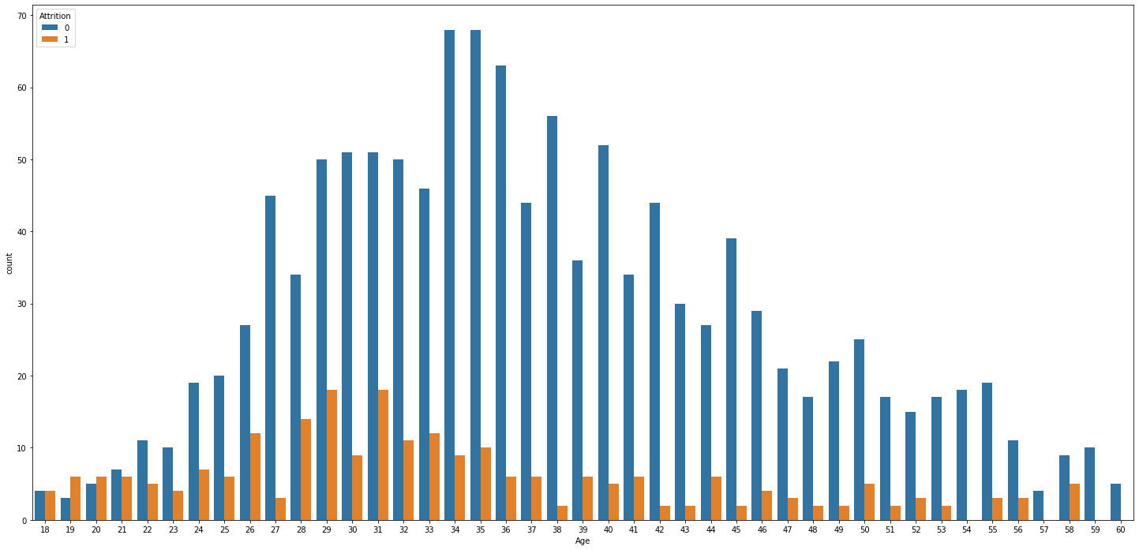
Age Vs Attrition Bi-Variate Analysis
Age distribution of the employees with Attrition = 0 and Attrition = 1 using boxplot
Group Bar chart of count of employees with attrition = 1 and attrition = 0

Slide 5
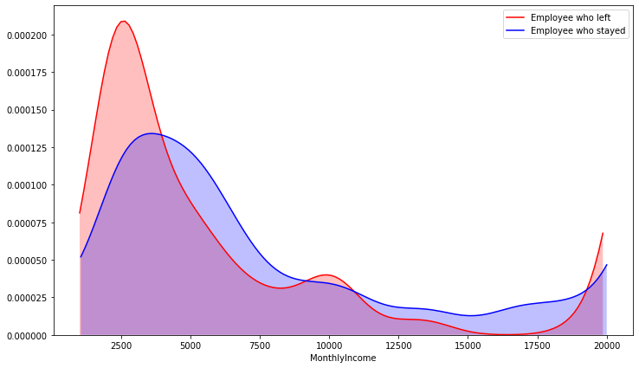
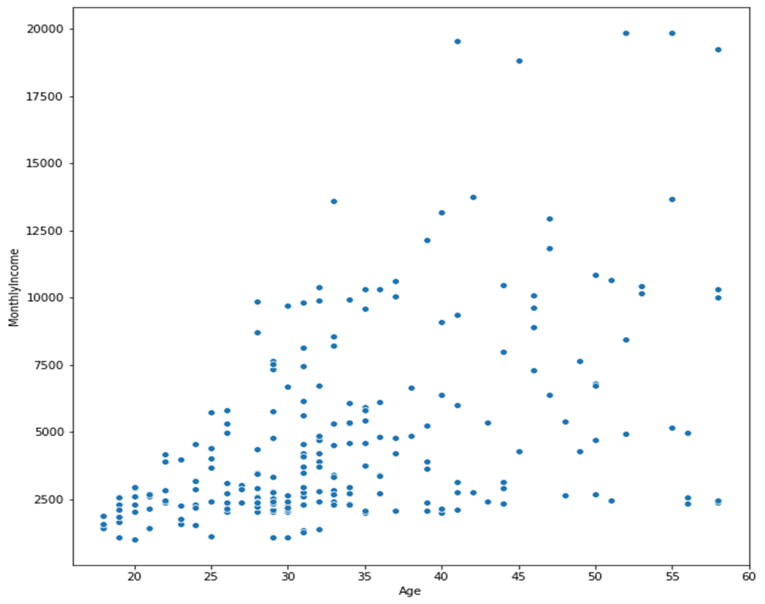
Monthly income vs Attrition correlation analysis
KDE plot for univariate analysis of monthly income
among employees
Scatter plot for bivariate analysis of age vs monthly incomes among employees who left the organization

Slide 6
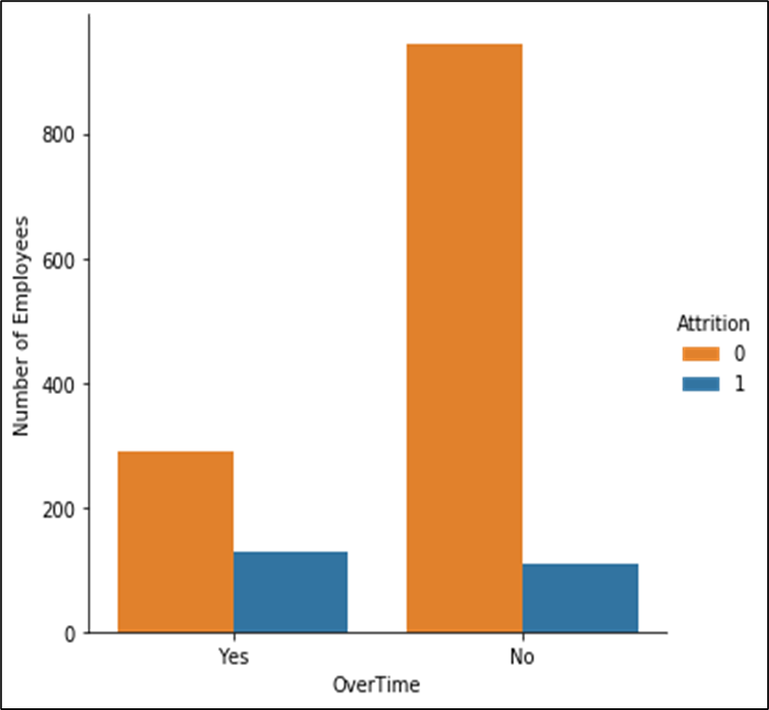
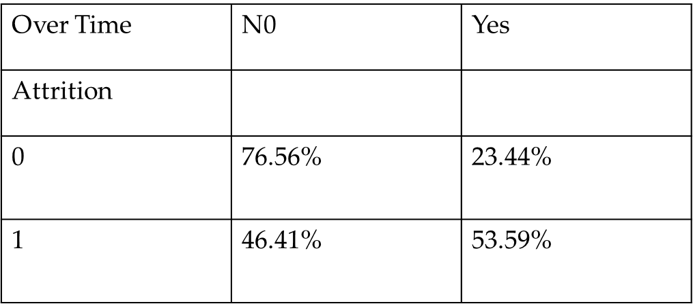
Overtime VS Attrition
Cross matrix distribution of the percentages of people working over time within different attrition levels
Count plot distribution of employees working overtime within different attrition levels

Slide 7
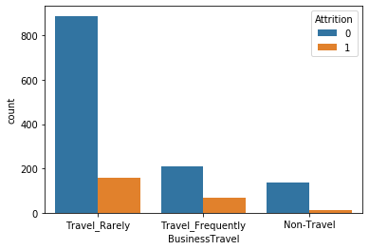
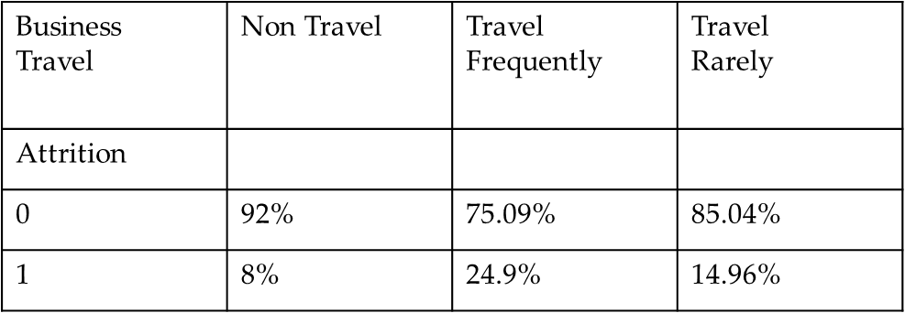
Business Travel Vs Attrition
Cross matrix distribution of the percentages of people working under different travel frequency modes within different attrition levels
Count plot distribution of employees working under different travel frequency modes within different attrition levels

Slide 8
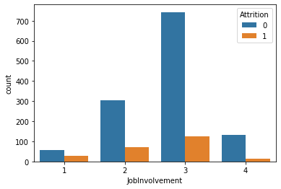
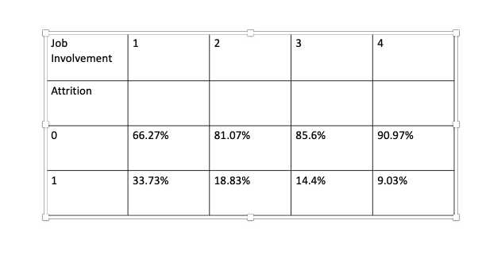
Job Involvement Vs Attrition
Cross matrix distribution of employees among different degrees of job involvement within different attrition levels
Count plot distribution of employees among different degrees of job involvement within different attrition levels

Slide 9
THANK YOU

