Slide 1

Safety enhancement for workers in construction sites with Machine Learning approach
PHAM, Trung Kien
DO, Van Quyet

Slide 2
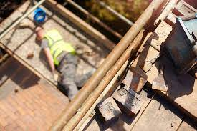
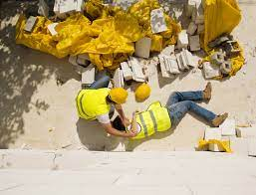
Overview
# giant buildings and skyscrapers grows significantly annually
So does # accidents in construction sites
Prevention exists but rely heavily on human effort. Drawbacks:
+ Slow reaction ability
+ Inaccurate decision making

Slide 3
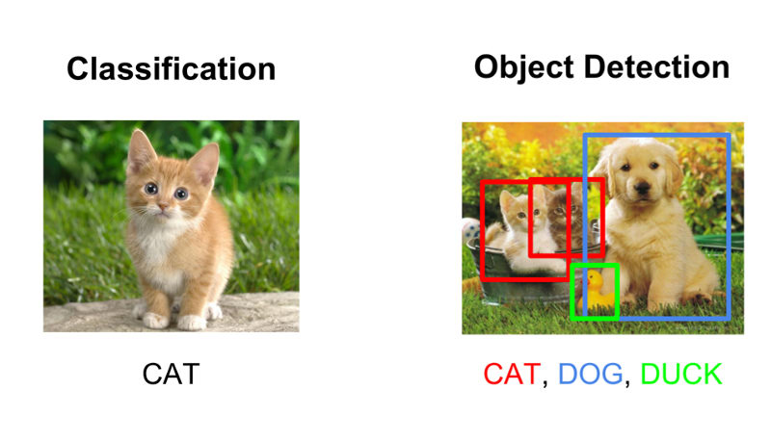
Overview
Minimize human factor by adopting
Object Detection
Image Classification

Slide 4
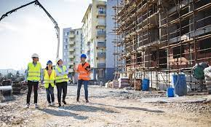
Methodology
Object Detection Model
Image Classification
Next frame
If not wearing required safety equipment, then send alerts or make according punishments.
All wearing safety equipment

Slide 5

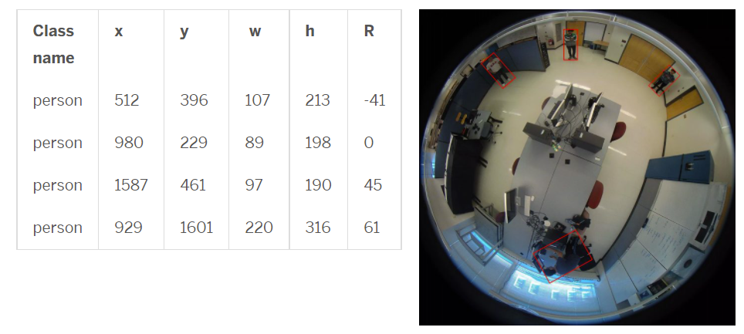
Datasets
Object Detection:
COCO in https://cocodataset.org/#home
HABBOF, CEPDOF, MW-R in http://vip.bu.edu/projects/vsns/cossy/datasets/
Image Classification:
Scrape from the internet + Crop from the above Object Detection datasets

