Slide 1
Warehouse
System
Carton sorting
and tracking system.
Pre-sort and Sort
Notes:
Warehouse System organizes carton handling: it records where cartons are placed during unloading, then helps sort them and collect the required products. This presentation follows the user's journey from login through completed work and administration.
Source: the current Warehouse System code, templates and active client workflows. Screenshots of the real interface were captured using a separate temporary database; tracking codes and quantities are demonstration examples.

Slide 2
The idea
Know where to find each carton,
and use that information when sorting.
Pre-sort
Sort
During unloading,
record each carton
on a numbered pallet.
Sort different products
or collect matching cartons
from saved locations.
Notes:
There are just two main modes. Pre-sort is used when products are unloaded onto mixed pallets: it creates a map of their locations. Sort is used for regular sorting or guided collection of matching cartons using that map. The saved data remain available for monitoring and managing the work.
Source: the current Warehouse System code, templates and active client workflows. Screenshots of the real interface were captured using a separate temporary database; tracking codes and quantities are demonstration examples.

Slide 3
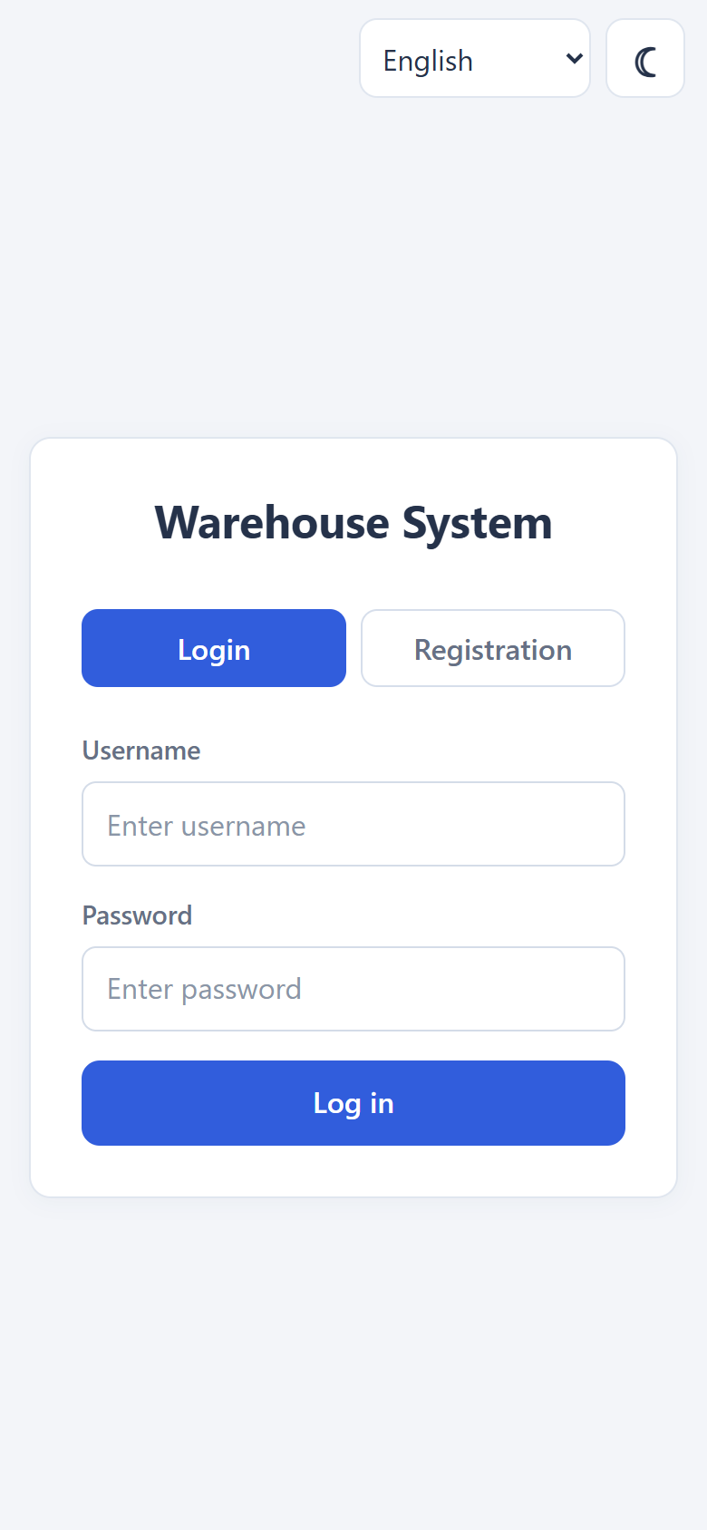
Login and registration
New user
Select “Registration”, enter a username,
password and confirmation. Then log in.
Already have an account
Enter your username and password on the “Login” tab.
Notes:
The start page has Login and Registration tabs. A new user enters a username, password and password confirmation, then logs into their account. Self-registration creates a regular worker account. An administrator can also create worker and administrator accounts through the admin panel. Source: the current Warehouse System interface and code.

Slide 4
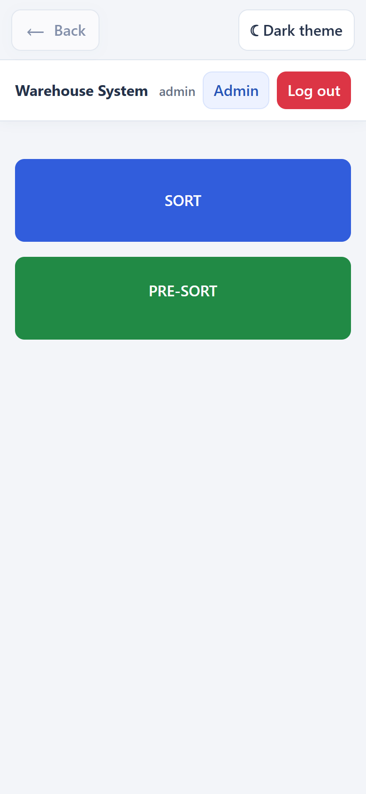
Main menu and roles
Worker
Opens Sort or Pre-sort,
selects a job and handles cartons.
Administrator
Creates jobs and manages data
using the “Admin” button.
Notes:
The home screen has separate SORT and PRE-SORT buttons. Administrators also see Admin. In this project, leader and admin mean the same role. To start working, users select an existing job; the current interface has no additional container selection or workstation reservation.
Source: the current Warehouse System code, templates and active client workflows. Screenshots of the real interface were captured using a separate temporary database; tracking codes and quantities are demonstration examples.

Slide 5
Why create a job
Each job has its own data
Location, date, carton types and status
keep the work together in one job.
Products, pallets, workers and movements are linked to it.
Later, you can open the required job, review its results
and continue working with the saved data.
Notes:
A job has its own ID, a name based on its location, a date, allowed types and a status. Records and pallets are kept separate for each job. This is useful beyond today's sorting: later, an administrator can find the relevant dataset and review the results, original locations, participants and operation log. These are existing features, not a promise of future analytics modules.
Source: the current Warehouse System code, templates and active client workflows. Screenshots of the real interface were captured using a separate temporary database; tracking codes and quantities are demonstration examples.

Slide 6
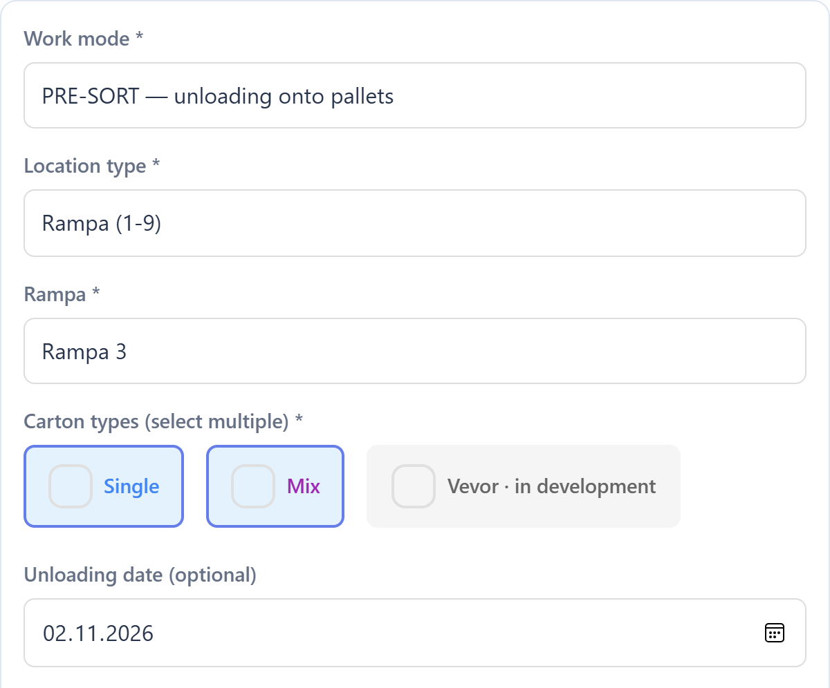
Creating Sort or Pre-sort
Admin: “SORT: products and jobs”, then “Jobs and creation”.
1. Mode and location
Select SORT / PRE-SORT,
a zone or ramp and its number.
2. Carton types
Single and/or Mix.
Date and notes are optional.
3. Click “Create”
Notes:
Only an administrator can create Sort and Pre-sort jobs. The form has no free-text name field: the name is the selected location, for example Rampa 3. Available locations are Zona Single A–C, Zona Mix A–C and Rampa 1–9. At least one allowed type, Single or Mix, must be selected. A blank date defaults to today; notes are optional. The button reads Create SORT or Create PRE-SORT depending on the mode. The screenshot shows the upper fields of the real form.
Source: the current Warehouse System code, templates and active client workflows. Screenshots of the real interface were captured using a separate temporary database; tracking codes and quantities are demonstration examples.

Slide 7
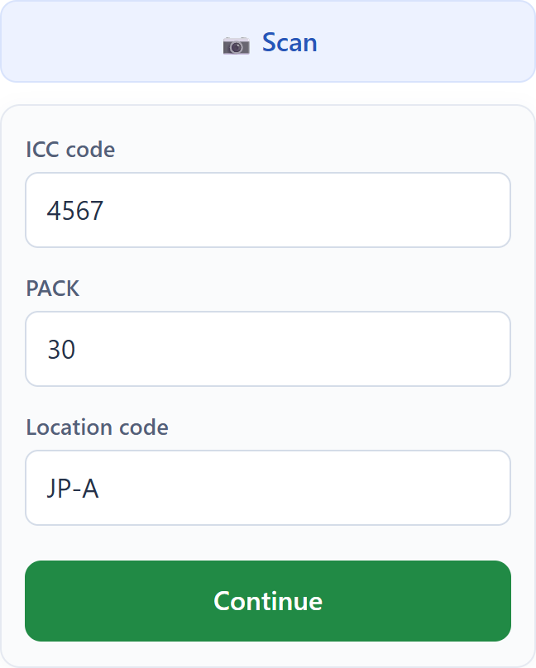
Entering carton data
Using OCR
“Scan”, frame the label, take a photo.
A complete, valid result
is confirmed automatically.
Manually
Single: ICC, PACK and location code.
Mix: label code. Then “Continue”.
Notes:
OCR uses the camera: the user places the label within the frame and taps Take photo. Flash is available if the device supports it. A complete, valid result automatically advances the relevant workflow. Incomplete data do not create a movement; they can be completed manually. Manual entry is always available: Single uses ICC, PACK and location code; Mix uses its own label code. Single example: 4567 / 30 PACK / JP-A. Confirm with the button or Enter. PACK is a label attribute, not the number of cartons being held.
Source: the current Warehouse System code, templates and active client workflows. Screenshots of the real interface were captured using a separate temporary database; tracking codes and quantities are demonstration examples.

Slide 8
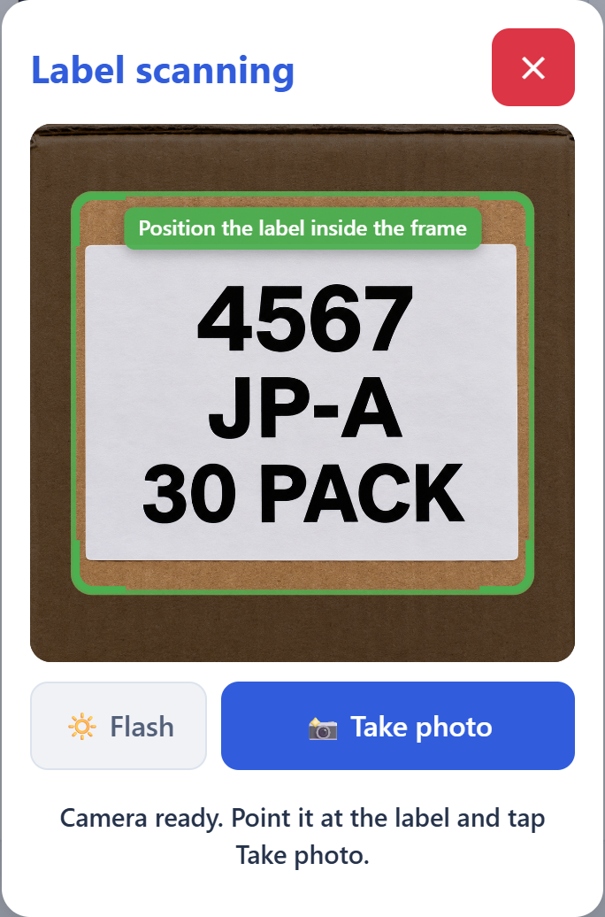
OCR: scanning a label
1. Open the camera
Tap “Scan” and allow camera access.
2. Place the label in the frame
The code, PACK and letters must be clearly visible.
3. Tap “Take photo”
The site reads the data and continues the workflow.
Incomplete results can be completed manually.
Notes:
Scanning starts with the Scan button. After allowing camera access, the user places the label within the frame and taps Take photo. The camera does not take a photo without this tap. Single requires ICC, PACK and location code; Mix requires the label code. A complete, valid result automatically advances the current workflow: Pre-sort adds one carton and keeps the camera open; Different products moves to the actual quantity; One product confirms one match. An incomplete result can be rescanned or completed manually. Flash is available if the device supports it.
Interface source: the real Warehouse System OCR form, captured in a browser using a separate temporary database. No physical camera was used. The carton and label image was created for demonstration using imagegen; it illustrates a camera frame and is not evidence of an OCR scan being performed.

Slide 9
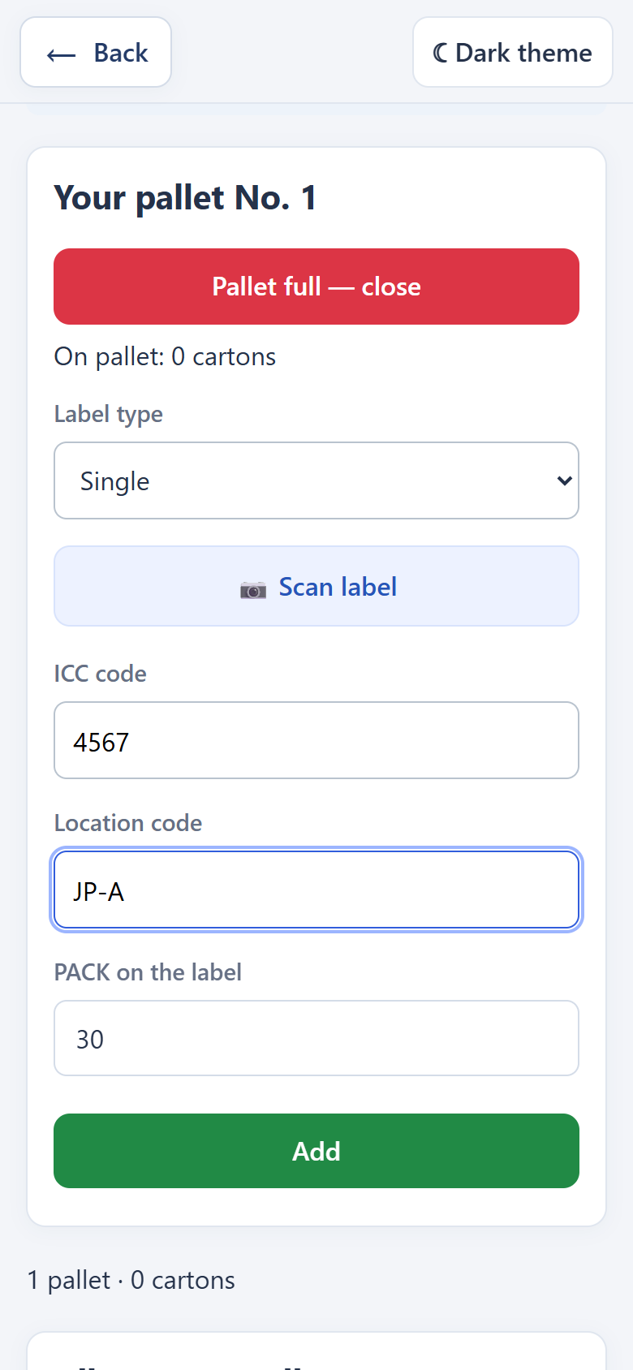
Pre-sort
A numbered pallet.
Every carton on the list.
Scan the label.
Add one at a time.
Close the full pallet.
Notes:
The worker selects a Pre-sort job created by an administrator and opens a numbered pallet. Each confirmed label adds one carton, through OCR or manual entry. An addition message appears; after OCR, the camera stays open. When the pallet is full, the worker closes it and starts the next one. The workflow includes totals, a pallet list, undoing the last carton and retrying an unconfirmed save. The Pre-sort work screen has no storage location search.
Source: the current Warehouse System code, templates and active client workflows. Screenshots of the real interface were captured using a separate temporary database; tracking codes and quantities are demonstration examples.

Slide 10
From Pre-sort to Sort
After unloading, the administrator closes Pre-sort
and confirms “Convert to SORT”.
What is kept
Why it matters
Label data, original pallets
and the history of additions.
Sort knows which pallets hold
the matching cartons.
There is no need to re-enter Pre-sort data.
Notes:
The administrator first closes the entire Pre-sort job, then converts it to Sort with confirmation. The job keeps the same ID, label data, original pallet numbers and contents. It becomes active again as a Sort job. One product uses these source data. The original archive remains available in Admin after conversion.
Source: the current Warehouse System code, templates and active client workflows. Screenshots of the real interface were captured using a separate temporary database; tracking codes and quantities are demonstration examples.

Slide 11
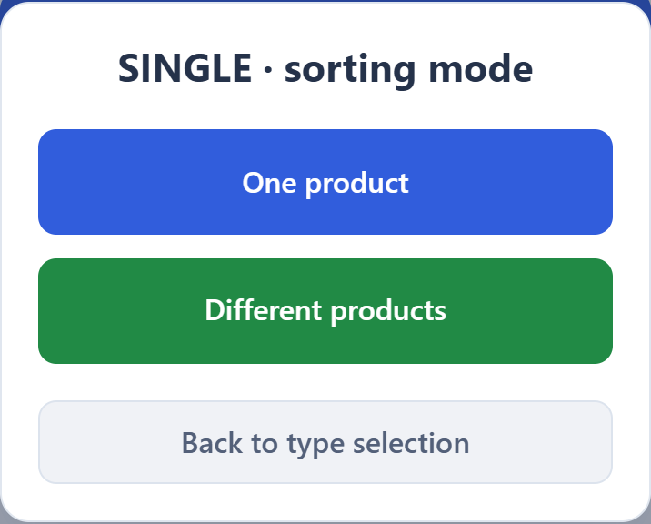
Sort. Two ways to work.
Select a job, then Single or Mix and a workflow.
One product
Collect matching cartons
from Pre-sort source pallets.
Different products
Enter the quantity being held
and the SORT pallet.
Single and Mix
Vevor — in development
Notes:
The worker opens SORT, selects an active job by location and date, chooses an allowed type, Single or Mix, then One product or Different products. The list shows progress and whether Pre-sort data are available. One product is available for jobs converted from Pre-sort; the regular Different products mode also works without Pre-sort. Vevor is still in development. Users can switch jobs without losing cartons already confirmed.
Source: the current Warehouse System code, templates and active client workflows. Screenshots of the real interface were captured using a separate temporary database; tracking codes and quantities are demonstration examples.

Slide 12
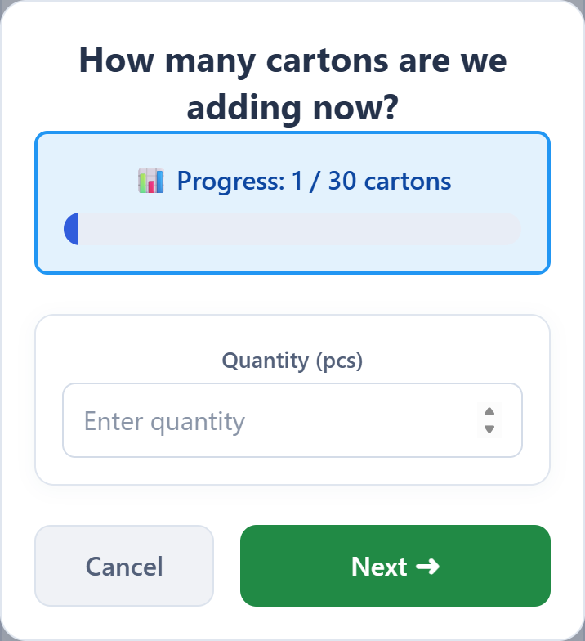
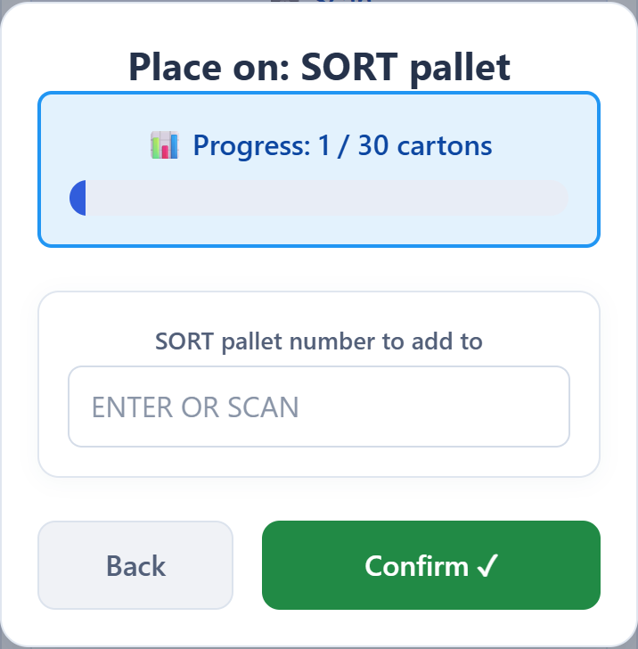
Different products
Label → quantity being held → SORT pallet.
PACK is not the number of cartons being held.
Notes:
In Different products, the label is entered through OCR or manually. The worker then enters the actual number of cartons being held, followed by the destination SORT pallet number, and confirms. PACK is not used as the quantity to add automatically. Collection progress is shown, and if a product is already fully collected, the system asks whether this is a new, separate batch. In the relevant workflow, the worker can close their pallet.
Source: the current Warehouse System code, templates and active client workflows. Screenshots of the real interface were captured using a separate temporary database; tracking codes and quantities are demonstration examples.

Slide 13
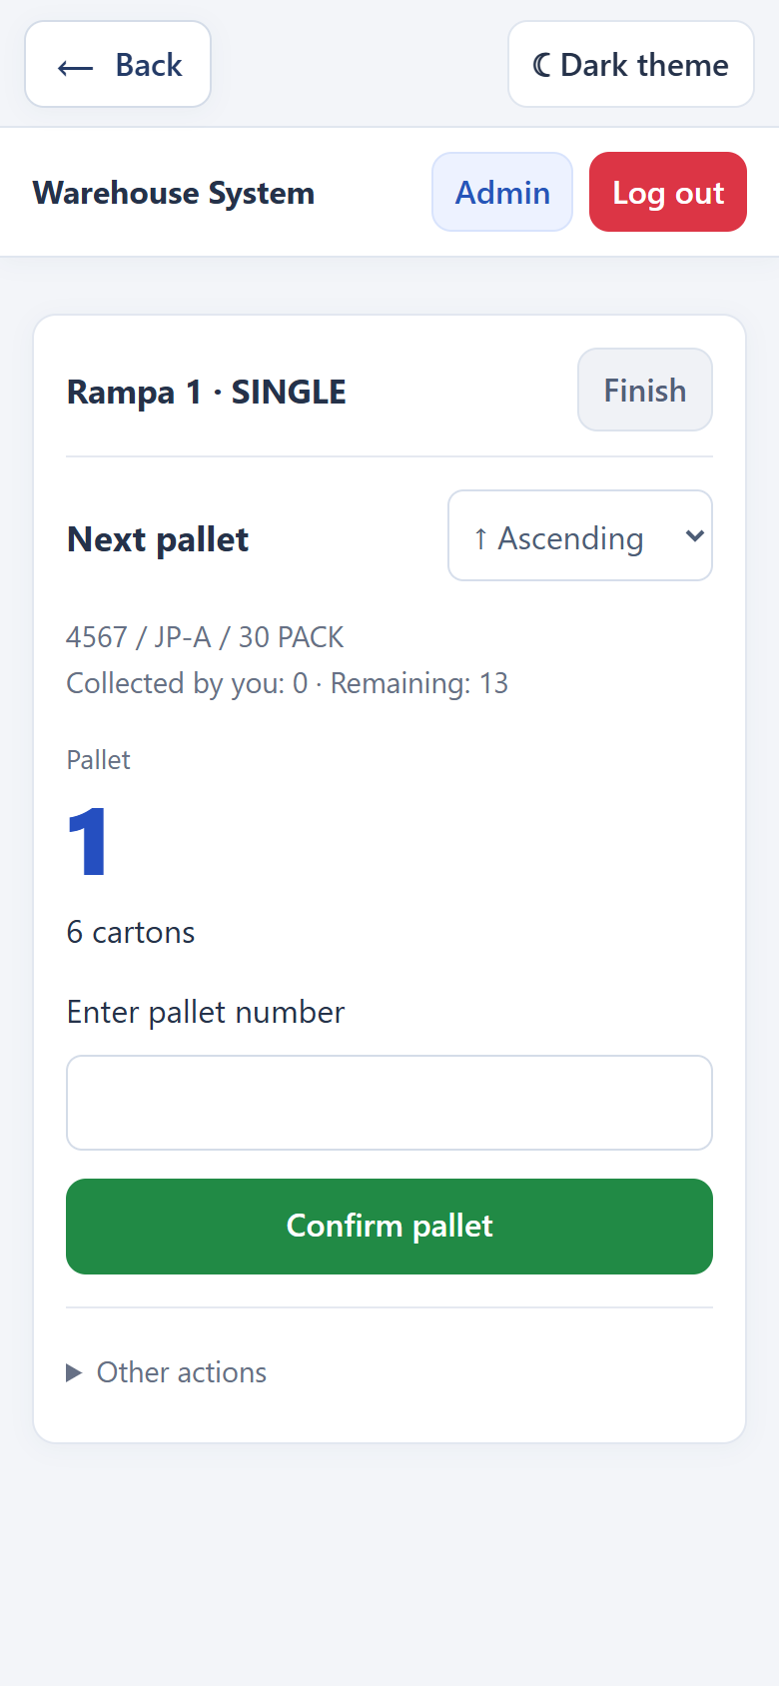
One product
The system shows
where to go next.
1 → 4 → 10
Confirm the pallet and each carton.
One label match means one carton.
The collection order can be changed.
Notes:
In One product, the worker selects the required label, sees the source pallet and its balance, enters its number, then confirms each matching carton through OCR or manual entry. The prompt shows the expected data, but these must be checked by entering them again. One match means one carton. When a source is empty, the system shows a central message and the next pallet; after the last source, it returns to product selection. The route can follow ascending or descending pallet numbers. Collected cartons are recorded against the worker, who takes a pallet along; no destination location number is entered here. The workflow includes balance refresh, undoing the last pick and session recovery.
Source: the current Warehouse System code, templates and active client workflows. Screenshots of the real interface were captured using a separate temporary database; tracking codes and quantities are demonstration examples.

Slide 14
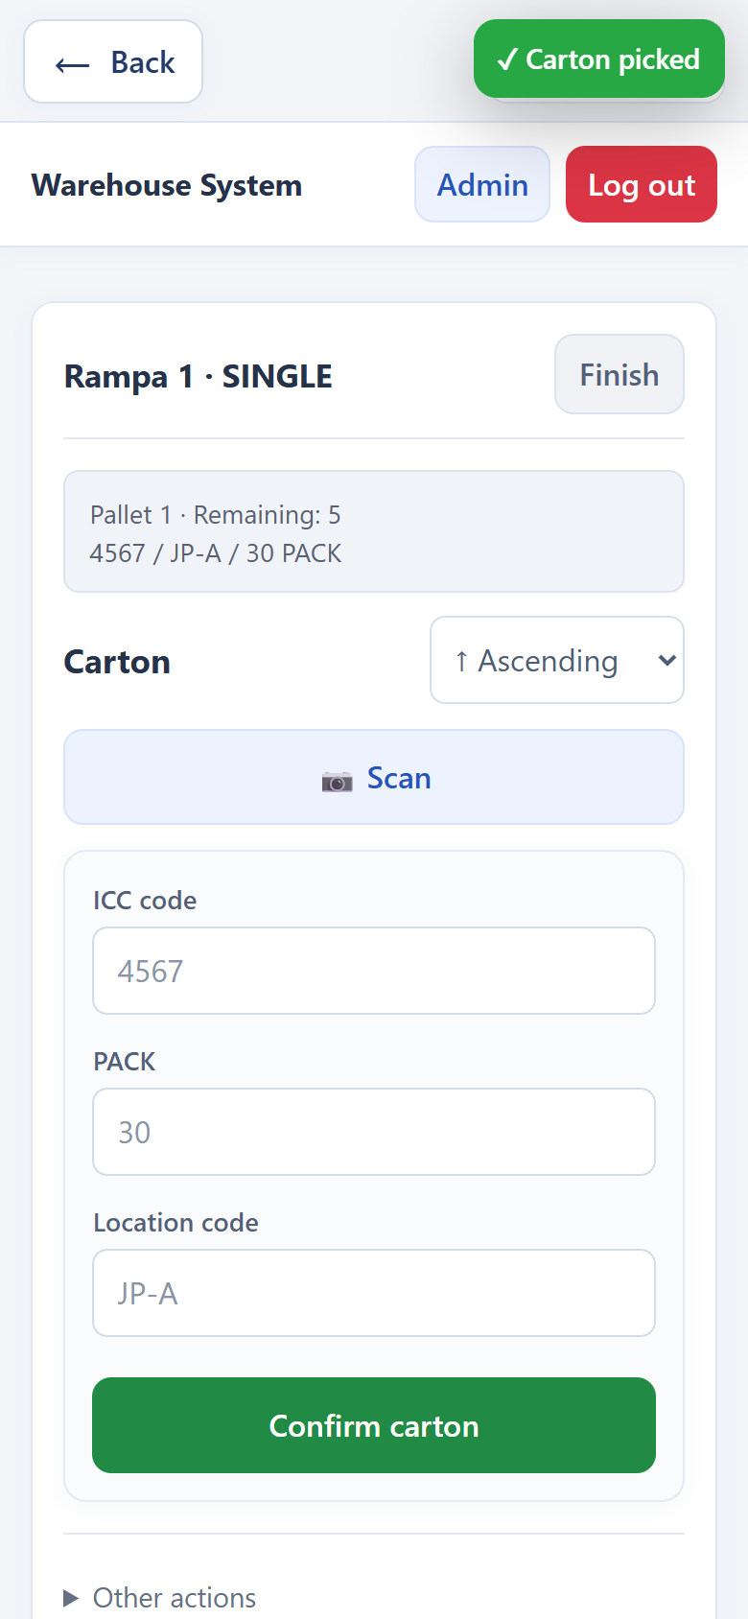
Finishing work
Worker
“Finish” exits the current workflow.
All confirmed cartons remain saved.
Administrator
Closes the entire job when the work is done.
Data and history remain available.
Notes:
In One product, after the last source, the system reports that the product is fully collected and returns to scanning or manual selection of the next product. For a worker, Finish exits their personal workflow; it does not close the job for everyone. Only the administrator closes the entire Sort job; open pallets are then closed, while confirmed records, balances and history are retained.
Source: the current Warehouse System code, templates and active client workflows. Screenshots of the real interface were captured using a separate temporary database; tracking codes and quantities are demonstration examples.

Slide 15
Saved Pre-sort data
Admin: product list or a log of every addition.
Product | Type | Added / PACK | Pallets | Locations
4567 JP-A 30 PACK | Single | 13 of 30 | 3 | #1: 6 pcs. #4: 4 pcs. #10: 3 pcs.
Code, PACK, quantity and pallets; search and filters.
This is the unloading summary. For the current state,
open “Movements and balances”.
Notes:
The Pre-sort cartons section is available during active Pre-sort and after conversion to Sort. It provides a product summary: label data, cartons added out of PACK, progress, pallet count and locations. The log shows every addition with its pallet, worker, time and cancellations. Search, type and record-status filters, and pagination are available. The editable table reproduces the main columns of the real demonstration screenshot presort-archive-table: 4567 JP-A 30 PACK, 13 cartons added across 3 pallets: 1 — 6, 4 — 4, 10 — 3. This is the original Pre-sort summary, not the current balance after picking.
Source: the current Warehouse System code, templates and active client workflows. Screenshots of the real interface were captured using a separate temporary database; tracking codes and quantities are demonstration examples.

Slide 16
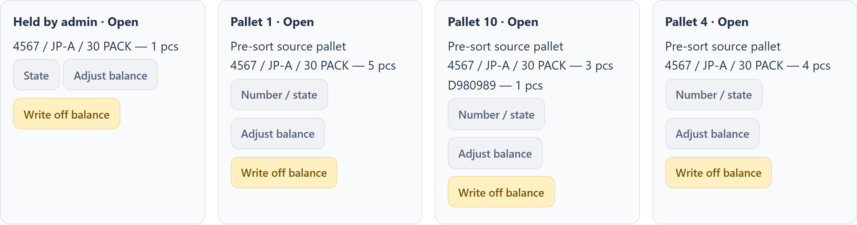
Current movements and balances
What is on the pallets now and what each worker has collected.
Search by product, pallet or worker.
Notes:
Movements and balances shows the current state: expected and collected product quantities, pallets and balances, workers and activity times. Movement history includes the time, author, reason and operation. Picking subtracts a carton from the source and adds it to the worker's collected quantity. Balances are calculated from movements. This state must be distinguished from the original Pre-sort archive.
Source: the current Warehouse System code, templates and active client workflows. Screenshots of the real interface were captured using a separate temporary database; tracking codes and quantities are demonstration examples.

Slide 17
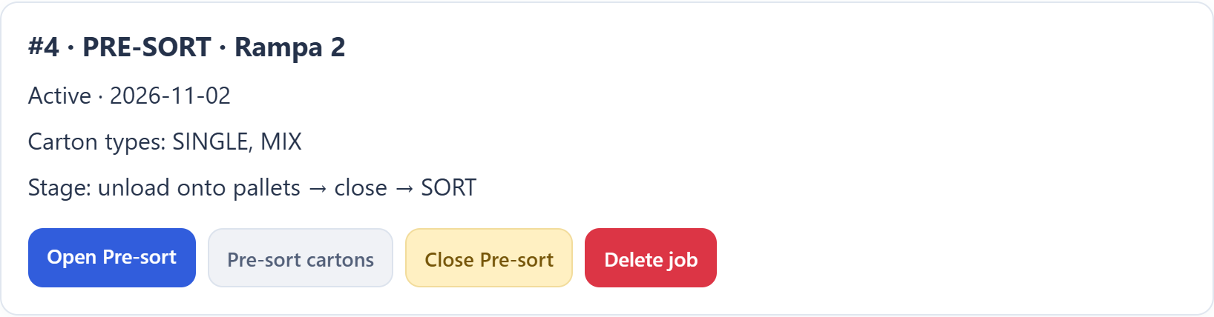
Managing jobs and the team
Jobs
Statuses, progress and SORT pallets.
Closing and converting Pre-sort.
Deletion after “Yes / No” confirmation.
Users
Account creation, roles, online status
and the number of cartons processed.
Notes:
In SORT: products and jobs, the administrator sees products in progress, completed products, SORT pallets and job creation, with progress and filters for type and open/closed state. Jobs can also be filtered by status. An active, unfinished job can be deleted through Yes/No confirmation: this hides it logically while preserving its accounting history. In the admin panel, administrators can create a user or admin, view roles, online/offline status, carton counts and registration dates, and delete a regular user.
Source: the current Warehouse System code, templates and active client workflows. Screenshots of the real interface were captured using a separate temporary database; tracking codes and quantities are demonstration examples.

Slide 18
Adjustments and data protection
Administrator controls
Preserving history
Expected product quantity.
Regular pallet number and status.
Add or write off stock with a reason.
Undo creates a reverse movement.
Retries do not add a carton twice.
Picking checks available stock.
Guided picking has an ICC format validation setting.
Notes:
The administrator can change the expected quantity, the number and open/closed status of a regular pallet, add or write off stock with a reason, and write off an entire pallet balance. The number of a worker's mobile pallet cannot be edited. An eligible movement can be corrected through a compensating movement and a new movement; sorting operations are not edited directly, but use Undo or a separate adjustment. The available balance check is transactional, and the request identifier prevents duplicate saves. The job's ICC format setting is currently used by guided picking in One product; regular Sort and Pre-sort have their own validation. This must not be presented as a global switch to disable checks.
Source: the current Warehouse System code, templates and active client workflows. Screenshots of the real interface were captured using a separate temporary database; tracking codes and quantities are demonstration examples.

Slide 19
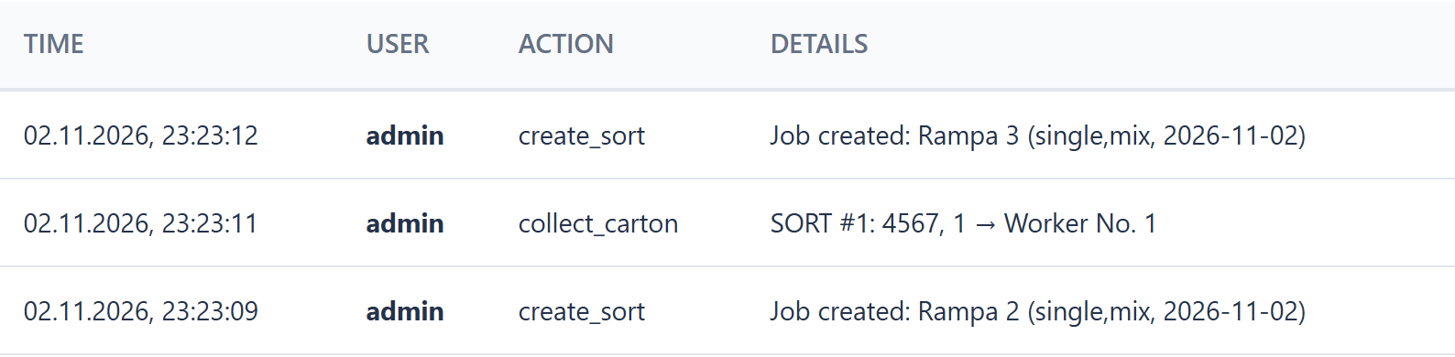
Activity and OCR logs
Activity
OCR logs
Photos, recognized data, results and manual corrections.
Filters by label type, success and date.
Notes:
Activity shows the time, user, action and details, with an overview and the option to select an individual worker. OCR logs contain the label photo, recognized data, raw OCR, time, user, success/failure and manual corrections. Type and result filters and date ordering are available. These tools support troubleshooting and monitoring; they are not an unlimited archive: Activity returns up to 100 records, OCR up to 200, and movement history up to 1000. The table on the slide is the real activity log using temporary data.
Source: the current Warehouse System code, templates and active client workflows. Screenshots of the real interface were captured using a separate temporary database; tracking codes and quantities are demonstration examples.

Slide 20
Thank you
for your attention!
Questions and discussion.
Warehouse System
Notes:
Thank the audience for their attention and invite questions about registration, working with Pre-sort and Sort, saved data and administration.
Source: the current Warehouse System code, templates and active client workflows. Screenshots of the real interface were captured using a separate temporary database; tracking codes and quantities are demonstration examples.

