Slide 1
Warehouse
System
Sorting and inventory
system for cartons.
Pre-sort and Sort
Notes:
Warehouse System organises carton work: during unloading it records their placement, then helps sort and collect needed items. The presentation follows the user journey from login to work results and administration.
Source: current Warehouse System code, templates and active client scenarios. Screenshots of the real interface were taken on a separate temporary database; account codes and quantities are demonstration examples.

Slide 2
System concept
Know where the needed carton is
and use that data during sorting.
Pre-sort
Sort
During unloading
we record each carton
on a numbered pallet.
Sort different items
or collect identical ones
from saved locations.
Notes:
There are only two main modes. Pre-sort is needed when items are unloaded onto mixed pallets: it creates a placement map. Sort is used for regular sorting or managed collection of identical cartons from this map. Saved data remains available for monitoring and managing the work.
Source: current Warehouse System code, templates and active client scenarios. Screenshots of the real interface were taken on a separate temporary database; account codes and quantities are demonstration examples.

Slide 3
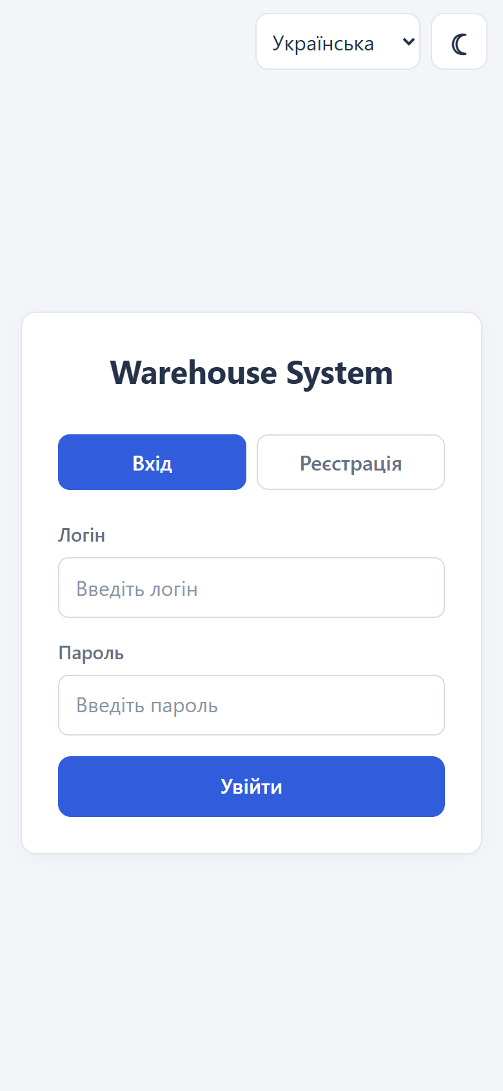
Login and registration
New user
Select "Register", enter login,
password and its confirmation. Then log in.
Already have an account
Enter login and password on the "Login" tab.
Notes:
The start page has Login and Register. A new user enters the login, password and its confirmation, then logs in. Self-registration creates a regular worker. The administrator can separately create workers and administrators through the panel. Source: current Warehouse System interface and code.

Slide 4
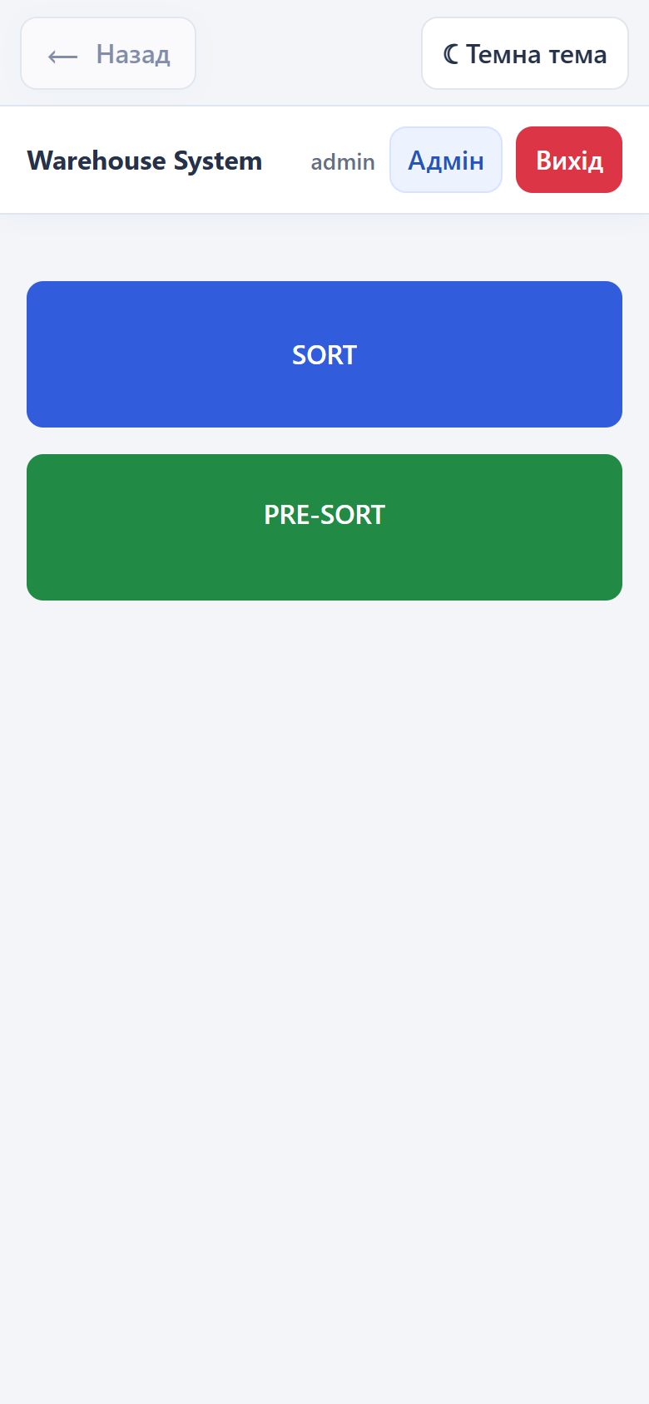
Main menu and roles
Worker
Opens Sort or Pre-sort,
selects a task and works with cartons.
Administrator
Creates tasks and manages data
via the "Admin" button.
Notes:
The main screen has separate SORT and PRE-SORT buttons. The administrator additionally sees Admin. Leader and admin in this project mean the same role. To start working, an already created task is selected; there is no additional container selection or workstation booking in the current interface.
Source: current Warehouse System code, templates and active client scenarios. Screenshots of the real interface were taken on a separate temporary database; account codes and quantities are demonstration examples.

Slide 5
Why create tasks
Each task has its own data
Location, date, carton types and status
об’єднують роботу в одному завданні.
До нього прив’язані товари, палети, працівники та рухи.
Later you can open the needed sort, check
its result and continue working with the saved data.
Notes:
A task has its own ID, name from location, date, allowed types and status. Accounting and pallets of different tasks are separated. This is needed not only for today's sorting: later the administrator can find the needed data set, view the result, initial placement, participants and operation log. These are current capabilities, not a promise of future analytics modules.
Source: current Warehouse System code, templates and active client scenarios. Screenshots of the real interface were taken on a separate temporary database; account codes and quantities are demonstration examples.

Slide 6
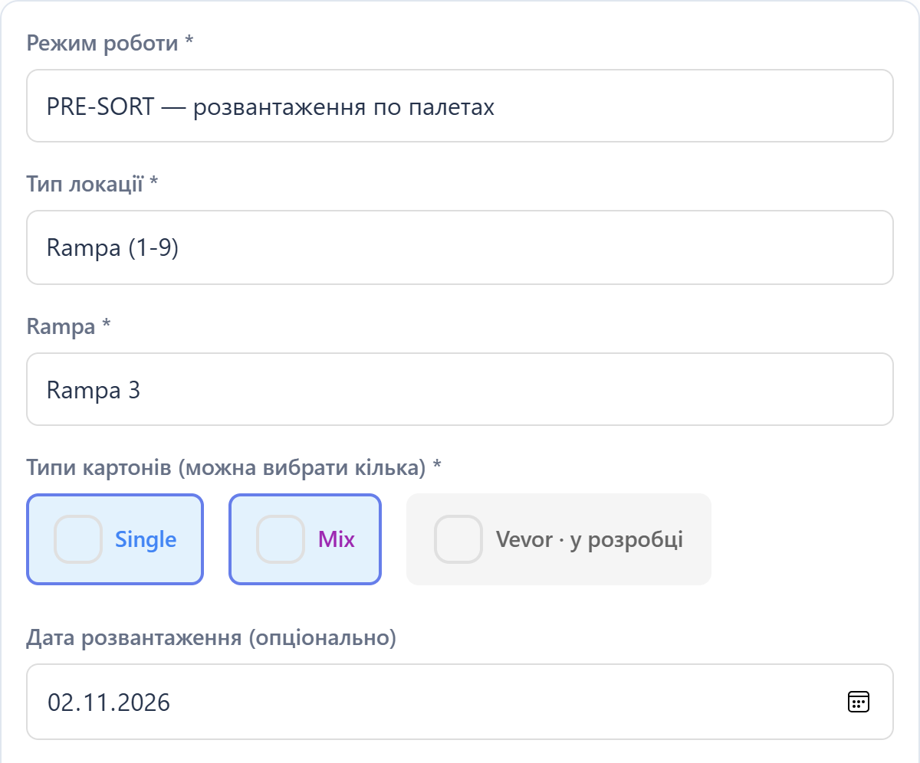
Creating Sort or Pre-sort
Admin: "Sort: items and tasks", then "Tasks and creation".
1. Mode and location
Select SORT / PRE-SORT,
zone or ramp and its number.
2. Carton types
Single and/or Mix.
Дата й примітки необов’язкові.
3. Click "Create"
Notes:
Створювати Sort і Pre-sort може лише адміністратор. У формі немає довільного поля назви: назва дорівнює вибраній локації, наприклад Rampa 3. Доступні Zona Single A–C, Zona Mix A–C та Rampa 1–9. Потрібно вибрати хоча б один дозволений тип, Single або Mix. Порожня дата стає поточною; примітки необов’язкові. Кнопка показує Створити SORT або Створити PRE-SORT відповідно до режиму. Скриншот показує верхні поля реальної форми.
Source: current Warehouse System code, templates and active client scenarios. Screenshots of the real interface were taken on a separate temporary database; account codes and quantities are demonstration examples.

Slide 7
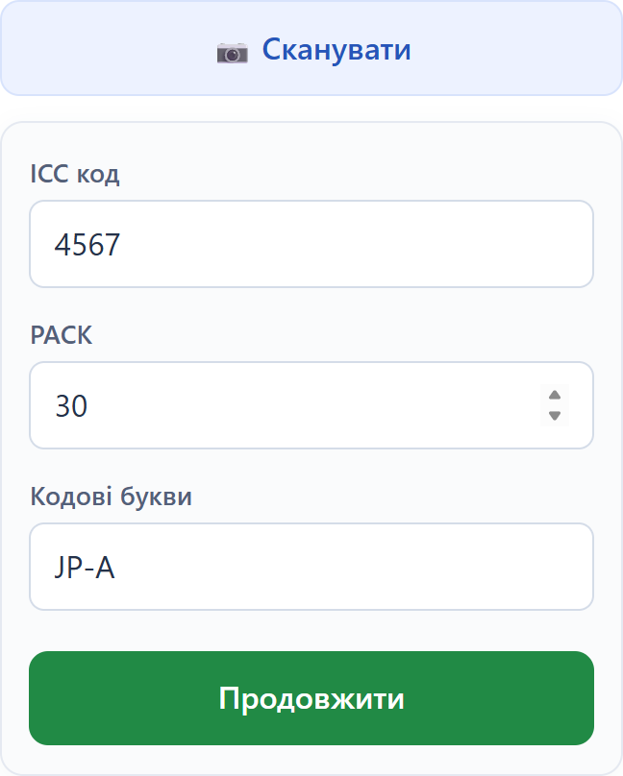
Entering carton data
Via OCR
"Scan", label in frame, photo.
A complete correct result
is confirmed automatically.
Manually
Single: ICC, PACK and code letters.
Mix: label code. Then "Continue".
Notes:
OCR uses the camera: the user places the label in the frame and presses Take photo. Flash is available when the device supports it. A full correct result automatically continues the relevant scenario. Incomplete data does not create a movement; it can be completed manually. The manual path is always available: Single has ICC, PACK, code letters, Mix has its own label code. Single example: 4567 / 30 PACK / JP-A. Confirm with button or Enter. PACK is a label characteristic, not the number of cartons in hand.
Source: current Warehouse System code, templates and active client scenarios. Screenshots of the real interface were taken on a separate temporary database; account codes and quantities are demonstration examples.

Slide 8
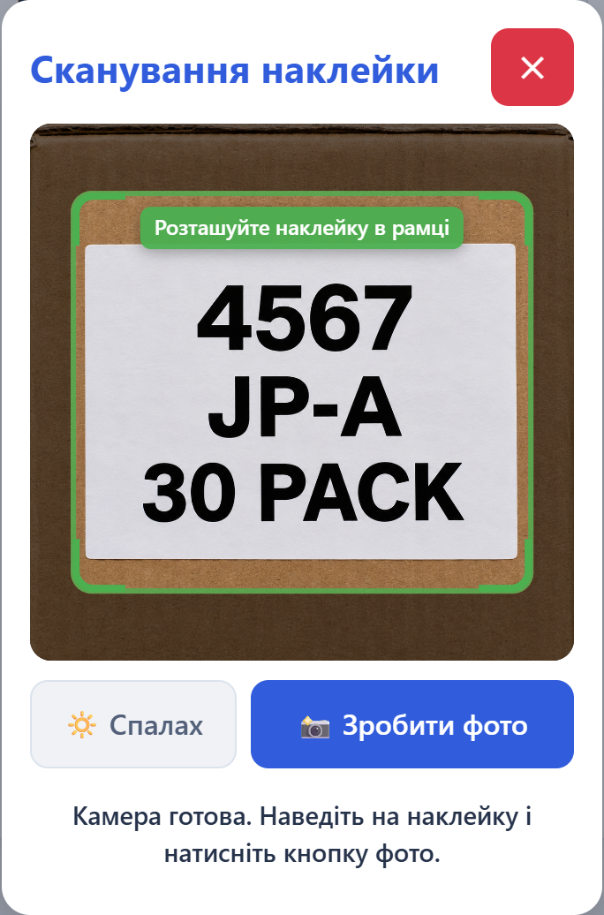
OCR: label scanning
1. Open the camera
Press "Scan" and allow access.
2. Place the label in the frame
Code, PACK and letters must be clearly visible.
3. Press "Take photo"
The site recognises the data and continues.
An incomplete result can be completed manually.
Notes:
Scanning starts with the Scan button. After camera permission the user places the label in the frame and presses Take photo. The camera does not photograph automatically without this press. Single requires ICC, PACK and code letters; Mix requires the label code. A full correct result automatically continues the current scenario: Pre-sort adds one carton and leaves the camera open; Mixed items moves to the actual quantity; One item confirms one match. An incomplete result can be rescanned or completed manually. Flash is available when the device supports it.
Interface source: the real Warehouse System OCR form, captured in the browser on a separate temporary database. No physical camera was used. The box and label image was created for demonstration using imagegen; it is an example frame, not proof of an OCR being performed.

Slide 9
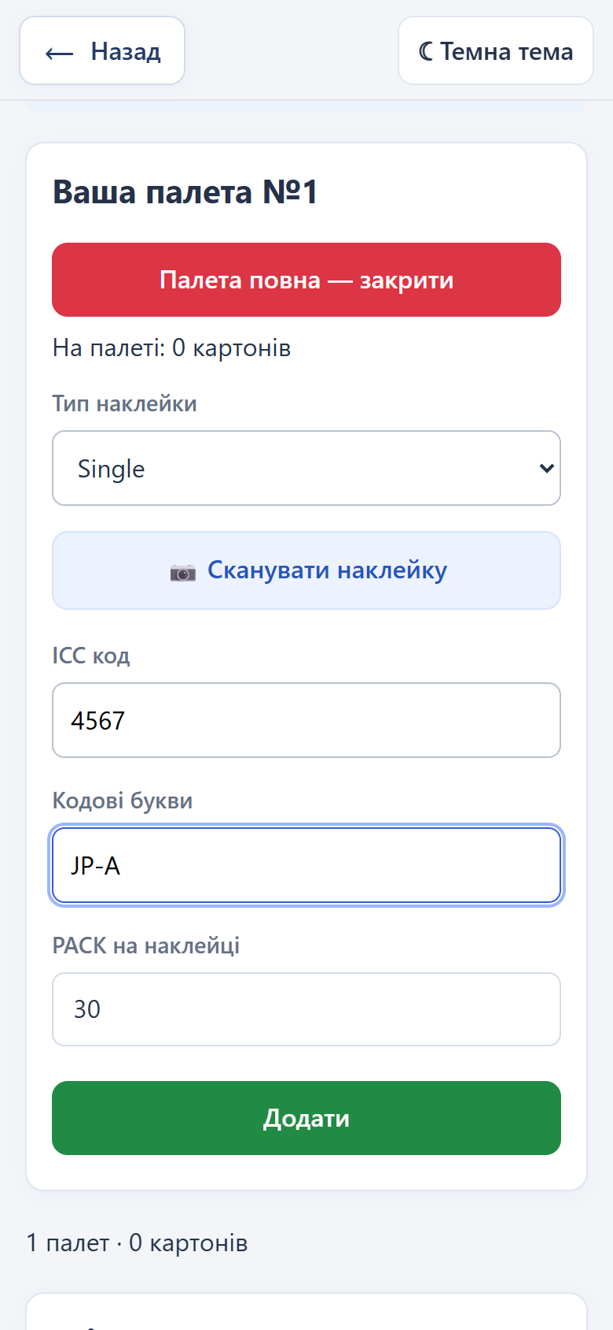
Pre-sort
Numbered pallet.
Each carton — in the list.
Scan the label.
Add one at a time.
Close the full pallet.
Notes:
Працівник обирає створене адміністратором завдання Pre-sort і відкриває пронумеровану палету. Кожна підтверджена наклейка додає один картон, OCR або вручну. З’являється повідомлення про додавання; після OCR камера залишається відкритою. Повну палету закривають і починають наступну. Є підсумки, список палет, скасування останнього картона й повтор непідтвердженого збереження. Пошуку місць зберігання в робочому Pre-sort немає.
Source: current Warehouse System code, templates and active client scenarios. Screenshots of the real interface were taken on a separate temporary database; account codes and quantities are demonstration examples.

Slide 10
From Pre-sort to Sort
After unloading, the admin closes Pre-sort
and confirms "Convert to SORT".
What is preserved
Purpose
Label data, initial
pallets and addition history.
Sort knows which pallets
to look for matching cartons.
No need to re-enter Pre-sort data.
Notes:
The admin first closes the entire Pre-sort task, then converts it to Sort with confirmation. The same task ID, label data, initial pallet numbers and contents remain. The task becomes active again as Sort. One item mode works based on these source data. The initial archive remains accessible in Admin even after conversion.
Source: current Warehouse System code, templates and active client scenarios. Screenshots of the real interface were taken on a separate temporary database; account codes and quantities are demonstration examples.

Slide 11
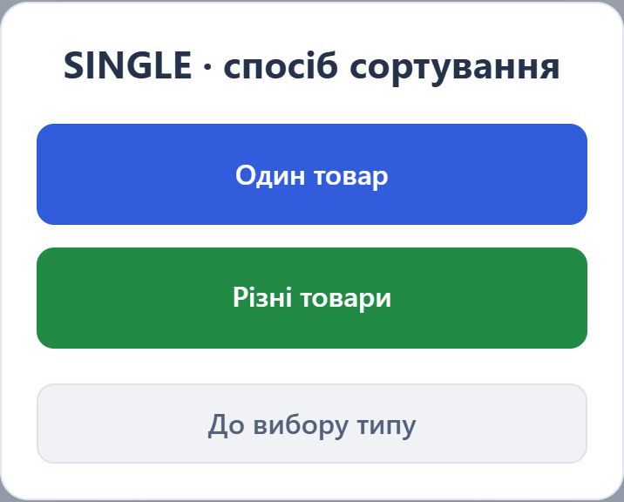
Sort. Two working modes.
Select a task, then Single or Mix and the working mode.
One item
Collect identical cartons
from Pre-sort source pallets.
Mixed items
We specify the quantity in hand
and the SORT pallet.
Single and Mix
Vevor — in development
Notes:
The worker opens SORT, selects an active task by location and date, allowed Single or Mix, then One item or Mixed items. The list shows progress and available Pre-sort data. One item is available for tasks converted from Pre-sort; regular Mixed items mode works without Pre-sort too. Vevor is still in development. The task can be changed without losing already confirmed cartons.
Source: current Warehouse System code, templates and active client scenarios. Screenshots of the real interface were taken on a separate temporary database; account codes and quantities are demonstration examples.

Slide 12
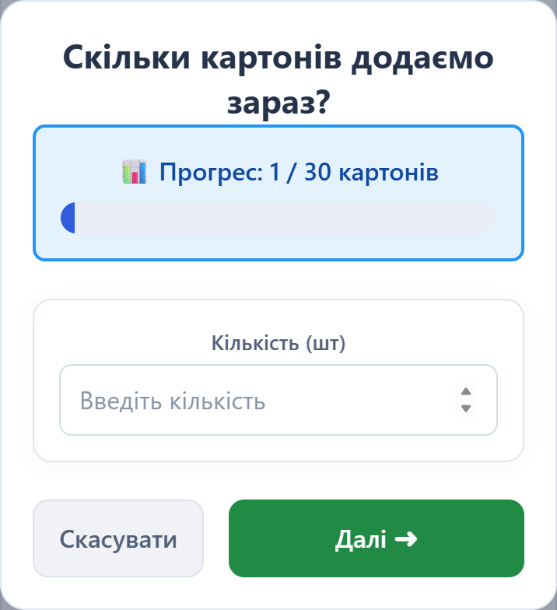
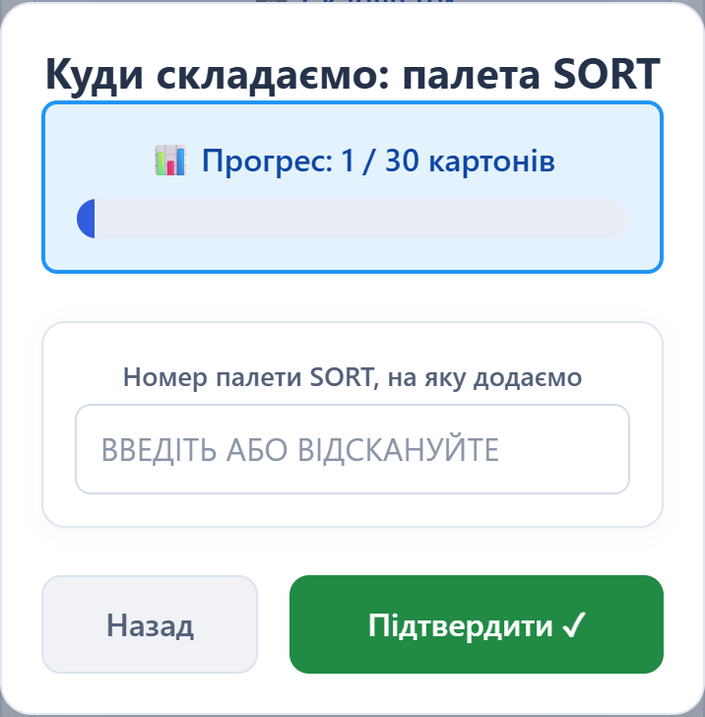
Mixed items
Label → quantity in hand → SORT pallet.
PACK does not equal the number of cartons in hand.
Notes:
In Mixed items the label is entered via OCR or manually. The worker then specifies the actual quantity of cartons in hand, then the target SORT pallet number and confirms. PACK is not used as an automatic added quantity. Collection progress is shown, and for an already fully collected item the system asks if this is a new separate batch. In the relevant scenario the worker can close their pallet.
Source: current Warehouse System code, templates and active client scenarios. Screenshots of the real interface were taken on a separate temporary database; account codes and quantities are demonstration examples.

Slide 13
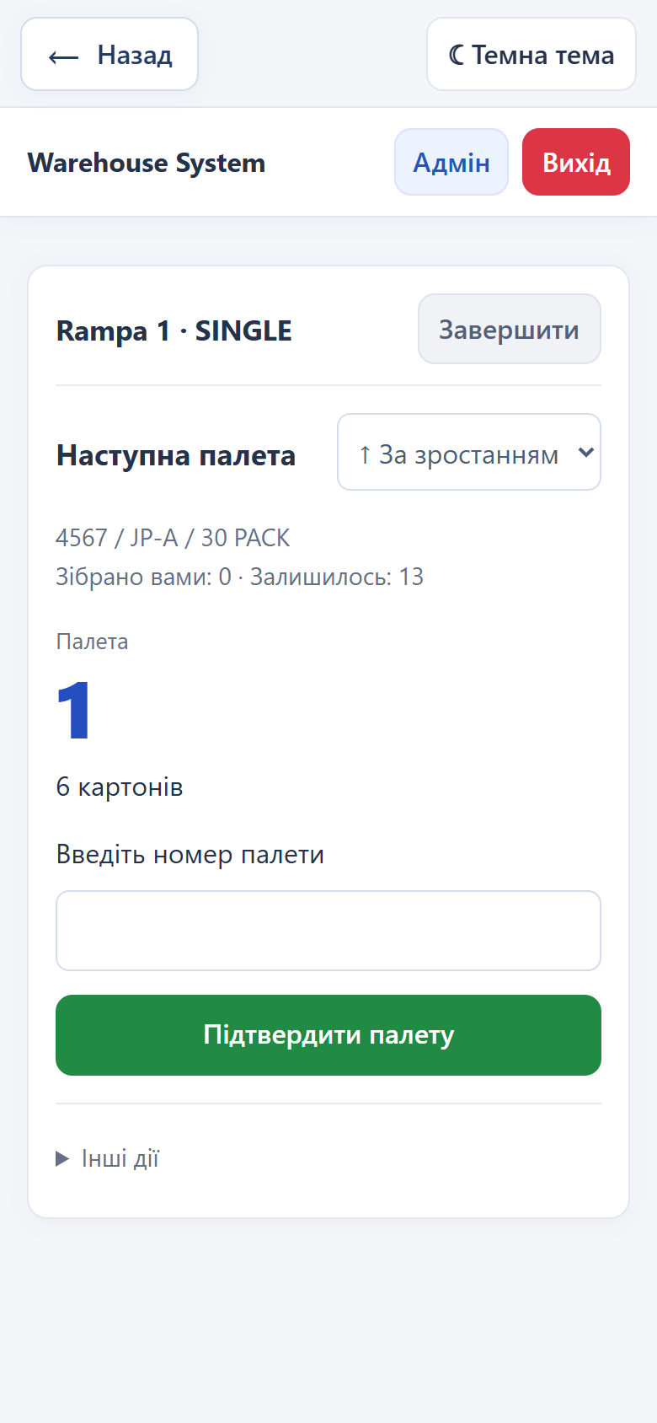
One item
The system shows
where to go next.
1 → 4 → 10
Confirm the pallet and each carton.
One label match means one carton.
The traversal order can be changed.
Notes:
In One item the worker selects the needed label, sees the source pallet and balance, enters its number, then confirms each identical carton by OCR or manually. The hint shows expected data but it must be verified by re-entry. One match means one carton. When the source is exhausted the system shows a centred message and the next pallet; after the last source it returns to item selection. Traversal direction toggles ascending or descending. Collected items are attributed to the worker who carries the pallet; no final location number is entered here. Balance updates, last pick undo and session restore are available.
Source: current Warehouse System code, templates and active client scenarios. Screenshots of the real interface were taken on a separate temporary database; account codes and quantities are demonstration examples.

Slide 14
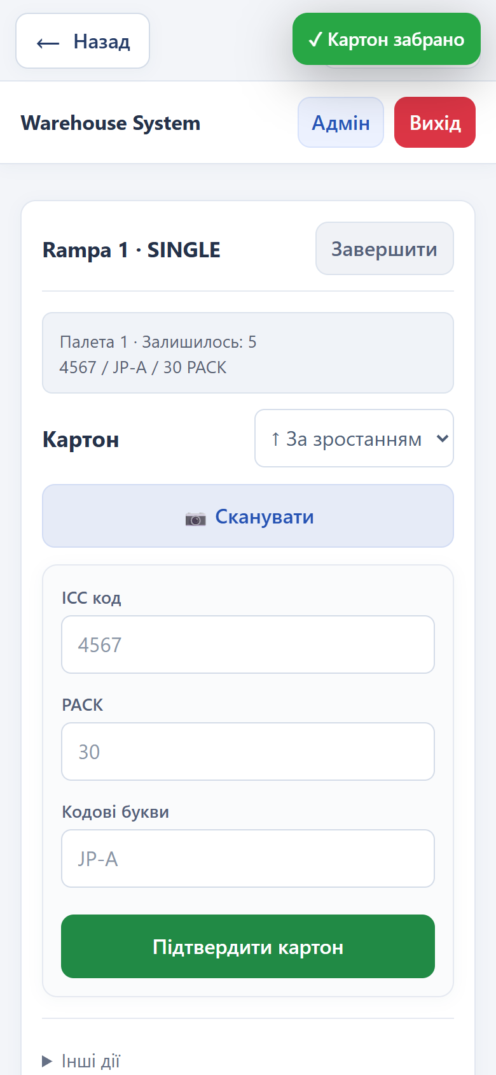
End of work
Worker
"Finish" exits the working scenario.
All confirmed cartons are saved.
Administrator
Closes the entire task when the work is done.
Data and history remain accessible.
Notes:
In One item, after the last source the system reports that the item is fully collected and returns to scanning or manual selection of the next one. Finish for the worker means exiting the personal scenario, not closing the task for everyone. Only the admin closes the entire Sort work; open pallets are closed and confirmed records, balances and history remain.
Source: current Warehouse System code, templates and active client scenarios. Screenshots of the real interface were taken on a separate temporary database; account codes and quantities are demonstration examples.

Slide 15
Saved Pre-sort data
Admin: item list or log of every addition.
Item | Type | Added / PACK | Pallets | Location
4567 JP-A 30 PACK | Single | 13 із 30 | 3 | #1: 6 pcs. #4: 4 pcs. #10: 3 pcs.
Code, PACK, quantity and pallets; search and filters.
This is the unloading summary. Current state is in
the "Movements and balances" section.
Notes:
The Pre-sort cartons section is available during an active Pre-sort and after conversion to Sort. There is an item summary: label data, added vs PACK, progress, pallet count and placement. The log shows each addition with pallet, worker, time and cancellations. Search, type, record status and pages are available. The editable table reproduces the main columns of the real demo screenshot presort-archive-table: 4567 JP-A 30 PACK, 13 cartons added on 3 pallets: 1 — 6, 4 — 4, 10 — 3. This is the initial Pre-sort summary, not the current balance after picking.
Source: current Warehouse System code, templates and active client scenarios. Screenshots of the real interface were taken on a separate temporary database; account codes and quantities are demonstration examples.

Slide 16
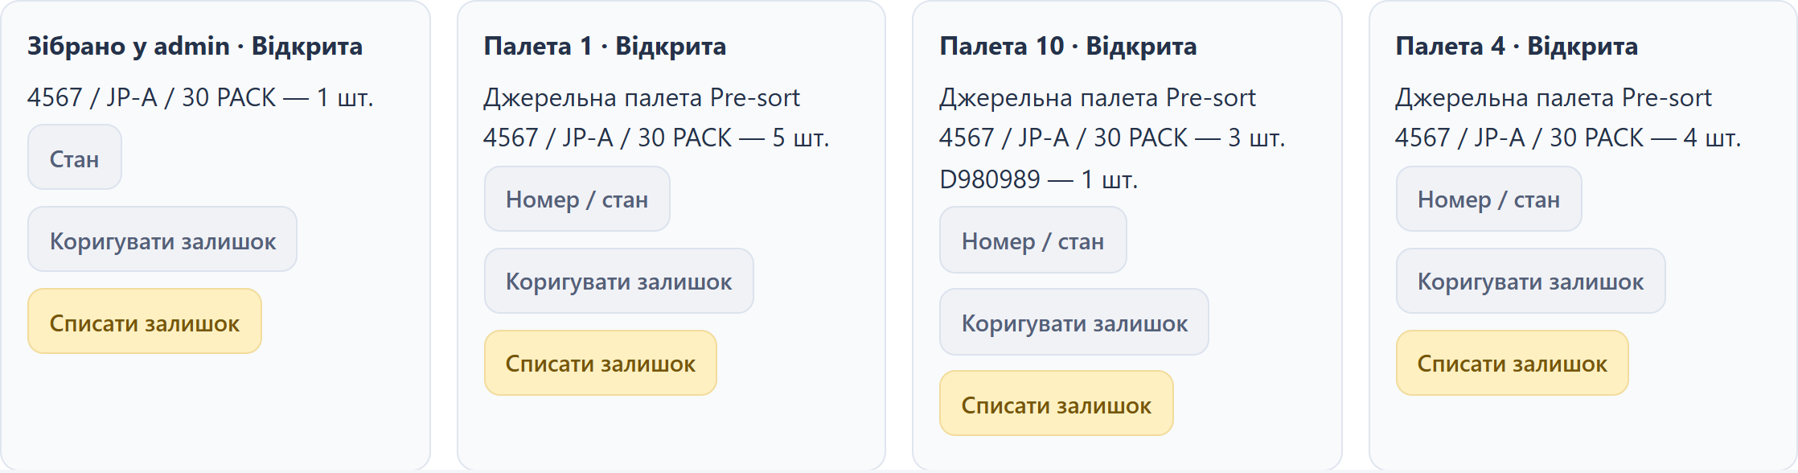
Current movements and balances
What is on the pallets now and what each worker has already collected.
Search by item, pallet or worker.
Notes:
Movements and balances show the current state: expected and collected item quantities, pallets and balance, workers and activity time. Movement history shows time, author, reason and operation. During picking, a carton is subtracted from the source and added to the worker's collected total. The balance is calculated from movements. This state must be distinguished from the initial Pre-sort archive.
Source: current Warehouse System code, templates and active client scenarios. Screenshots of the real interface were taken on a separate temporary database; account codes and quantities are demonstration examples.

Slide 17
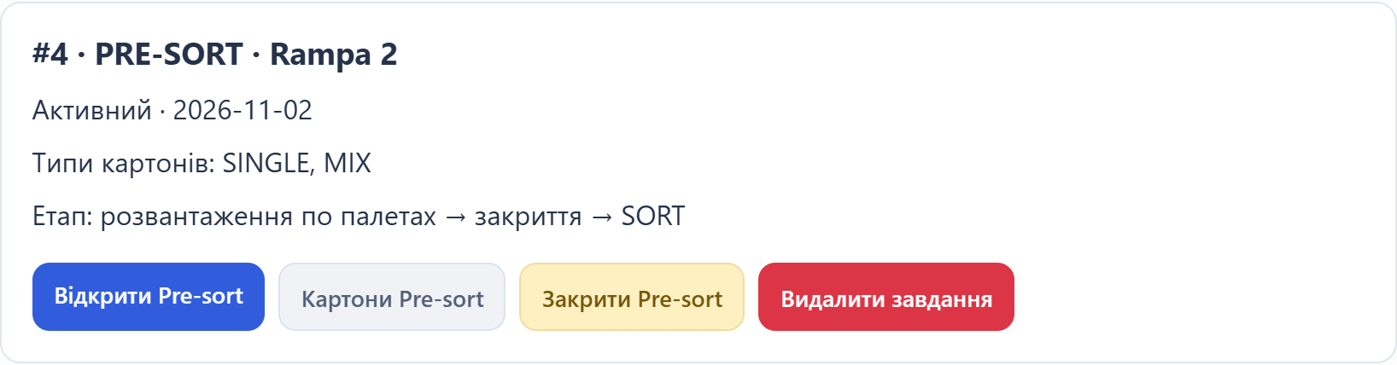
Task and team management
Tasks
Statuses, progress and SORT pallets.
Closing and converting Pre-sort.
Delete after "Yes / No" confirmation.
Users
Account creation, roles, online status
and number of processed cartons.
Notes:
In Sort: items and tasks the admin sees items in progress, completed items, SORT pallets and task creation; there is progress and filters by type and open/closed status. Task statuses can be filtered. An active unfinished task can also be deleted via Yes/No: this is logical hiding while preserving accounting history. In the admin panel you can create a user or admin, see roles, online/offline status, carton counter and registration date, and delete a regular user.
Source: current Warehouse System code, templates and active client scenarios. Screenshots of the real interface were taken on a separate temporary database; account codes and quantities are demonstration examples.

Slide 18
Adjustments and data protection
Administrator control
History preservation
Expected item quantity.
Number and status of a regular pallet.
Addition or write-off with reason.
Undo creates a reverse movement.
Retrying the request does not duplicate a carton.
Picking checks the available balance.
Managed picking has an ICC format validation setting.
Notes:
The administrator can change the expected quantity, number and open/closed status of a regular pallet, add or write off the balance with a reason, and write off the entire pallet balance. The mobile pallet number of a worker is not edited. An allowed movement can be corrected with a compensation and a new movement; sorting operations are not edited directly — use Undo or a separate adjustment. The available balance check is transactional and the request identifier prevents duplicate saving. The ICC format setting for a task currently reads managed One item picking; regular Sort and Pre-sort have their own validation. This should not be presented as a global disabling of checks.
Source: current Warehouse System code, templates and active client scenarios. Screenshots of the real interface were taken on a separate temporary database; account codes and quantities are demonstration examples.

Slide 19
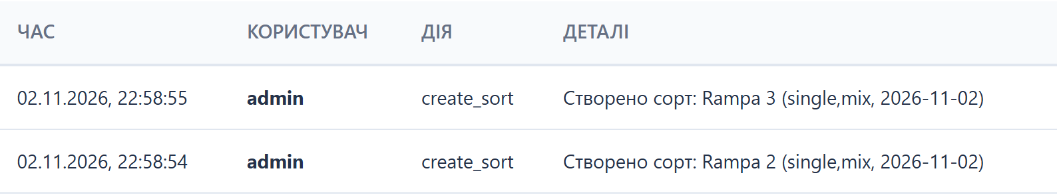
Action logs and OCR
Activity
OCR Logs
Photo, recognised data, result and manual corrections.
Filters by label type, success and date.
Notes:
Activity shows time, user, action and details; there is an overall view and selection of an individual worker. OCR Logs contain the label photo, recognised data, raw OCR, time, user, success/failure and manual corrections. Filters by type and result and date order are available. These are error search and control tools, not an unlimited archive: activity returns up to 100 records, OCR up to 200, movement history up to 1000. The table on the slide is a real action log on temporary data.
Source: current Warehouse System code, templates and active client scenarios. Screenshots of the real interface were taken on a separate temporary database; account codes and quantities are demonstration examples.

Slide 20
Thank you
for your attention!
Questions and discussion.
Warehouse System
Notes:
Thank the audience for their attention and invite questions about registration, working with Pre-sort and Sort, saved data and administration.
Source: current Warehouse System code, templates and active client scenarios. Screenshots of the real interface were taken on a separate temporary database; account codes and quantities are demonstration examples.

