Slide 1

Real world analytics Assessment 2
Student name: Van An Duong
StudentID: 223603395

Slide 2
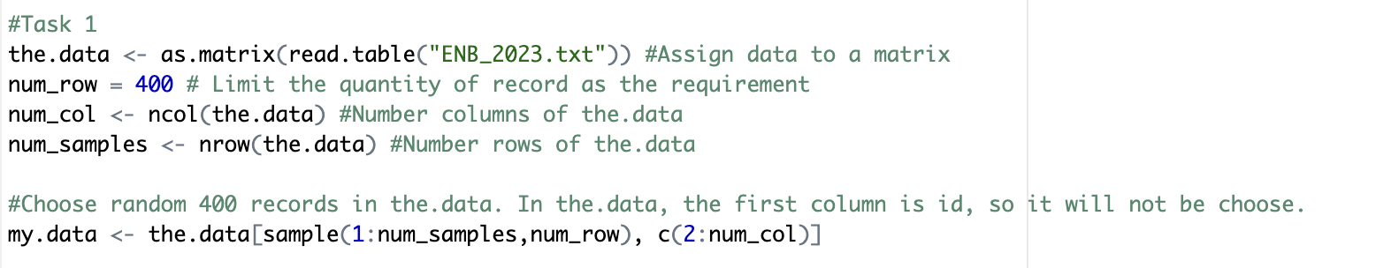
About dataset
The original dataset is data used in Candanedo et al 2017.
400 samples data are used in this assignment to predict home electricity usage through X variables.
Except for the first ID column, there are 6 columns in the dataset, including 5 columns X1, X2, X3, X4, X5 and column Y: X1: Temperature in living room area (Celsius degrees) X2: Humidity in living room area (percentage) X3: Temperature in office room (Celsius degrees) X4: Humidity in office room (percentage) X5: Pressure (millimeter of mercury) Y: Appliances energy consumption (Wh)

Slide 3
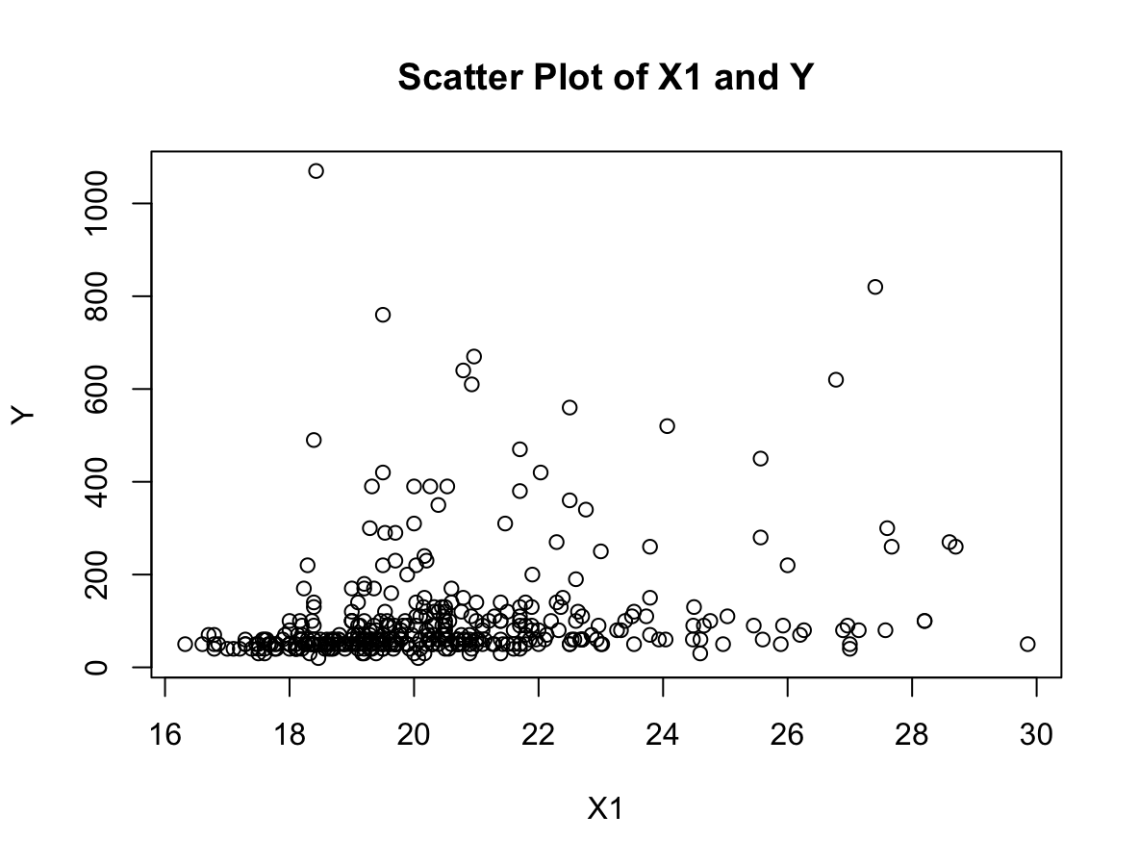
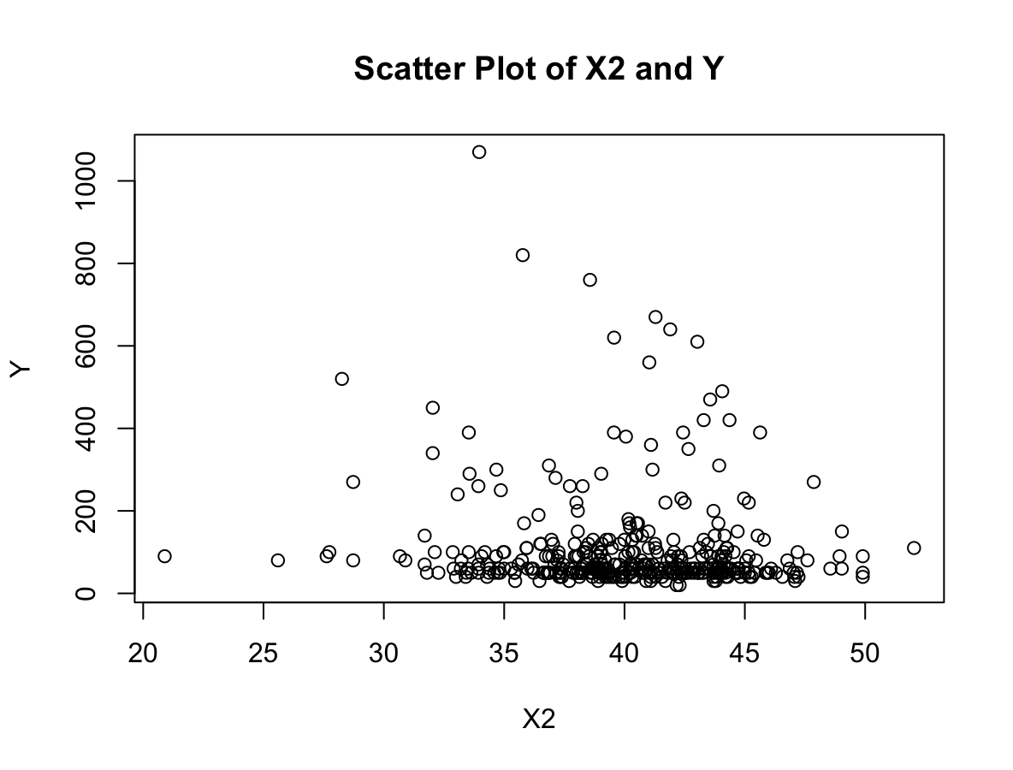
Task 1: Scatter plot of five X with Y Correlations between the variables
Correlation X1 and Y is 0.22691526
Correlation X2 and Y is -0.09273544

Slide 4
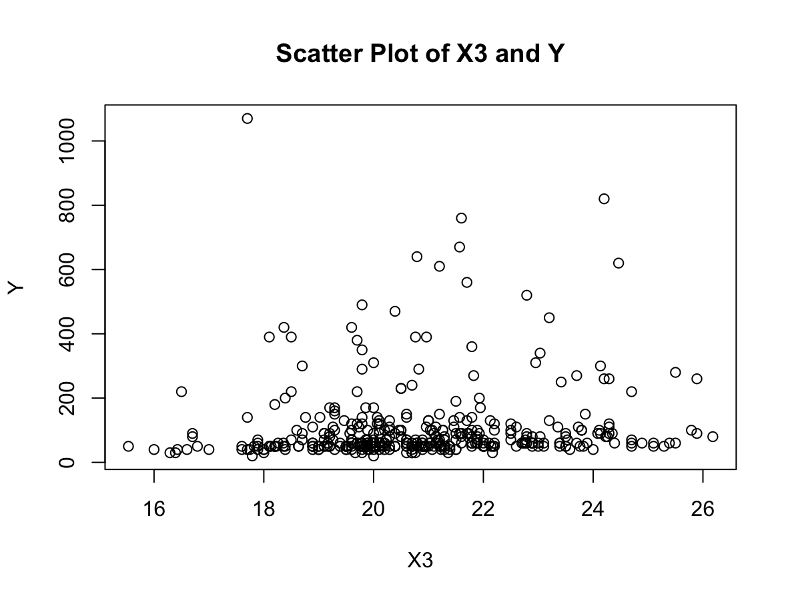
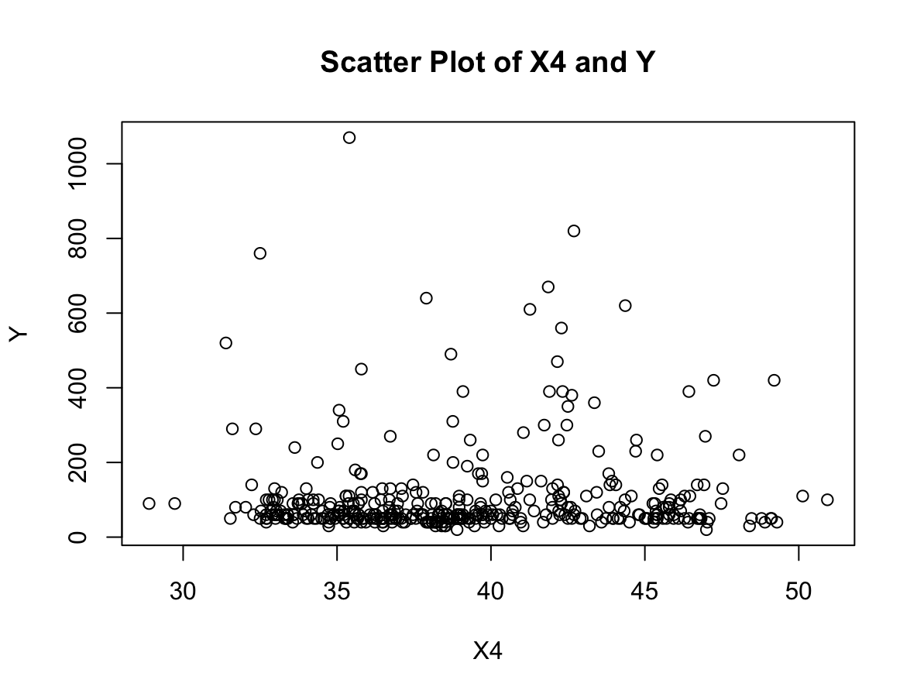
Task 1: Scatter plot of five X with Y Correlations between the variables
Correlation X3 and Y is 0.09493204
Correlation X4 and Y is 0.06363531

Slide 5
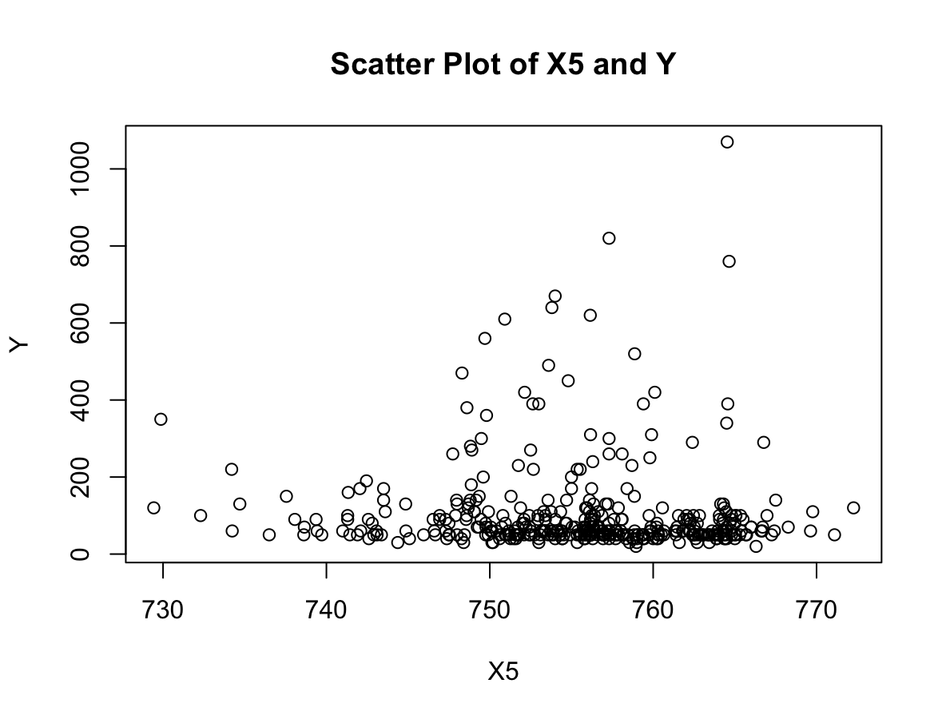
Task 1: Scatter plot of five X with Y Correlations between the variables
Correlation X5 and Y is -0.04648270

Slide 6
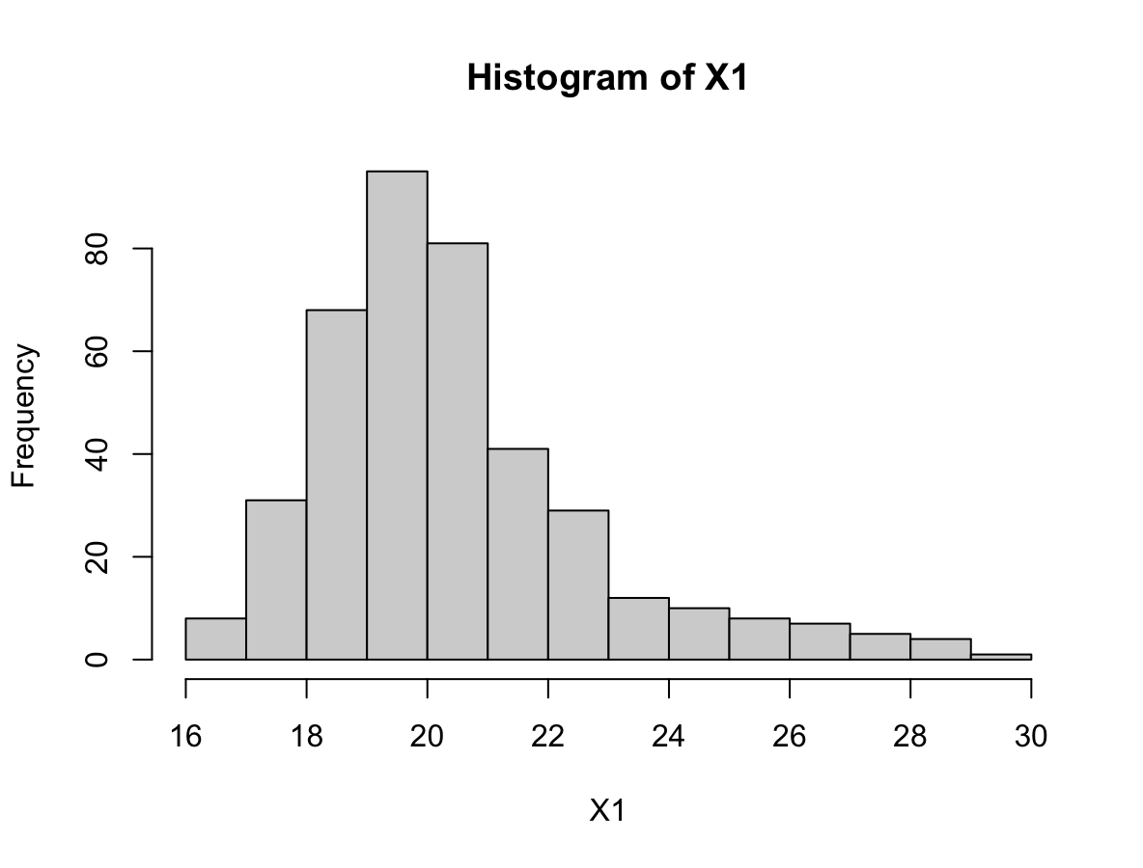
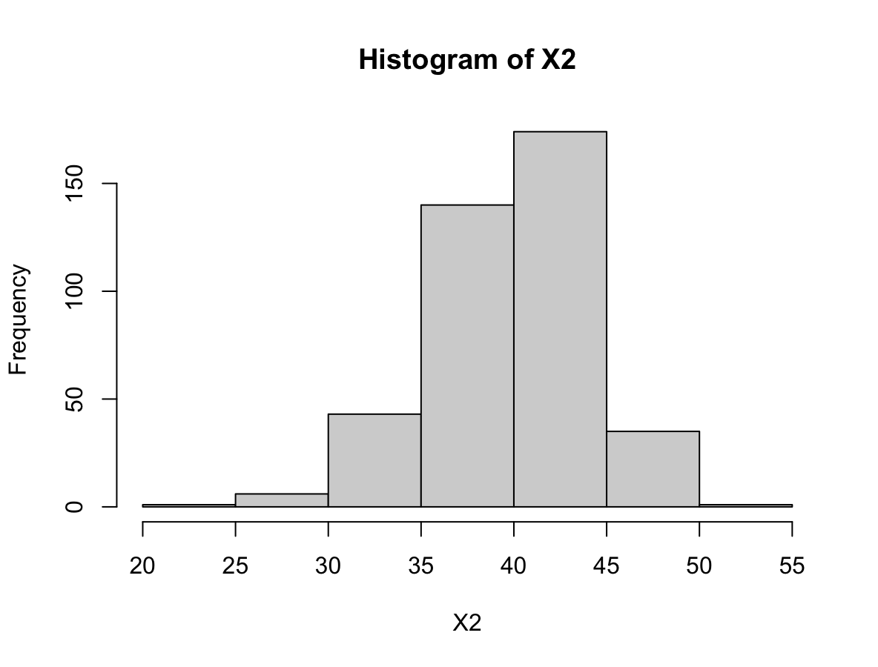
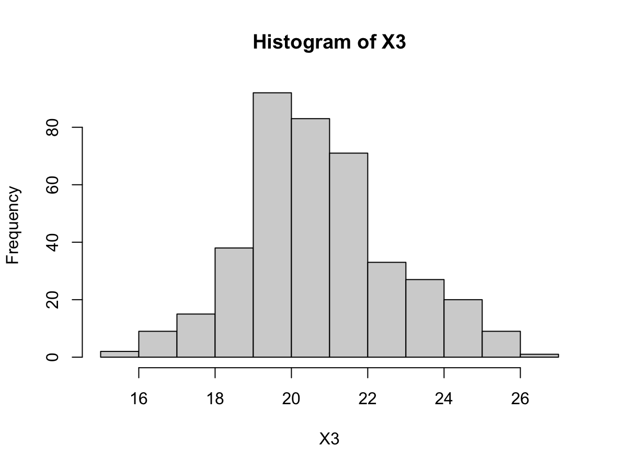
Task 1: Scatter plot of five X with Y Data distribution

Slide 7
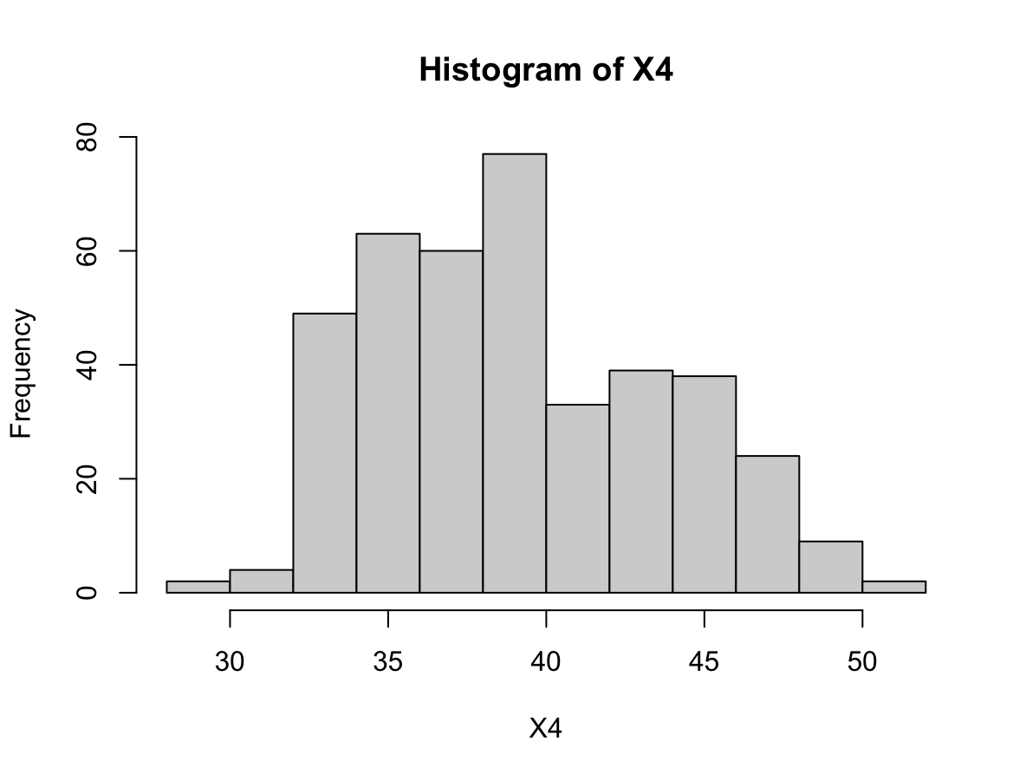
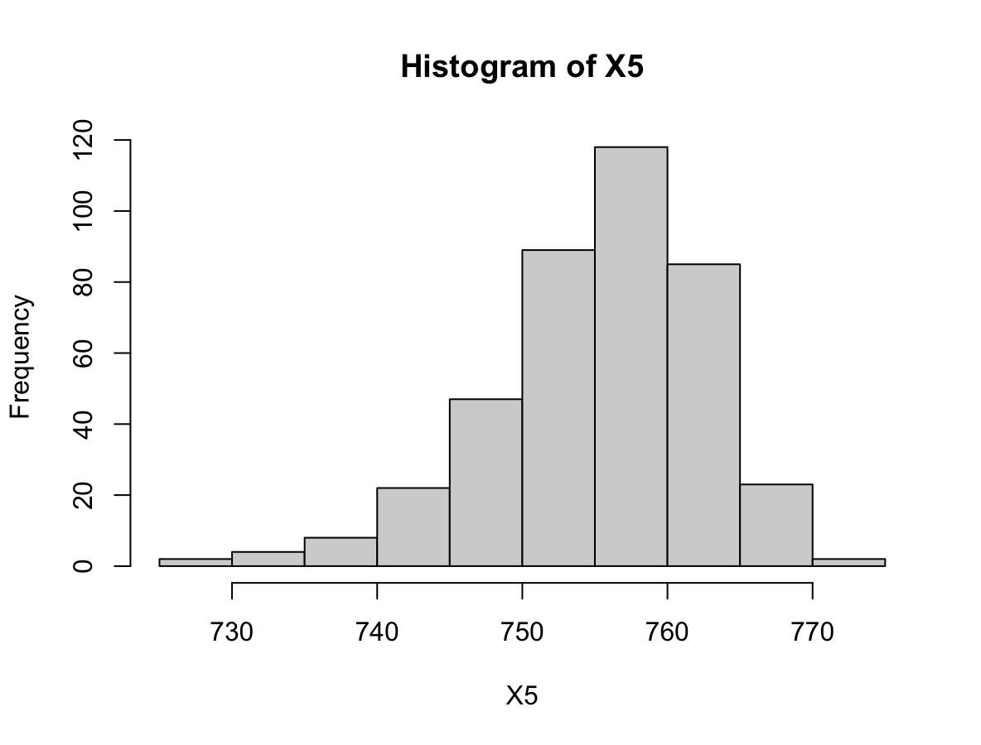
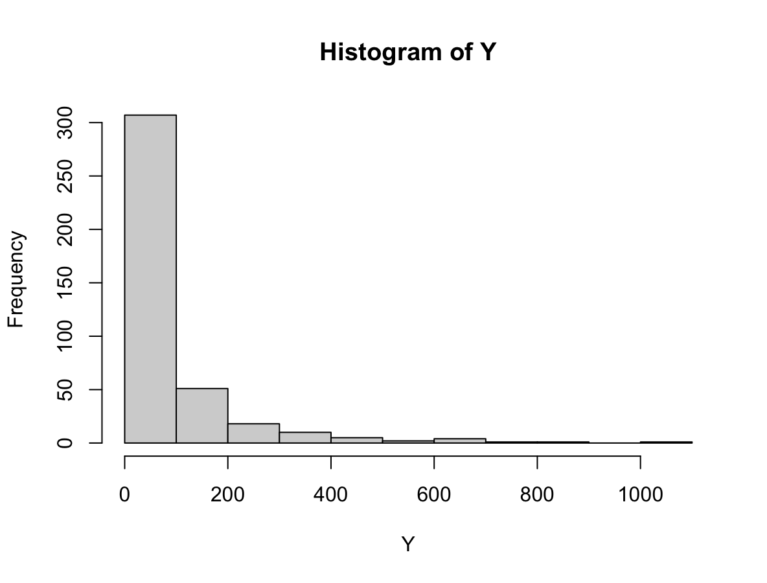
Task 1: Scatter plot of five X with Y Data distribution

Slide 8
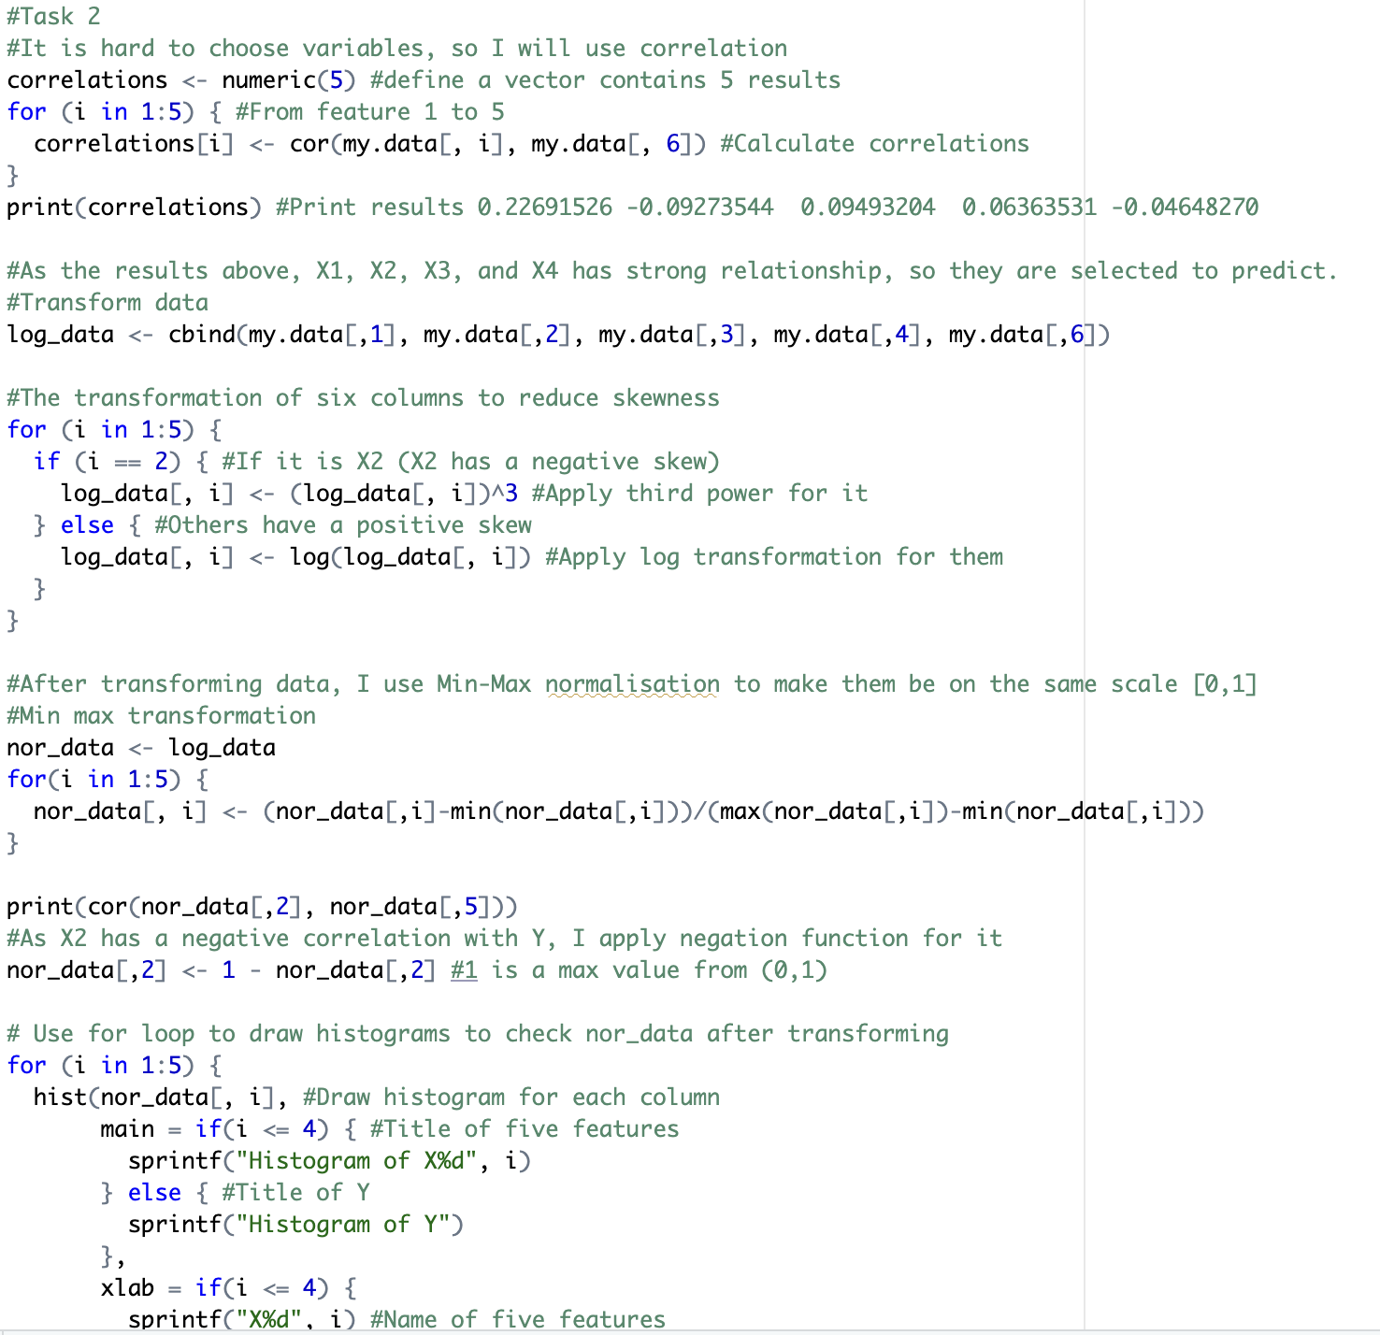
Task 2: Transformation
X1, X2, X3, and X4 are chosen as they have strong relationship with Y
The log transformation will be applied for X1, X3, X4 and Y because they have a positive skew
The third power will be applied for X2 because it has a negative skew
Min max normalization will be used to make all variables on scale [0,1]
As X2 has a negative correlation with Y, a negation function will be applied for it

Slide 9
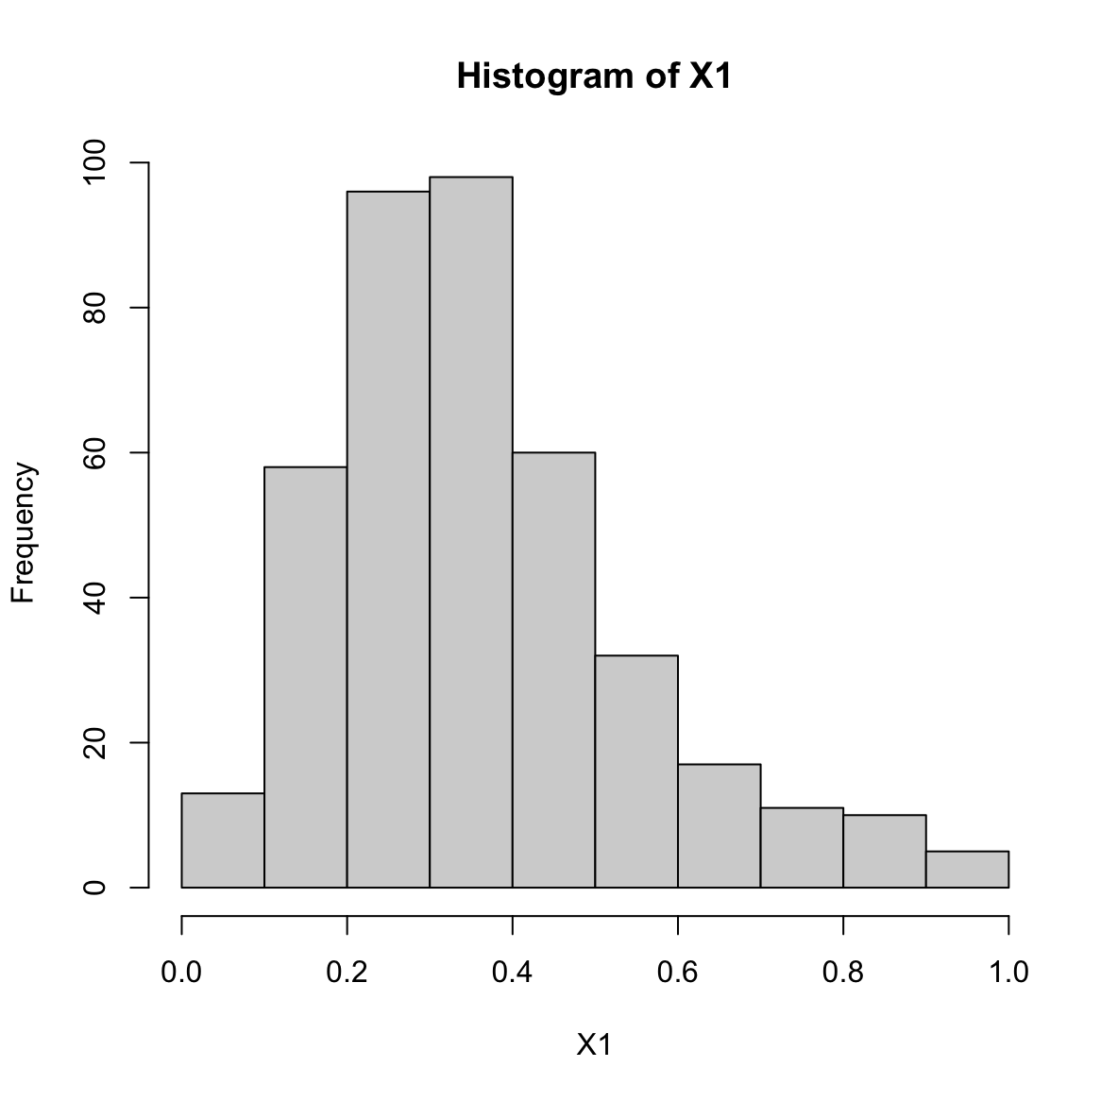
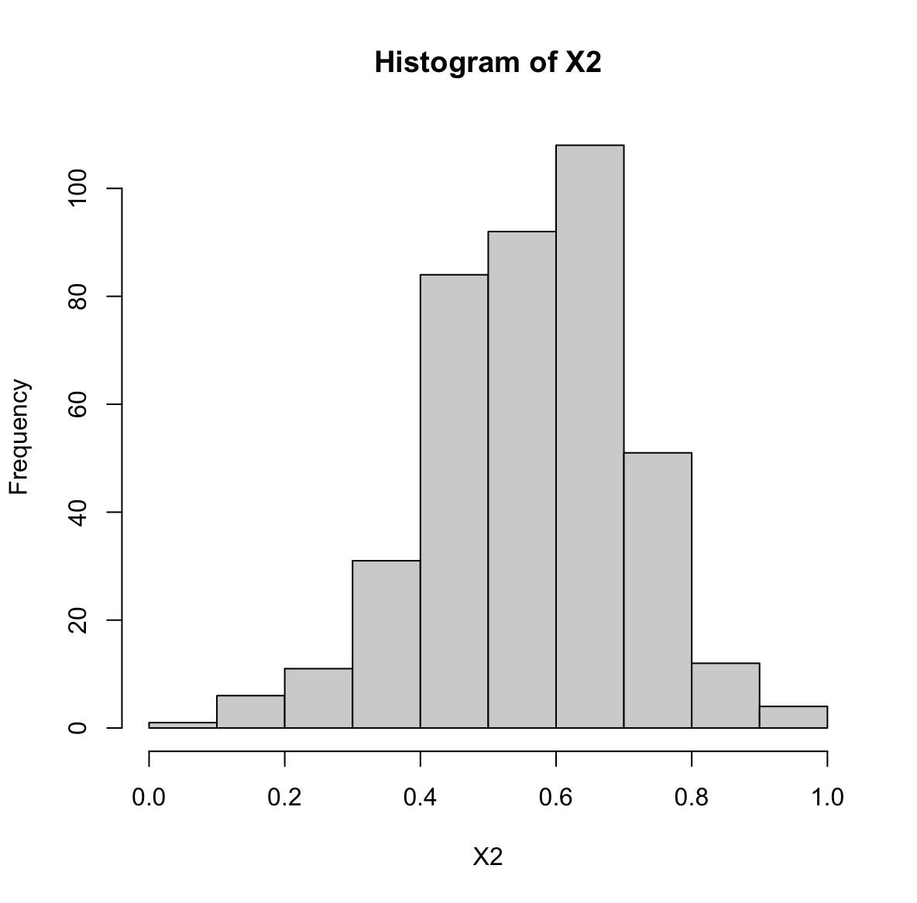
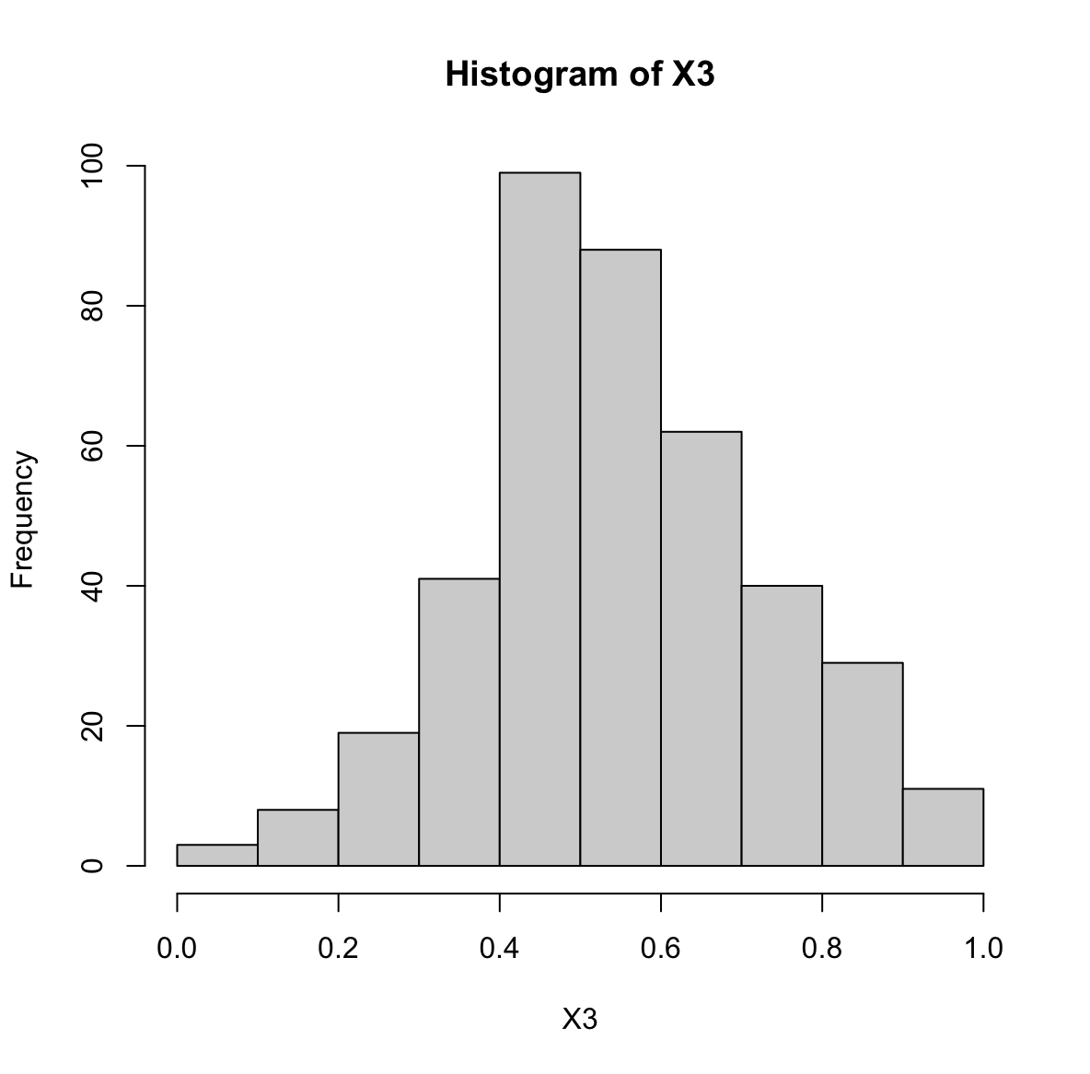
Task 2: Transformation
After transforming

Slide 10
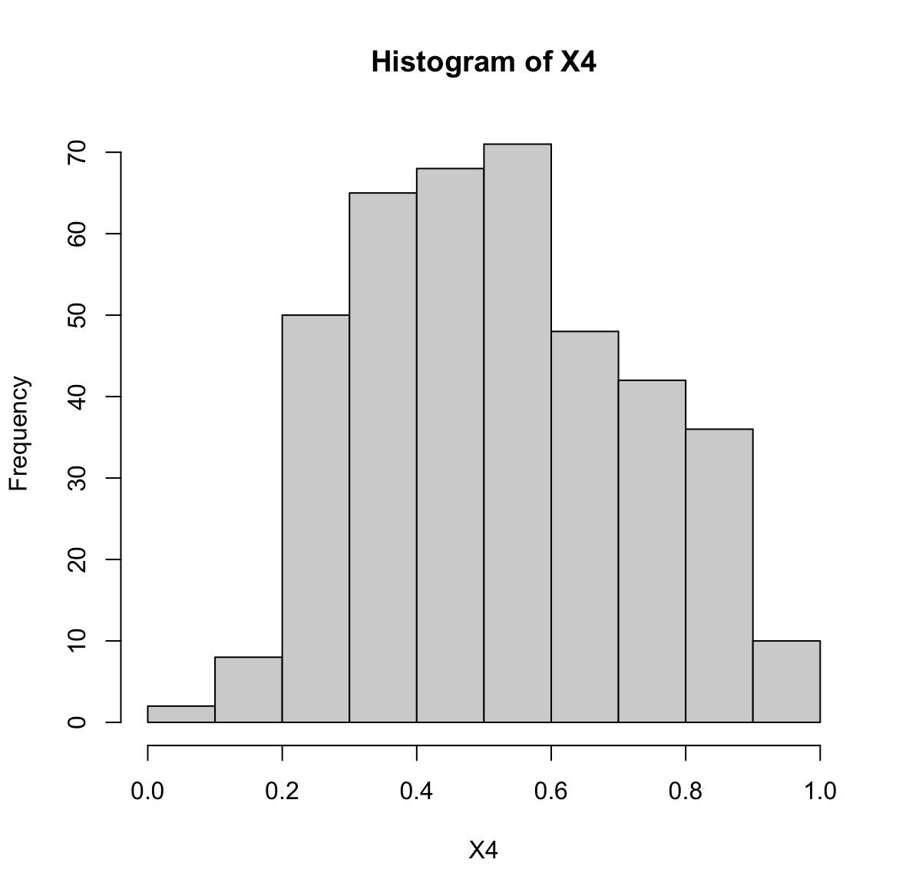
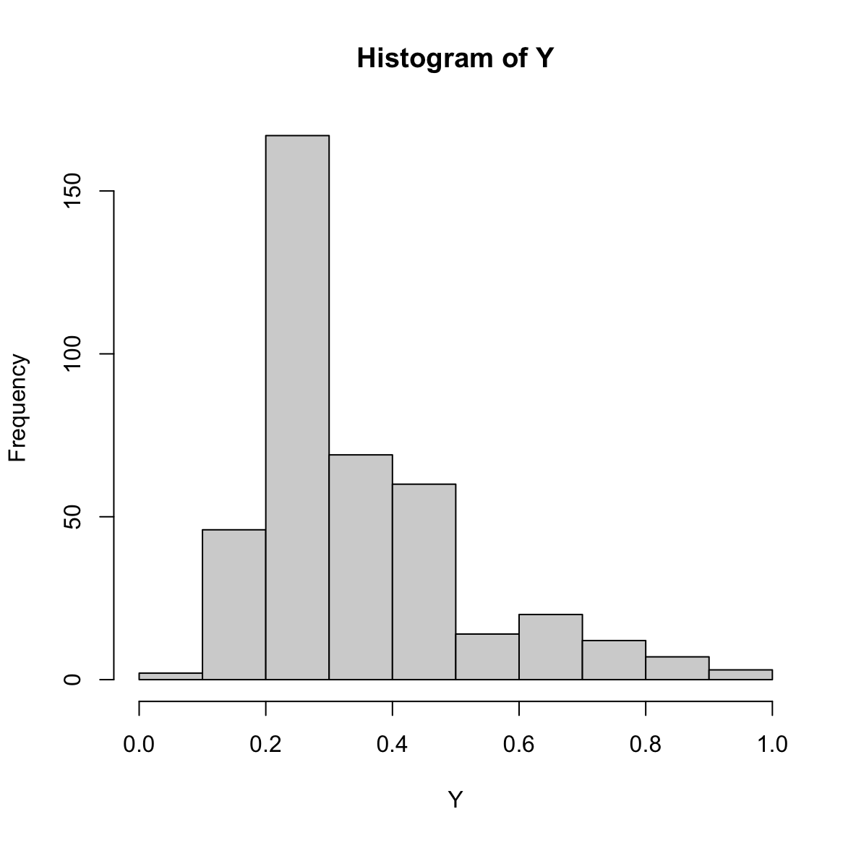
Task 2: Transformation
After transforming

Slide 11
Task 3: Best fitting model
 | WAM | WPM (p = 0.5) | WPM (p = 2) | OWA
RMSE | 0.197701168922134 | 0.196971507881922 | 0.19894112336117 | 0.172272806591901
Av. abs error | 0.14604763803171 | 0.146351535790201 | 0.145068400824675 | 0.126527832140127
Pearson correlation | 0.323744962345102 | 0.326433667149631 | 0.317816328862095 | 0.315793059312208
Spearman correlation | 0.389108561236961 | 0.391337063330759 | 0.387667035381315 | 0.325014950289811
Orness |  |  |  | 0.103107009830362
Table of the error measures and correlation coefficients
OWA has the lowest RMSE, Av. Abs error, Pearson correlation, and Spearman correlation.
OWA is the best fitting model.

Slide 12
Task 3: Best fitting model Important variables based on weights
 | WAM | WPM (p = 0.5) | WPM (p = 2) | OWA
w1 | 0.849157223623278 | 0.79798950194464 | 0.927624710119346 | 0.800547752843707
w2 | 0.150842776376723 | 0.20201049805536 | 0.072375289880652 | 0.0895834648215261
w3 | 0 | 0 | 0 | 0.109868782334779
w4 | 0 | 0 | 0 | 0
Table of weights
The OWA function sorts input from low to high
The lowest input get the highest weight

Slide 13
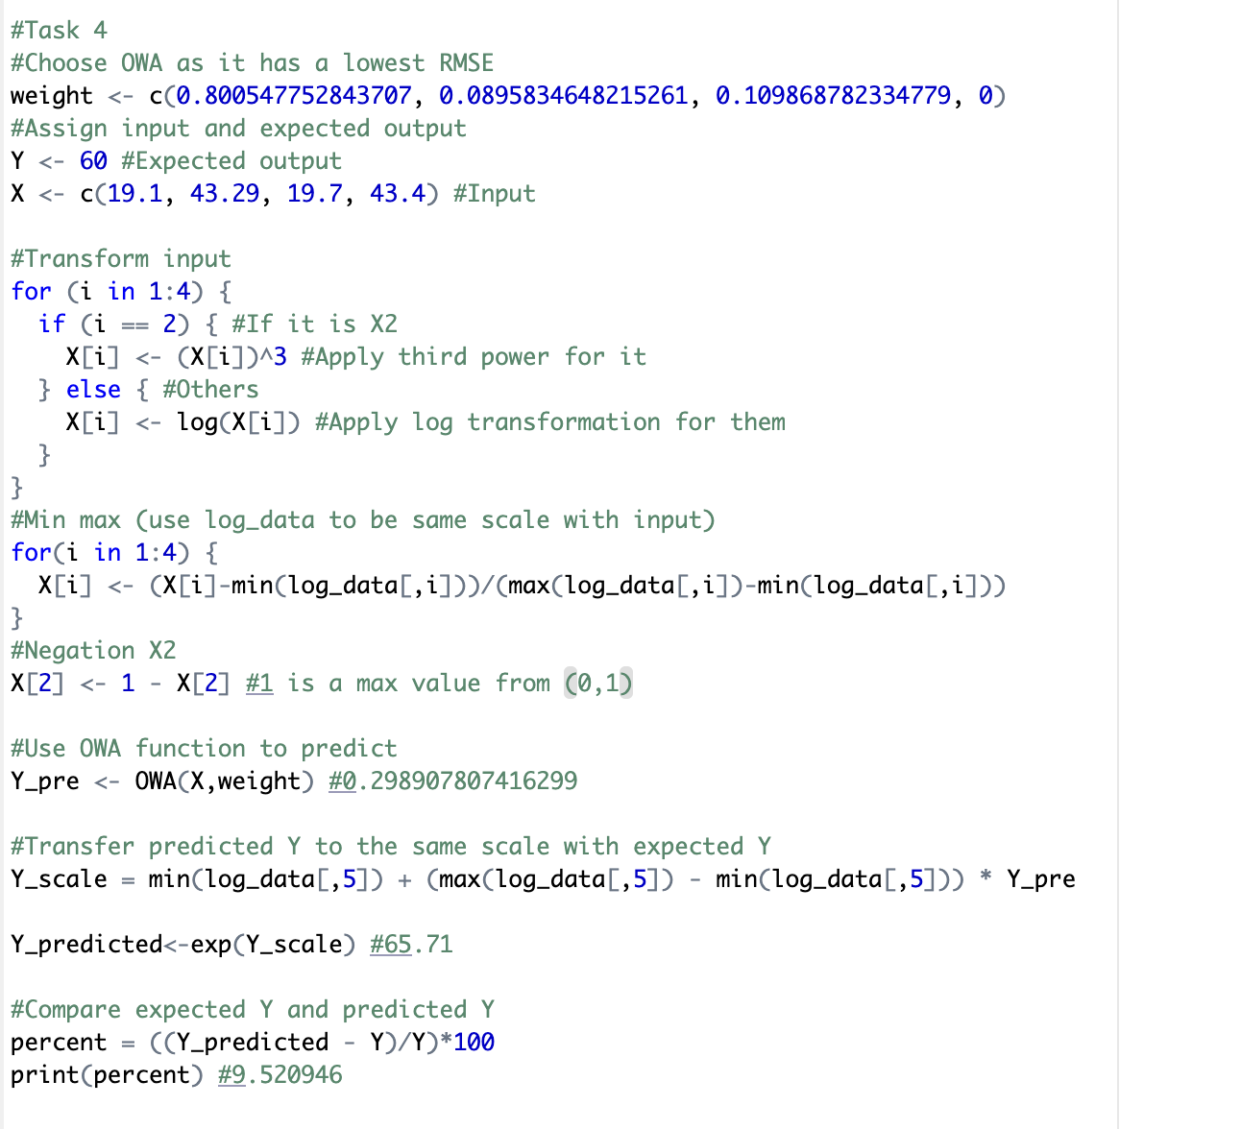
Task 4: Prediction result
The same process in task 2 is applied to handle input data
The OWA function is be applied to predict Y
Predicted Y is transformed back to be the same scale with expected Y
Expected Y is 60, while predicted Y is 65.71
The predicted Y is greater than expected Y approximately 9.52%

Slide 14
Best conditions for a low energy use of appliances
Temperature in living room area should be low (because the correlation is positive)
Humidity in living room area should be high (because the correlation is negative)
Temperature in office room should be low (because the correlation is positive)
Humidity in office room should be low (because the correlation is positive)

Slide 15
Implications and limitations
Implications:
We can flexibly favour higher inputs or lower inputs according to preference on defined function.
The order of inputs does not affect output because the OWA function will sort the order based on our preference.
Limitations:
The OWA can be affected by outliers.

Slide 16
References
Candanedo, L.M., Feldheim, V. and Deramaix, D., 2017. Data driven prediction models of energy use of appliances in a low-energy house. Energy and buildings, 140, pp.81-97.

Slide 17
Thank you for listening

