Slide 1

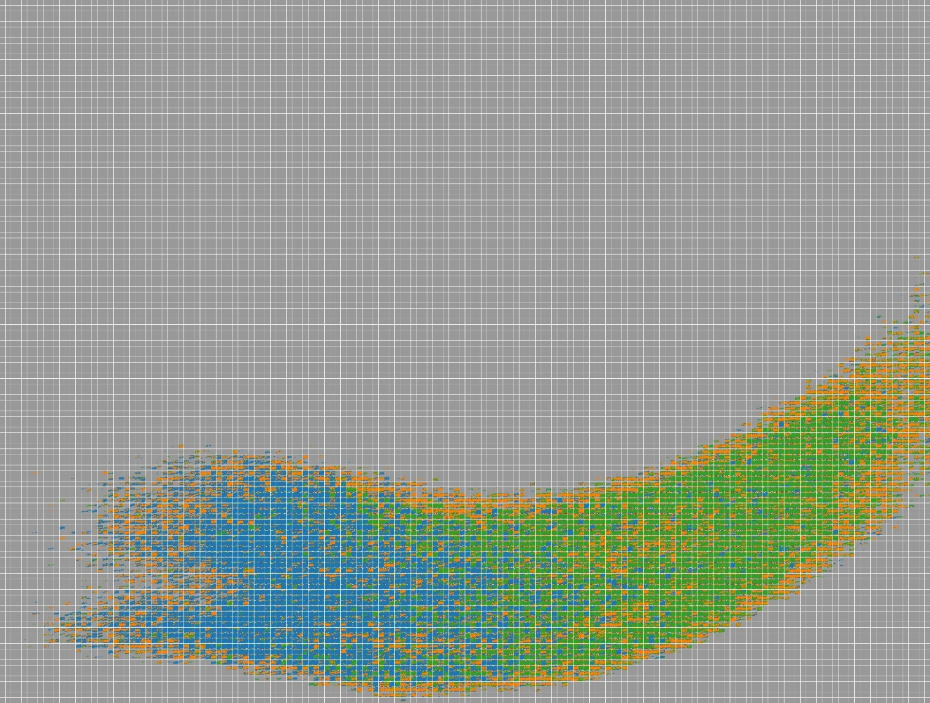
Top 10 Communities
Proximity
Primary
X
Select All
Similarity
Primary
Number of Neighbors
PAS Node-Link Diagram
Lens Size
Zoom Level
Time Barcodes for comparison

Slide 2
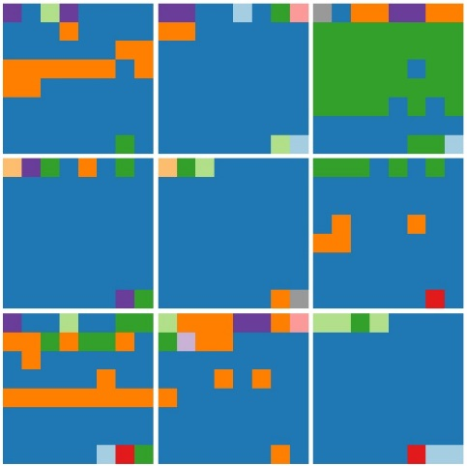
Top 10 Communities
Proximity
Primary
Select All
Similarity
Primary
Number of Neighbors
PAS Node-Link Diagram
Lens Size
Zoom Level
Time Barcodes for comparison

Slide 3
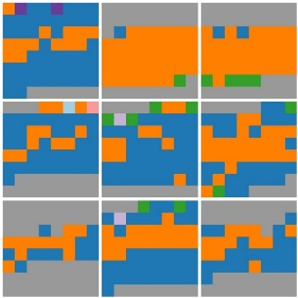
Top 10 Communities
Proximity
Primary
Select All
Similarity
Primary
Number of Neighbors
PAS Node-Link Diagram
Lens Size
Zoom Level
Same zoom level, but different lens size
Time Barcodes for comparison

Slide 4
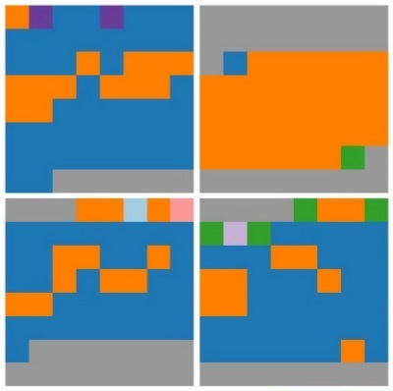
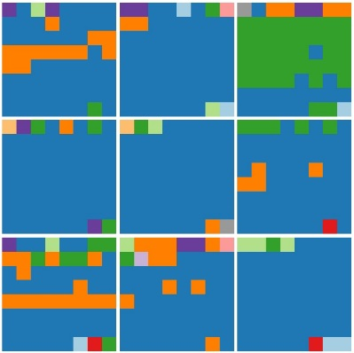
Top 10 Communities
Proximity
Primary
Select All
Similarity
Primary
Number of Neighbors
PAS Node-Link Diagram
Lens Size
Zoom Level
Same lens size, but different zoom level
Time Barcodes for comparison

Slide 5

Top 10 Communities
Proximity
Primary
Select All
Similarity
Primary
Number of Neighbors
PAS Node-Link Diagram
Lens Size
Zoom Level
Time Barcodes for comparison

Slide 6

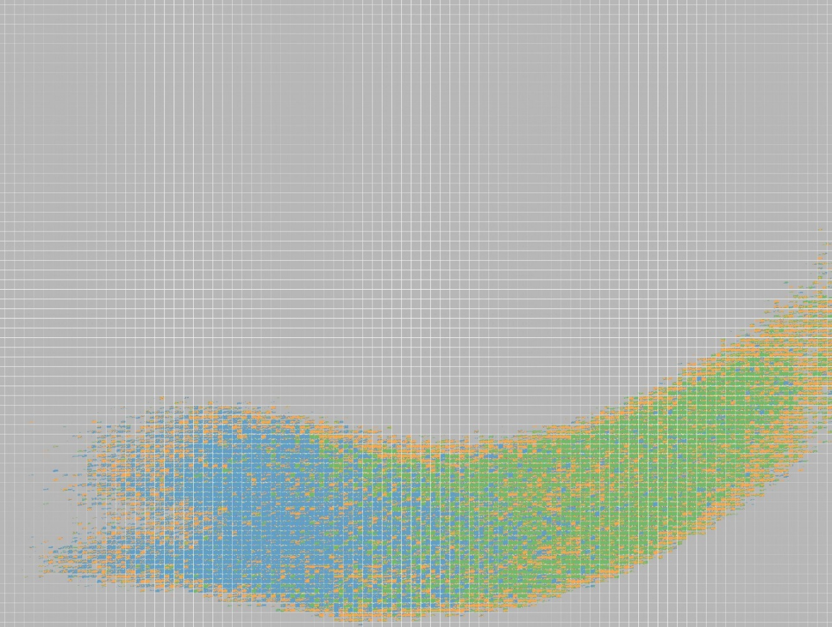





Top 10 Communities
Proximity
X
Primary
Select All
1
Max
Similarity
Primary
0
1
Number of Neighbors
5
Apply
PAS Node-Link Diagram
Lens Size
Zoom Level
Time Barcodes for comparison
Proximity
Similarity

Slide 7
Top 10 Communities
Proximity
X
Primary
Select All
1
Max
Similarity
Primary
0
1
Number of Neighbors
4
Apply
PAS Node-Link Diagram
Lens Size
Zoom Level
Time Barcodes for comparison
Proximity
Similarity

Slide 8
Top 10 Communities
Proximity
X
Primary
Select All
1
Max
Similarity
Primary
0
1
Number of Neighbors
5
Apply
PAS Node-Link Diagram
Lens Size
Zoom Level
Parallel Coordinates

Slide 9
Combine Temporal Similarity with Spatial Proximity
Discover interesting members
Expected – nodes have high similarity to the nodes far in the distance
Unexpected – nodes have low similarity to the nodes close in the distance
Noise
How to discover interesting members
Expected: observe first, then auto-detection (semi-autodetection)
Unexpected: observe first, then auto-detection (semi-autodetection)
Noise: manually or auto-detection

Slide 10
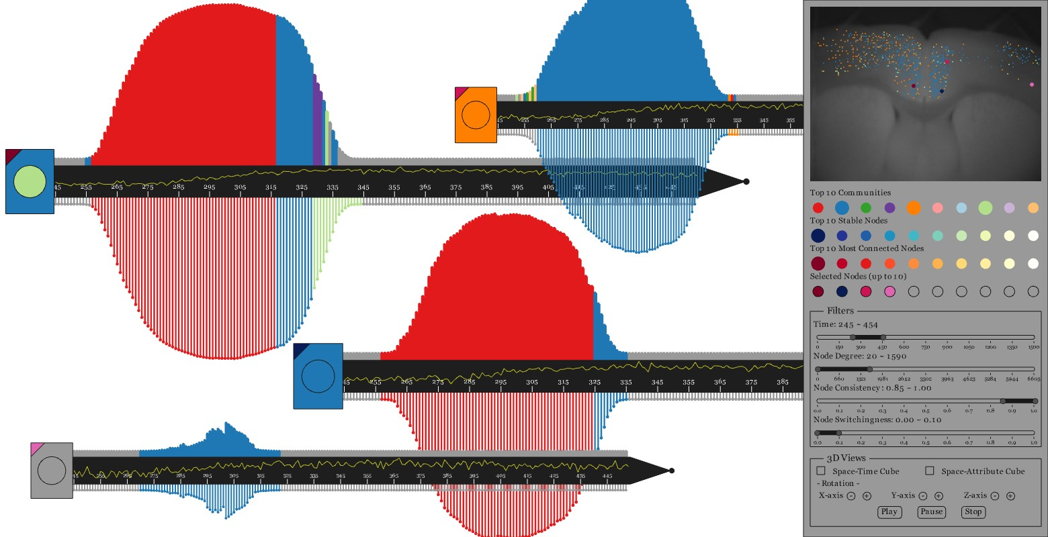
SwordPlots – Overview

Slide 11
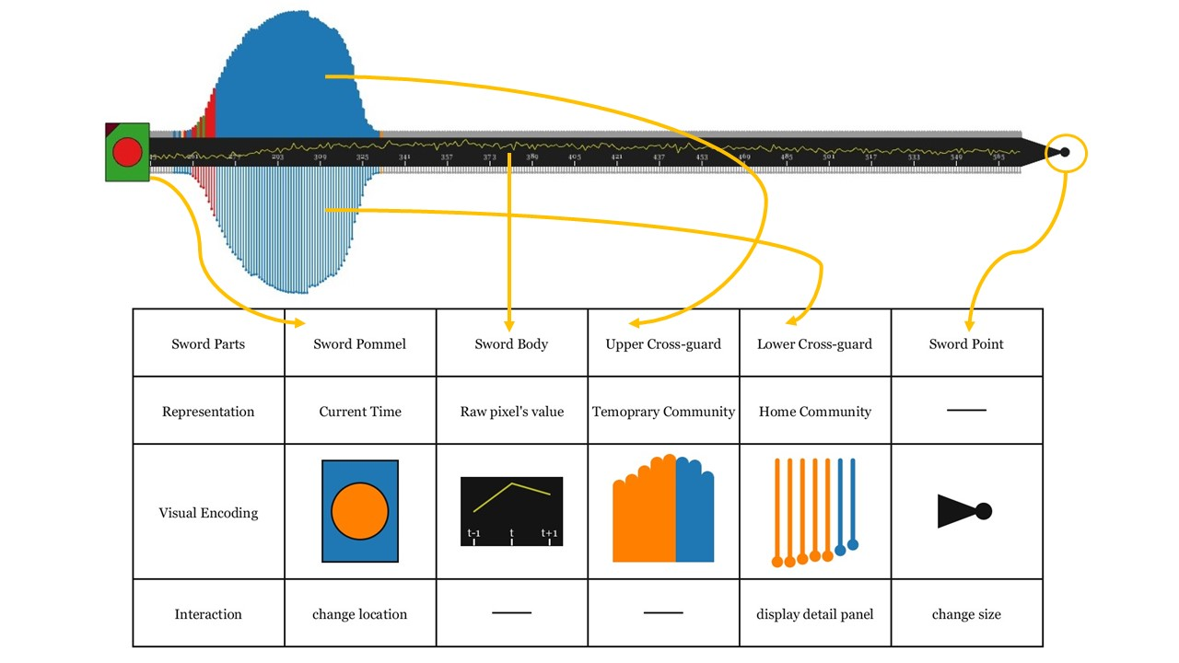
SwordPlot

Slide 12
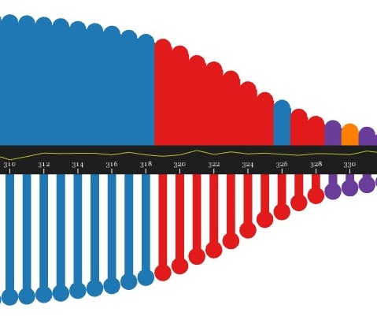
SwordPlot – Zoom In

Slide 13
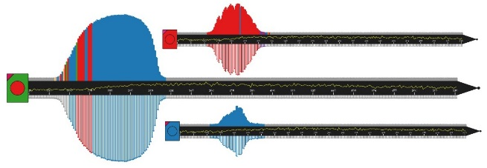
Top 10 Communities
Proximity
X
Primary
Select All
1
Max
Similarity
Primary
0
1
Number of Neighbors
5
Apply
Leave the space for SwordPlots
Lens Size
Zoom Level
PAS Node-Link Diagram

