Slide 1

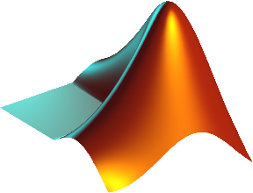
The flow of Filter
START
COUNTER
RAM
The order of being processed pixel
oImageTest.txt
64x64 Grayscale
Image (noised)
PRE_ADDR
DECODER
The address of 9 pixels (3x3 window) that being processed.
The starting row and column of the 3x3 window that being processed.
ADDR
DECODER
The grayscale of 9 pixels, corresponding to the input addresses
FILTER
(MEDIAN/RANK-ORDER)
The value of pixel that is filtered
result.txt
FIFO
The 64x64 grayscale image that was filtered
FINISH
Error Calculation

Slide 2
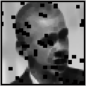
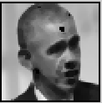
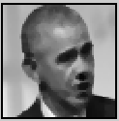
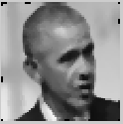

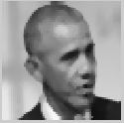
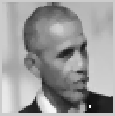
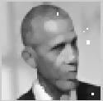
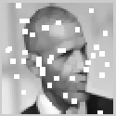
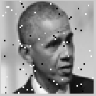
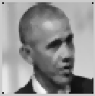
Result
 | 1 | 2 | 3 | 4 | 5(MEDIAN) | 6 | 7 | 8 | 9
SSMI | 0.32 | 0.56 | 0.63 | 0.88 | 0.92 | 0.93 | 0.84 | 0.76 | 0.47
SSMI = ~ 0.9275
Input noise Image | Filtered Image Using Matlab Function

