Slide 1
Predicting Heart Rate from PPG* sensor data
By Peter Crowder
*Photoplethysmography

Slide 2
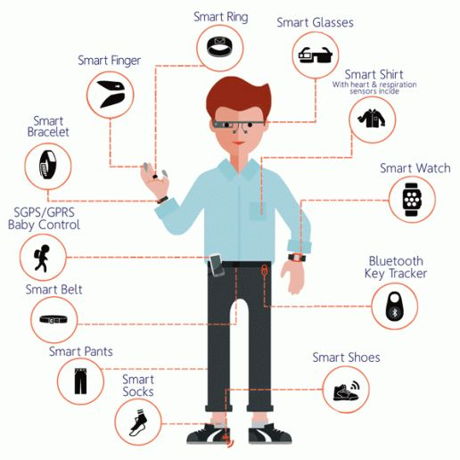
Industry : Wearable sensors
Wearable technology (e.g.):
Smart phone
Wrist (fit-bit, apple watch)
Google glass
Measures(e.g.):
Step counter
Heart rate
Blood [O2]
Sleep quality
US market estimated at $14B in 2020

Slide 3

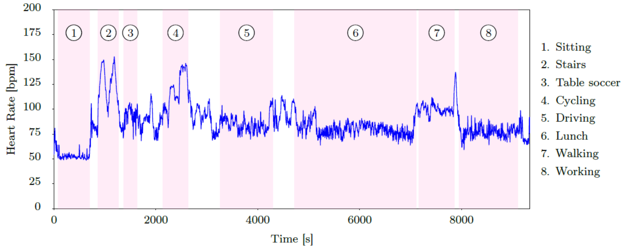
Data Set: PPG-DaLiA
Total measurements: 8.3M
Study participants: 15
Measurement duration: ~2.5hr
Monitored During Various Tasks:
[1] A. Reiss, I. Indlekofer, P. Schmidt, and K. Van Laerhoven, “Deep PPG: Large-Scale Heart Rate Estimation with Convolutional Neural Networks,” Sensors, vol. 19, no. 14, p. 3079, Jul. 2019, doi: 10.3390/s19143079.

Slide 4
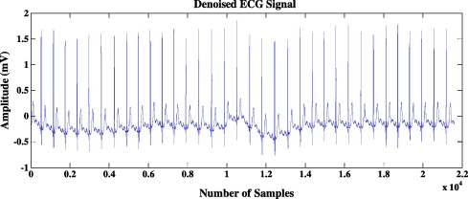
Sensors
Chest (RespiBAN):
ECG
X-Y-Z Accelerometer
Respiration Rate
Wrist (Empatica E4):
PPG (64 Hz)
X-Y-Z Accelerometer (32 Hz)
Electrodermal Activity (4 Hz)
Skin Temperature (4 Hz)
HR1
HR2
HR3
Other Data Collected:
Weight
Gender
Age
Height
Skin type
Fitness level

Slide 5
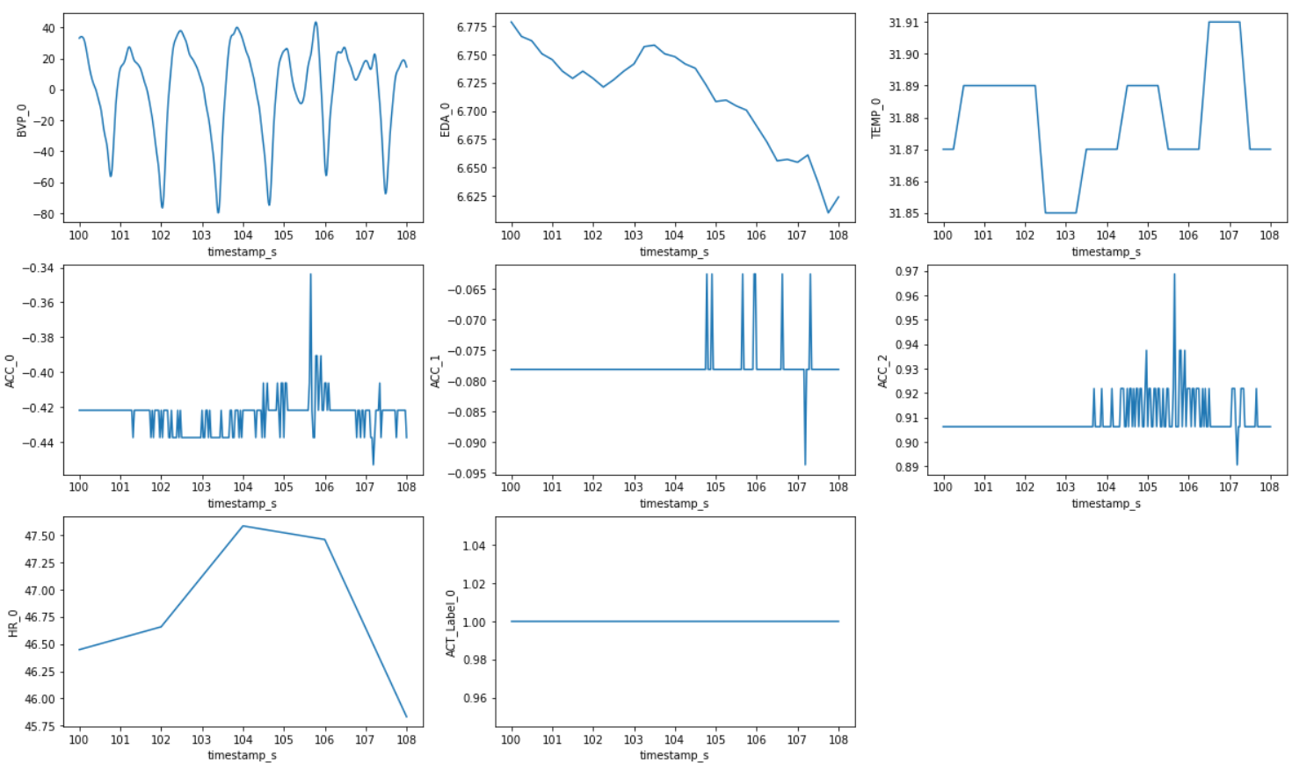
Raw Data

Slide 6
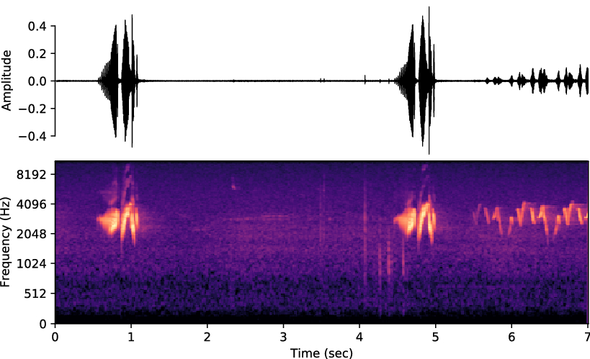
Data Processing
Large Reduction in Size of Data:
Ground truth heart rate at 0.5Hz
Total of 65K heart rates
Need a method for encoding the high frequency sensor data over a window into a feature for ML
Solution: FFT-(Fast Fourier transform)

Slide 7
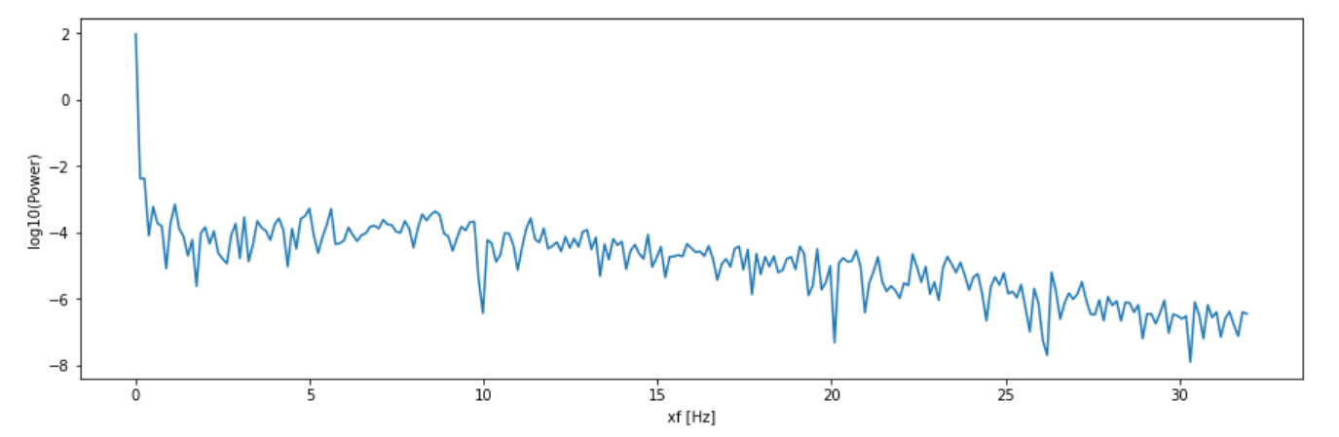
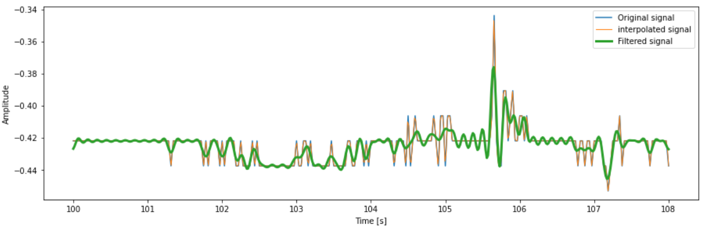
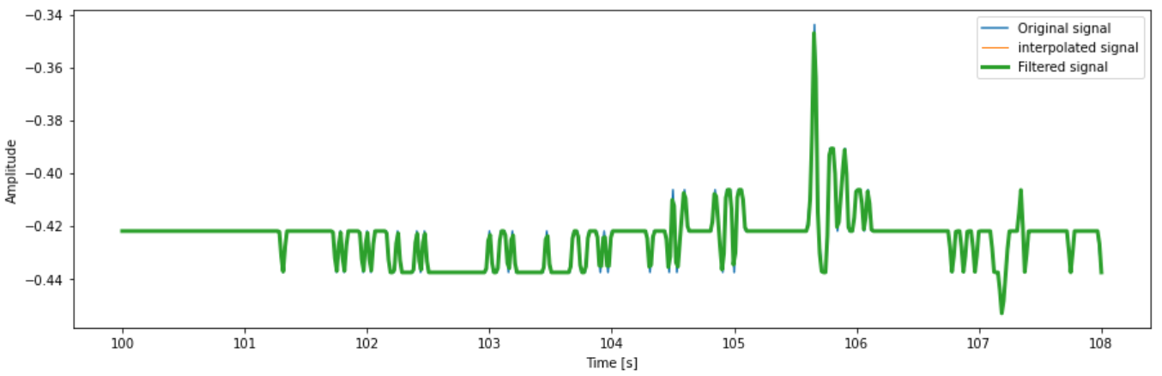
Data Processing
Brick-Wall filter
Brick-Wall filter:
Removes high frequency components
Reduces dimensionality
Freq. bins: 275 -> 65

Slide 8
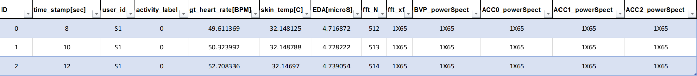
Data Processing
Classes:
y_class
Label: y
Flatten: X
NX1
NX1
NX262

Slide 9
Data Processing (CNN)
Concat for stratification
Label: y
Pack each row into ‘fingerprint’ array: X
1x65
NX1
NX1
X
Nx5x65
1x65
1x65
1x65
1x65

Slide 10
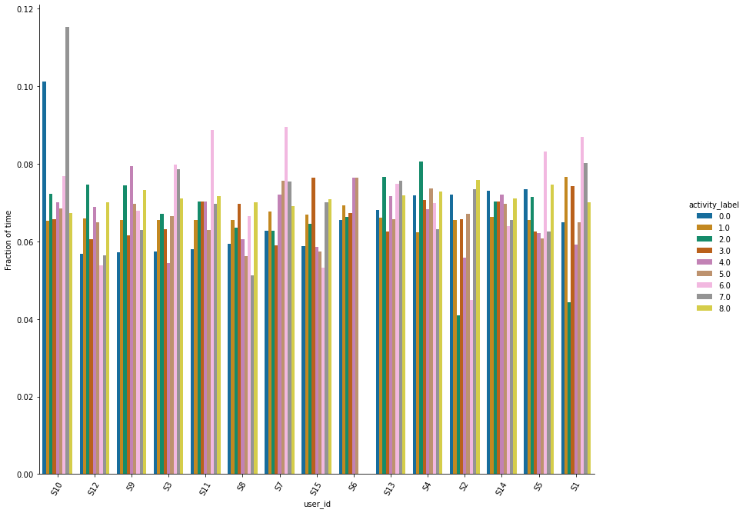
Data Splitting
(X_train, X_test, y_train, y_test) = train_test_split(X, y,
test_size=0.15,
stratify=y_class)
len(X) = 64,697
len(X_test) = 9,705
len(X_train) = 54,992
len(X_learn) = 46,743
len(X_val) = 8,249

Slide 11
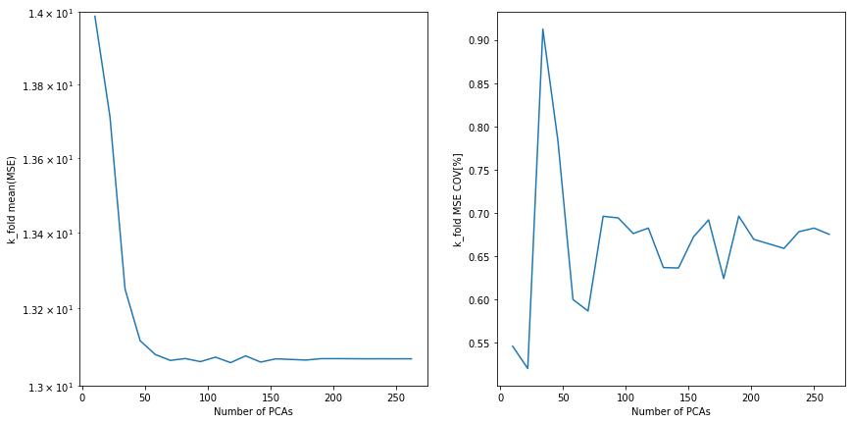
Traditional Machine Learning:
LinearRegression
Pipeline:
PCA
MinMaxScaler
ML_Algorithm
LinearRegression:
MAE = 13.01[BPM]
SVM:
MAE = 9.64[BPM]
RandomForestRegressor:
MAE = 10.77[BPM]
cross_validate(X_train, y_train, k=5)
Metrics:
MSE
MAE

Slide 12
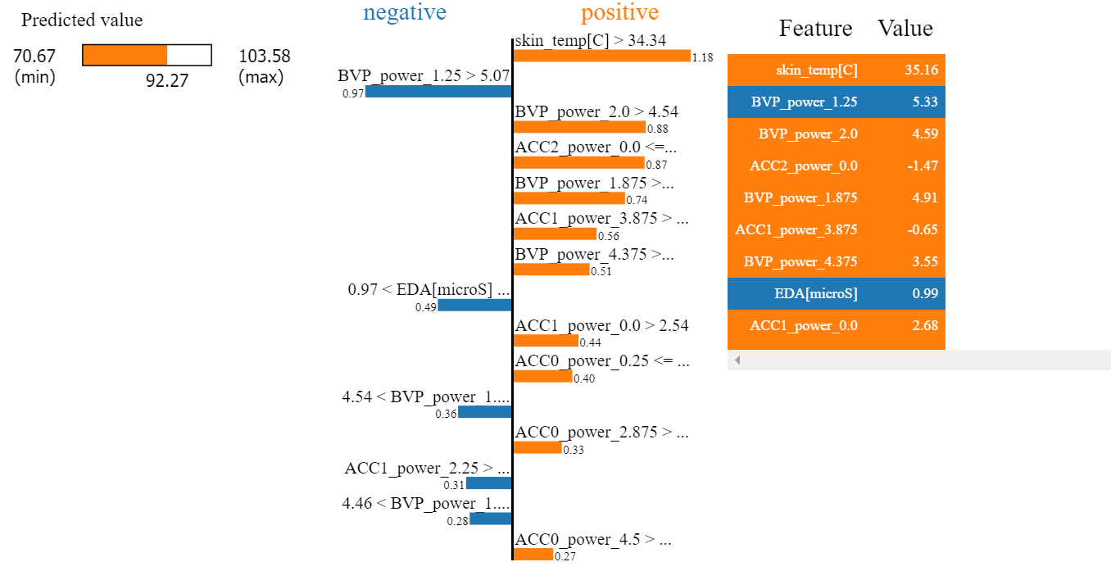
Model Interpretation: SVM

Slide 13
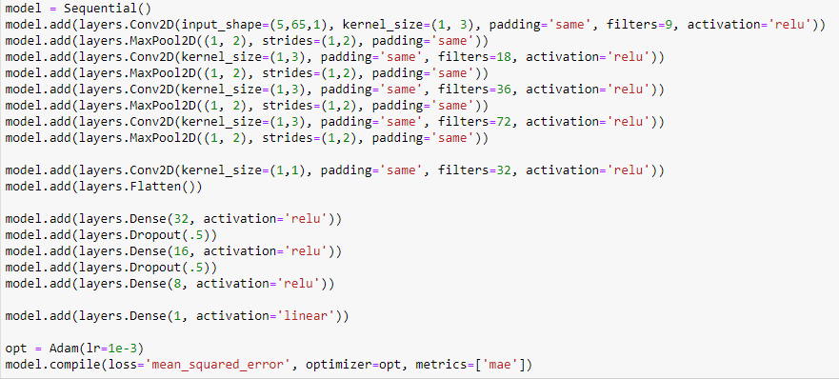
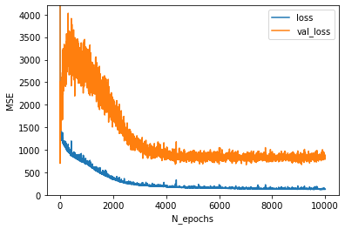
Convolutional Neural Network (CNN)
Starting with a architecture similar to Reiss et al. with some added complexity
[1] A. Reiss, I. Indlekofer, P. Schmidt, and K. Van Laerhoven, “Deep PPG: Large-Scale Heart Rate Estimation with Convolutional Neural Networks,” Sensors, vol. 19, no. 14, p. 3079, Jul. 2019, doi: 10.3390/s19143079.
Test MAE = 24.8[BPM]

Slide 14
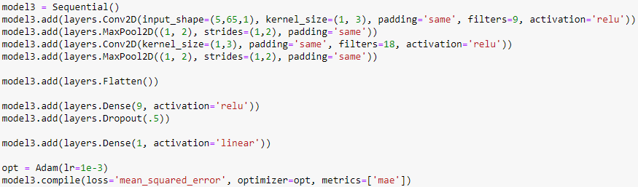
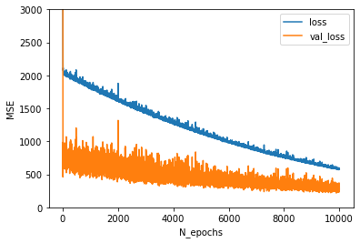
Convolutional Neural Network (CNN)
Simplify the network a to try to remove over fitting
Test MAE = 10.5[BPM]

Slide 15
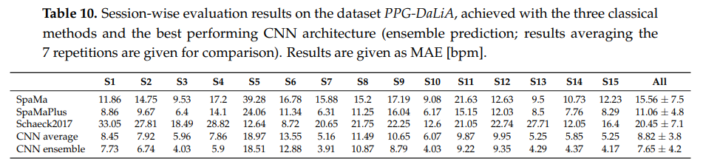
Comparison to Benchmark
 | LinearRegression | SVM | RandomForestRegressor | CNN
MAE [BPM] | 13.01 | 9.64 | 10.77 | 10.5
[1] A. Reiss, I. Indlekofer, P. Schmidt, and K. Van Laerhoven, “Deep PPG: Large-Scale Heart Rate Estimation with Convolutional Neural Networks,” Sensors, vol. 19, no. 14, p. 3079, Jul. 2019, doi: 10.3390/s19143079.

Slide 16
Conclusion + Possible Improvements
Conclusions:
CNN seemed well suited to this problem
While a tree based regression method may work these generally execute quite slow.
Improvements
Incorporating several ‘windows’ of data to add the temporal dimension
Tracking problem
More optimized CNN architecture
More training time for CNN

