Slide 1
Potted History of
Programming Languages
CS 345
Vitaly Shmatikov
slide <number>

Slide 2
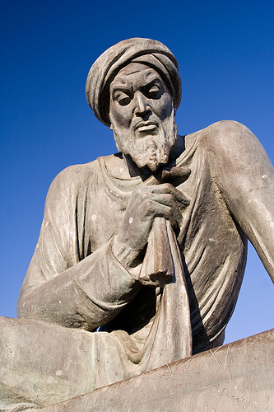
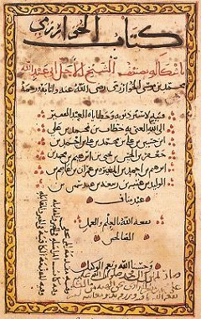
Algorithm
Abu Ja’far Muhammad ibn Musa
al-Khorezmi (“from Khorezm”)
  Lived in Baghdad around 780 – 850 AD
  Chief mathematician in Khalif Al Mamun’s “House of Wisdom”
  Author of “A Compact Introduction To Calculation Using Rules Of Completion And Reduction”
Removing negative units from the equation by adding the same quantity on the other side (“al-gabr” in Arabic)
slide <number>

Slide 3
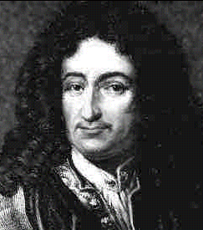
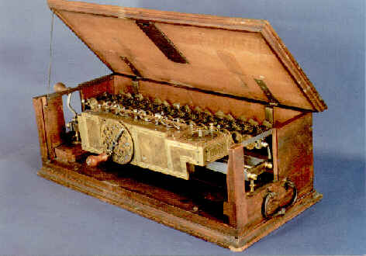
“Calculus of Thought”
Gottfried Wilhelm Leibniz
  1646 - 1716
  Inventor of calculus and binary system
  “Calculus ratiocinator”: human reasoning can be reduced to a formal symbolic language, in which all arguments would be settled by mechanical manipulation of logical concepts
  Invented a mechanical calculator
slide <number>

Slide 4
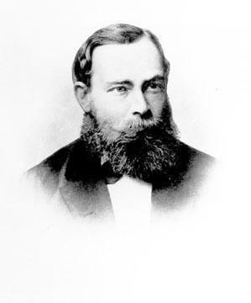
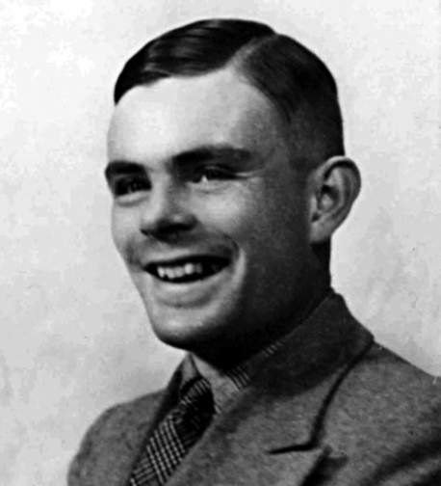
Formalisms for Computation (1)
Predicate logic
  Gottlöb Frege (1848-1925)
  Formal basis for proof theory and automated theorem proving
  Logic programming
    Computation as logical deduction
Turing machines
  Alan Turing (1912-1954)
  Imperative programming
    Sequences of commands, explicit state transitions, update via assignment
slide <number>

Slide 5
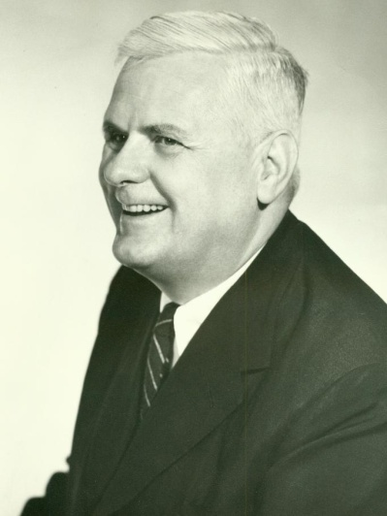
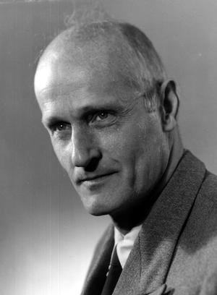
Formalisms for Computation (2)
Lambda calculus
  Alonzo Church (1903-1995)
  Formal basis for all functional languages, semantics, type theory
  Functional programming
    Pure expression evaluation, no assignment operator
Recursive functions & automata
  Stephen Kleene (1909-1994)
  Regular expressions, finite-state machines, PDAs
slide <number>

Slide 6
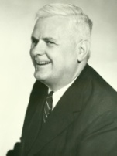
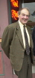
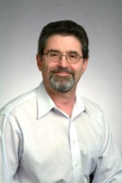
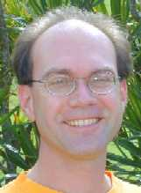
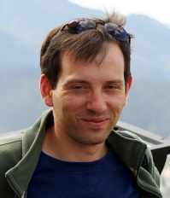
Church’s Legacy
Alonzo Church (PhD Princeton 1927)
1916 other
academic
descendants
Hartley Rogers (PhD Princeton 1952)
Recursion theory
…
Albert Meyer (PhD Harvard 1972)
Semantics, concurrency
John Mitchell (PhD MIT 1984)
Theory of object-oriented languages
Vitaly Shmatikov (PhD Stanford 2000)
slide <number>

Slide 7
Church’s Thesis
All these different syntactic formalisms describe the same class of mathematical objects
  Church’s Thesis: “Every effectively calculable function (effectively decidable predicate) is general recursive”
  Turing’s Thesis: “Every function which would be naturally regarded as computable is computable by a Turing machine”
Recursion, lambda-calculus and Turing machines are equivalent in their expressive power
Why is this a “thesis” and not a “theorem”?
slide <number>

Slide 8
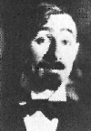
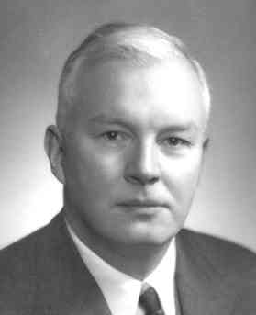
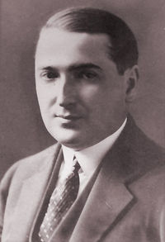
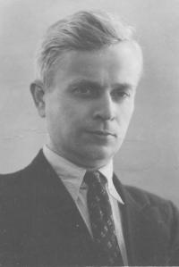
Formalisms for Computation (3)
Combinatory logic
  Moses Schönfinkel (1889-1942??)
  Haskell Curry (1900-1982)
Post production systems
  Emil Post (1897-1954)
Markov algorithms
  Andrey Markov (1903-1979)
slide <number>

Slide 9
Programming Language
Formal notation for specifying computations
  Syntax (usually specified by a context-free grammar)
  Semantics for each syntactic construct
  Practical implementation on a real or virtual machine
    Translation vs. compilation vs. interpretation
      C++ was originally translated into C by Stroustrup’s Cfront
      Java originally used a bytecode interpreter, now native code compilers are commonly used for greater efficiency
      Lisp, Scheme and most other functional languages are interpreted by a virtual machine, but code is often precompiled to an internal executable for efficiency
    Efficiency vs. portability
slide <number>

Slide 10
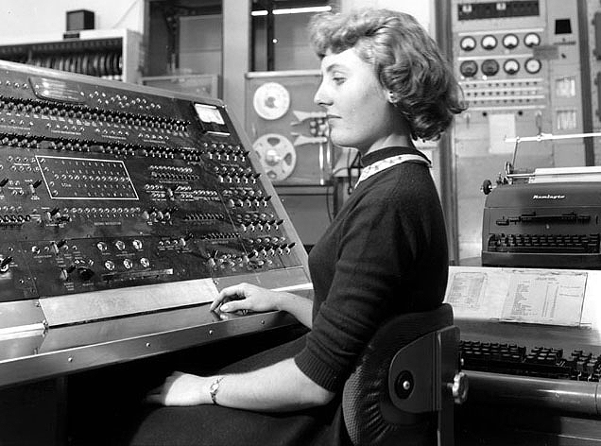
Assembly Languages
Invented by machine designers
the early 1950s
Mnemonics instead of
binary opcodes
push ebp
mov ebp, esp
sub esp, 4
push edi
Reusable macros and subroutines
slide <number>

Slide 11
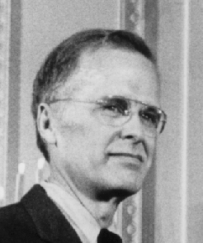
FORTRAN
Procedural, imperative language
  Still used in scientific computation
Developed at IBM in the 1950s by
John Backus (1924-2007)
  Backus’s 1977 Turing award lecture (see course website) made the case for functional programming
  On FORTRAN: “We did not know what we wanted and how to do it. It just sort of grew. The first struggle was over what the language would look like. Then how to parse expressions – it was a big problem…”
    BNF: Backus-Naur form for defining context-free grammars
slide <number>

Slide 12
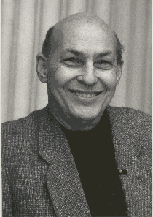
From FORTRAN to LISP
“Anyone could learn Lisp in one day,
except that if they already knew FORTRAN, it would take three days”
- Marvin Minsky
slide <number>

Slide 13
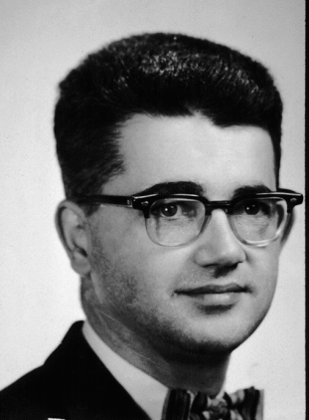
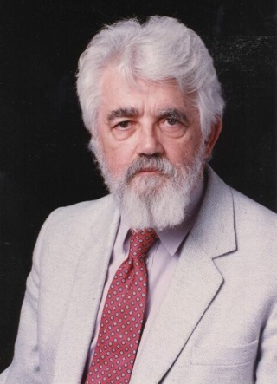
LISP
Invented by John McCarthy (b. 1927, Turing award: 1971)
  See original paper on course website
Formal notation for lambda-calculus
Pioneered many PL concepts
  Automated memory management (garbage collection)
  Dynamic typing
  No distinction between code and data
Still in use: ACL2, Scheme, …
slide <number>

Slide 14
LISP Quotes
  “The greatest single programming language ever designed” --Alan Kay
  “LISP being the most powerful and cleanest of languages, that's the language that the GNU project always prefer” -- Richard Stallman
  “Programming in Lisp is like playing with the primordial forces of the universe. It feels like lightning between your fingertips.” -- Glenn Ehrlich
  “Lisp has all the visual appeal of oatmeal with fingernail clippings mixed in” -- Larry Wall
  “LISP programmers know the value of everything and the cost of nothing” -- Alan Perlis
slide <number>

Slide 15
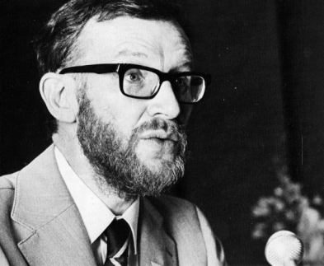
Algol 60
Designed in 1958-1960
Great influence on modern languages
  Formally specified syntax (BNF)
    Peter Naur: 2005 Turing award
  Lexical scoping: begin … end or {…}
  Modular procedures, recursive procedures, variable type declarations, stack storage allocation
“Birth of computer science” -- Dijkstra
“A language so far ahead of its time that it was not only an improvement on its predecessors, but also on nearly all its successors” -- Hoare
slide <number>

Slide 16
Algol 60 Sample
real procedure average(A,n);
real array A; integer n;
begin
real sum; sum := 0;
for i = 1 step 1 until n do
sum := sum + A[i];
average := sum/n
end;
no array bounds
no ; here
set procedure return value by assignment
slide <number>

Slide 17
Algol Oddity
Question
  Is x := x equivalent to doing nothing?
Interesting answer in Algol
  integer procedure p;
  begin
  …
  p := p
  …
  end;
  Assignment here is actually a recursive call
slide <number>

Slide 18
Some Trouble Spots in Algol 60
Type discipline improved by later languages
  Parameter types can be array
    No array bounds
  Parameter type can be procedure
    No argument or return types for procedure parameter
Parameter passing methods
  Pass-by-name had various anomalies
    “Copy rule” based on substitution, interacts with side effects
  Pass-by-value expensive for arrays
Some awkward control issues
  Goto out of block requires memory management
slide <number>

Slide 19
Algol 60 Pass-by-Name
Substitute text of actual parameter
  Unpredictable with side effects!
Example
  procedure inc2(i, j);
  integer i, j;
  begin
  i := i+1;
  j := j+1
  end;
  inc2 (k, A[k]);
  begin
  k := k+1;
  A[k] := A[k] +1
  end;
Is this what you expected?
slide <number>

Slide 20
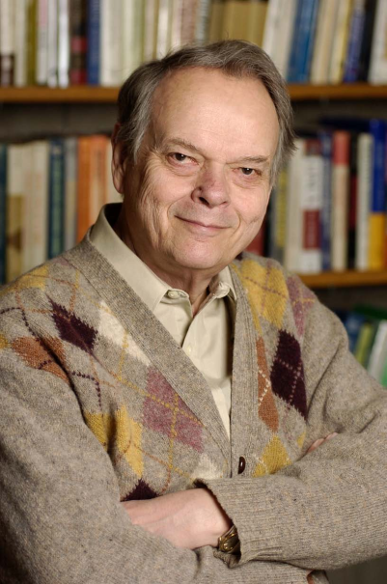
Algol 60 Legacy
“Another line of development stemming from Algol 60 has led to languages such
as Pascal and its descendants, e.g.,
Euclid, Mesa, and Ada, which are significantly lower­level than Algol. Each
of these languages seriously restricts the block or procedure mechanism of Algol by eliminating features such as call by name, dynamic arrays, or procedure parameters.”
- John C. Reynolds
slide <number>

Slide 21
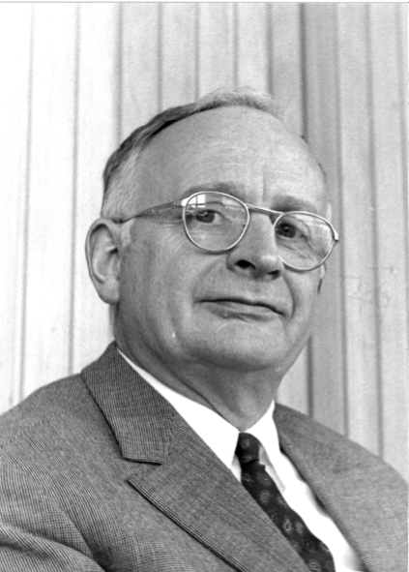
Algol 68
Very elaborate type system
  Complicated type conversions
  Idiosyncratic terminology
    Types were called “modes”
    Arrays were called “multiple values”
vW grammars instead of BNF
  Context-sensitive grammar invented by A. van Wijngaarden
Eliminated pass-by-name
Considered difficult to understand
slide <number>

Slide 22
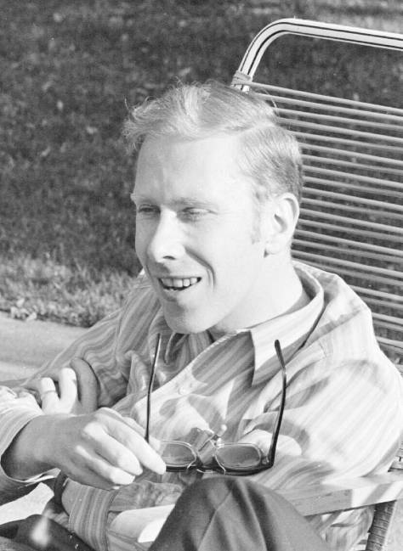
Pascal
Designed by Niklaus Wirth
  1984 Turing Award
Revised type system of Algol
  Good data structure concepts
    Records, variants, subranges
  More restrictive than Algol 60/68
    Procedure parameters cannot have procedure parameters
Popular teaching language
Simple one-pass compiler
slide <number>

Slide 23
Limitations of Pascal
illegal
Array bounds part of type
  procedure p(a: array [1..10] of integer)
  procedure p(n: integer, a: array [1..n] of integer)
  Attempt at orthogonal design backfires
    Parameter must be given a type
    Type cannot contain variables
  How could this have happened? Emphasis on teaching!
Not successful for “industrial-strength” projects
  See Kernighan’s “Why Pascal is not my favorite language” on the course website
slide <number>

Slide 24
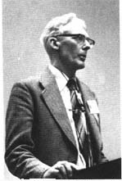
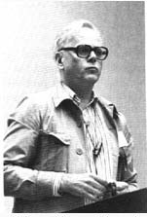
SIMULA 67
Ole-Johan Dahl (1931-2002)
Kristen Nygaard (1926-2002)
  Joint 2001 Turing Award
First object-oriented language
  Objects and classes
  Subclasses and inheritance
  Virtual procedures
slide <number>

Slide 25
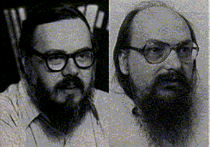
BCPL / B / C Family
Born of frustration with big OSes
and big languages (Multics, PL/I, Algol 68)
Keep lexical scope and recursion
Low-level machine access
  Manual memory management
  Explicit pointer manipulation
  Weak typing (introduced in C)
Systems programming for small-memory machines
  PDP-7, PDP-11, later VAX, Unix workstations and PCs
  C has been called a “portable assembly language”
slide <number>

Slide 26
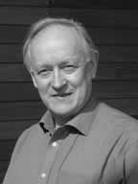
BCPL
Designed by Martin Richards (1966)
Emphasis on portability and ease of compilation
  Front end: parse + generate code for virtual machine
  Back end: translate code for native machine
Single data type (word), equivalence of pointers and arrays, pointer arithmetic – this is unusual!
“The philosophy of BCPL is not one of the tyrant who thinks he knows
best and lays down the law on what is and what is not allowed; rather,
BCPL acts more as a servant offering his services to the best of his ability
without complaint, even when confronted with apparent nonsense. The
programmer is always assumed to know what he is doing and is not
hemmed in by petty restrictions.”
slide <number>

Slide 27
Arrays and Pointers
An array is treated as a pointer to first element
BCPL: let V = vec 10
V!i to index the i^{th} array element
C: A[i] is equivalent to
pointer dereference *( (A) + (i) )
slide <number>

Slide 28
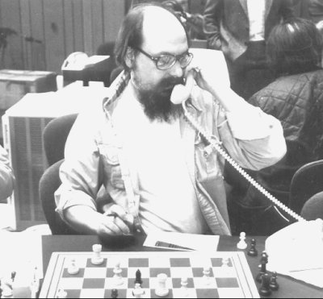
B
“BCPL squeezed into 8K bytes of
memory & filtered through Ken Thompson’s brain”
Very compact syntax
  One-pass compiler on a small-memory machine
    Generates intermediate “threaded code,” not native code
  No nested scopes
  Assignment: = instead of Algol-style :=
    How many times have you written if (a=b) { … } ?
  Pre-/postfix notation: x++ instead of x:=x+1
  Null-terminated strings
    In C, strings are null-terminated sequences of bytes referenced either by a pointer-to-char, or an array variable s[]
slide <number>

Slide 29
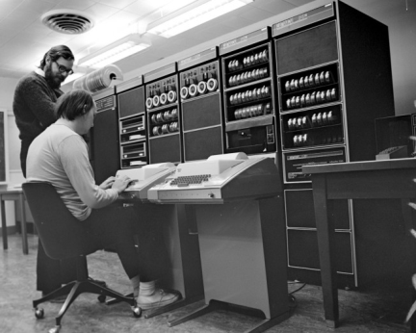
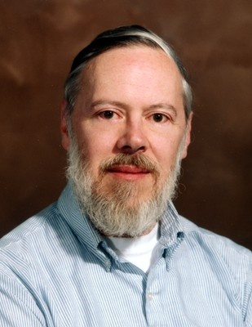
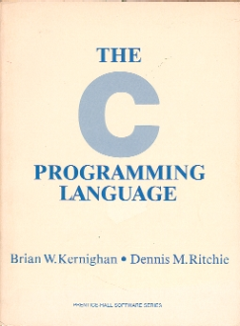
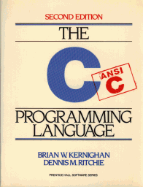
C
Bell Labs 1972 (Dennis Ritchie)
Development closely related to UNIX
  1983 Turing Award to Thompson and Ritchie
Added weak typing to B
  int, char, their pointer types
  Typed arrays = typed pointers
    int a[10]; … x = a[i]; means
    x = *(&a[0]+i*sizeof(int))
Compiles to native code
slide <number>

Slide 30
Types in C
Main difference between B and C
Syntax of type rules influenced by Algol 68
  int i, *pi, **ppi;
  int f(), *f(), **f(), *(*pf)(), (*pf)(int);
  int *api[10], (*pai)[10];
Also structs and unions
What do these
declarations mean?
slide <number>

Slide 31
Evolution of C
1973-1980: new features; compiler ported
  unsigned, long, union, enums
1978: K&R C book published
1989: ANSI C standardization
  Function prototypes as in C++
1999: ISO 9899:1999 also known as “C99”
  Inline functions, C++-like decls, bools, variable arrays
Concurrent C, Objective C, C*, C++, C#
“Portable assembly language”
  Early C++, Modula-3, Eiffel source-translated to C
slide <number>

Slide 32
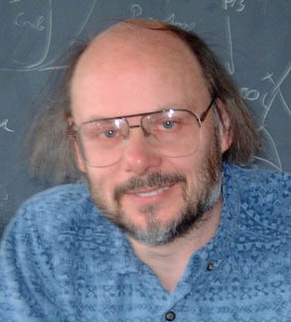
C++
Bell Labs 1979 (Bjarne Stroustrup)
  “C with Classes” (C++ since 1983)
Influenced by Simula
Originally translated into C using Cfront, then native compilers
  GNU g++
Several PL concepts
  Multiple inheritance
  Templates / generics
  Exception handling
slide <number>

Slide 33
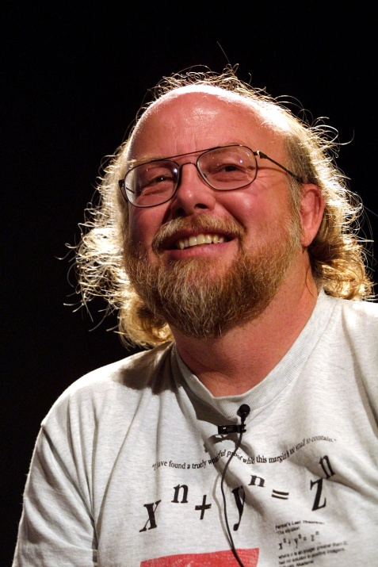
Java
Sun 1991-1995 (James Gosling)
  Originally called Oak,
  intended for set top boxes
Mixture of C and Modula-3
  Unlike C++
    No templates (generics), no multiple inheritance, no operator overloading
  Like Modula-3 (developed at DEC SRC)
    Explicit interfaces, single inheritance, exception handling, built-in threading model, references & automatic garbage collection (no explicit pointers!)
“Generics” added later
slide <number>

Slide 34
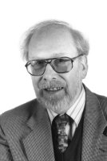
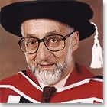
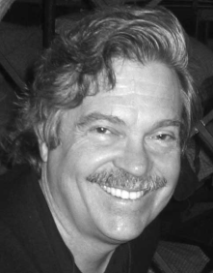
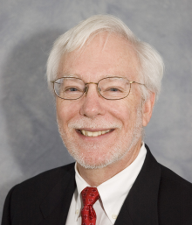
Other Important Languages
Algol-like
  Modula, Oberon, Ada
Functional
  ISWIM, FP, SASL, Miranda, Haskell, LCF, ML, Caml, Ocaml, Scheme, Common LISP
Object-oriented
  Smalltalk, Objective-C, Eiffel, Modula-3, Self, C#, CLOS
Logic programming
  Prolog, Gödel, LDL, ACL2, Isabelle, HOL
slide <number>

Slide 35
… And More
Data processing and databases
  Cobol, SQL, 4GLs, XQuery
Systems programming
  PL/I, PL/M, BLISS
Specialized applications
  APL, Forth, Icon, Logo, SNOBOL4, GPSS, Visual Basic
Concurrent, parallel, distributed
  Concurrent Pascal, Concurrent C, C*, SR, Occam, Erlang, Obliq
slide <number>

Slide 36
Brave New World
Programming tool “mini-languages”
  awk, make, lex, yacc, autoconf …
Command shells, scripting and “web” languages
  sh, csh, tcsh, ksh, zsh, bash …
  Perl, JavaScript, PHP, Python, Rexx, Ruby, Tcl, AppleScript, VBScript …
Web application frameworks and technologies
  ASP.NET, AJAX, Flash, Silverlight …
    Note: HTML/XML are markup languages, not programming languages, but they often embed executable scripts like Active Server Pages (ASPs) & Java Server Pages (JSPs)
slide <number>

Slide 37
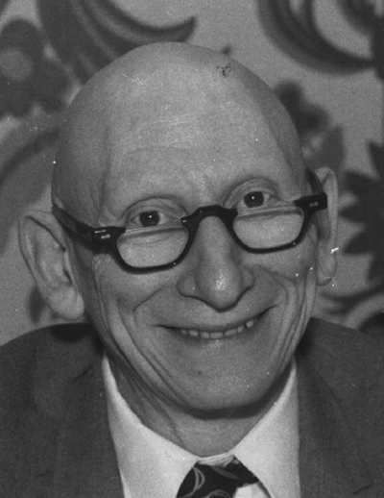
Why So Many Languages?
“There will always be things we wish to say in our programs that in all languages can only be said poorly.”
- Alan Perlis
slide <number>

Slide 38
What’s Driving Their Evolution?
Constant search for better ways to build software tools for solving computational problems
  Many PLs are general purpose tools
  Others are targeted at specific kinds of problems
    For example, massively parallel computations or graphics
Useful ideas evolve into language designs
  Algol → Simula → Smalltalk → C with Classes → C++
Often design is driven by expediency
  Scripting languages: Perl, Tcl, Python, PHP, etc.
    “PHP is a minor evil perpetrated by incompetent amateurs, whereas Perl is a great and insidious evil, perpetrated by skilled but perverted professionals.” - Jon Ribbens
slide <number>

Slide 39
What Do They Have in Common?
Lexical structure and analysis
  Tokens: keywords, operators, symbols, variables
  Regular expressions and finite automata
Syntactic structure and analysis
  Parsing, context-free grammars
Pragmatic issues
  Scoping, block structure, local variables
  Procedures, parameter passing, iteration, recursion
  Type checking, data structures
Semantics
  What do programs mean and are they correct
slide <number>

Slide 40
Core Features vs. Syntactic Sugar
What is the core high-level language syntax required to emulate a universal Turing machine?
  What is the core syntax of C?
    Are ++, --, +=, -=, ?:, for/do/while part of the core?
Convenience features?
  Structures/records, arrays, loops, case/switch?
  Preprocessor macros (textual substitution)
  Run-time libraries
    String handling, I/O, system calls, threads, networking, etc.
  “Syntactic sugar causes cancer of the semicolons”
  - Alan Perlis
slide <number>

Slide 41
Final Thoughts
There will be new languages invented
  You will have to spend time learning them on your own!
  For now, enjoy the luxury of being able to take a class
Conflicting goals for language design can lead to feature creep and hideous complexity
  Exhibit A: PL/I
  Exhibit B: C++
Then someone gets fed up …
  A language that adopts the original simple and elegant ideas, while eliminating the complexity (e.g., Java)
slide <number>

