Slide 1
Programming Languages
CS 345
Vitaly Shmatikov
http://www.cs.utexas.edu/~shmat/courses/cs345/
slide <number>

Slide 2
Course Materials
Textbook:
Mitchell. “Concepts in Programming Languages.”
  Attend lectures! Lectures will cover some material that is not in the textbook – and you will be tested on it!
Harbison, Steele. “C: A Reference Manual.”
(5th edition)
Occasional assigned readings
slide <number>

Slide 3
Syllabus
Survey of fundamental concepts underlying modern programming languages
  Goal: understand paradigms, not vocational training in any given language
  Examples drawn from ANSI C, C++, Java, Scheme, ML, JavaScript …
Procedural / imperative
Functional / applicative
Object-oriented
Concurrent
slide <number>

Slide 4
Some Course Goals
Language as a framework for problem-solving
  Understand the languages you use, by comparison
  Appreciate history, diversity of ideas in programming
  Be prepared for new methods, paradigms, tools
Critical thought
  Identify properties of language, not syntax or sales pitch
Language and implementation tradeoffs
  Every convenience has its cost
    Recognize the cost of presenting an abstract view of machine
    Understand tradeoffs in programming language design
slide <number>

Slide 5
What’s Worth Studying?
Dominant languages and paradigms
  C, C++, Java… JavaScript?
  Imperative and object-oriented languages
Important implementation ideas
Performance challenges
  Concurrency
Design tradeoffs
Concepts that research community is exploring for new programming languages and tools
slide <number>

Slide 6
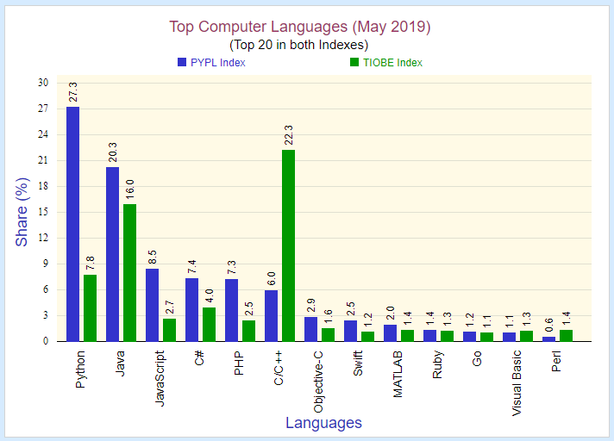
slide <number>

Slide 7
Latest Trends
Commercial trends
  Increasing use of type-safe languages: Java, C#, …
  Scripting and other languages for Web applications
Teaching trends: Java replacing C
Research and development trends
  Modularity
  Program analysis
    Automated error detection, programming environments, compilation
  Isolation and security
    Sandboxing, language-based security, …
slide <number>

Slide 8
Support for Abstraction
Data
  Programmer-defined types and classes
  Class libraries
Procedural
  Programmer-defined functions
  Standard function libraries
slide <number>

Slide 9
Reliability
Program behavior is the same on different platforms
  E.g., early versions of Fortran
Type errors are detected
  E.g., C vs. ML
Semantic errors are properly trapped
  E.g., C vs. C++
Memory leaks are prevented
  E.g., C vs. Java
slide <number>

Slide 10
Efficient Implementation
Embedded systems
  Real-time responsiveness (e.g., navigation)
  Failures of early Ada implementations
Web applications
  Responsiveness to users (e.g., Google search)
Corporate database applications
  Efficient search and updating
AI applications
  Modeling human behaviors
slide <number>

