Slide 1
Functions
CS 345
Vitaly Shmatikov
slide <number>

Slide 2
Procedural Abstraction
Contains local
variable declarations
and statements
Can be overloaded
(e.g., binary +)
Can pass arguments
into the scope
Procedure is a named parameterized scope
  Allows programmer to focus on a function interface, ignoring the details of how it is computed
Value-returning functions
  Example: x = (b*b - sqrt(4*a*c))/2*a
Non-value returning functions
  Called “procedures” (Ada), “subroutines” (Fortran), “void functions/methods” (C, C++, Java)
  Have a visible side effect: change the state of some data value not defined in the function definition
  Example: strcpy(s1,s2)
slide <number>

Slide 3
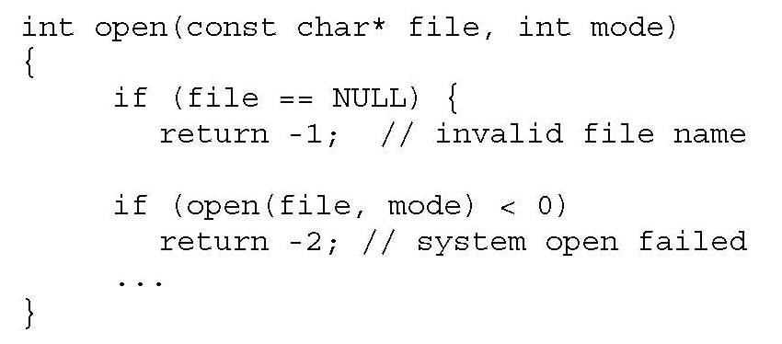
System Calls
OS procedures often return status codes
  Not the result of computing some function, but an indicator of whether the procedure succeeded or failed to cause a certain side effect
slide <number>

Slide 4
Arguments and Parameters
Argument: expression that appears in a function call
Parameter: identifier that appears in function declaration
Parameter-argument matching by number and position
  Exception: Perl. Instead of being declared in a function header, parameters are available as elements of special array @_
int h, i;
void B(int w) {
int j, k;
i = 2*w;
w = w+1;
}
void A(int x, int y) {
bool i, j;
B(h);
}
int main() {
int a, b;
h = 5; a = 3; b = 2;
A(a, b);
}
slide <number>

Slide 5
Parameter Passing Mechanisms
By value
By reference
By value-result
By result
By name
slide <number>

Slide 6
Pass by Value
Caller passes r-value of the argument to function
  Compute the value of the argument at the time of the call and assign that value to the parameter
  Reduces “aliasing”
    Aliasing: two names refer to the same memory location
Function cannot change value of caller’s variable
All arguments in C and Java are passed by value
  To allow caller’s variables to be modified, pointers can be passed as arguments
    Example: void swap(int *a, int *b) { … }
  Is there a contradiction here?
slide <number>

Slide 7
Pass by Reference
Caller passes l-value of the argument to function
  Compute the address of the argument and assign that address to the parameter
  Increases aliasing (why?)
Function can modify caller’s variable via the address it received as argument
int h, i;
void B(int* w) {
int j, k;
i = 2*(*w);
*w = *w+1;
}
void A(int* x, int* y) {
bool i, j;
B(&h);
}
int main() {
int a, b;
h = 5; a = 3; b = 2;
A(&a, &b);
}
slide <number>

Slide 8
ML Example
pseudo-code
Standard ML
pass-by-ref
  fun f (x : int ref) =
  ( x := !x+1; !x );
  val y = ref 0;
  f(y) + !y;
  function f (x) =
  { x = x+1; return x; }
  var y = 0;
  print (f(y)+y);
  fun f (z : int) =
  let x = ref z in
  x := !x+1; !x
  end;
  val y = ref 0;
  f(!y) + !y;
pass-by-value
slide <number>

Slide 9
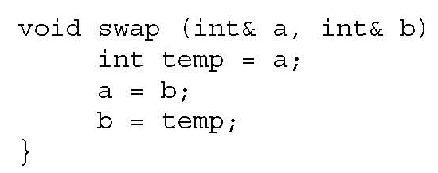
Pass by Reference in C++
Special “reference type” indicates that l-value is passed as argument
  Recall that in C, only r-values can be arguments
& operator is overloaded in C++
  When applied to a variable, gives its l-value
  When applied to type name in parameter list, means pass the argument by reference
l-values for C++ reference
types are completely determined
at compile-time
(why is this important?)
slide <number>

Slide 10
Two Ways To Pass By Reference
C or C++
C++ only
void swap (int *a, int *b) {
int temp = *a;
*a = *b;
*b = temp;
}
int x=3, y=4;
swap(&x, &y);
void swap (int& a, int& b) {
int temp = a;
a = b;
b = temp;
}
int x=3, y=4;
swap(x, y);
Which one is better? Why?
slide <number>

Slide 11
Pass by Value-Result
Pass by value at the time of the call and/or copy the result back to the argument at the end of the call (copy-in-copy-out)
  Example: “in out” parameters in Ada
Reference and value-result are the same, except when aliasing occurs
  Same variable is passed for two different parameters
  Same variable is both passed and globally referenced from the called function
slide <number>

Slide 12
Pass by Name
Textually substitute the argument for every instance of its corresponding parameter in the function body
  Originated with Algol 60 but dropped by Algol’s successors -- Pascal, Ada, Modula
Example of late binding
  Evaluation of the argument is delayed until its occurrence in the function body is actually executed
  Associated with lazy evaluation in functional languages (e.g., Haskell)
slide <number>

Slide 13

Jensen’s Device
Computes in Algol 60
passed by name
begin
integer i;
real procedure sum (i, lo, hi, term);
value lo, hi;
integer i, lo, hi;
real term;
begin
real temp;
temp := 0;
for i := lo step 1 until hi do
temp := temp + term;
sum := temp
end;
print (sum (i, 1, 100, 1/i))
end
becomes 1/i when
sum is executed
slide <number>

Slide 14
Macro
Textual substitution
  #define swap(a,b) temp=a; a=b; b=temp;
  …
  int x=3, y=4;
  int temp;
  swap(x,y);
Looks like a function definition, but …
  Does not obey the lexical scope rules (i.e., visibility of variable declarations)
  No type information for arguments or result
Textually expands to
temp=x; x=y; y=temp;
slide <number>

Slide 15
Problems with Macro Expansion
  #define swap(a,b) temp=a; a=b; b=temp;
  …
  if (x<y)
  swap(x,y);
Textually expands to
if (x<y)
temp=x;
x=y;
y=temp;
Why not #define swap(a,b) { int temp=a; a=b; b=temp; }?
Instead #define swap(a,b) do {
int temp=a; a=b; b=temp;
} while(false);
Fixes type of swapped variables
slide <number>

Slide 16
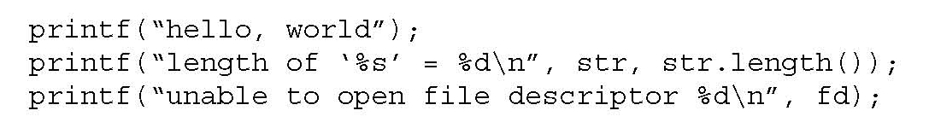
Variable Arguments
In C, can define a function with a variable number of arguments
  Example: void printf(const char* format, …)
Examples of usage:
Part of
syntax!
Format specification encoded by
special %-encoded characters
%d,%i,%o,%u,%x,%X – integer argument
%s – string argument
%p – pointer argument (void *)
Several others (see C Reference Manual!)
slide <number>

Slide 17
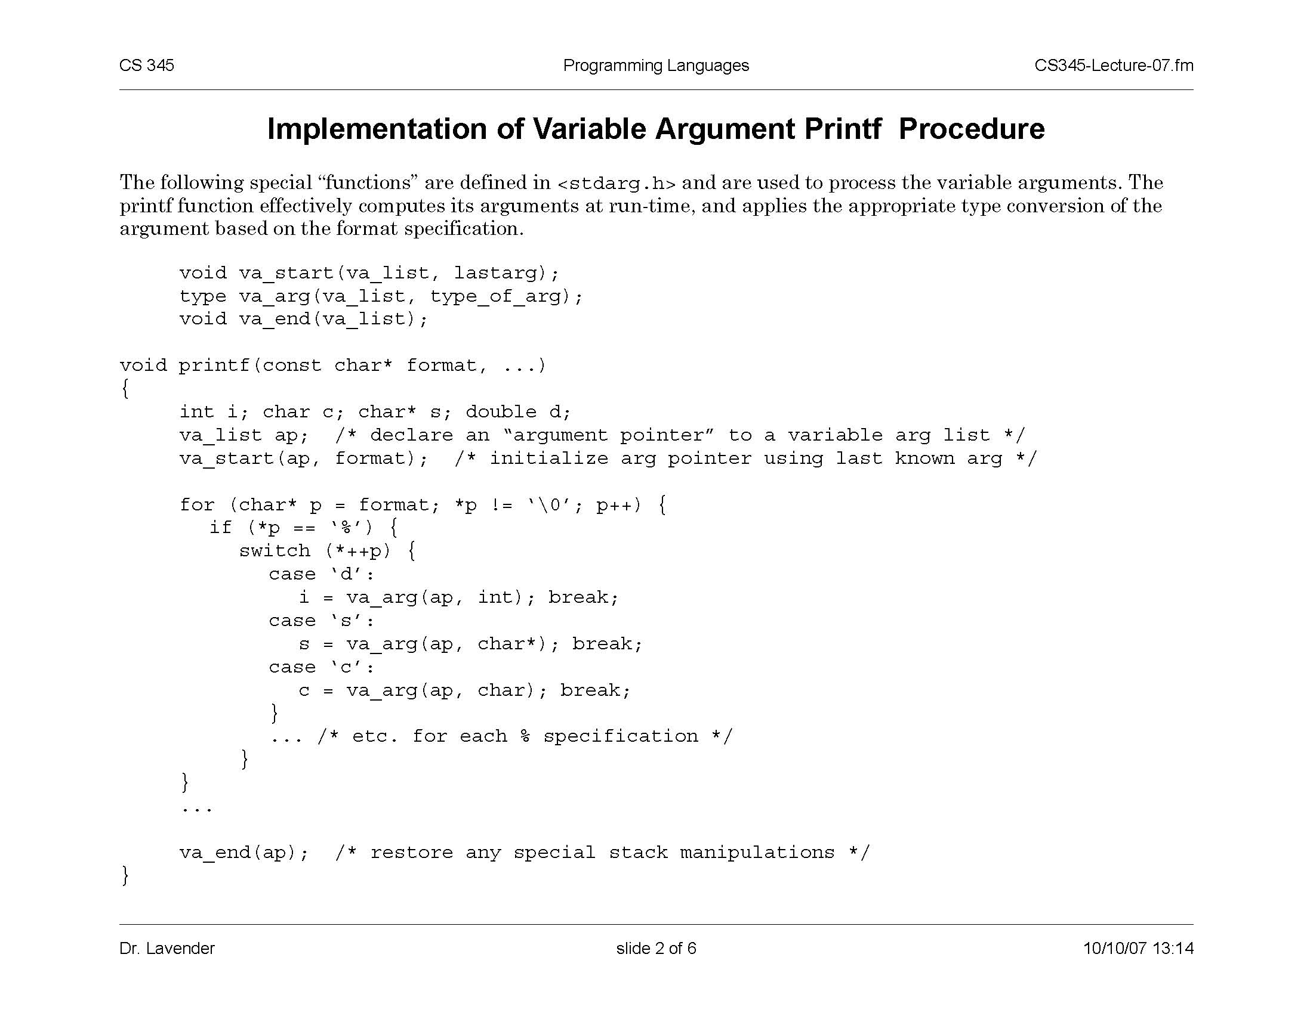
Implementation of Variable Args
Special functions va_start, va_arg, va_end compute arguments at run-time (how?)
slide <number>

