Slide 1
Imperative Programming
CS 345
Vitaly Shmatikov
slide <number>

Slide 2
Imperative Programming
Oldest and most popular paradigm
  Fortran, Algol, C, Java …
Mirrors computer architecture
  In a von Neumann machine, memory holds instructions and data
Key operation: assignment
  Side effect: updating state (i.e., memory) of the machine
Control-flow statements
  Conditional and unconditional (GO TO) branches, loops
slide <number>

Slide 3
Elements of Imperative Programs
Data type definitions
Variable declarations (usually typed)
Expressions and assignment statements
Control flow statements (usually structured)
Lexical scopes and blocks
  Goal: provide locality of reference
Declarations and definitions of procedures and functions (i.e., parameterized blocks)
slide <number>

Slide 4
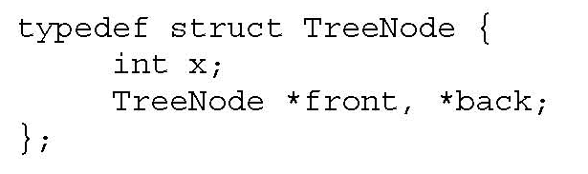
Variable Declarations
Typed variable declarations restrict the values that a variable may assume during program execution
  Built-in types (int, char …) or user-defined
  Initialization: Java integers to 0. What about C?
Variable size
  How much space needed to hold values of this variable?
    C on a 32-bit machine: sizeof(char) = 1 byte, sizeof(short) = 2 bytes, sizeof(int) = 4 bytes, sizeof(char*) = 4 bytes (why?)
    What about this user-defined datatype:
slide <number>

Slide 5
Variables: Locations and Values
When a variable is declared, it is bound to some memory location and becomes its identifier
  Location could be in global, heap, or stack storage
l-value: memory location (address)
r-value: value stored at the memory location identified by l-value
Assignment: A (target) = B (expression)
  Destructive update: overwrites the memory location identified by A with a value of expression B
    What if a variable appears on both sides of assignment?
slide <number>

Slide 6
Copy vs. Reference Semantics
Copy semantics: expression is evaluated to a value, which is copied to the target
  Used by imperative languages
Reference semantics: expression is evaluated to an object, whose pointer is copied to the target
  Used by object-oriented languages
slide <number>

Slide 7
Variables and Assignment
On the RHS of an assignment, use the variable’s r-value; on the LHS, use its l-value
  Example: x = x+1
  Meaning: “get r-value of x, add 1, store the result into the l-value of x”
An expression that does not have an l-value cannot appear on the LHS of an assignment
  What expressions don’t have l-values?
    Examples: 1=x+1, ++x++ (why?)
    What about a[1] = x+1, where a is an array? Why?
slide <number>

Slide 8
l-Values and r-Values (1)
Any expression or assignment statement in an imperative language can be understood in terms of l-values and r-values of variables involved
  In C, also helps with complex pointer dereferencing and pointer arithmetic
Literal constants
  Have r-values, but not l-values
Variables
  Have both r-values and l-values
  Example: x=x*y means “compute rval(x)*rval(y) and store it in lval(x)”
slide <number>

Slide 9
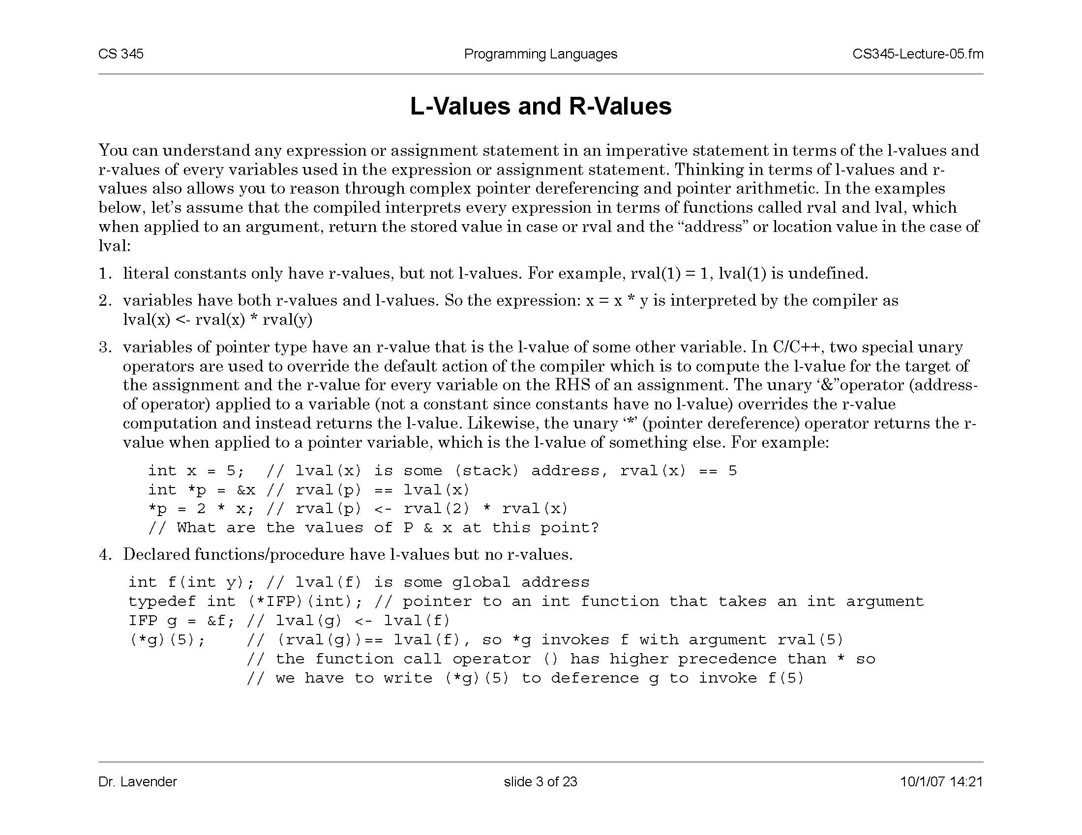
l-Values and r-Values (2)
Pointer variables
  Their r-values are l-values of another variable
    Intuition: the value of a pointer is an address
Overriding r-value and l-value computation in C
  &x always returns l-value of x
  *p always return r-value of p
    If p is a pointer, this is an l-value of another variable
What are the values of
p and x at this point?
slide <number>

Slide 10
l-Values and r-Values (3)
Declared functions and procedures
  Have l-values, but no r-values
slide <number>

Slide 11
Turing-Complete Mini-Language
Integer variables, values, operations
Assignment
If
Go To
slide <number>

Slide 12
Structured Control Flow
Control flow in imperative languages is most often designed to be sequential
  Instructions executed in order they are written
  Some also support concurrent execution (Java)
Program is structured if control flow is evident from syntactic (static) structure of program text
  Big idea: programmers can reason about dynamic execution of a program by just analyzing program text
  Eliminate complexity by creating language constructs for common control-flow “patterns”
    Iteration, selection, procedures/functions
slide <number>

Slide 13

Fortran Control Structure
  10 IF (X .GT. 0.000001) GO TO 20
  11 X = -X
  IF (X .LT. 0.000001) GO TO 50
  20 IF (X*Y .LT. 0.00001) GO TO 30
  X = X-Y-Y
  30 X = X+Y
  ...
  50 CONTINUE
  X = A
  Y = B-A
  GO TO 11
  …
Similar structure may occur in assembly code
slide <number>

Slide 14
Historical Debate
Dijkstra, “GO TO Statement Considered Harmful”
  Letter to Editor, Comm. ACM, March 1968
  Linked from the course website
Knuth, “Structured Prog. with Go To Statements”
  You can use goto, but do so in structured way …
Continued discussion
  Welch, “GOTO (Considered Harmful)^{n}, n is Odd”
General questions
  Do syntactic rules force good programming style?
  Can they help?
slide <number>

Slide 15
Modern Style
Standard constructs that structure jumps
  if … then … else … end
  while … do … end
  for … { … }
  case …
Group code in logical blocks
Avoid explicit jumps (except function return)
Cannot jump into the middle of a block or function body
slide <number>

Slide 16
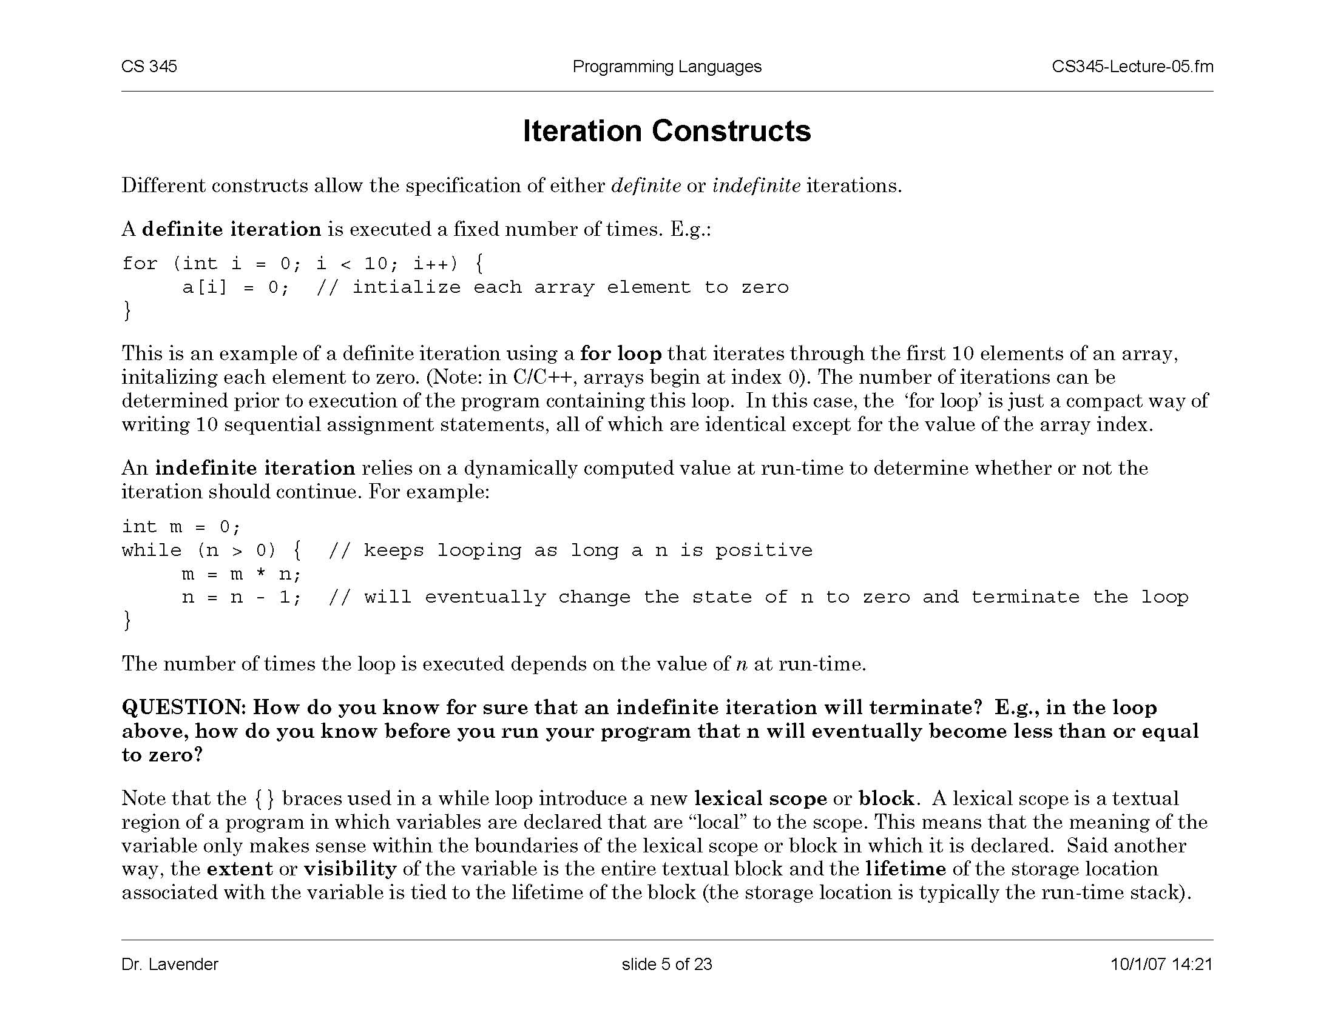
Iteration
Definite
Indefinite
  Termination depends on a dynamically computed value
How do we know statically (i.e., before we run the program) that the loop will terminate, i.e., that n will eventually become less than or equal to 0?
slide <number>

Slide 17
Iteration Constructs in C
  while (condition) stmt;
  while (condition) { stmt; stmt; …; }
  do stmt while (condition);
  do { stmt; stmt; …; } while (condition);
  for (<initialize>; <test>; <step>) stmt;
    Restricted form of “while” loop – same as
    <initialize>; while (<test>) { stmt; <step> }
  for (<initialize>; <test>; <step>) { stmt; stmt; …; }
slide <number>

Slide 18
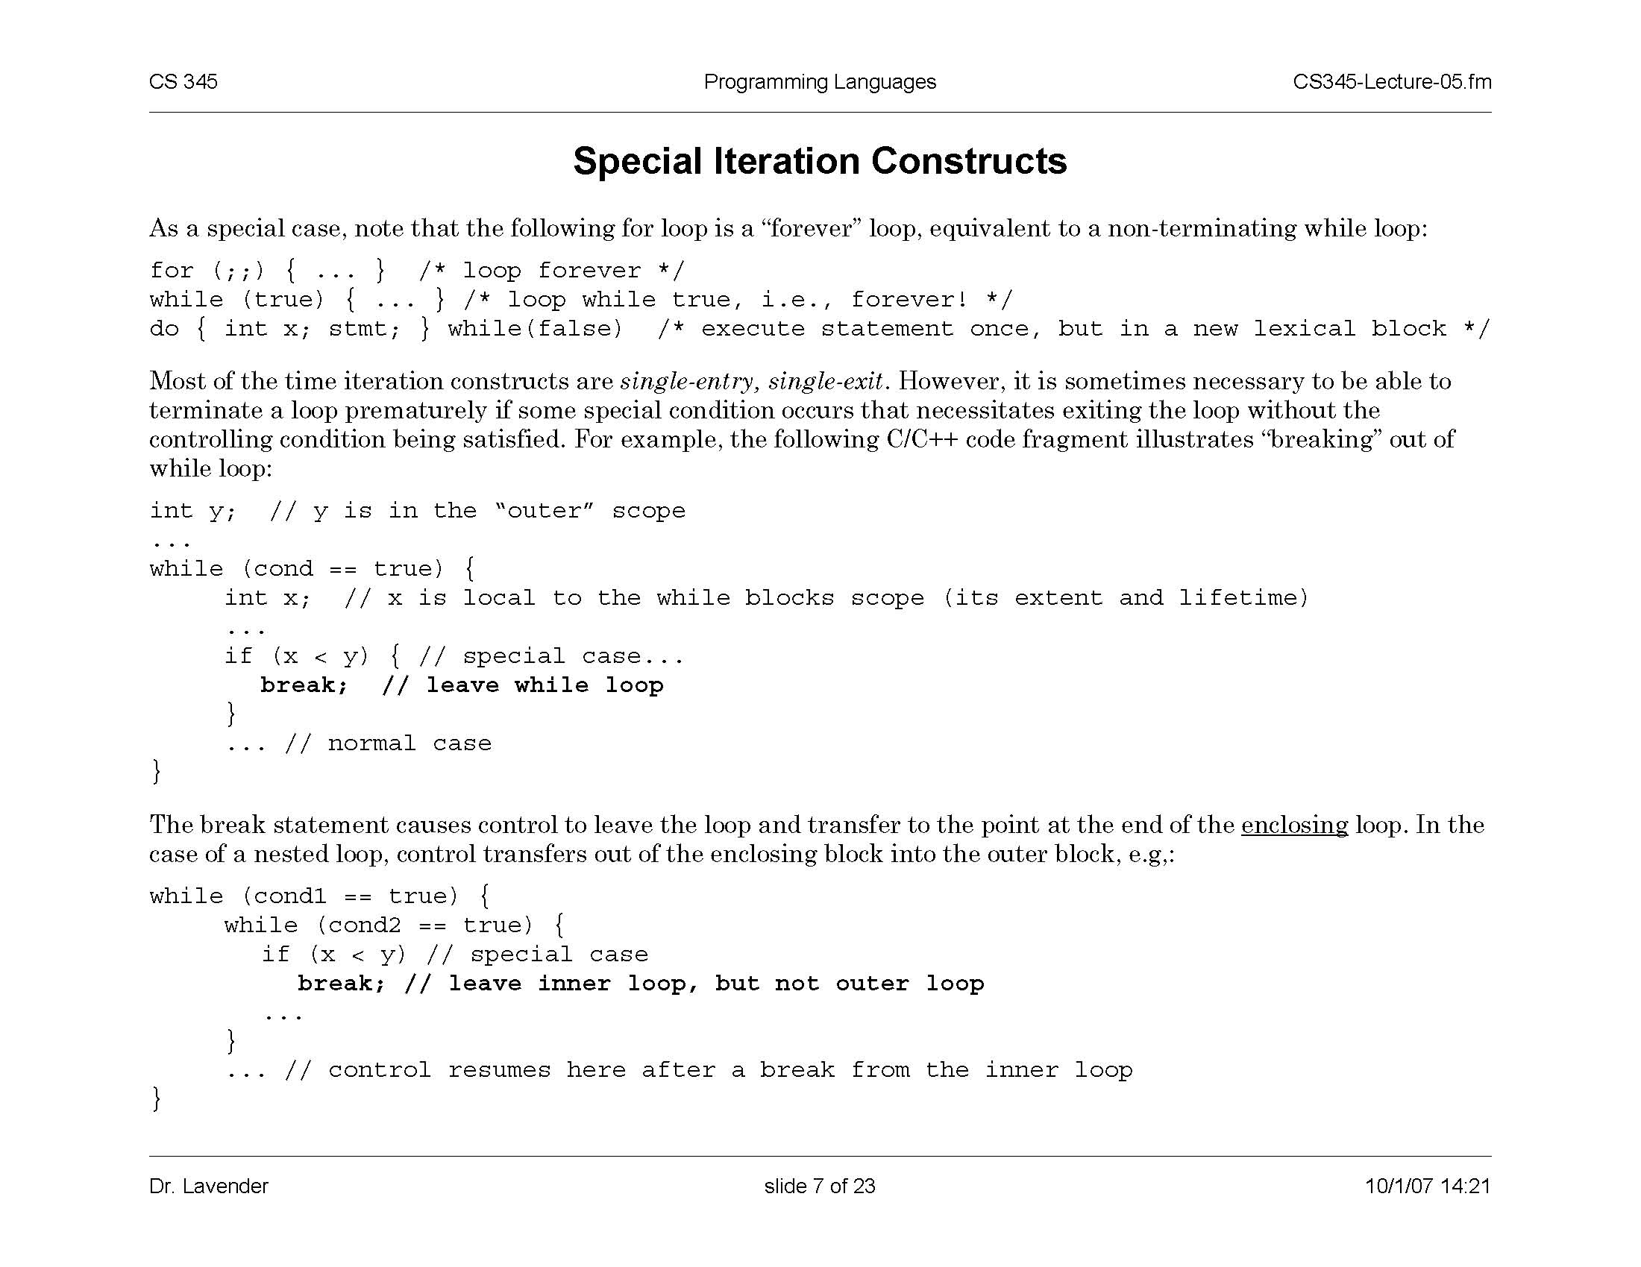
“Breaking Out” Of A Loop in C
slide <number>

Slide 19
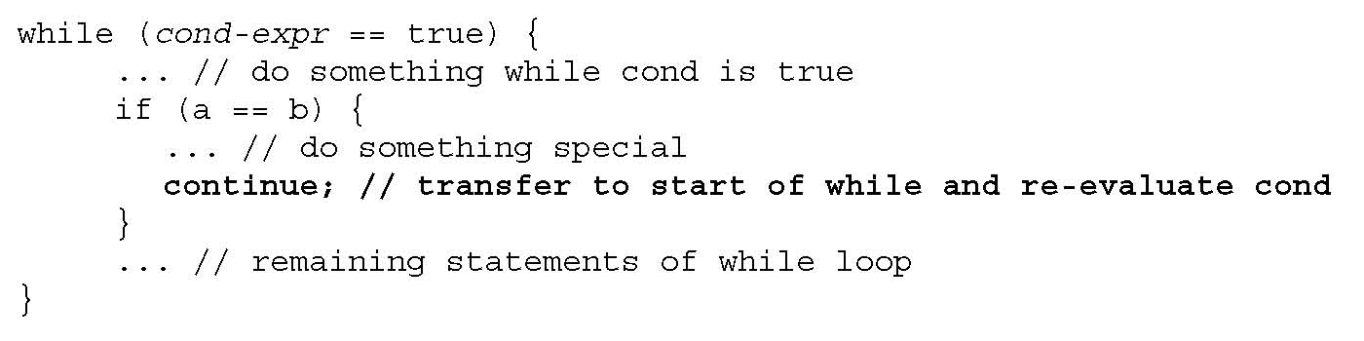
Forced Loop Re-Entry in C
slide <number>

Slide 20
Block-Structured Languages
Nested blocks with local variables
  { int x = 2;
  { int y = 3;
  x = y+2;
  }
  }
  Storage management
    Enter block: allocate space for variables
    Exit block: some or all space may be deallocated
new variables declared in nested blocks
outer block
inner block
local variable
global variable
slide <number>

Slide 21
Blocks in Common Languages
Examples
  C, JavaScript * { … }
  Algol begin … end
  ML let … in … end
Two forms of blocks
  Inline blocks
  Blocks associated with functions or procedures
    We’ll talk about these later
* JavaScript functions provides blocks
slide <number>

Slide 22
Simplified Machine Model
Registers
Code
Data
Stack
Program counter
Environment pointer
Heap
slide <number>

Slide 23
Memory Management
Registers, Code segment, Program counter
  Ignore registers (for our purposes) and details of instruction set
Data segment
  Stack contains data related to block entry/exit
  Heap contains data of varying lifetime
  Environment pointer points to current stack position
    Block entry: add new activation record to stack
    Block exit: remove most recent activation record
slide <number>

Slide 24
Scope and Lifetime
Scope
  Region of program text where declaration is visible
Lifetime
  Period of time when location is allocated to program
  { int x = … ;
  { int y = … ;
  { int x = … ;
  ….
  };
  };
  };
  Inner declaration of x hides outer one
  (“hole in scope”)
  Lifetime of outer x includes time when inner block is executed
  Lifetime ≠ scope
slide <number>

Slide 25
Inline Blocks
Activation record
  Data structure stored on run-time stack
  Contains space for local variables
  { int x=0;
  int y=x+1;
  { int z=(x+y)*(x-y);
  };
  };
  Push record with space for x, y
  Set values of x, y
  Push record for inner block
  Set value of z
  Pop record for inner block
  Pop record for outer block
May need space for variables and intermediate results like (x+y), (x-y)
slide <number>

Slide 26
Activation Record For Inline Block
Control link
Control link
  Pointer to previous record on stack
Push record on stack
  Set new control link to point to old env ptr
  Set env ptr to new record
Pop record off stack
  Follow control link of current record to reset environment pointer
Local variables
Intermediate results
Control link
Local variables
Intermediate results
Environment pointer
In practice, can be optimized away
slide <number>

Slide 27
Example
  { int x=0;
  int y=x+1;
  { int z=(x+y)*(x-y);
  };
  };
Control link
x
0
y
1
Control link
  Push record with space for x, y
  Set values of x, y
  Push record for inner block
  Set value of z
  Pop record for inner block
  Pop record for outer block
z
-1
x+y
1
x-y
-1
Environment pointer
slide <number>

