Slide 1
Introduction to ML
CS 345
Vitaly Shmatikov
slide <number>

Slide 2
Reading Assignment
Mitchell, Chapter 5.3-4
slide <number>

Slide 3
ML
General-purpose, non-C-like, non-OO language
  Related languages: Haskell, Ocaml, F#, …
Combination of Lisp and Algol-like features
  Expression-oriented
  Higher-order functions
  Garbage collection
  Abstract data types
  Module system
  Exceptions
Originally intended for interactive use
slide <number>

Slide 4
Why Study ML ?
Types and type checking
  General issues in static/dynamic typing
  Polymorphic type inference
Memory management
  Static scope and block structure, activation records
  Higher-order functions
Control
  Type-safe exceptions
  Tail recursion and continuations
slide <number>

Slide 5
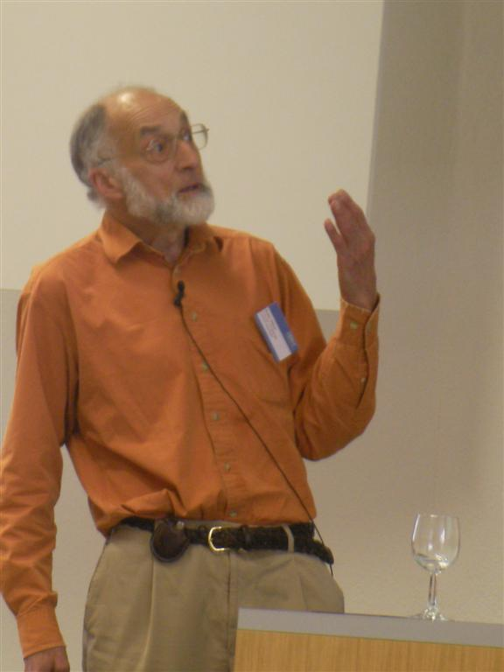
History of ML
Robin Milner
  Stanford, U. of Edinburgh, Cambridge
  1991 Turing Award
Logic for Computable Functions (LCF)
  One of the first automated theorem provers
Meta-Language of the LCF system
slide <number>

Slide 6
Logic for Computable Functions
Dana Scott (1969)
  Formulated a logic for proving properties of typed functional programs
Robin Milner (1972)
  Project to automate logic
  Notation for programs
  Notation for assertions and proofs
  Need to write programs that find proofs
    Too much work to construct full formal proof by hand
  Make sure proofs are correct
slide <number>

Slide 7
LCF Proof Search
Tactic: function that tries to find proof
  succeed and return proof
  tactic(formula) = search forever
  fail
Express tactics in the Meta-Language (ML)
Use type system to facilitate correctness
slide <number>

Slide 8
Tactics in ML Type System
Tactic has a functional type
  tactic : formula → proof
Type system must allow “failure”
  succeed and return proof
  tactic(formula) = search forever
  fail and raise exception
slide <number>

Slide 9
Function Types in ML
f : A → B means
  for every x ∈ A,
  some element y=f(x) ∈ B
  f(x) = run forever
  terminate by raising an exception
  In words, “if f(x) terminates normally, then f(x)∈ B.”
  Addition never occurs in f(x)+3 if f(x) raises exception.
  This form of function type arises directly from motivating application for ML. Integration of type system and exception mechanism mentioned in Milner’s 1991 Turing Award lecture.
slide <number>

Slide 10
Higher-Order Functions
Tactic is a function
Method for combining tactics is a function on functions
Example:
  f(tactic₁, tactic₂) =
  λ formula. try tactic₁(formula)
  else tactic₂ (formula)
We haven’t seen λ-expressions yet
(think of them as functions for now)
slide <number>

Slide 11
Basic Overview of ML
Interactive compiler: read-eval-print
  Compiler infers type before compiling or executing
  Type system does not allow casts or other loopholes
Examples
  - (5+3)-2;
  > val it = 6 : int
  - if 5>3 then “Bob” else “Fido”;
  > val it = “Bob” : string
  - 5=4;
  > val it = false : bool
slide <number>

Slide 12
Basic Types
Booleans
  true, false : bool
  if … then … else … (types must match)
Integers
  0, 1, 2, … : int
  +, * , … : int * int → int and so on …
Strings
  “Austin Powers”
Reals
  1.0, 2.2, 3.14159, … decimal point used to disambiguate
slide <number>

Slide 13
Compound Types
Tuples
  (4, 5, “noxious”) : int * int * string
Lists
  nil
  1 :: [2, 3, 4]
Records
  {name = “Fido”, hungry=true}
  : {name : string, hungry : bool}
type
type
slide <number>

Slide 14
Patterns and Declarations
Patterns can be used in place of variables
  <pat> ::= <var> | <tuple> | <cons> | <record> …
Value declarations
  General form: val <pat> = <exp>
    val myTuple = (“Conrad”, “Lorenz”);
    val (x,y) = myTuple;
    val myList = [1, 2, 3, 4];
    val x::rest = myList;
  Local declarations
    let val x = 2+3 in x*4 end;
slide <number>

Slide 15
Functions and Pattern Matching
Anonymous function
  fn x => x+1; like function (…) in JavaScript
Declaration form
  fun <name> <pat₁> = <exp₁>
  | <name> <pat₂> = <exp₂> …
  | <name> <pat_{n}> = <exp_{n}> …
Examples
  fun f (x,y) = x+y; actual argument must match pattern (x,y)
  fun length nil = 0
  | length (x::s) = 1 + length(s);
slide <number>

Slide 16
Functions on Lists
Apply function to every element of list
  fun map (f, nil) = nil
  | map (f, x::xs) = f(x) :: map (f,xs);
Reverse a list
  fun reverse nil = nil
  | reverse (x::xs) = append ((reverse xs), [x]);
Append lists
  fun append (nil, ys) = ys
  | append (x::xs, ys) = x :: append(xs, ys);
  Example: map (fn x => x+1, [1,2,3]); [2,3,4]
How efficient is this?
Can you do it with only
one pass through the list?
slide <number>

Slide 17
More Efficient Reverse Function
  fun reverse xs =
  let fun rev(nil, z) = z
  | rev(y::ys, z) = rev(ys, y::z)
  in rev( xs, nil )
  end;
1
3
2
2
2
2
3
3
1
3
1
1
slide <number>

Slide 18
Datatype Declarations
General form
  datatype <name> = <clause> | … | <clause>
  <clause> ::= <constructor> |<constructor> of <type>
Examples
  datatype color = red | yellow | blue
    Elements are red, yellow, blue
  datatype atom = atm of string | nmbr of int
    Elements are atm(“A”), atm(“B”), …, nmbr(0), nmbr(1), ...
  datatype list = nil | cons of atom*list
    Elements are nil, cons(atm(“A”), nil), …
    cons(nmbr(2), cons(atm(“ugh”), nil)), ...
slide <number>

Slide 19
Datatypes and Pattern Matching
Recursively defined data structure
  datatype tree = leaf of int | node of int*tree*tree
  node(4, node(3,leaf(1), leaf(2)),
  node(5,leaf(6), leaf(7))
  )
Recursive function
  fun sum (leaf n) = n
  | sum (node(n,t1,t2)) = n + sum(t1) + sum(t2)
4
3
5
1
2
6
7
slide <number>

Slide 20
Example: Evaluating Expressions
Define datatype of expressions
  datatype exp = Var of int | Const of int | Plus of exp*exp;
  Write (x+3)+y as Plus(Plus(Var(1),Const(3)), Var(2))
Evaluation function
  fun ev(Var(n)) = Var(n)
  | ev(Const(n)) = Const(n)
  | ev(Plus(e1,e2)) = …
  ev(Plus(Const(3),Const(2))) Const(5)
  ev(Plus(Var(1),Plus(Const(2),Const(3))))
  ev(Plus(Var(1), Const(5))
slide <number>

Slide 21
Case Expression
Datatype
  datatype exp = Var of int | Const of int | Plus of exp*exp;
Case expression
  case e of
  Var(n) => … |
  Const(n) => …. |
  Plus(e1,e2) => …
slide <number>

Slide 22
Evaluation by Cases
  datatype exp = Var of int | Const of int | Plus of exp*exp;
  fun ev(Var(n)) = Var(n)
  | ev(Const(n)) = Const(n)
  | ev(Plus(e1,e2)) = (case ev(e1) of
  Var(n) => Plus(Var(n),ev(e2)) |
  Const(n) => (case ev(e2) of
  Var(m) => Plus(Const(n),Var(m)) |
  Const(m) => Const(n+m) |
  Plus(e3,e4) => Plus(Const(n),Plus(e3,e4)) ) |
  Plus(e3,e4) => Plus(Plus(e3,e4),ev(e2)) );
slide <number>

Slide 23
ML Imperative Features
Remember l-values and r-values?
  Assignment y := x+3
ML reference cells and assignment
  Different types for location and contents
    x : int non-assignable integer value
    y : int ref location whose contents must be integer
    !y the contents of cell y
    ref x expression creating new cell initialized to x
  ML form of assignment
    y := x + 3 place value of x+3 in location (cell) y
    y := !y + 3 add 3 to contents of y and store in location y
Refers to location (l-value)
Refers to contents (r-value)
slide <number>

Slide 24
Reference Cells in ML
Variables in most languages
  Variable names a storage location
  Contents of location can be read, can be changed
ML reference cells
  A mutable cell is another type of value
  Explicit operations to read contents or change contents
  Separates naming (declaration of identifiers) from “variables”
slide <number>

Slide 25
Imperative Examples in ML
Create cell and change contents
  val x = ref “Bob”;
  x := “Bill”;
Create cell and increment
  val y = ref 0;
  y := !y + 1;
“while” loop
  val i = ref 0;
  while !i < 10 do i := !i +1;
  !i;
x
Bob
Bill
y
0
1
slide <number>

Slide 26
Core ML
Basic Types
  Unit
  Booleans
  Integers
  Strings
  Reals
  Tuples
  Lists
  Records
Patterns
Declarations
Functions
Polymorphism
Overloading
Type declarations
Exceptions
Reference cells
slide <number>

Slide 27
Related Languages
ML family
  Standard ML – Edinburgh, Bell Labs, Princeton, …
  CAML, OCAML – INRIA (France)
    Some syntactic differences from Standard ML (SML)
    Object system
Haskell
  Lazy evaluation, extended type system, monads
F#
  ML-like language for Microsoft .NET platform
    “Combining the efficiency, scripting, strong typing and productivity of ML with the stability, libraries, cross-language working and tools of .NET. “
  Compiler produces .NET intermediate language
slide <number>

