Slide 1
Lambda-Calculus
CS 345
Vitaly Shmatikov
slide <number>

Slide 2
Lambda Calculus
Formal system with three parts
  Notation for function expressions
  Proof system for equations
  Calculation rules called reduction
Additional topics in lambda calculus
  Mathematical semantics
  Type systems
slide <number>

Slide 3
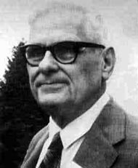
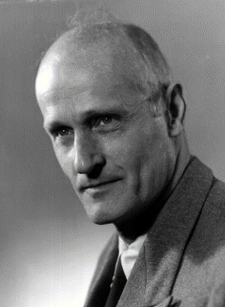
History
Origins: formal theory of substitution
  For first-order logic, etc.
More successful for computable functions
  Substitution → symbolic computation
  Church/Turing thesis
Influenced design of Lisp, ML, other languages
Important part of CS history and foundations
slide <number>

Slide 4
Why Study Lambda-Calculus?
Basic syntactic notions
  Free and bound variables
  Functions
  Declarations
Calculation rule
  Symbolic evaluation useful for discussing programs
  Used in optimization (inlining), macro expansion
    Correct macro processing requires variable renaming
  Illustrates some ideas about scope of binding
    Lisp originally departed from standard lambda calculus, returned to the fold through Scheme, Common Lisp
slide <number>

Slide 5
Expressions and Functions
Expressions
  x + y x + 2*y + z
Functions
  λx. (x+y) λz. (x + 2*y + z)
Application
  (λx. (x+y)) 3 = 3 + y
  (λz. (x + 2*y + z)) 5 = x + 2*y + 5
Parsing: λx. f (f x) = λx.( f (f (x)) )
slide <number>

Slide 6
Higher-Order Functions
Given function f, return function f ° f
  λf. λx. f (f x)
How does this work?
  (λf. λx. f (f x)) (λy. y+1)
  = λx. (λy. y+1) ((λy. y+1) x)
  = λx. (λy. y+1) (x+1)
  = λx. (x+1)+1
Same result if step 2 is altered
slide <number>

Slide 7
Same Procedure (ML)
Given function f, return function f ° f
  fn f => fn x => f(f(x))
How does this work?
  (fn f => fn x => f(f(x))) (fn y => y + 1)
  = fn x => ((fn y => y + 1) ((fn y => y + 1) x))
  = fn x => ((fn y => y + 1) (x + 1))
  = fn x => ((x + 1) + 1)
slide <number>

Slide 8
Same Procedure (JavaScript)
Given function f, return function f ° f
  function (f) { return function (x) { return f(f(x)); } ; }
How does this work?
  (function (f) { return function (x) { return f(f(x)); } ; })
  (function (y) { return y + 1; })
  function (x) { return (function (y) { return y + 1; })
  ((function (y) { return y + 1; }) (x)); }
  function (x) { return (function (y) { return y +1; }) (x + 1); }
  function (x) { return ((x + 1) + 1); }
slide <number>

Slide 9
Declarations as “Syntactic Sugar”
  function f(x) {
  return x+2;
  }
  f(5);
  (λf. f(5)) (λx. x+2)
block body
declared function
slide <number>

Slide 10
Free and Bound Variables
Bound variable is a “placeholder”
  Variable x is bound in λx. (x+y)
  Function λx. (x+y) is same function as λz. (z+y)
Compare
  ∫ x+y dx = ∫ z+y dz ∀x P(x) = ∀z P(z)
Name of free (i.e., unbound) variable matters!
  Variable y is free in λx. (x+y)
  Function λx. (x+y) is not same as λx. (x+z)
Occurrences
  y is free and bound in λx. ((λy. y+2) x) + y
slide <number>

Slide 11
Reduction
Basic computation rule is β-reduction
  (λx. e₁) e₂ → [e₂/x]e₁
  where substitution involves renaming as needed (why?)
Reduction
  Apply basic computation rule to any subexpression
  Repeat
Confluence
  Final result (if there is one) is uniquely determined
slide <number>

Slide 12
Renaming Bound Variables
Function application
  (λf. λx. f (f x)) (λy. y+x)
apply twice
add x to argument
Substitute “blindly” – do you see the problem?
  λx. [(λy. y+x) ((λy. y+x) x)] = λx. x+x+x
Rename bound variables
  (λf. λz. f (f z)) (λy. y+x)
  = λz. [(λy. y+x) ((λy. y+x) z))] = λz. z+x+x
Easy rule: always rename variables to be distinct
slide <number>

Slide 13
Main Points About Lambda Calculus
λ captures the “essence” of variable binding
  Function parameters
  Declarations
  Bound variables can be renamed
Succinct function expressions
Simple symbolic evaluator via substitution
Can be extended with
  Types, various functions, stores and side effects…
slide <number>

Slide 14
What is a Functional Language?
“No side effects”
Pure functional language: a language with functions, but without side effects or other imperative features
slide <number>

Slide 15
No-Side-Effects Language Test
Within the scope of specific declarations of x₁,x₂, …, x_{n}, all occurrences of an expression e containing only variables x₁,x₂, …, x_{n}, must have the same value.
  begin
  integer x=3; integer y=4;
  5*(x+y)-3
  … // no new declaration of x or y //
  4*(x+y)+1
  end
slide <number>

Slide 16
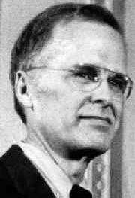
Backus’ Turing Award
John Backus: 1977 Turing Award
  Designer of Fortran, BNF, etc.
Turing Award lecture
  Functional programming better than imperative programming
  Easier to reason about functional programs
  More efficient due to parallelism
  Algebraic laws
    Reason about programs
    Optimizing compilers
slide <number>

Slide 17
Reasoning About Programs
To prove a program correct, must consider everything a program depends on
In functional programs, dependence on any data structure is explicit (why?)
Therefore, it’s easier to reason about functional programs
Do you believe this?
slide <number>

Slide 18
Quicksort in Haskell
Very succinct program
  qsort [] = []
  qsort (x:xs) = qsort elts_lt_x ++ [x]
  ++ qsort elts_greq_x
  where elts_lt_x = [y | y <- xs, y < x]
  elts_greq_x = [y | y <- xs, y >= x]
This is the whole thing
  No assignment – just write expression for sorted list
  No array indices, no pointers, no memory management, …
slide <number>

Slide 19
Compare: Quicksort in C
  qsort( a, lo, hi ) int a[], hi, lo;
  { int h, l, p, t;
  if (lo < hi) {
  l = lo; h = hi; p = a[hi];
  do {
  while ((l < h) && (a[l] <= p)) l = l+1;
  while ((h > l) && (a[h] >= p)) h = h-1;
  if (l < h) { t = a[l]; a[l] = a[h]; a[h] = t; }
  } while (l < h);
  t = a[l]; a[l] = a[hi]; a[hi] = t;
  qsort( a, lo, l-1 );
  qsort( a, l+1, hi );
  }
  }
slide <number>

Slide 20
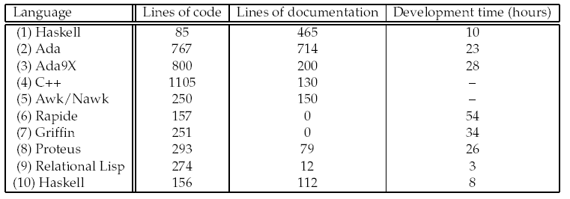
Case Study
Naval Center programming experiment
  Separate teams worked on separate languages
  Some programs were incomplete or did not run
  Many evaluators didn’t understand, when shown the code, that the Haskell program was complete. They thought it was a high-level partial specification.
slide <number>

Slide 21
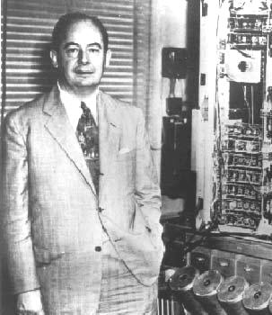
Von Neumann Bottleneck
Von Neumann
  Mathematician responsible for idea of stored program
Von Neumann bottleneck
  Backus’ term for limitation in CPU-memory transfer
Related to sequentiality of imperative languages
  Code must be executed in specific order
    function f(x) { if (x<y) then y = x; else x = y; }
    g( f(i), f(j) );
slide <number>

Slide 22
Eliminating VN Bottleneck
No side effects
  Evaluate subexpressions independently
    function f(x) { return x<y ? 1 : 2; }
    g(f(i), f(j), f(k), … );
Good idea but ...
  Too much parallelism
  Little help in allocation of processors to processes
  ...
Effective, easy concurrency is a hard problem
slide <number>

