Slide 1
Concurrent Programming
CS 345
Vitaly Shmatikov
slide <number>

Slide 2
Reading Assignment
Mitchell, Chapter 14
slide <number>

Slide 3
Concurrency
Two or more sequences of events occur “in parallel”
Multiprogramming
  Single processor runs several programs at the same time
  Each program proceeds sequentially
  Actions of one program may occur between two steps of another
Multiprocessors
  Two or more processors
  Programs on one processor communicate with programs on another
  Actions may happen simultaneously
Process: sequential program running on a processor
slide <number>

Slide 4
The Promise of Concurrency
Speed
  If a task takes time t on one processor, shouldn’t it take time t/n on n processors?
Availability
  If one process is busy, another may be ready to help
Distribution
  Processors in different locations can collaborate to solve a problem or work together
Humans do it so why can’t computers?
  Vision, cognition appear to be highly parallel activities
slide <number>

Slide 5
Example: Rendering a Web page
Page is a shared resource
Multiple concurrent activities in the Web browser
  Thread for each image load
  Thread for text rendering
  Thread for user input (e.g., “Stop” button)
Cannot all write to page simultaneously!
  Big challenge in concurrent programming: managing access to shared resources
slide <number>

Slide 6
The Challenges of Concurrency
Concurrent programs are harder to get right
  Folklore: need at least an order of magnitude in speedup for concurrent program to be worth the effort
Some problems are inherently sequential
  Theory – circuit evaluation is P-complete
  Practice – many problems need coordination and communication among sub-problems
Specific issues
  Communication – send or receive information
  Synchronization – wait for another process to act
  Atomicity – do not stop in the middle and leave a mess
slide <number>

Slide 7
Language Support for Concurrency
Threads
  Think of a thread as a system “object” containing the state of execution of a sequence of function calls
  Each thread needs a separate run-time stack (why?)
  Pass threads as arguments, return as function results
Communication abstractions
  Synchronous communication
  Asynchronous buffers that preserve message order
Concurrency control
  Locking and mutual exclusion
  Atomicity is more abstract, less commonly provided
slide <number>

Slide 8
Inter-Process Communication
Processes may need to communicate
  Process requires exclusive access to some resources
  Process need to exchange data with another process
Can communicate via:
  Shared variables
  Message passing
  Parameters
slide <number>

Slide 9
Explicit vs. Implicit Concurrency
Explicit concurrency
  Fork or create threads / processes explicitly
  Explicit communication between processes
    Producer computes useful value
    Consumer requests or waits for producer
Implicit concurrency
  Rely on compiler to identify potential parallelism
  Instruction-level and loop-level parallelism can be inferred, but inferring subroutine-level parallelism has had less success
slide <number>

Slide 10

cobegin / coend
Limited concurrency primitive
    Concurrent Pascal [Per Brinch Hansen, 1970s]
  x := 0;
  cobegin
  begin x := 1; x := x+1 end;
  begin x := 2; x := x+1 end;
  coend;
  print(x);
execute sequential
blocks in parallel
x := 1
x := x+1
x := 0
print(x)
x := 2
x := x+1
  Atomicity at level of assignment statement
slide <number>

Slide 11
Properties of cobegin/coend
Simple way to create concurrent processes
Communication by shared variables
No mutual exclusion
No atomicity
Number of processes fixed by program structure
Cannot abort processes
  All must complete before parent process can go on
slide <number>

Slide 12
Race Conditions
Race condition occurs when the value of a variable depends on the execution order of two or more concurrent processes (why is this bad?)
Example
  procedure signup(person)
  begin
  number := number + 1;
  list[number] := person;
  end;
  signup(joe) || signup(bill)
slide <number>

Slide 13
Critical Section
Two concurrent processes may access a shared resource
Inconsistent behavior if processes are interleaved
Allow only one process in critical section
Issues
  How to select which process is allowed to access the critical section?
  What happens to the other process?
slide <number>

Slide 14
Locks and Waiting
<initialize concurrency control>
Process 1:
<wait>
signup(joe); // critical section
<signal>
Process 2:
<wait> signup(bill); // critical section
<signal>
Need atomic operations to implement wait
slide <number>

Slide 15
Deadlock
Deadlock occurs when a process is waiting for an event that will never happen
Necessary conditions for a deadlock to exist:
  Processes claim exclusive access to resources
  Processes hold some resources while waiting for others
  Resources may not be removed from waiting processes
  There exists a circular chain of processes in which each process holds a resource needed by the next process in the chain
Example: “dining philosophers”
slide <number>

Slide 16
Implementing Mutual Exclusion
Atomic test-and-set
  Instruction atomically reads and writes some location
  Common hardware instruction
  Combine with busy-waiting loop to implement mutex
Semaphore
  Keep queue of waiting processes
    Avoid busy-waiting loop
  Scheduler has access to semaphore; process sleeps
  Disable interrupts during semaphore operations
    OK since operations are short
slide <number>

Slide 17
Semaphores
Semaphore is an integer variable and an associated process queue
Operations: P wait, V signal, s số chỗ còn
  P(s) if s > 0 then s--
  else enqueue process
  V(s) if a process is enqueued then dequeue it
  else s++
Binary semaphore
Counting semaphore
slide <number>

Slide 18
Simple Producer-Consumer
program SimpleProducerConsumer;
var buffer : string;
full : semaphore = 0;
empty : semaphore = 1;
begin
cobegin
Producer; Consumer;
coend;
end.
procedure Producer;
var tmp : string
begin
while (true) do begin
produce(tmp);
P(empty); { begin critical section }
buffer := tmp;
V(full); { end critical section }
end;
end;
procedure Consumer;
var tmp : string
begin
while (true) do begin
P(full); { begin critical section }
tmp := buffer;
V(empty); { end critical section }
consume(tmp);
end;
end;
slide <number>

Slide 19
Producer-Consumer
program ProducerConsumer;
const size = 5;
var buffer : array[1..size] of string;
inn : integer = 0;
out : integer = 0;
lock : semaphore = 1;
nonfull : semaphore = size;
nonempty : semaphore = 0; …
procedure Producer;
var tmp : string
begin
while (true) do begin
produce(tmp);
P(nonfull);
P(lock); { begin critical section }
inn := inn mod size + 1;
buffer[inn] := tmp;
V(lock); { end critical section }
V(nonempty);
end;
end;
procedure Consumer;
var tmp : string
begin
while (true) do begin
P(nonempty);
P(lock); { begin critical section }
out = out mod size + 1;
tmp := buffer[out];
V(lock); { end critical section }
V(nonfull);
consume(tmp);
end;
end;
slide <number>

Slide 20
Monitors
Monitor encapsulates a shared resource (monitor = “synchronized object”)
  Private data
  Set of access procedures (methods)
  Locking is automatic
    At most one process may execute a monitor procedure at a time (this process is “in” the monitor)
    If one process is in the monitor, any other process that calls a monitor procedure will be delayed
slide <number>

Slide 21
Example of a Monitor
monitor Buffer;
const size = 5;
var buffer : array[1..size] of string;
in : integer = 0;
out : integer = 0;
count : integer = 0;
nonfull : condition;
nonempty : condition; …
procedure put(s : string);
begin
if (count = size) then wait(nonfull);
in := in mod size + 1;
buffer[in] := tmp;
count := count + 1;
signal(nonempty);
end;
function get : string;
var tmp : string
begin
if (count = 0) then wait(nonempty);
out = out mod size + 1;
tmp := buffer[out];
count := count - 1;
signal(nonfull);
get := tmp;
end;
slide <number>

Slide 22
Java Threads
Thread
  Set of instructions to be executed one at a time, in a specified order
  Special Thread class is part of the core language
    In C/C++, threads are part of an “add-on” library
Methods of class Thread
  start : method called to spawn a new thread
    Causes JVM to call run() method on object
  suspend : freeze execution (requires context switch)
  interrupt : freeze and throw exception to thread
  stop : forcibly cause thread to halt
slide <number>

Slide 23
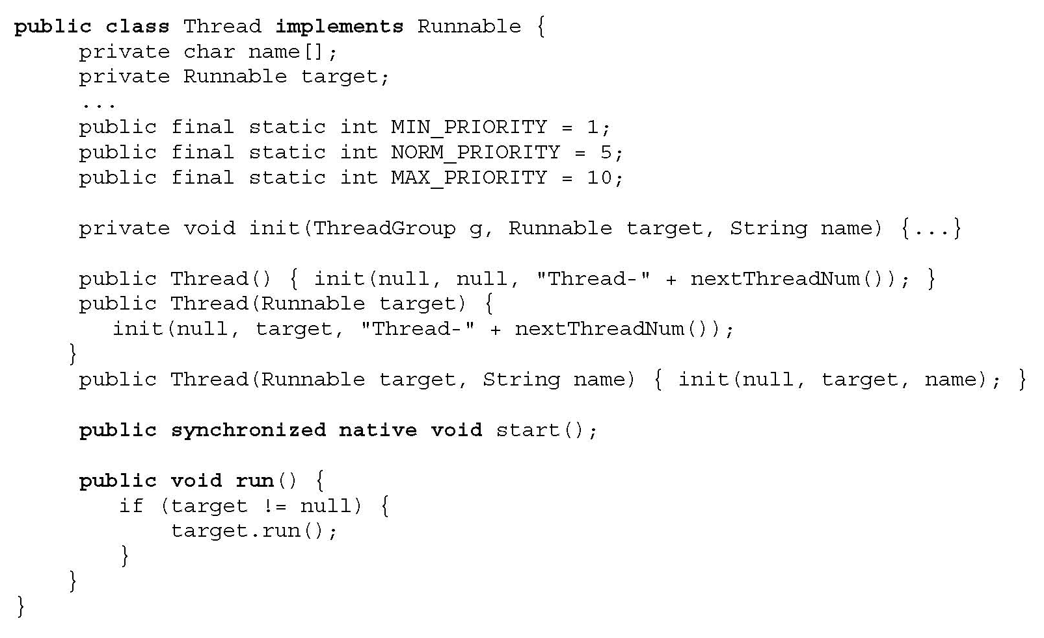
java.lang.Thread
What does
this mean?
Creates execution environment
for the thread
(sets up a separate run-time stack, etc.)
slide <number>

Slide 24
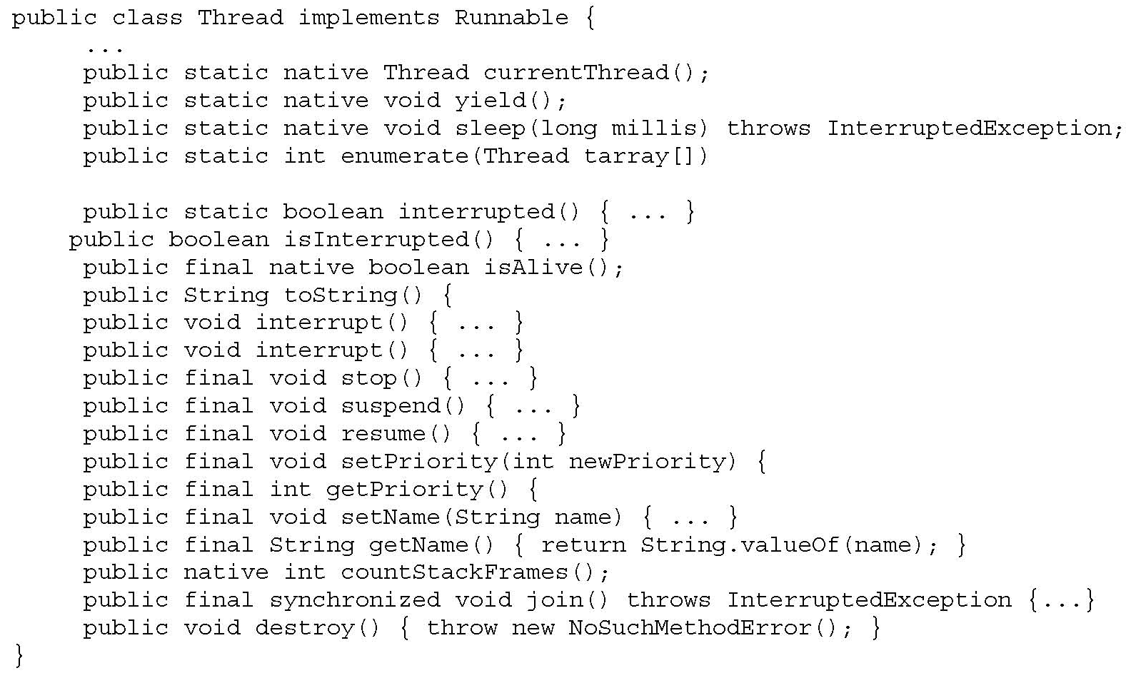
Methods of Thread Class
slide <number>

Slide 25
Runnable Interface
Thread class implements Runnable interface
Single abstract (pure virtual) method run()
  public interface Runnable {
  public void run(); }
Any implementation of Runnable must provide an implementation of the run() method
  public class ConcurrentReader implements Runnable {
  …
  public void run() { …
  … code here executes concurrently with caller … }
  }
slide <number>

Slide 26
Two Ways to Start a Thread
Construct a thread with a runnable object
  ConcurrReader readerThread = new ConcurrReader();
  Thread t = new Thread(readerThread);
  t.start(); // calls ConcurrReader.run() automatically
… OR …
Instantiate a subclass of Thread
  class ConcurrWriter extends Thread { …
  public void run() { … } }
  ConcurrWriter writerThread = new ConcurrWriter();
  writerThread.start(); // calls ConcurrWriter.run()
slide <number>

Slide 27
Why Two Ways?
Java only has single inheritance
Can inherit from some class, but also implement Runnable interface so that can run as a thread
  class X extends Y implements Runnable { …
  public synchronized void doSomething() { … }
  public void run() { doSomething(); }
  }
  X obj = new X();
  obj.doSomething(); // runs sequentially in current thread
  Thread t = new Thread(new X()); // new thread
  t.start(); // calls run() which calls doSomething()
slide <number>

Slide 28
Interesting “Feature”
[Allen Holub, “Taming Java Threads”]
Java language specification allows access to objects that have not been fully constructed
  class Broken {
  private long x;
  Broken() {
  new Thread() {
  public void run() { x = -1; }
  }.start();
  x = 0;
  } }
Thread created within constructor can access partial object
slide <number>

Slide 29
Interaction Between Threads
Shared variables and method calls
  Two threads may assign/read the same variable
    Programmer is responsible for avoiding race conditions by explicit synchronization!
  Two threads may call methods on the same object
Synchronization primitives
  All objects have an internal lock (inherited from Object)
  Synchronized method locks the object
    While it is active, no other thread can execute inside object
  Synchronization operations (inherited from Object)
    Wait: pause current thread until another thread calls Notify
    Notify: wake up waiting thread
slide <number>

Slide 30
Synchronized Methods
Provide mutual exclusion
  If a thread calls a synchronized method, object is locked
  If another thread calls a synchronized method on the same object, this thread blocks until object is unlocked
    Unsynchronized methods can still be called!
“synchronized” is not part of method signature
  Subclass may replace a synchronized method with unsynchronized method
slide <number>

Slide 31
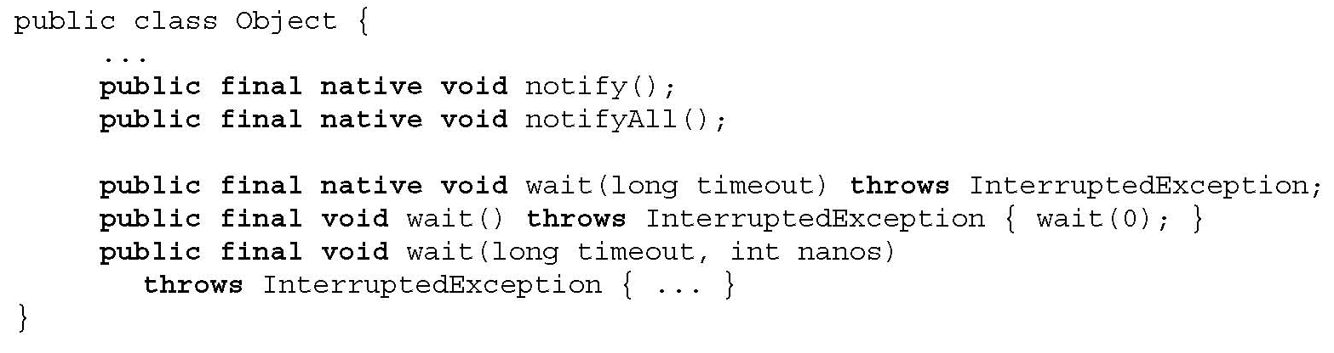
Wait, Notify, NotifyAll
wait() releases object lock, thread waits on internal queue
notify() wakes the highest-priority thread closest to the front of the object’s internal queue
notifyAll() wakes up all waiting threads
  Threads non-deterministically compete for access to object
  May not be fair (low-priority threads may never get access)
May only be called when object is locked (when is that?)
slide <number>

Slide 32
Using Synchronization
public synchronized void consume() {
while (!consumable()) {
wait(); } // release lock and wait for resource
… // have exclusive access to resource, can consume
}
public synchronized void produce() {
… // do something that makes consumable() true
notifyAll(); // tell all waiting threads to try consuming
// can also call notify() and notify one thread at a time
}
slide <number>

Slide 33
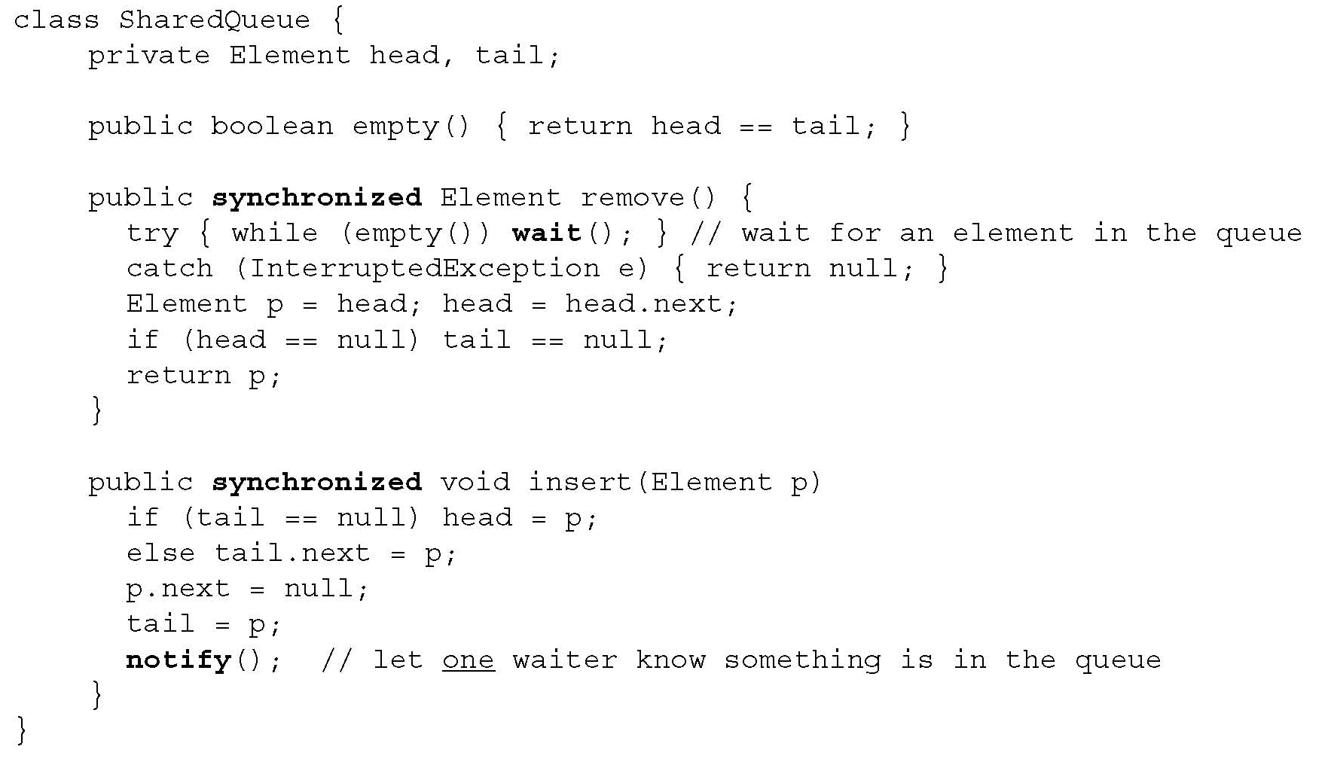
Example: Shared Queue
slide <number>

Slide 34
Example: Producer-Consumer
Producer
Consumer
Producer
Buffer
Consumer
Producer
Consumer
Method call is synchronous
How do we do this in Java?
slide <number>

Slide 35
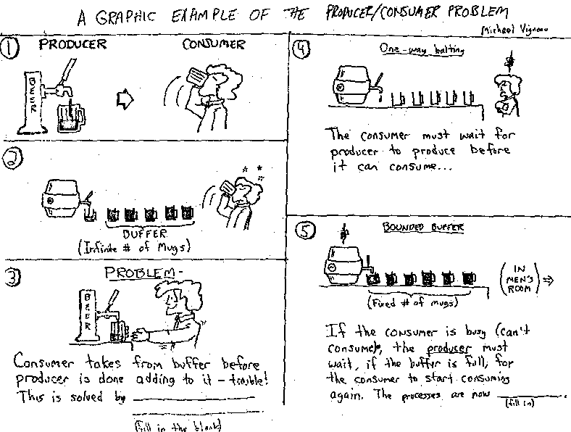
In Pictures
[from Jeffrey Smith]
slide <number>

Slide 36
Solving Producer-Consumer
Cannot be solved with locks alone
Consumer must wait until buffer is not empty
  While waiting, must sleep (use wait method)
  Need condition recheck loop
Producer must inform waiting consumers when there is something in the buffer
  Must wake up at least one consumer (use notify method)
slide <number>

Slide 37
Implementation in Stack<T>
  public synchronized void produce (T object) {
  stack.add(object); notify();
  }
  public synchronized T consume () {
  while (stack.isEmpty()) {
  try {
  wait();
  } catch (InterruptedException e) { }
  }
  int lastElement = stack.size() - 1;
  T object = stack.get(lastElement);
  stack.remove(lastElement);
  return object; }
Why is loop needed here?
slide <number>

Slide 38
Condition Rechecks
Want to wait until condition is true
  public synchronized void lock() throws InterruptedException {
  if ( isLocked ) wait();
  isLocked = true; }
  public synchronized void unLock() {
  isLocked = false;
  notify(); }
Need a loop because another process may run instead
  public synchronized void lock() throws InterruptedException {
  while ( isLocked ) wait();
  isLocked = true; }
slide <number>

Slide 39
Nested Monitor Lockout Problem
Wait and notify used within synchronized code
  Purpose: make sure that no other thread has called method of same object
Wait causes the thread to give up its lock and sleep until notified
  Allow another thread to obtain lock and continue processing
Calling a blocking method within a synchronized method can lead to deadlock
slide <number>

Slide 40
Nested Monitor Lockout Example
  class Stack {
  LinkedList list = new LinkedList();
  public synchronized void push(Object x) { synchronized(list) {
  list.addLast( x ); notify();
  } }
  public synchronized Object pop() { synchronized(list) {
  if( list.size() <= 0 ) wait();
  return list.removeLast();
  } }
  }
Could be blocking method of List class
Releases lock on Stack object but not lock on list;
a push from another thread will deadlock
slide <number>

Slide 41
Preventing Nested Monitor Deadlock
No blocking calls in synchronized methods, OR
Provide some nonsynchronized method of the blocking object
No simple solution that works for all programming situations
slide <number>

Slide 42
Synchronized Blocks
Any Java block can be synchronized
  synchronized(obj) {
  … mutual exclusion on obj holds inside this block …
  }
Synchronized method declaration is just syntactic sugar for syncronizing the method’s scope
  public synchronized void consume() { … body … }
  is the same as
  public void consume() {
  synchronized(this) { … body … }
  }
slide <number>

Slide 43
Locks Are Recursive
A thread can request to lock an object it has already locked without causing deadlock
  public class Foo {
  public void synchronized f() { … }
  public void synchronized g() { … f(); … }
  }
  Foo f = new Foo;
  synchronized(f) { … synchronized(f) { … } … }
slide <number>

Slide 44
Synchronizing with Join()
Join() waits for thread to terminate
  class Future extends Thread {
  private int result;
  public void run() { result = f(…); }
  public int getResult() { return result;}
  }
  …
  Future t = new future;
  t.start() // start new thread
  …
  t.join(); x = t.getResult(); // wait and get result
slide <number>

Slide 45
States of a Java Thread
Non-existing
create thread object
destroy
New
start
Runnable
destroy
Thread may not execute any “finally” clauses, leave objects locked
wait, join
notify, notifyAll
thread termination
run method
exits
Blocked
Terminated (Dead)
destroy
garbage collected
and finalization
Non-Existing
slide <number>

Slide 46
Concurrent Garbage Collection
Need to stop thread while mark-and-sweeping
  Do other threads need to be stopped?
Problem: objects may change during collection
Solution: prevent read/write to memory area
  Subtle!
  Generational GC distinguishes short-lived and long-lived objects
  Copying collectors allows reads from old area if writes are blocked…
slide <number>

Slide 47
Limitations of Java 1.4 Primitives
Cannot back off an attempt to acquire a lock
  Can’t give up after waiting for a certain period of time or after an interrupt
Cannot alter the semantics of a lock
  Reentrancy, read versus write protection, fairness, …
No access control for synchronization
  Any method can do synchronized(obj) on any object
Synchronization limited to block-structured locking
  Can’t acquire a lock in one method, release in another
slide <number>

Slide 48
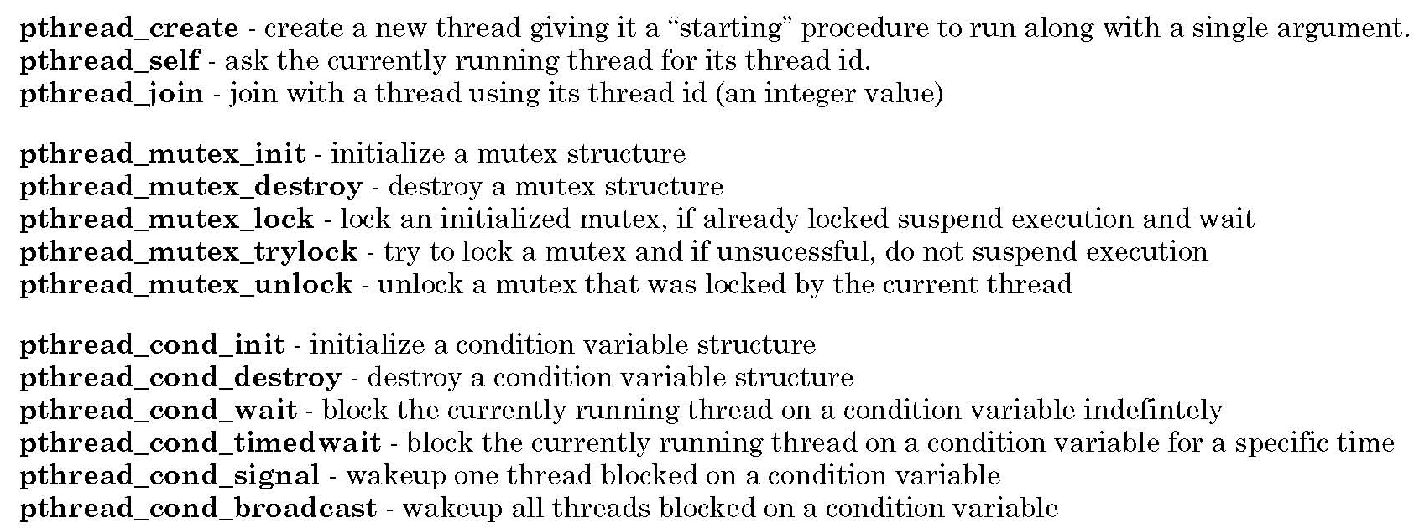
POSIX Threads
Pthreads library for C
slide <number>

Slide 49
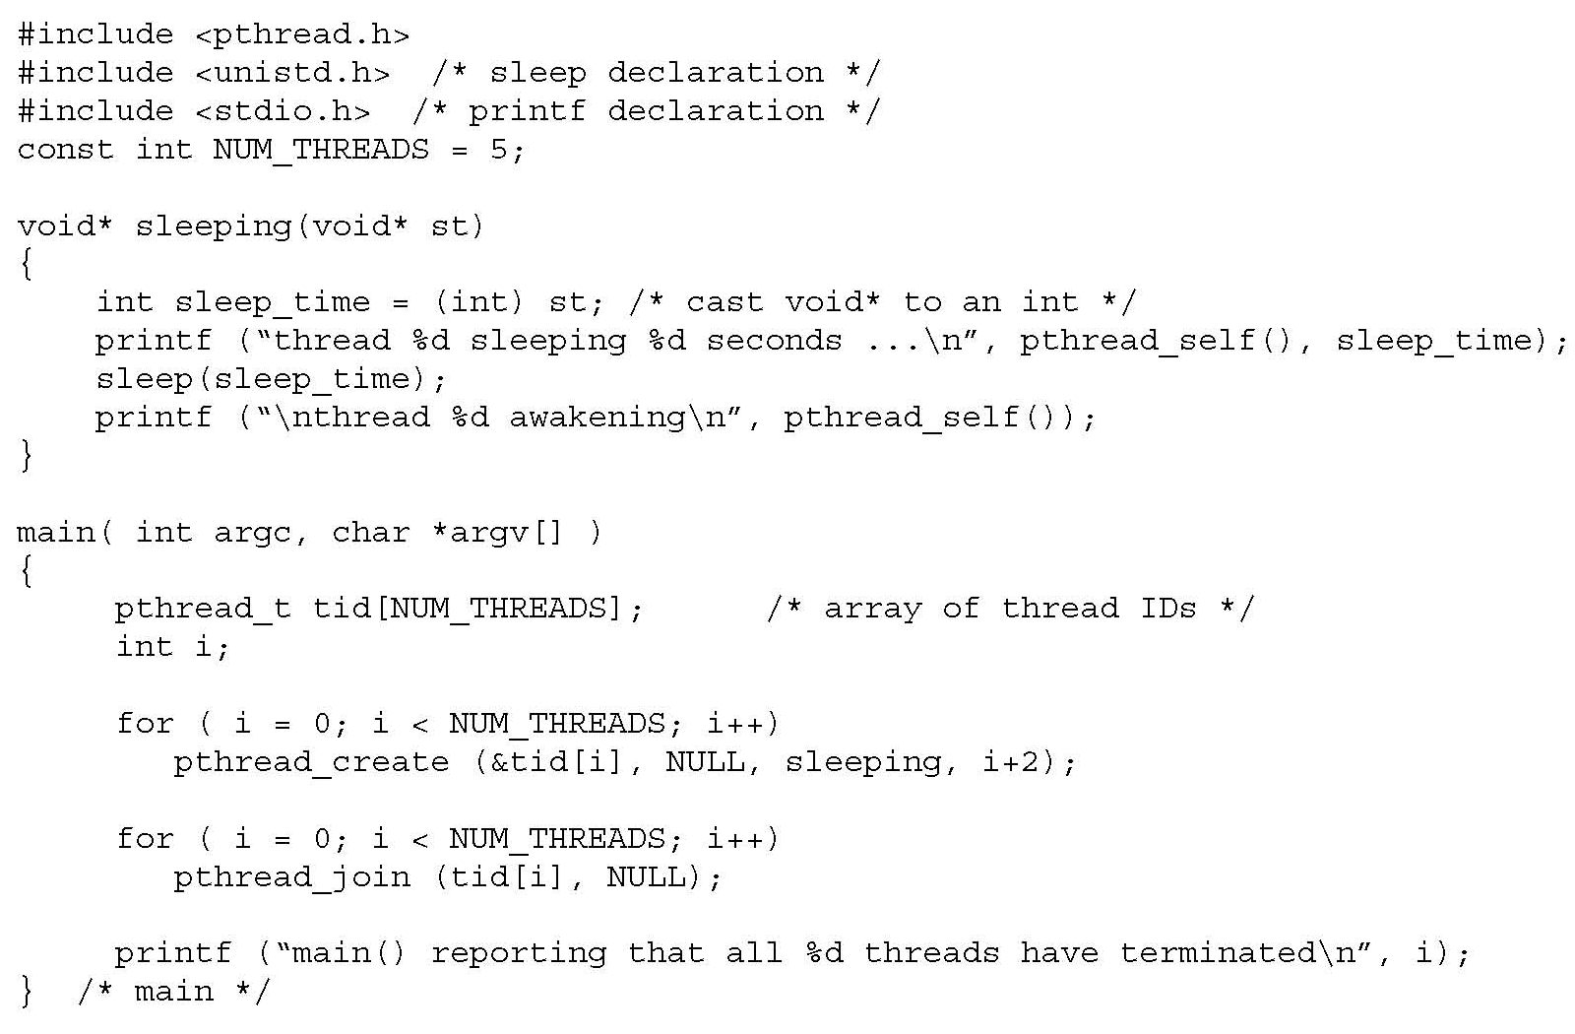
Example of Using POSIX Threads
Create several
child threads
Wait for children to finish
slide <number>

Slide 50
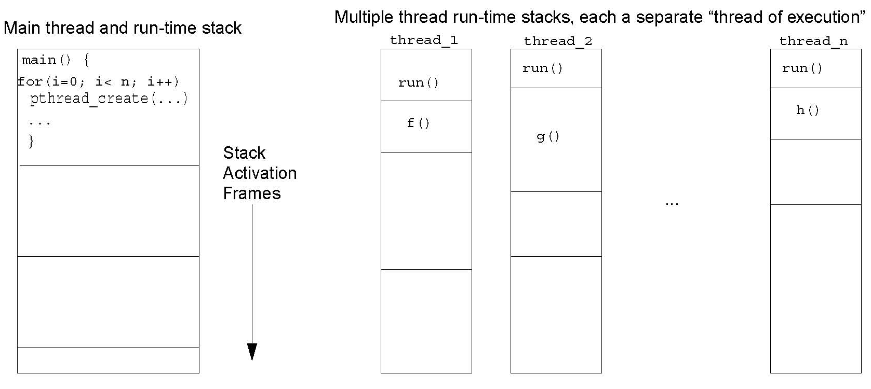
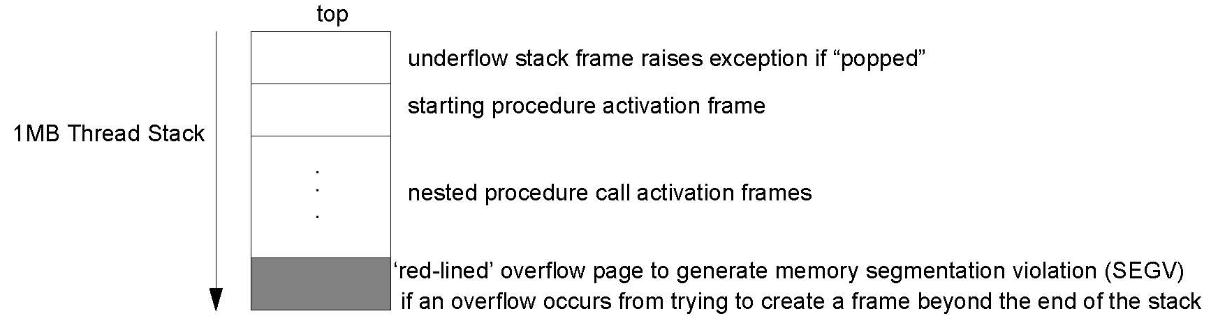
Thread Stacks
slide <number>

Slide 51
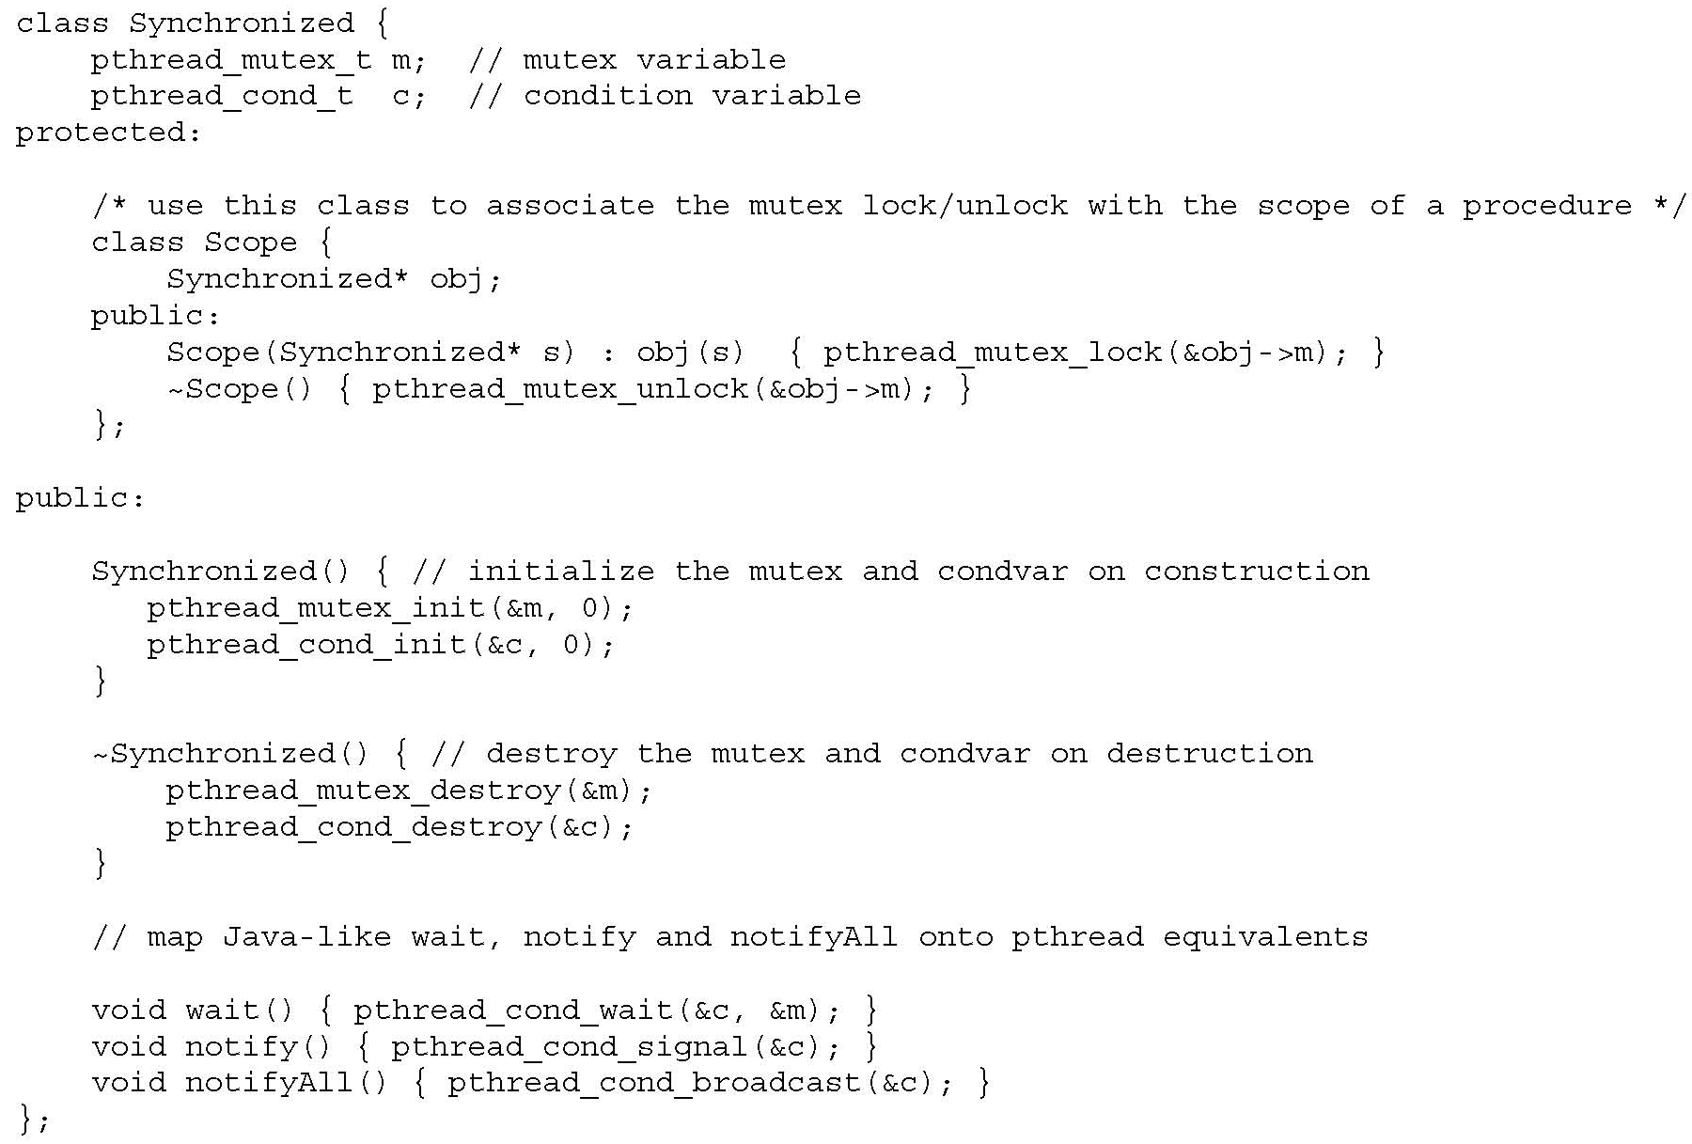
Java-Style Synchronization in C++
slide <number>

Slide 52
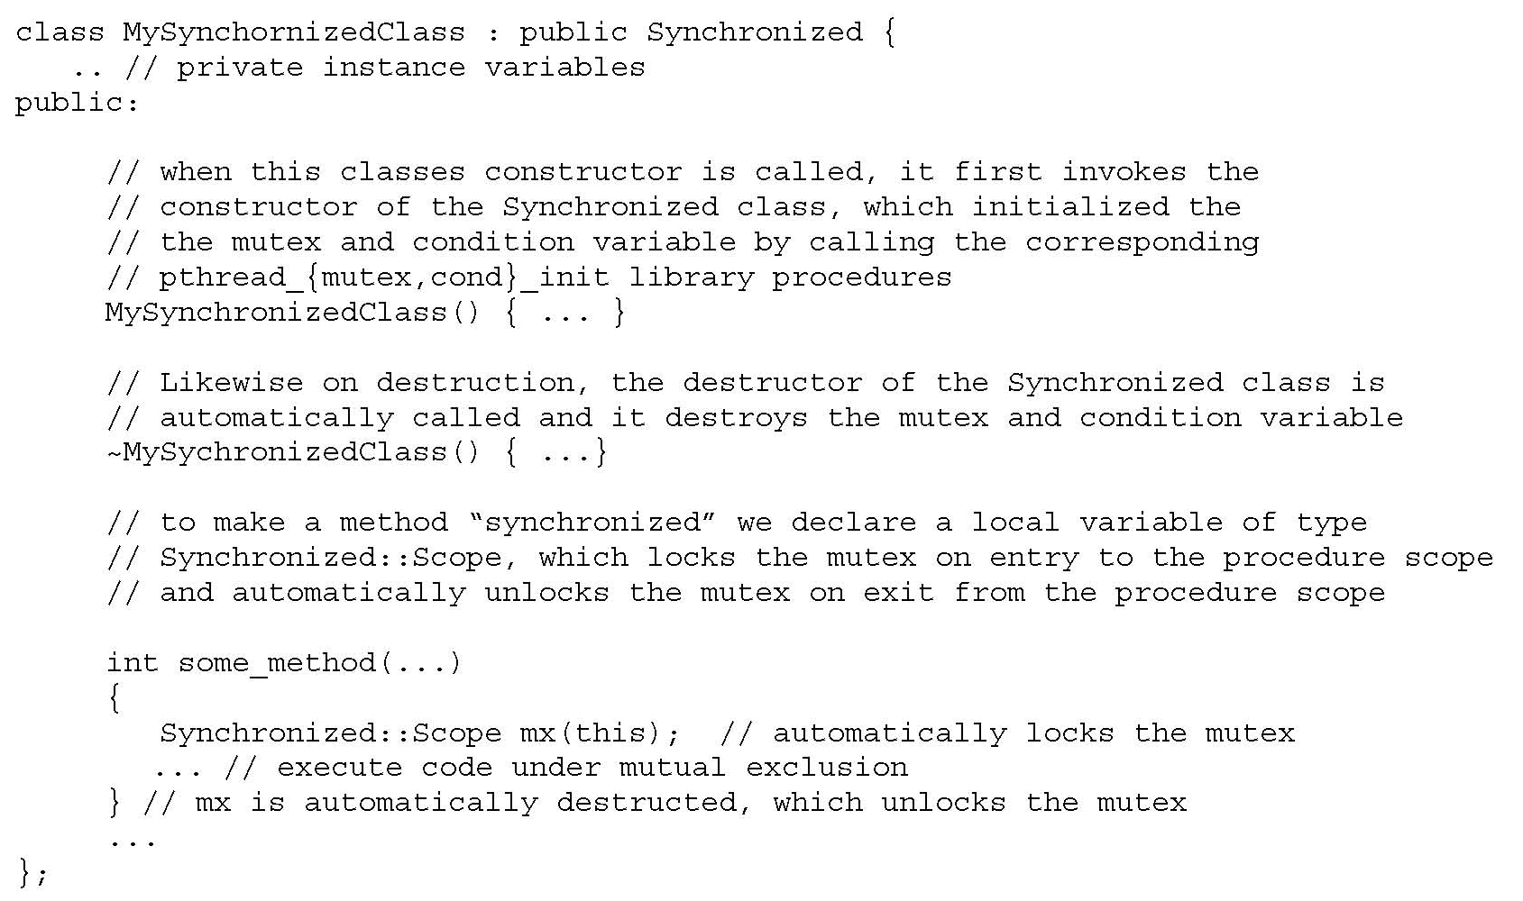
Using C++ Threads
slide <number>

Slide 53
Thread Safety of Classes
Fields of an object or class must always be in a valid state, even when used concurrently by multiple threads
  What’s a “valid state”? Serializability …
Classes are designed so that each method preserves state invariants on entry and exit
  Example: priority queues represented as sorted lists
  If invariant fails in the middle of a method call, concurrent execution of another method call will observe an inconsistent state
slide <number>

Slide 54
Example: RGBColor Class
  public class RGBColor {
  private int r; private int g; private int b;
  public RGBColor(int r, int g, int b) {
  checkRGBVals(r, g, b);
  this.r = r; this.g = g; this.b = b;
  }
  private static void checkRGBVals(int r, int g, int b) {
  if (r < 0 || r > 255 || g < 0 || g > 255 ||
  b < 0 || b > 255) {
  throw new IllegalArgumentException();
  }
  }
  }
  public void setColor(int r, int g, int b) {
  checkRGBVals(r, g, b);
  this.r = r; this.g = g; this.b = b;
  }
  public int[] getColor() {
  // returns array of three ints: R, G, B
  int[] retVal = new int[3];
  retVal[0] = r;
  retVal[1] = g;
  retVal[2] = b;
  return retVal;
  }
  public void invert() {
  r = 255 - r; g = 255 - g; b = 255 - b;
  }
What goes wrong with
multi-threaded use of this class?
slide <number>

Slide 55
Problems with RGBColor Class
Write/write conflicts
  If two threads try to write different colors, result may be a “mix” of R,G,B from two different colors
Read/write conflicts
  If one thread reads while another writes, the color that is read may not match the color before or after
slide <number>

Slide 56
Making Classes Thread-Safe
Synchronize critical sections
  Make fields private, synchronize access to them
Make objects immutable
  State cannot be changed after object is created
    public RGBColor invert() {
    RGBColor retVal = new RGBColor(255 - r, 255 - g, 255 - b);
    return retVal; }
  Examples: Java String and primitive type wrappers Integer, Long, Float, etc.
  Pure functions are always re-entrant!
Use a thread-safe wrapper
slide <number>

Slide 57
Thread-Safe Wrapper
Define new class which has objects of original class as fields, provides methods to access them
  public synchronized void setColor(int r, int g, int b) {
  color.setColor(r, g, b);
  }
  public synchronized int[] getColor() {
  return color.getColor();
  }
  public synchronized void invert() {
  color.invert();
  }
slide <number>

Slide 58
Comparison
Synchronizing critical sections
  Good way to build thread-safe classes from scratch
  Only way to allow wait() and notify()
Using immutable objects
  Good if objects are small, simple abstract data types
  Benefits: pass without aliasing, unexpected side effects
Using wrapper objects
  Works with existing classes, gives users choice between thread-safe version and original (unsafe) one
    Example: Java 1.2 collections library – classes not thread-safe, but some have methods to enclose objects in safe wrapper
slide <number>

Slide 59
Why Not Synchronize Everything?
Performance costs
  Current Sun JVM – synchronized methods are 4 to 6 times slower than non-synchronized
Risk of deadlock from too much locking
Unnecessary blocking and unblocking of threads can reduce concurrency
Alternative: immutable objects
  Issue: often short-lived, increase garbage collection
slide <number>

Slide 60
Inheritance Anomaly
Inheritance and concurrency do not mix well
  Inheritance anomaly identified in 1993 (before Java)
  Arises in different languages, to different degrees, depending on concurrency primitives
Concurrency control in derived classes requires redefinition of base class and parents
  Concurrency control = synchronization, waiting, etc.
Modification of class requires modifications of seemingly unrelated features in parent classes
slide <number>

Slide 61
Examples of Inheritance Anomaly
Partitioning of acceptable states
  Method can only be entered in certain states (enforced by base class)
  New method in derived class changes set of states
  Must redefine base class method to check new states
History-sensitive method entry
  New method in derived class can only be called after other calls
  Must modify existing methods to keep track of history
slide <number>

Slide 62
Example: Buffer Class
  public class Buffer {
  protected Object[] buf; protected int MAX; protected int current = 0;
  Buffer(int max) {
  MAX = max;
  buf = new Object[MAX]; }
  public synchronized Object get() throws Exception {
  while (current<=0) { wait(); }
  current--;
  Object ret = buf[current];
  notifyAll();
  return ret; }
  public synchronized void put(Object v) throws Exception {
  while (current>=MAX) { wait(); }
  buf[current] = v;
  current++;
  notifyAll(); } }
slide <number>

Slide 63
Problems in Derived Class
  public class HistoryBuffer extends Buffer {
  boolean afterGet = false;
  public HistoryBuffer(int max) { super(max); }
  public synchronized Object gget() throws Exception {
  while ((current<=0)||(!afterGet)) { wait(); }
  afterGet = false;
  return super.get(); }
  public synchronized Object get() throws Exception {
  Object o = super.get();
  afterGet = true;
  return o; }
  public synchronized void put(Object v) throws Exception {
  super.put(v);
  afterGet = false; } }
New method, can be called only after get
Must be redefined to keep track of last method called
Need to redefine to keep track of last method called
slide <number>

Slide 64
util.concurrent
Doug Lea’s utility classes
  A few general-purpose interfaces
  Implementations tested over several years
Principal interfaces and implementations
  Sync: acquire/release protocols
  Channel: put/take protocols
  Executor: executing Runnable tasks
slide <number>

Slide 65
Sync
Main interface for acquire/release protocols
  Used for custom locks, resource management, other common synchronization idioms
  Coarse-grained interface, doesn’t distinguish different lock semantics
Implementations
  Mutex, ReentrantLock, Latch, CountDown, Semaphore, WaiterPreferenceSemaphore, FIFOSemaphore, PrioritySemaphore
  ObservableSync, LayeredSync to simplify composition and instrumentation
slide <number>

Slide 66
Channel
Main interface for buffers, queues, etc.
Implementations
  LinkedQueue, BoundedLinkedQueue, BoundedBuffer, BoundedPriorityQueue, SynchronousChannel, Slot
put, offer
take, poll
Producer
Channel
Consumer
slide <number>

Slide 67
Executor
Main interface for Thread-like classes
  Pools
  Lightweight execution frameworks
  Custom scheduling
Need only support execute(Runnable r)
  Analogous to Thread.start
Implementations
  PooledExecutor, ThreadedExecutor, QueuedExecutor, FJTaskRunnerGroup
  Related ThreadFactory class allows most Executors to use threads with custom attributes
slide <number>

Slide 68
java.util.Collection
Adapter-based scheme
  Allow layered synchronization of collection classes
Basic collection classes are unsynchronized
  Example: java.util.ArrayList
  Except for Vector and Hashtable
Anonymous synchronized Adapter classes
  Constructed around the basic classes, e.g.,
  List l = Collections.synchronizedList(new ArrayList());
slide <number>

Slide 69
Java Memory Model
Multithreaded access to shared memory
  Competitive threads access shared data
  Can lead to data corruption
Memory model determines:
  Which program transformations are allowed
    Should not be too restrictive
  Which program outputs may occur on correct implementation
    Should not be too generous
  Need semantics for incorrectly synchronized programs
slide <number>

Slide 70
Memory Hierarchy
Shared Memory
Thread
Cache
code
read/write
load/store
use/assign
Thread
Cache
code
Old memory model placed complex constraints on read, load, store, etc.
slide <number>

Slide 71
Program and Locking Order
[Manson, Pugh]
Thread 1
Thread 2
y = 1
lock M
lock M
program
order
lock
sync
program
order
x = 1
i = x
unlock M
unlock M
j = y
slide <number>

Slide 72
Race Conditions
“Happens-before” order
  Transitive closure of program order and synchronizes-with order (what does this mean?)
    Program order as written or as compiled and optimized?
Conflict
  An access is a read or a write
  Two accesses conflict if at least one is a write
Race condition
  Two accesses form a data race if they are from different threads, they conflict, and they are not ordered by happens-before
slide <number>

Slide 73

Races in Action
Northeast Blackout of 2003
  Affected 50 million people in U.S. and Canada
Race condition in alarm management system caused it to stall, alarms backed up and stalled both primary and backup server
  “We had in excess of three million online operational hours in which nothing had ever exercised that bug. I'm not sure that more testing would have revealed it.”
  -- GE Energy's Mike Unum
slide <number>

Slide 74
Memory Model Question
How should the compiler and run-time system be allowed to schedule instructions?
Possible partial answer
  If instruction A occurs in Thread 1 before release of lock, and B occurs in Thread 2 after acquire of same lock, then A must be scheduled before B
Does this solve the problem?
  Too restrictive: if no reordering allowed in threads
  Too permissive: if arbitrary reordering in threads
  Compromise: allow local thread reordering that would be OK for sequential programs
slide <number>

Slide 75
Instruction Reordering
Compilers can reorder instructions
  If two instructions are independent, do in any order
  Take advantage of registers, etc.
Correctness for sequential programs
  Observable behavior should be same as if program instructions were executed in the order written
Sequential consistency for concurrent programs
  If program has no data races, then memory model should guarantee sequential consistency
  What about programs with races?
    Reasonable programs may have races (need to test, debug, …)
slide <number>

Slide 76
Example Program with Data Race
[Manson, Pugh]
x = y = 0
Thread 1
start threads
Thread 2
x = 1
y = 1
j = y
i = x
Can we end up with i = 0 and j = 0?
slide <number>

Slide 77
Sequential Reordering + Data Race
[Manson, Pugh]
x = y = 0
Thread 1
start threads
Thread 2
x = 1
y = 1
OK to reorder
single thread
OK to reorder
single thread
j = y
i = x
Can we end up with i = 0 and j = 0? Yes!
Java definition considers this OK since there is a data race
slide <number>

Slide 78
Allowed Sequential Reordering
[Manson, Pugh]
“Roach motel” ordering
  Compiler/processor can move accesses into synchronized blocks
  Can only move them out under special circumstances, generally not observable
Release only matters to a matching acquire
Special cases:
  Locks on thread local objects are a no-op
  Reentrant locks are a no-op
Java SE 6 (Mustang) optimizes based on this
slide <number>

Slide 79
Want To Prevent This
[Manson, Pugh]
x = y = 0
r1 = x
r2 = y
y = r1
x = r2
Must not result in r1 = r2 = 42
  Imagine if 42 were a reference to an object!
Value appears “out of thin air”
  Causality run amok
  Legal under a simple “happens-before” model of possible behaviors
slide <number>

Slide 80
Summary of Memory Model
Strong guarantees for race-free programs
  Equivalent to interleaved execution that respects synchronization actions
  Reordering must preserve thread’s sequential semantics
Weaker guarantees for programs with races
  No weird out-of-the-blue program results
  Allows program transformation and optimization
Form of actual memory model definition
  Happens-before memory model
  Additional condition: for every action that occurs, there must be identifiable cause in the program
slide <number>

Slide 81
Example: Concurrent Hash Map
Implements a hash table
  Insert and retrieve data elements by key
  Two items in same bucket placed in linked list
Tricky
  “ConcurrentHashMap is both a very useful class for many concurrent applications and a fine example of a class that understands and exploits the subtle details of the Java Memory Model (JMM) to achieve higher performance. … Use it, learn from it, enjoy it – but unless you're an expert on Java concurrency, you probably shouldn't try this on your own.”
slide <number>

Slide 82
ConcurrentHashMap
Array
Linked lists
Data
Data
Data
Data
Data
Data
Data
Data
Data
Concurrent operations
  read: no problem
  read/write: OK if different lists
  read/write to same list: clever tricks sometimes avoid locking
slide <number>

Slide 83
ConcurrentHashMap Tricks
Array
Linked lists
Data
Data
Data
List cells immutable, except for data field
  Read thread sees a linked list, even if concurrent write in progress
Add to list by inserting at the head
Remove from list: set data field to null, rebuild list to skip this cell
  Unreachable cells eventually garbage collected
slide <number>

Slide 84
Atomicity
Mark block so that compiler and run-time system will execute it without interaction from other threads
Advantages
  Simple, powerful correctness property
  Stronger than race freedom (why?)
  Enables sequential reasoning
slide <number>

Slide 85
Limitations of Race-Freedom (1)
[Flanaghan]
class Ref {
int i;
void inc() {
int t;
synchronized (this) {
t = i;
}
synchronized (this) {
i = t+1;
}
}
...
}
Ref.inc()
Race-free
Behaves incorrectly in a multithreaded context
Race freedom does not prevent errors due to unexpected interactions
between threads
slide <number>

Slide 86
Limitations of Race-Freedom (2)
[Flanaghan]
class Ref {
int i;
void inc() {
int t;
synchronized (this) {
t = i;
i = t+1;
}
}
void read() { return i; }
...
}
Ref.read()
Has a race condition
Behaves correctly in a multithreaded context
Race freedom is not necessary to prevent errors due to unexpected interactions
between threads
slide <number>

Slide 87
Atomicity
[Flanaghan]
An easier-to-use and harder-to-implement primitive:
void deposit(int x){
synchronized(this) {
int tmp = balance;
tmp += x;
balance = tmp;
}}
void deposit(int x){
atomic {
int tmp = balance;
tmp += x;
balance = tmp;
}}
semantics:
lock acquire/release
semantics:
(behave as if)
no interleaved execution
No fancy hardware, code restrictions, deadlock, or unfair scheduling (e.g., disabling interrupts)
slide <number>

Slide 88
AtomJava
[Grossman]
New prototype from the University of Washington
  Based on source-to-source translation for Java
Atomicity via locking (object ownership)
  Poll for contention and rollback
  No support for parallel readers yet
Key pieces of the implementation
  All writes logged when an atomic block is executed
  If thread is pre-empted in atomic, rollback the thread
  Duplicate so non-atomic code is not slowed by logging
  Smooth interaction with GC
slide <number>

