Slide 1
Modularity and
Object-Oriented Programming
CS 345
Vitaly Shmatikov
slide <number>

Slide 2
Reading Assignment
Mitchell, Chapters 9 and 10
slide <number>

Slide 3
Topics
Modular program development
  Stepwise refinement
  Interface, specification, and implementation
Language support for modularity
  Procedural abstraction
  Abstract data types
  Packages and modules
  Generic abstractions
    Functions and modules with type parameters
slide <number>

Slide 4
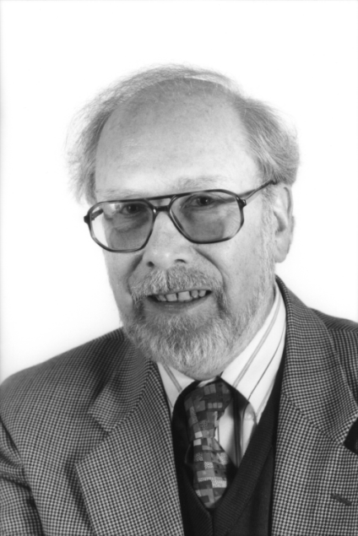
Stepwise Refinement
“… program ... gradually developed in a sequence of refinement steps … In each step, instructions … are decomposed into more detailed instructions.”
  Niklaus Wirth, 1971
slide <number>

Slide 5
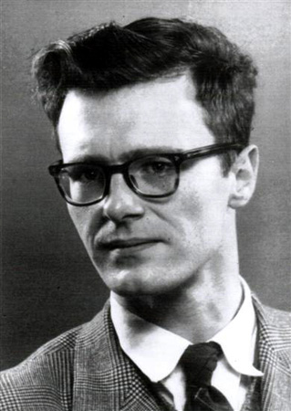
Dijkstra’s Example (1969)
begin
print first 1000 primes
end
begin
variable table p
fill table p with first 1000 primes
print table p
end
begin
int array p[1:1000]
make for k from 1 to 1000
p[k] equal to k-th prime
print p[k] for k from 1 to 1000
end
slide <number>

Slide 6
Program Structure
Main Program
Sub-program
Sub-program
Sub-program
Sub-program
Sub-program
slide <number>

Slide 7
Data Refinement
“As tasks are refined, so the data may have to be refined, decomposed, or structured, and it is natural to refine program and data specifications in parallel”
  Wirth, 1971
slide <number>

Slide 8
Example
Bank Transactions
Deposit
Withdraw
Print Statement
For level 2, represent account balance by integer variable
For level 3, need to maintain list of past transactions
Print transaction
history
slide <number>

Slide 9
Modularity: Basic Concepts
Component
  Meaningful program unit
    Function, data structure, module, …
Interface
  Types and operations defined within a component that are visible outside the component
Specification
  Intended behavior of component, expressed as property observable through interface
Implementation
  Data structures and functions inside component
slide <number>

Slide 10
Example: Function Component
Component
  Function to compute square root
Interface
  float sqroot (float x)
Specification
  If x>0, then sqrt(x)*sqrt(x) ≈ x.
Implementation
  float sqroot (float x){
  float y = x/2; float step=x/4; int i;
  for (i=0; i<20; i++){if ((y*y)<x) y=y+step; else y=y-step; step = step/2;}
  return y;
  }
slide <number>

Slide 11
Example: Data Type
Component
  Priority queue: data structure that returns elements in order of decreasing priority
Interface
  Type pq
  Operations empty : pq
  insert : elt * pq → pq
  deletemax : pq → elt * pq
Specification
  Insert adds to set of stored elements
  Deletemax returns max elt and pq of remaining elts
slide <number>

Slide 12
Using Priority Queue Data Type
Priority queue: structure with three operations
  empty : pq
  insert : elt * pq → pq
  deletemax : pq → elt * pq
Algorithm using priority queue (heap sort)
  begin
  create empty pq s
  insert each element from array into s
  remove elts in decreasing order and place in array
  end
slide <number>

Slide 13

Abstract Data Types (ADT)
Prominent language development of 1970s
Idea 1: Separate interface from implementation
  Example:
  Sets have operations empty, insert, union,
  is_member?, …
  Sets are implemented as … linked list …
Idea 2: Use type checking to enforce separation
  Client program only has access to operations in the interface
  Implementation encapsulated inside ADT construct
slide <number>

Slide 14
Modules
General construct for information hiding
  Known as modules (Modula), packages (Ada), structures (ML), …
Interface:
  A set of names and their types
Implementation:
  Declaration for every entry in the interface
  Additional declarations that are hidden
slide <number>

Slide 15
Modules and Data Abstraction
  module Set
  interface
  type set
  val empty : set
  fun insert : elt * set -> set
  fun union : set * set -> set
  fun isMember : elt * set -> bool
  implementation
  type set = elt list
  val empty = nil
  fun insert(x, elts) = ...
  fun union(…) = ...
  ...
  end Set
Can define ADT
  Private type
  Public operations
Modules are more general
  Several related types and operations
Some languages separate interface & implementation
  One interface can have multiple implementations
slide <number>

Slide 16
Generic Abstractions
Parameterize modules by types, other modules
Create general implementations
  Can be instantiated in many ways
  Same implementation for multiple types
Language examples:
  Ada generic packages, C++ templates (especially STL – Standard Template Library), ML functors, …
slide <number>

Slide 17
C++ Templates
Type parameterization mechanism
  template<class T> … indicates type parameter T
  C++ has class templates and function templates
Instantiation at link time
  Separate copy of template generated for each type
  Why code duplication?
    Size of local variables in activation record
    Link to operations on parameter type
Remember swap function?
  See lecture notes on overloading and polymorphism
slide <number>

Slide 18

C++ Standard Template Library
Many generic abstractions
  Polymorphic abstract types and operations
  Excellent example of generic programming
Efficient running time
(but not always space)
Written in C++
  Uses template mechanism and overloading
  Does not rely on objects – no virtual functions!
  Architect: Alex Stepanov
slide <number>

Slide 19
Main Entities in STL
Container: Collection of typed objects
  Examples: array, list, associative dictionary, ...
Iterator: Generalization of pointer or address
Algorithm
Adapter: Convert from one form to another
  Example: produce iterator from updatable container
Function object: Form of closure (“by hand”)
Allocator: encapsulation of a memory pool
  Example: GC memory, ref count memory, ...
slide <number>

Slide 20
Example of STL Approach
Function to merge two sorted lists (concept)
  merge : range(s) × range(t) × comparison(u)
  → range(u)
  range(s) - ordered “list” of elements of type s, given by pointers to first and last elements
  comparison(u) - boolean-valued function on type u
  subtyping - s and t must be subtypes of u
  (This is not STL syntax, but illustrates the concept)
slide <number>

Slide 21
Merge in STL
Ranges represented by iterators
  Iterator is generalization of pointer
  supports ++ (move to next element)
Comparison operator is object of class Compare
Polymorphism expressed using template
  template < class InputIterator1, class InputIterator2,
  class OutputIterator, class Compare >
  OutputIterator merge(InputIterator1 first1, InputIterator1 last1,
  InputIterator2 first2, InputIterator1 last2,
  OutputIterator result, Compare comp)
slide <number>

Slide 22
STL vs. “Raw” C and C++
C:
  qsort( (void*)v, N, sizeof(v[0]), compare_int );
C++, using raw C arrays:
  int v[N];
  sort( v, v+N );
C++, using a vector class:
  vector v(N);
  sort( v.begin(), v.end() );
slide <number>

Slide 23
Object-Oriented Programming
Several important language concepts
Dynamic lookup
Encapsulation
Inheritance
Subtyping
slide <number>

Slide 24
Objects
An object consists of …
  Hidden data
    Instance variables (member data)
    Hidden functions also possible
  Public operations
    Methods (member functions)
    Can have public variables in some languages
Object-oriented program:
  Send messages to objects
hidden data
msg₁
method₁
. . .
. . .
msg_{n}
method_{n}
Universal encapsulation
construct
(can be used for data
structures, file systems,
databases, windows, etc.)
slide <number>

Slide 25
Dynamic Lookup
In conventional programming,
  operation (operands)
meaning of operation is always the same
In object-oriented programming,
  object → message (arguments)
code depends on object and message
Fundamental difference between
abstract data types and objects!
slide <number>

Slide 26
Overloading vs. Dynamic Lookup
Conventional programming add (x, y)
function add has fixed meaning
Add two numbers x → add (y)
different add if x is integer, complex
Similar to overloading, but critical difference: overloading is resolved at compile time, dynamic lookup at run time
slide <number>

Slide 27
Encapsulation
Builder of a concept has detailed view
User of a concept has “abstract” view
Encapsulation separates these two views
  Implementation code: operate on representation
  Client code: operate by applying fixed set of operations provided by implementer of abstraction
message
Object
slide <number>

Slide 28
Subtyping and Inheritance
Interface
  The external view of an object
Subtyping
  Relation between interfaces
Implementation
  The internal representation of an object
Inheritance
  Relation between implementations
  New objects may be defined by reusing implementations of other objects
slide <number>

Slide 29
Object Interfaces
Interface
  The messages understood by an object
Example: point
  x-coord : returns x-coordinate of a point
  y-coord : returns y-coordinate of a point
  move : method for changing location
The interface of an object is its type
slide <number>

Slide 30
Subtyping
If interface A contains all of interface B, then A objects can also be used as B objects
  Point
  x-coord
  y-coord
  move
  Colored_point
  x-coord
  y-coord
  color
  move
  change_color
Colored_point interface contains Point
  Colored_point is a subtype of Point
slide <number>

Slide 31
Example
Subtyping
  Colored points can be used in place of points
  Property used by client program
Inheritance
  Colored points can be implemented by reusing point implementation
  Technique used by implementer of classes
class Point
  private
  float x, y
  public
  point move (float dx, float dy);
class Colored_point
  private
  float x, y; color c
  public
  point move(float dx, float dy);
  point change_color(color newc);
slide <number>

Slide 32
Object-Oriented Program Structure
Group data and functions
Class
  Defines behavior of all objects that are instances of the class
Subtyping
  Place similar data in related classes
Inheritance
  Avoid reimplementing functions that are already defined
slide <number>

Slide 33
Example: Geometry Library
Define general concept shape
Implement two shapes: circle, rectangle
Functions on shapes: center, move, rotate, print
Anticipate additions to library
slide <number>

Slide 34
Shapes
Interface of every shape must include
center, move, rotate, print
Different kinds of shapes are implemented differently
  Square: four points, representing corners
  Circle: center point and radius
slide <number>

Slide 35
Subtype Hierarchy
Shape
Circle
Rectangle
General interface defined in the shape class
Implementations defined in circle, rectangle
Extend hierarchy with additional shapes
slide <number>

Slide 36
Code Placed in Classes
 | center | move | rotate | print
Circle | c_center | c_move | c_rotate | c_print
Rectangle | r_center | r_move | r_rotate | r_print
Dynamic lookup
  circle → move(x,y) calls function c_move
Conventional organization
  Place c_move, r_move in move function
slide <number>

Slide 37
Usage Example: Processing Loop
Remove shape from work queue
Perform action
Control loop does not know the type of each shape
slide <number>

Slide 38
Subtyping ≠ Inheritance
Collection
Indexed
Set
Array
Dictionary
Sorted Set
String
Subtyping
Inheritance
slide <number>

