Slide 1
Logic Programming
CS 345
Vitaly Shmatikov
slide <number>

Slide 2
Reading Assignment
Mitchell, Chapter 15
slide <number>

Slide 3
Logic Programming
Function (method) is the basic primitive in all languages we have seen so far
  F(x)=y – function F takes x and return y
Relation (predicate) is the basic primitive in logic programming
  R(x,y) – relationship R holds between x and y
slide <number>

Slide 4

Prolog
Short for Programmation en logique
  Alain Colmeraurer (1972)
Basic idea: the program declares the goals of the computation, not the method for achieving them
Applications in AI, databases, even systems
  Originally developed for natural language processing
  Automated reasoning, theorem proving
  Database searching, as in SQL
  Expert systems
  Recent work at Berkeley on declarative programming
slide <number>

Slide 5


Example: Logical Database
OKC
In Prolog:
nonstop(aus, dal).
nonstop(aus, hou).
nonstop(aus, phx).
nonstop(dal, okc).
nonstop(dal, hou).
nonstop(hou, okc).
nonstop(okc, phx).
PHX
DAL
AUS
HOU
slide <number>

Slide 6
Logical Database Queries
Where can we fly from Austin?
SQL
  SELECT dest FROM nonstop WHERE source=“aus”;
Prolog
  ?- nonstop(aus, X).
  More powerful than SQL because can use recursion
slide <number>

Slide 7
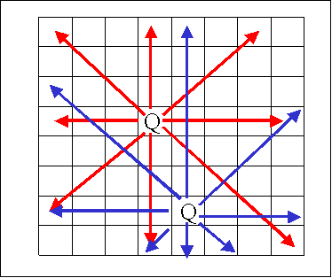
N-Queens Problem
Place N non-attacking queens on the chessboard
  Example of a search problem (why?)
slide <number>

Slide 8
N-Queens in Prolog
diagsafe(_, _, []).
diagsafe(Row, ColDist, [QR|QRs]) :-
RowHit1 is Row + ColDist, QR =n= RowHit1,
RowHit2 is Row - ColDist, QR =n= RowHit2,
ColDist1 is ColDist + 1,
diagsafe(Row, ColDist1, QRs).
safe_position([_]).
safe_position([QR|QRs]) :-
diagsafe(QR, 1, QRs),
safe_position(QRs).
nqueens(N, Y) :-
sequence(N, X), permute(X, Y), safe_position(Y).
slide <number>

Slide 9
Type Inference in ML
Given an ML term, find its type
fun
@
@
x
+
2
slide <number>

Slide 10
Flight Planning Example
Each line is
called a clause
and represents
a known fact
OKC
nonstop(aus, dal).
nonstop(aus, hou).
nonstop(aus, phx).
nonstop(dal, okc).
nonstop(dal, hou).
nonstop(hou, okc).
nonstop(okc, phx).
PHX
DAL
A fact is true if
and only if we
can prove it true
using some clause
AUS
HOU
Relation: nonstop(X, Y) – there is a flight from X to Y
slide <number>

Slide 11
Queries in Prolog
OKC
?-
Yes
?-
Yes
?-
No
?-
nonstop(aus, dal).
nonstop(dal, okc).
nonstop(aus, okc).
PHX
DAL
AUS
HOU
slide <number>

Slide 12
Logical Variables in Prolog
Is there an X such that
nonstop(okc, X) holds?
OKC
?-
X=phx ;
No
?-
Y=aus ;
No
?-
nonstop(okc, X).
nonstop(Y, dal).
PHX
DAL
AUS
HOU
slide <number>

Slide 13
Non-Determinism
OKC
?-
X=hou ;
X=okc ;
No
?-
No
?-
nonstop(dal, X).
nonstop(phx, X).
PHX
DAL
AUS
HOU
Predicates may return multiple answers or no answers
slide <number>

Slide 14
Logical Conjunction
OKC
?-
X=dal ;
X=hou ;
No
?-
nonstop(aus, X), nonstop(X, okc).
PHX
DAL
AUS
HOU
Combine multiple conditions into one query
slide <number>

Slide 15
Derived Predicates
Define new predicates using rules
conclusion :- premises.
  - conclusion is true if premises are true
OKC
flyvia(From, To, Via) :-
nonstop(From, Via),
nonstop(Via, To).
flyvia(aus, okc, Via).
PHX
DAL
?-
Via=dal ;
Via=hou ;
No
?-
AUS
HOU
slide <number>

Slide 16
Recursion
Predicates can be defined recursively
OKC
reach(X, X).
reach(X,Z) :-
nonstop(X, Y), reach(Y, Z).
reach(X, phx).
PHX
DAL
?-
X=aus ;
X=dal ;
…
?-
AUS
HOU
slide <number>

Slide 17
Prolog Program Elements
Prolog programs are made from terms
  Variables, constants, structures
Variables begin with a capital letter
  Bob
Constants are either integers, or atoms
  24, zebra, ‘Bob’, ‘.’
Structures are predicates with arguments
  n(zebra), speaks(Y, English)
slide <number>

Slide 18
Horn Clauses
A Horn clause has a head h, which is a predicate, and a body, which is a list of predicates p1, p2, …, pn
  It is written as h ← p1, p2, …, pn
  This means, “h is true if p1, p2, …, and pn are simultaneously true”
Example
  snowing(C) ← precipitation(C), freezing(C)
  This says, “it is snowing in city C if there is precipitation in city C and it is freezing in city C”
slide <number>

Slide 19
Facts, Rules, and Programs
A Prolog fact is a Horn clause without a right-hand side
  Term.
    The terminating period is mandatory
A Prolog rule is a Horn clause with a right-hand side (:- represents ←)
  term :- term1, term2, … termn.
  LHS is called the head of the rule
Prolog program = a collection of facts and rules
slide <number>

Slide 20
Horn Clauses and Predicates
Any Horn clause h ← p1, p2, …, pn can be written as a predicate p1 ∧ p2 ∧ … ∧ pn ⊃ h, or, equivalently, ¬(p1 ∧ p2 ∧ … ∧ pn) ∨ h
Not every predicate can be written as a Horn clause (why?)
  Example: literate(x) ⊃ reads(x) ∨ writes(x)
slide <number>

Slide 21
Lists
A list is a series of terms separated by commas and enclosed in brackets
  The empty list is written []
  A “don’t care” entry is signified by _, as in [_, X, Y]
  A list can also be written in the form [Head | Tail]
slide <number>

Slide 22
Appending a List
append([], X, X).
append([Head | Tail], Y, [Head | Z]) :-
append(Tail, Y, Z).
  The last parameter designates the result of the function, so a variable must be passed as an argument
This definition says:
  Appending X to the empty list returns X
  If Y is appended to Tail to get Z, then Y can be appended to a list one element larger [Head | Tail] to get [Head | Z]
slide <number>

Slide 23
List Membership
member(X, [X | _]).
member(X, [_ | Y]) :- member(X, Y).
The test for membership succeeds if either:
  X is the head of the list [X | _]
  X is not the head of the list [_ | Y] , but X is a member of the remaining list Y
Pattern matching governs tests for equality
“Don’t care” entries (_) mark parts of a list that aren’t important to the rule
slide <number>

Slide 24
More List Functions
X is a prefix of Z if there is a list Y that can be appended to X to make Z
  prefix(X, Z) :- append(X, Y, Z).
  Suffix is similar: suffix(Y, Z) :- append(X, Y, Z).
Finding all the prefixes (suffixes) of a list
  ?- prefix(X, [my, dog, has, fleas]).
  X = [];
  X = [my];
  X = [my, dog];
  …
slide <number>

Slide 25
Answering Prolog Queries
Computation in Prolog (answering a query) is essentially searching for a logical proof
Goal-directed, backtracking, depth-first search
  Resolution strategy:
  if h is the head of a Horn clause
  h ← terms
  and it matches one of the terms of another Horn clause
  t ← t1, h, t2
  then that term can be replaced by h’s terms to form
  t ← t1, terms, t2
  What about variables in terms?
slide <number>

Slide 26
Flight Planning Example
?- n(aus, hou).
?- n(aus, dal).
?- r(X, X).
?- r(X, Z) :- n(X, Y), r(Y, Z).
?- r(aus, X)
AUS
HOU
DAL
slide <number>

Slide 27
Flight Planning: Proof Search
Solution
r(aus, aus)
r(aus, hou)
r(aus, X)
AUS
r(aus,aus)
n(aus,Y), r(Y,X)
HOU
DAL
n(aus,Y)
r(hou,X)
Rule 1:
r(X, X).
Rule 2:
r(X, Z) :- n(X, Y), r(Y, Z).
n(aus,hou)
r(hou,hou)
n(hou,Z), r(Z,X)
slide <number>

Slide 28
Flight Planning: Backtracking
Solution
r(aus, aus)
r(aus, hou)
r(aus, dal)
r(aus, X)
AUS
r(aus,aus)
n(aus,Y), r(Y,X)
HOU
DAL
n(aus,Y)
r(dal,X)
Rule 1:
r(X, X).
Rule 2:
r(X, Z) :- n(X, Y), r(Y, Z).
n(aus,hou)
r(dal,dal)
n(dal,Z), r(Z,X)
n(aus,dal)
slide <number>

Slide 29
Unification
Two terms are unifiable if there is a variable substitution such that they become the same
  For example, f(X) and f(3) are unified by [X=3]
  f(f(Y)) and f(X) are unified by [X=f(Y)]
  How about g(X,Y) and f(3)?
Assignment of values to variables during resolution is called instantiation
Unification is a pattern-matching process that determines what instantiations can be made to variables during a series of resolutions
slide <number>

Slide 30
Example: List Membership
mem(Z, [1,2])
{X=Z, X=1}
{Z=X, Y=[2]}
mem(1, [1,2])
mem(X, [2])
{X=2}
{X’=X, Y’=[]}
Rule 1:
mem(X, [X | _]).
Rule 2:
mem(X, [_ | Y]) :- mem(X, Y).
mem(2, [2])
mem(X’, [])
Prolog
?- mem(X, [1,2]).
X=1 ;
X=2 ;
No
?-
?
?
slide <number>

Slide 31
Unification example
loves(john,mary).
loves(fred,hobbies).
Now let's look at some simple queries using variables
?- loves(john,Who). /* Who does john love? */
Who=mary /* yes , Who gets bound to mary */
yes /* and the query succeeds*/
?- loves(arnold,Who) /* does arnold love anybody */
no /* no, arnold doesn't match john or fred */
?- loves(fred,Who). /* Who does fred love */
Who = hobbies /* Note the to Prolog Who is
just the name of a variable, it */
yes /* semantic connotations are not picked up,
hence Who unifies with hobbies */
slide <number>

Slide 32
Unification example
tape(1,van_morrison,astral_weeks,madam_george).
tape(2,beatles,sgt_pepper,a_day_in_the_life).
tape(3,beatles,abbey_road,something).
tape(4,rolling_stones,sticky_fingers,brown_sugar).
tape(5,eagles,hotel_california,new_kid_in_town).
?- tape(5,Artist,Album,Fave_Song).
        /* what are the contents of tape 5 */
Artist=eagles
Album=hotel_california
Fave_Song=new_kid_in_town
yes
?- tape(4,rolling_stones,sticky_fingers,Song).
/* find just song */
Song=brown_sugar /* which you like best from the album */
yes
slide <number>

Slide 33
Soundness and Completeness
Soundness
  If we can prove something, then it is logically true
Completeness
  We can prove everything that is logically true
Prolog search procedure is sound, but incomplete
slide <number>

Slide 34
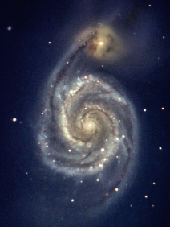
Flight Planning: Small Change
Solution
r(aus, aus)
r(aus, X)
AUS
r(aus,aus)
r(aus,Y), n(Y,Z)
HOU
DAL
r(aus,Y)
Rule 1:
r(X, X).
Rule 2:
r(X, Z) :- r(X, Y), n(Y, Z).
Infinite loop!
instead of n(X,Y), r(Y,Z)
slide <number>

Slide 35
“Is” Operator
is instantiates a temporary variable
  Similar to a local variable in Algol-like languages
Example: defining a factorial function
  ?- factorial(0, 1).
  ?- factorial(N, Result) :-
  N > 0, M is N - 1,
  factorial(M, SubRes), Result is N * SubRes.
slide <number>

Slide 36
Tracing
Tracing helps programmer see the dynamics of a proof search
Example: tracing a factorial call
  ?- factorial(0, 1).
  ?- factorial(N, Result) :-
  N > 0, M is N - 1,
  factorial(M, SubRes), Result is N * SubRes.
  ?- trace(factorial/2).
    Argument to “trace” must include function’s arity
  ?- factorial(4, X).
slide <number>

Slide 37
Tracing Factorial
These are
temporary
variables
?- factorial(4, X).
Call: ( 7) factorial(4, _G173)
Call: ( 8) factorial(3, _L131)
Call: ( 9) factorial(2, _L144)
Call: ( 10) factorial(1, _L157)
Call: ( 11) factorial(0, _L170)
Exit: ( 11) factorial(0, 1)
Exit: ( 10) factorial(1, 1)
Exit: ( 9) factorial(2, 2)
Exit: ( 8) factorial(3, 6)
Exit: ( 7) factorial(4, 24)
X = 24
These are
levels in the
search tree
slide <number>

Slide 38
The Cut
When inserted on the right-hand side of the rule, the cut operator ! operator forces subgoals not to be re-tried if r.h.s. succeeds once
Example: bubble sort
  bsort(L, S) :- append(U, [A, B | V], L),
  B < A, !,
  append(U, [B, A | V], M),
  bsort(M, S).
  bsort(L, L).
Gives one
answer rather
than many
slide <number>

Slide 39
Tracing Bubble Sort
?- bsort([5,2,3,1], Ans).
Call: ( 7) bsort([5, 2, 3, 1], _G221)
Call: ( 8) bsort([2, 5, 3, 1], _G221)
…
Call: ( 12) bsort([1, 2, 3, 5], _G221)
Redo: ( 12) bsort([1, 2, 3, 5], _G221)
…
Exit: ( 7) bsort([5, 2, 3, 1], [1, 2, 3, 5])
Ans = [1, 2, 3, 5] ;
No
Without the cut, this
would have given some
wrong answers
slide <number>

Slide 40
Negation in Prolog
not operator is implemented as goal failure
  not(G) :- G, !, fail.
  not(_).
    “fail” is a special goal that always fail
  What does this mean?
Example: factorial
  factorial(N, 1) :- N < 1.
  factorial(N, Result) :- not(N < 1), M is N - 1,
  factorial(M, P),
  Result is N * P.
slide <number>

Slide 41
Biểu diễn vị trí thắng trong trò chơi
% win(X) :- X is a winning position in the two-person finite game
% represented by the relation move.
win(X) :- move(X, Y), not win(Y).
slide <number>

Slide 42
If then else
if_then_else(B, S, T):- B,!,S.
if_then_else(B, S, T):- T.
B->S;T
part( , [], [], []).
part(X, [Y | Xs], Ls, Bs) :-
(X>Y->
Ls = [Y | L1s], part(X, Xs, L1s, Bs)
;
Bs=[Y | B1s], part(X, Xs, Ls, B1s)
).
slide <number>

Slide 43
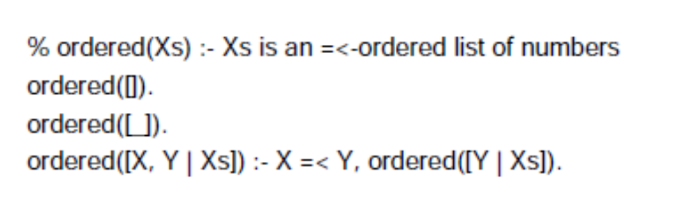
Order List
slide <number>

Slide 44
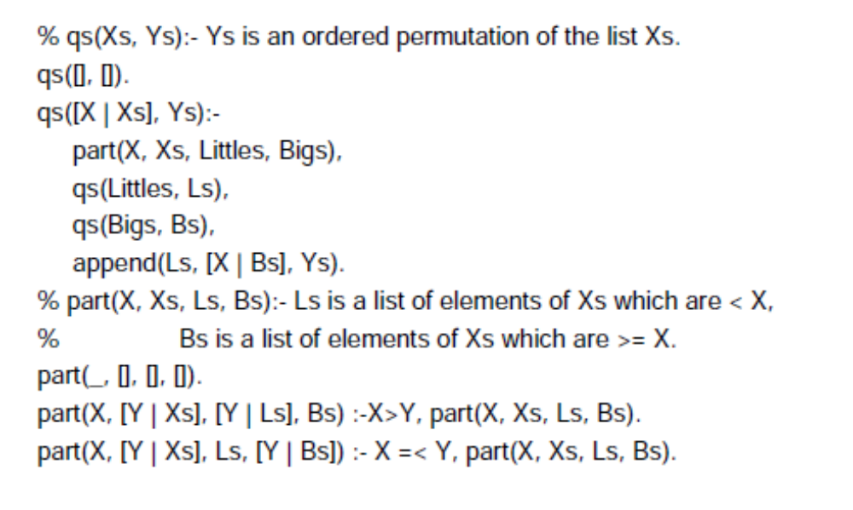
Quick sort in Prolog
slide <number>

Slide 45
Hight-Order functions
map(P, [], []).
map(P, [X | Xs] , [Y | Ys]) :- apply(P, [X, Y]), map(P, Xs, Ys).
?- map(square, [1,2,3,4], Ys).
Ys = [1, 4, 9, 16]
slide <number>

Slide 46
Tail recursion of Factorial
factorial(N, R) :- factorial(N, 1, R).
factorial(0, R, R) :- !.
factorial(N, Acc, R) :-
NewN is N - 1,
NewAcc is Acc * N,
factorial(NewN, NewAcc, R).
slide <number>

Slide 47
Assessment
Computing, testing, completing
Dual interpretation – Logical formulas
Optimization in excecution
One data type: term
Unification algorithm
Automatic backstracking
computational linguistics applications
AI application
Also verification of Prolog programs and its semantics were extensively studied
slide <number>

