Slide 1
Lexical and Syntactic Analysis
CS 345
Vitaly Shmatikov
slide <number>

Slide 2
Syntax
Syntax of a programming language is a precise description of all grammatically correct programs
  Precise formal syntax was first used in ALGOL 60
Lexical syntax
  Basic symbols (names, values, operators, etc.)
Concrete syntax
  Rules for writing expressions, statements, programs
Abstract syntax
  Internal representation of expressions and statements, capturing their “meaning” (i.e., semantics)
slide <number>

Slide 3
Grammars
A meta-language is a language used to define other languages
A grammar is a meta-language used to define the syntax of a language. It consists of:
  Finite set of terminal symbols
  Finite set of non-terminal symbols
  Finite set of production rules
  Start symbol
  Language = (possibly infinite) set of all sequences of symbols that can be derived by applying production rules starting from the start symbol
Backus-Naur
Form (BNF)
slide <number>

Slide 4
Example: Decimal Numbers
Grammar for unsigned decimal integers
  Terminal symbols: 0, 1, 2, 3, 4, 5, 6, 7, 8, 9
  Non-terminal symbols: Digit, Integer
  Production rules:
    Integer → Digit | Integer Digit
    Digit → 0 | 1 | 2 | 3 | 4 | 5 | 6 | 7 | 8 | 9
  Start symbol: Integer
Can derive any unsigned integer using this grammar
  Language = set of all unsigned decimal integers
Shorthand for
Integer → Digit
Integer → Integer Digit
slide <number>

Slide 5
Derivation of 352 as an Integer
  Production rules:
  Integer → Digit | Integer Digit
  Digit → 0 | 1 | 2 | 3 | 4 | 5 | 6 | 7 | 8 | 9
Integer ⇒ Integer Digit
⇒ Integer 2
⇒ Integer Digit 2
⇒ Integer 5 2
⇒ Digit 5 2
⇒ 3 5 2
    Rightmost derivation
At each step, the rightmost
non-terminal is replaced
slide <number>

Slide 6
Leftmost Derivation
  Production rules:
  Integer → Digit | Integer Digit
  Digit → 0 | 1 | 2 | 3 | 4 | 5 | 6 | 7 | 8 | 9
Integer ⇒ Integer Digit
⇒ Integer Digit Digit
⇒ Digit Digit Digit
⇒ 3 Digit Digit
⇒ 3 5 Digit
⇒ 3 5 2
At each step, the leftmost
non-terminal is replaced
slide <number>

Slide 7
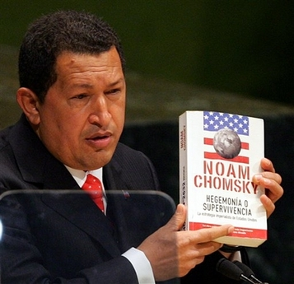
Chomsky Hierarchy
Regular grammars
  Regular expressions, finite-state automata
  Used to define lexical structure of the language
Context-free grammars
  Non-deterministic pushdown automata
  Used to define concrete syntax of the language
Context-sensitive grammars
Unrestricted grammars
  Recursively enumerable languages, Turing machines
slide <number>

Slide 8
Regular Grammars
Left regular grammar
  All production rules have the form
  A → ω or A → Bω
    Here A, B are non-terminal symbols, ω is a terminal symbol
Right regular grammar
  A → ω or A → ωB
Example: grammar of decimal integers
Not a regular language: {a^{n} b^{n} | n ≥ 1 } (why?)
What about this: “any sequence of integers where ( is eventually followed by )”?
slide <number>

Slide 9
Lexical Analysis
Source code = long string of ASCII characters
Lexical analyzer splits it into tokens
  Token = sequence of characters (symbolic name) representing a single terminal symbol
Identifiers: myVariable …
Literals: 123 5.67 true …
Keywords: char sizeof …
Operators: + - * / …
Punctuation: ; , } { …
Discards whitespace and comments
slide <number>

Slide 10
Regular Expressions
x character x
\x escaped character, e.g., \n
{ name } reference to a name
M | N M or N
M N M followed by N
M* 0 or more occurrences of M
M+ 1 or more occurrences of M
[x₁ … x_{n}] One of x₁ … x_{n}
  Example: [aeiou] – vowels, [0-9] - digits
slide <number>

Slide 11
Examples of Tokens in C
Lexical analyzer usually represents each token by a unique integer code
  “+” { return(PLUS); } // PLUS = 401
  “-” { return(MINUS); } // MINUS = 402
  “*” { return(MULT); } // MULT = 403
  “/” { return(DIV); } // DIV = 404
Some tokens require regular expressions
  [a-zA-Z_][a-zA-Z0-9_]* { return (ID); } // identifier
  [1-9][0-9]* { return(DECIMALINT); }
  0[0-7]* { return(OCTALINT); }
  (0x|0X)[0-9a-fA-F]+ { return(HEXINT); }
slide <number>

Slide 12
Reserved Keywords in C
auto, break, case, char, const, continue, default, do, double, else, enum, extern, float, for, goto, if, int, long, register, return, short, signed, sizeof, static, struct, switch, typedef, union, unsigned, void, volatile, wchar_t, while
C++ added a bunch: bool, catch, class, dynamic_cast, inline, private, protected, public, static_cast, template, this, virtual and others
Each keyword is mapped to its own token
slide <number>

Slide 13
Automatic Scanner Generation
Lexer or scanner recognizes and separates lexical tokens
  Parser usually calls lexer when it’s ready to process the next symbol (lexer remembers where it left off)
Scanner code usually generated automatically
  Input: lexical definition (e.g., regular expressions)
  Output: code implementing the scanner
    Typically, this is a deterministic finite automaton (DFA)
  Examples: Lex, Flex (C and C++), JLex (Java)
slide <number>

Slide 14
Finite State Automata
Set of states
  Usually represented as graph nodes
Input alphabet + unique “end of program” symbol
State transition function
  Usually represented as directed graph edges (arcs)
  Automaton is deterministic if, for each state and each input symbol, there is at most one outgoing arc from the state labeled with the input symbol
Unique start state
One or more final (accepting) states
slide <number>

Slide 15
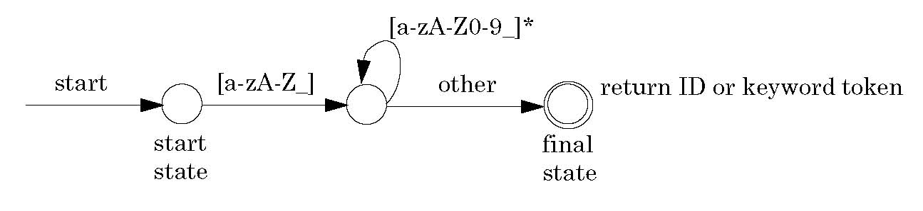
DFA for C Identifiers
slide <number>

Slide 16
Traversing a DFA
Configuration = state + remaining input
Move = traversing the arc exiting the state that corresponds to the leftmost input symbol, thereby consuming it
If no such arc, then…
  If no input and state is final, then accept
  Otherwise, error
Input is accepted if, starting with the start state, the automaton consumes all the input and halts in a final state
slide <number>

Slide 17
Context-Free Grammars
Used to describe concrete syntax
  Typically using BNF notation
Production rules have the form A → ω
  A is a non-terminal symbol, ω is a string of terminal and non-terminal symbols
Parse tree = graphical representation of derivation
  Each internal node = LHS of a production rule
    Internal node must be a non-terminal symbol (why?)
  Children nodes = RHS of this production rule
  Each leaf node = terminal symbol (token) or “empty”
slide <number>

Slide 18
Syntactic Correctness
Lexical analyzer produces a stream of tokens
Parser (syntactic analyzer) verifies that this token stream is syntactically correct by constructing a valid parse tree for the entire program
  Unique parse tree for each language construct
  Program = collection of parse trees rooted at the top by a special start symbol
Parser can be built automatically from the BNF description of the language’s CFG
  Example tools: yacc, Bison
slide <number>

Slide 19
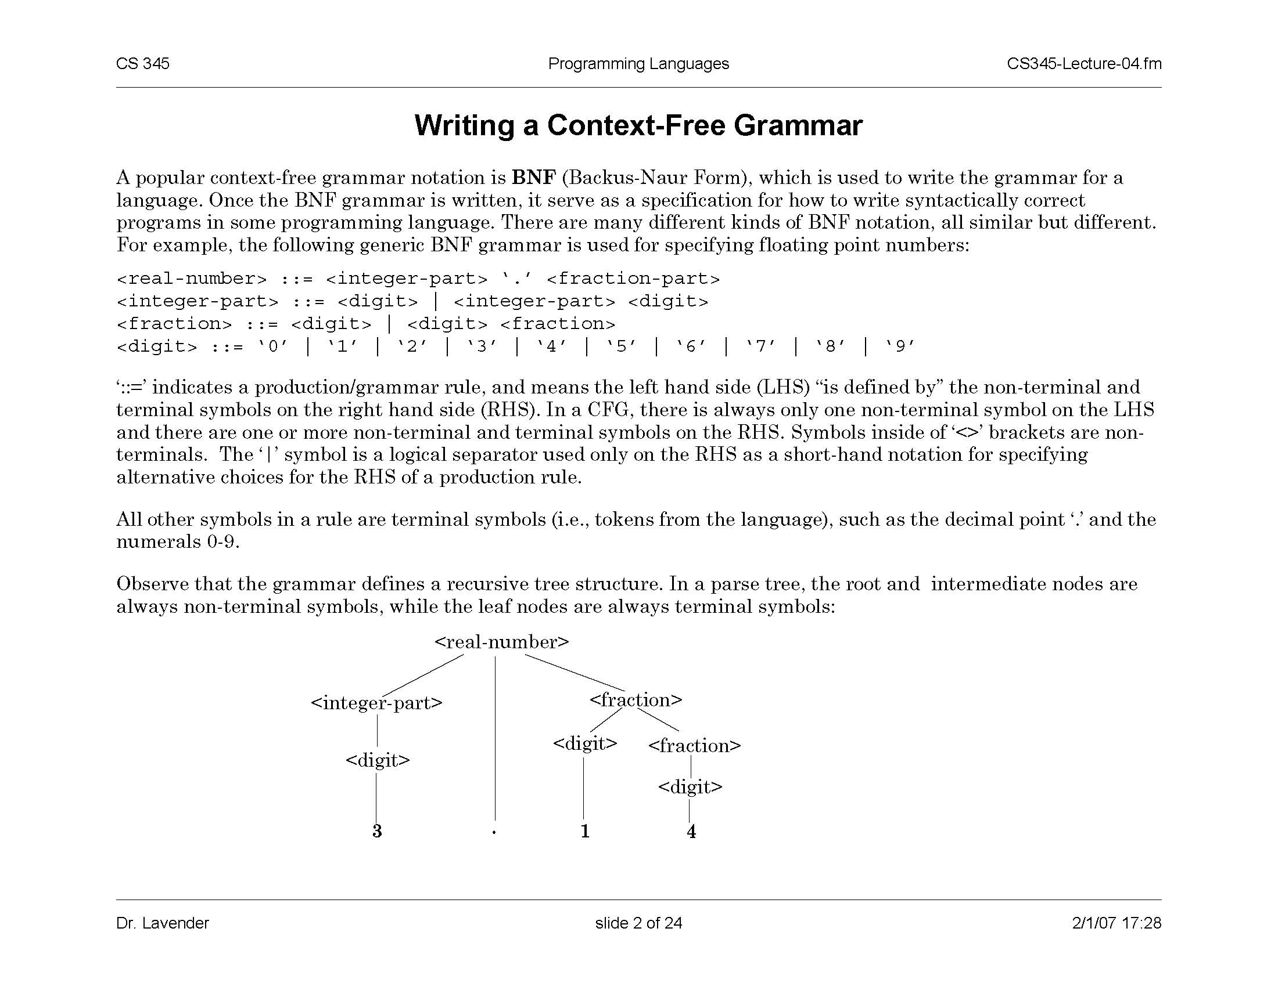
CFG For Floating Point Numbers
::= stands for production rule; <…> are non-terminals;
| represents alternatives for the right-hand side of a production rule
Sample parse tree:
slide <number>

Slide 20
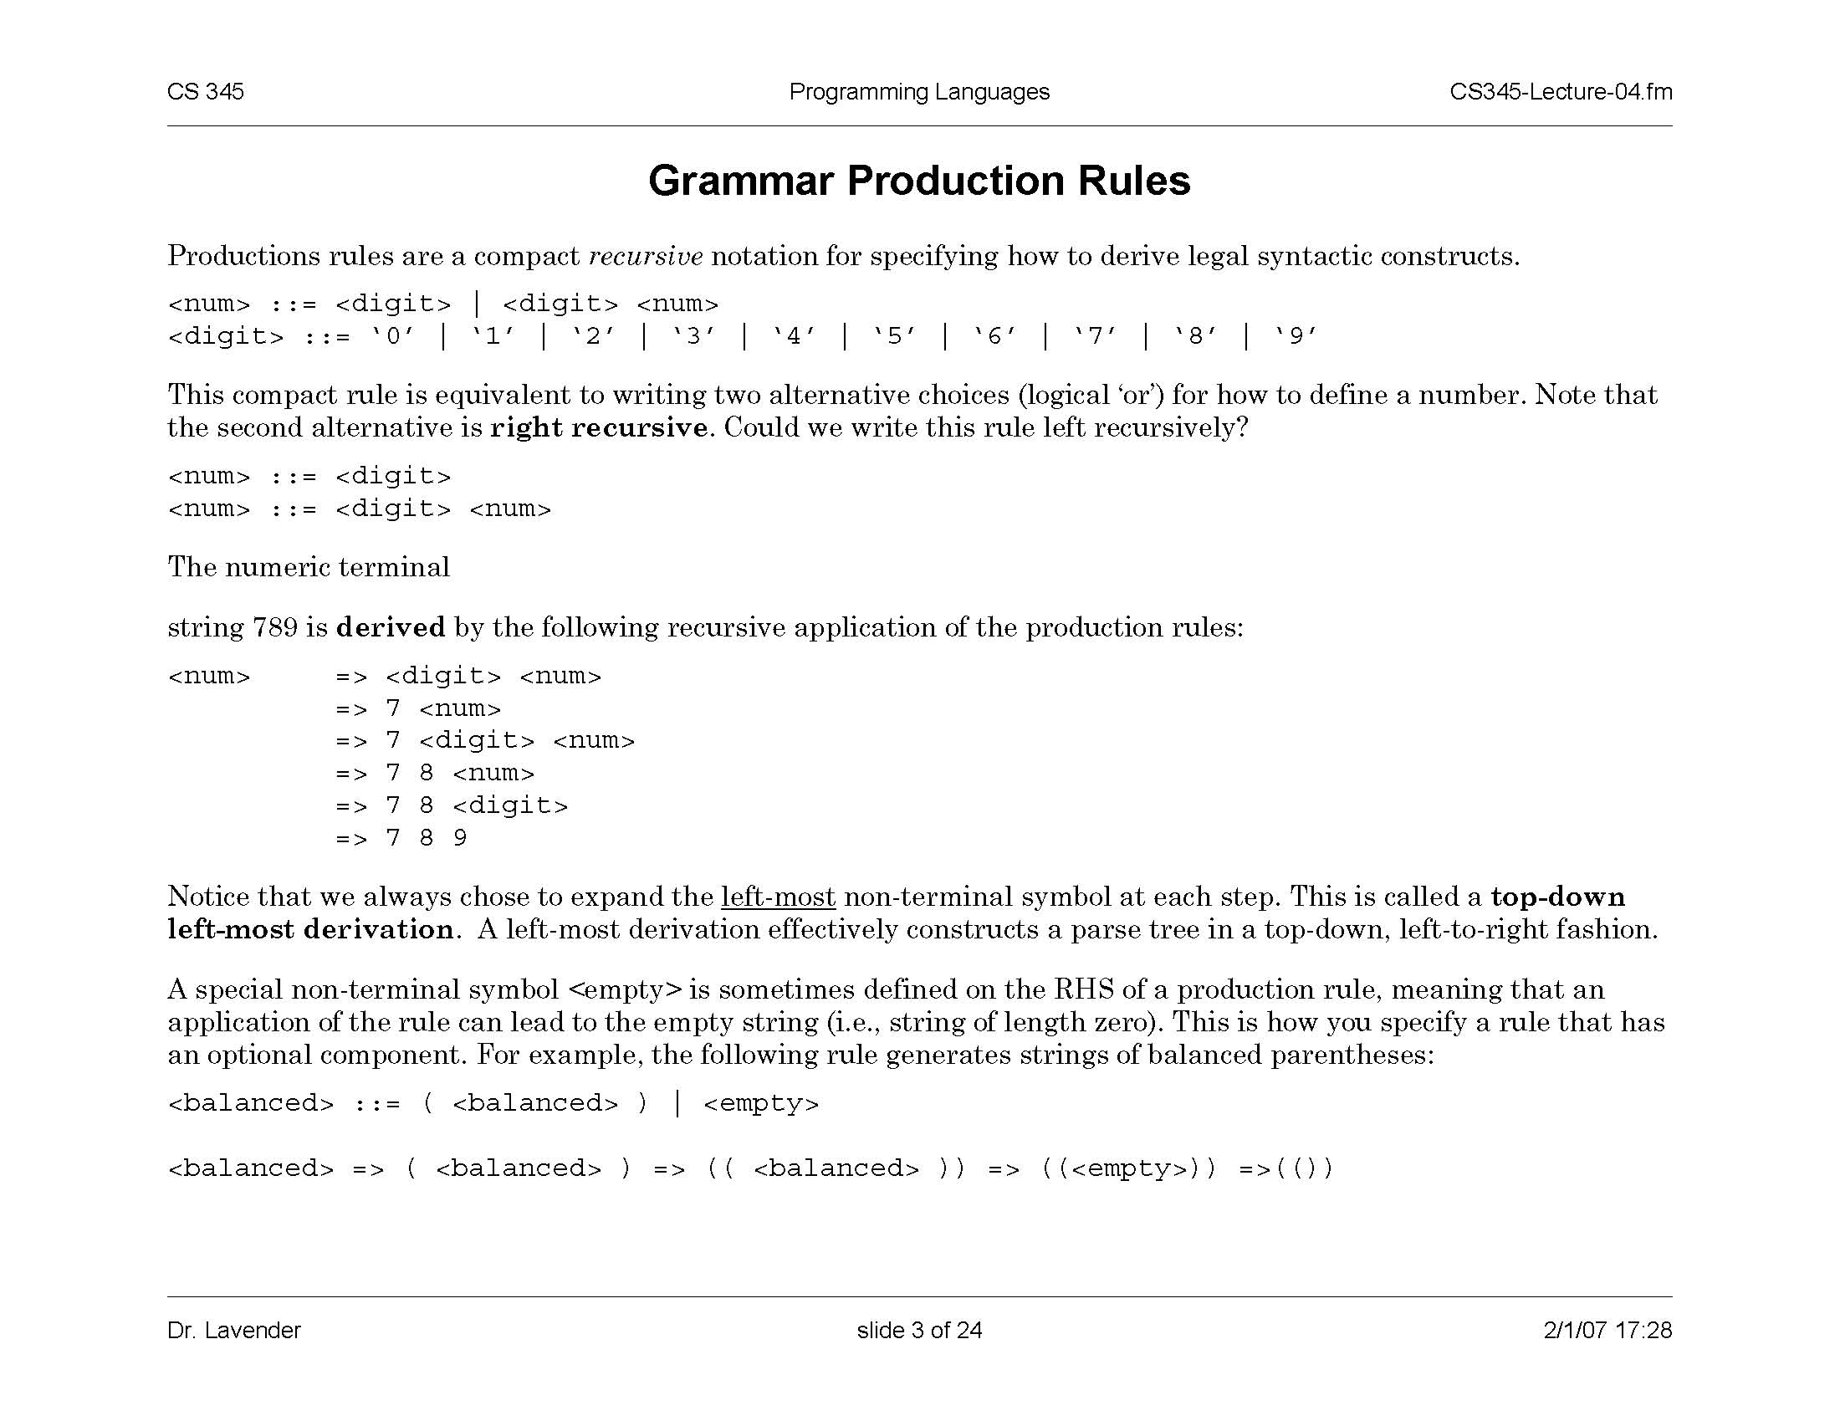
CFG For Balanced Parentheses
Could we write this grammar using regular expressions or DFA? Why?
Sample derivation:
<balanced> ⇒ ( <balanced> )
⇒ (( <balanced> ))
⇒ (( <empty> ))
⇒ (( ))
slide <number>

Slide 21
CFG For Decimal Numbers (Redux)
This grammar is right-recursive
Sample
top-down leftmost
derivation:
<num> ⇒ <digit> <num>
⇒ 7 <num>
⇒ 7 <digit> <num>
⇒ 7 8 <num>
⇒ 7 8 <digit>
⇒ 7 8 9
slide <number>

Slide 22
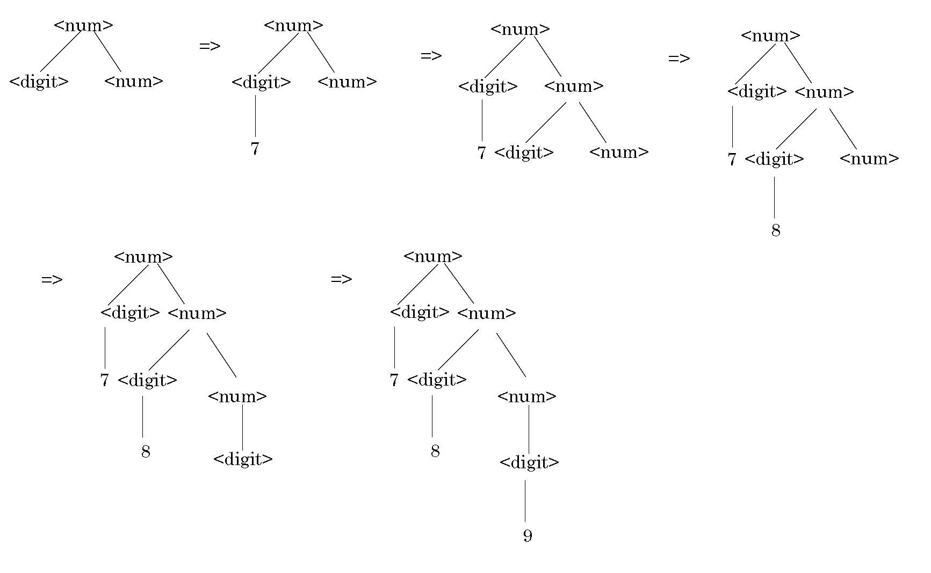
Recursive Descent Parsing
Top-down, left-to-right
construction of
the parse tree
slide <number>

Slide 23
Shift-Reduce Parsing
Idea: build the parse tree bottom-up
  Lexer supplies a token, parser find production rule with matching right-hand side (i.e., run rules in reverse)
  If start symbol is reached, parsing is successful
⇒ 7 8 <digit>
⇒ 7 8 <num>
⇒ 7 <digit> <num>
⇒ 7 <num>
⇒ <digit> <num>
⇒ <num>
789
  Production rules:
  Num → Digit | Digit Num
  Digit → 0 | 1 | 2 | 3 | 4 | 5 | 6 | 7 | 8 | 9
reduce
shift
reduce
shift
reduce
slide <number>

Slide 24
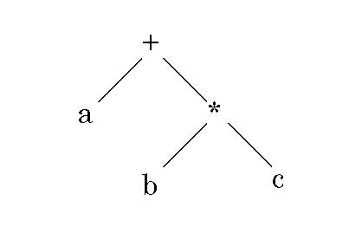
Concrete vs. Abstract Syntax
Different languages have different concrete syntax for representing expressions, but expressions with common meaning have the same abstract syntax
  C: a+b*c Forth: bc*a+ (reverse Polish notation)
This expression tree represents the
abstract “meaning” of expression
Assumes certain operator precedence (why?)
Not the same as parse tree (why?)
Does the value depend on traversal order?
slide <number>

Slide 25
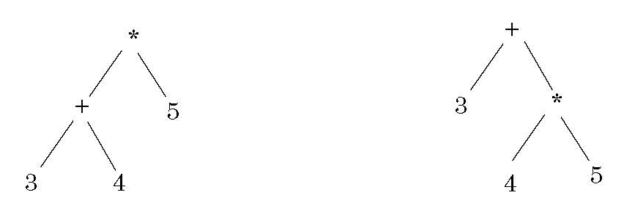
Expression Notation
Inorder traversal (3+4)*5=35 3+(4*5)=23
When constructing expression trees, we want inorder traversal to produce
correct arithmetic result based on operator precedence and associativity
Postorder traversal 3 4 + 5 * =35 3 4 5 * + =23
Easily evaluated using operand stack (example: Forth)
Leaf node: push operand value on the stack
Non-leaf binary or unary operator: pop two (resp. one) values from stack,
apply operator, push result back on the stack
End of evaluation: print top of the stack
slide <number>

Slide 26
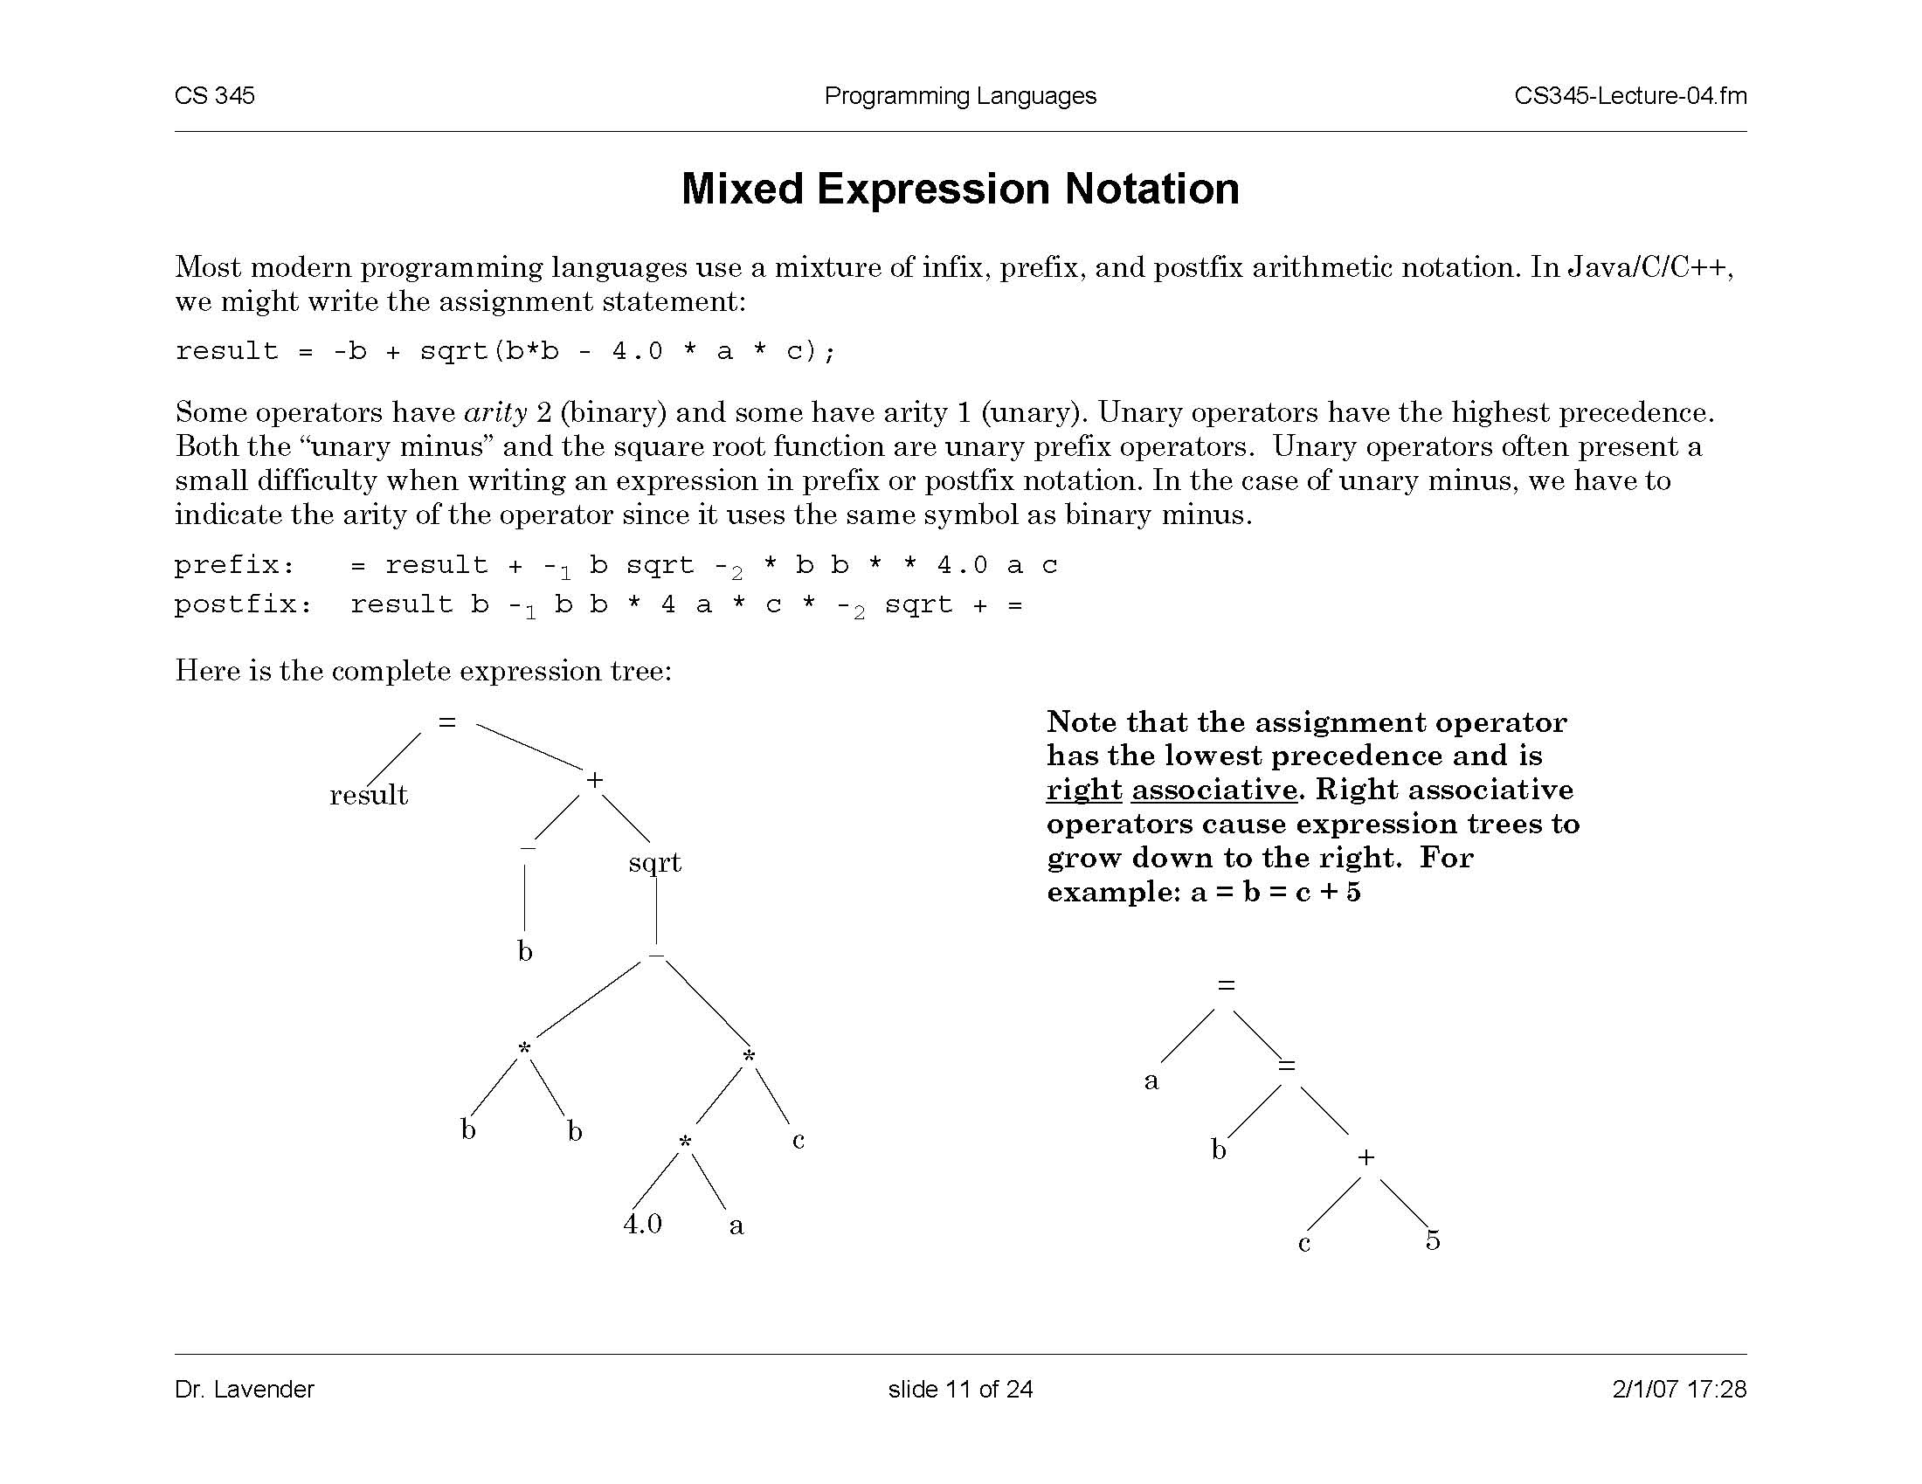
Mixed Expression Notation
unary prefix operators
Prefix:
Need to indicate arity to distinguish
between unary and binary minus
slide <number>

Slide 27
Postfix, Prefix, Mixfix in Java and C
Increment and decrement: x++, --y
  x = ++x + x++ legal syntax, undefined semantics!
Ternary conditional
  (conditional-expr) ? (then-expr) : (else-expr);
  Example:
  int min(int a, int b) { return (a<b) ? a : b; }
  This is an expression, NOT an if-then-else command
  What is the type of this expression?
slide <number>

Slide 28
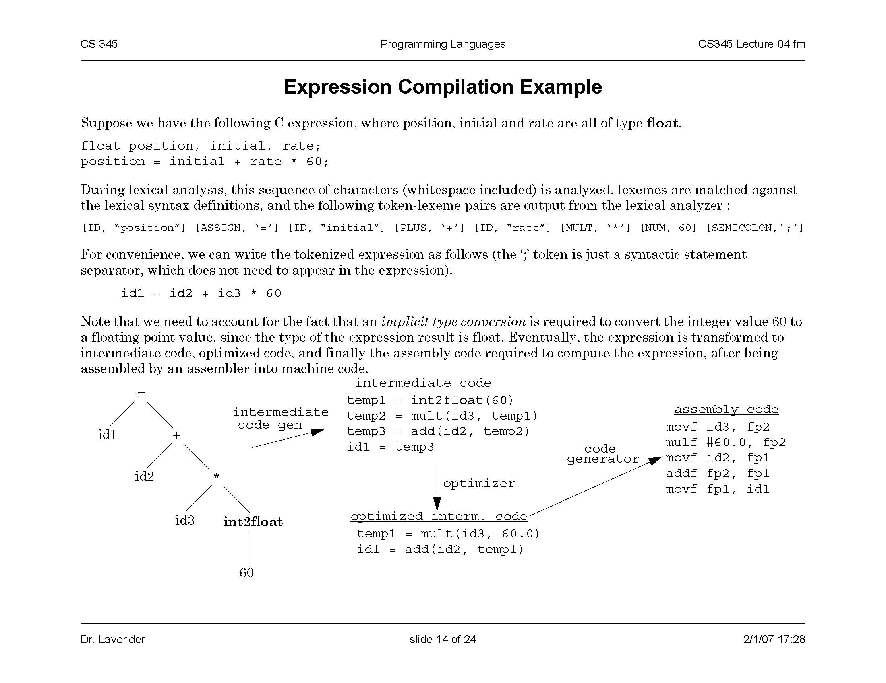
Expression Compilation Example
lexical analyzer
tokenized expression:
implicit type conversion (why?)
parser
slide <number>

Slide 29
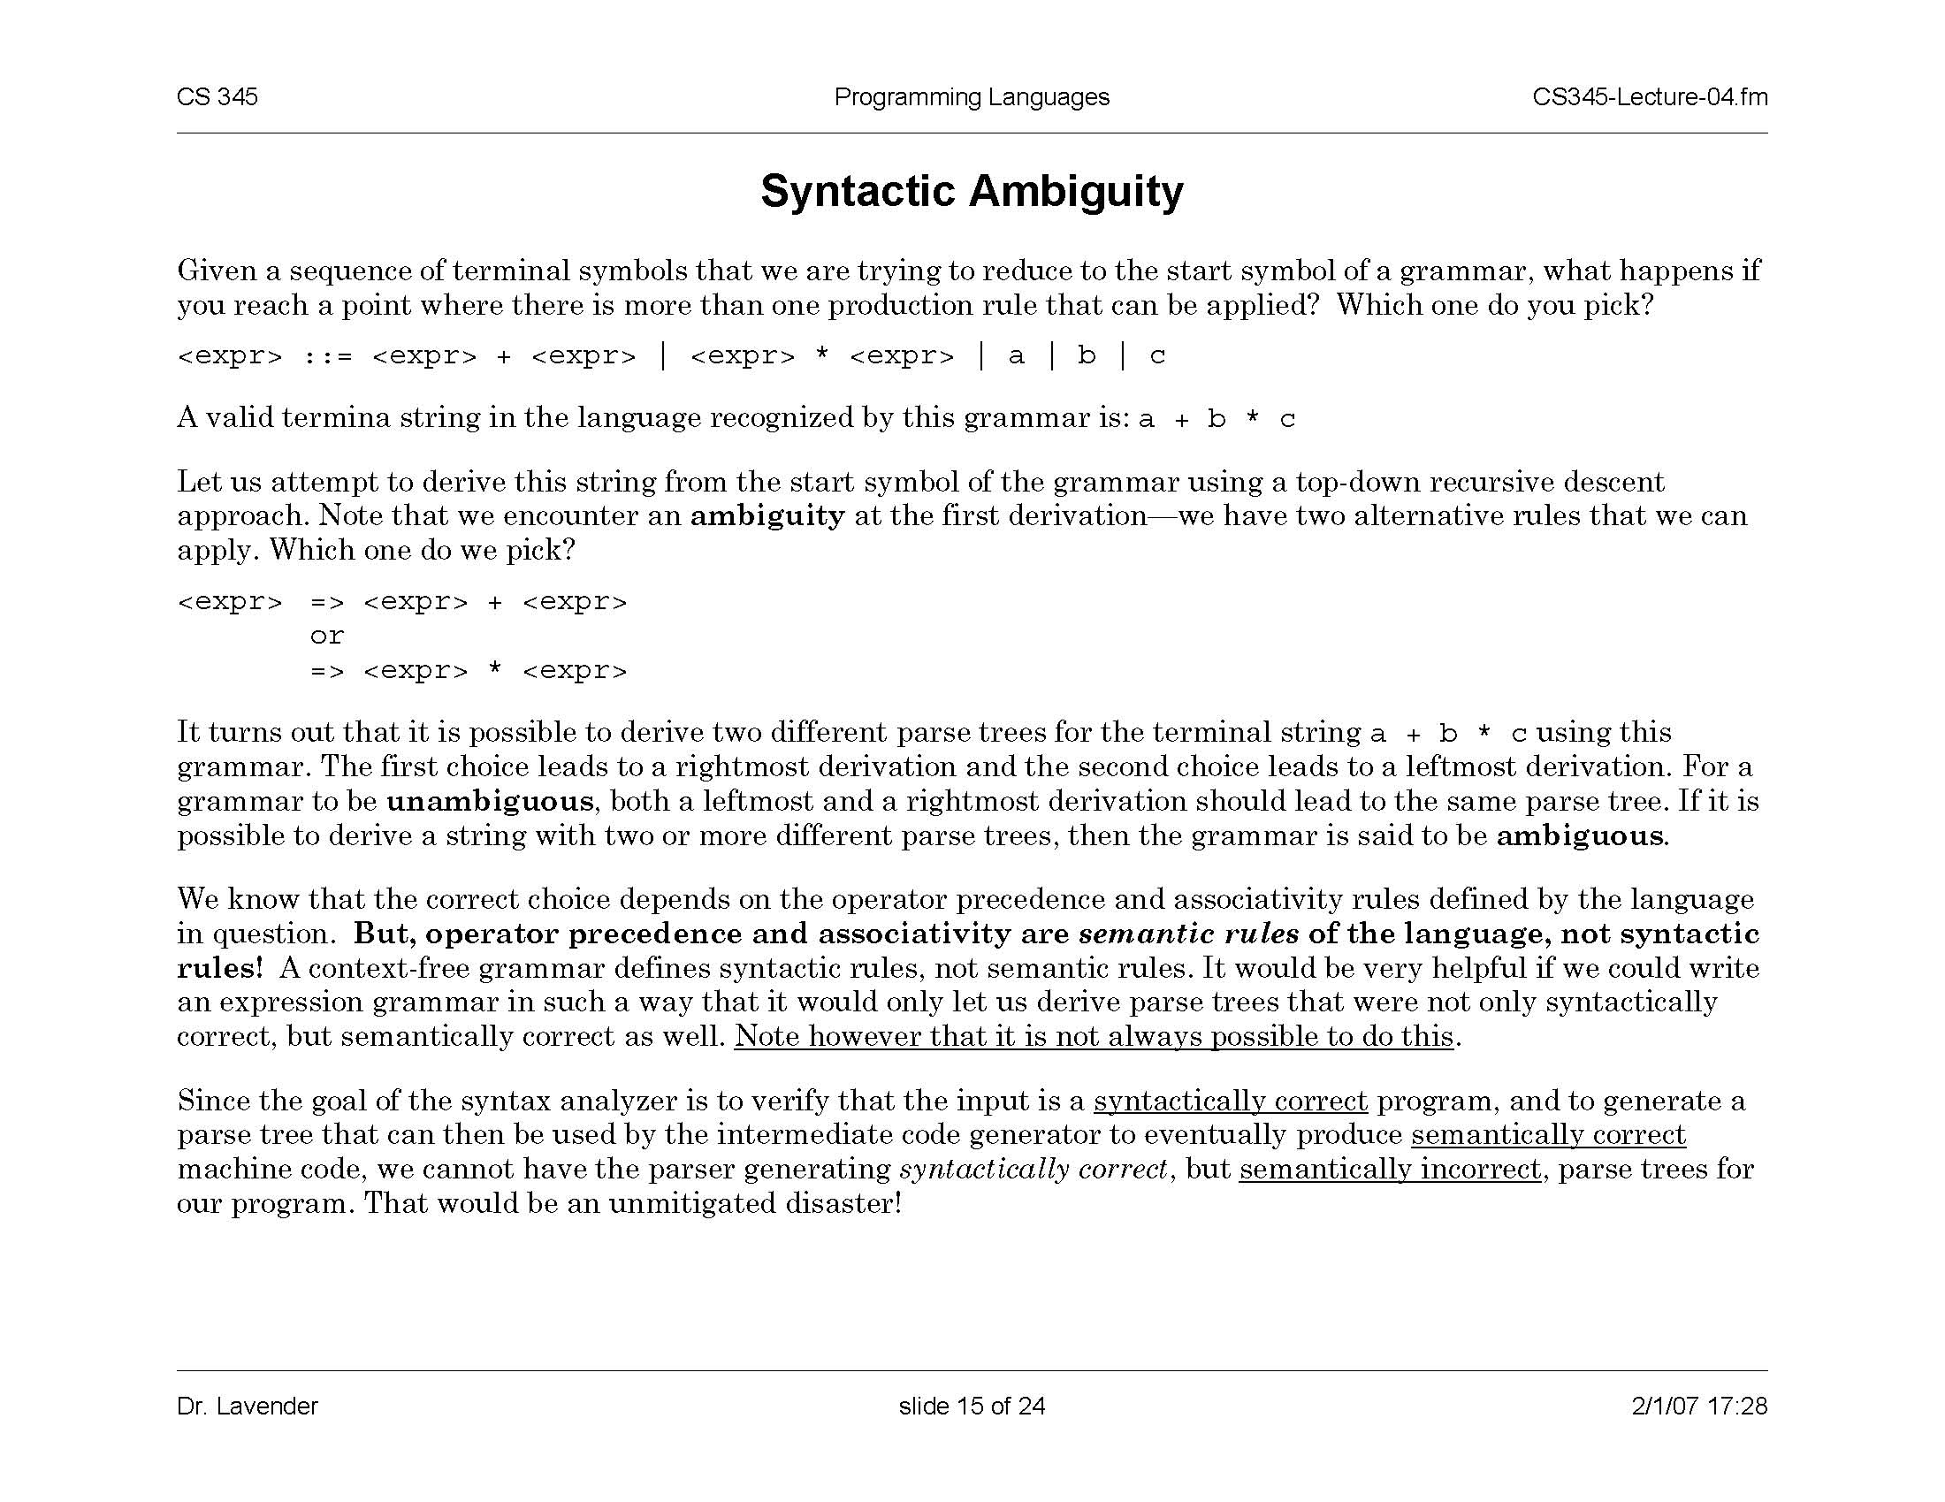
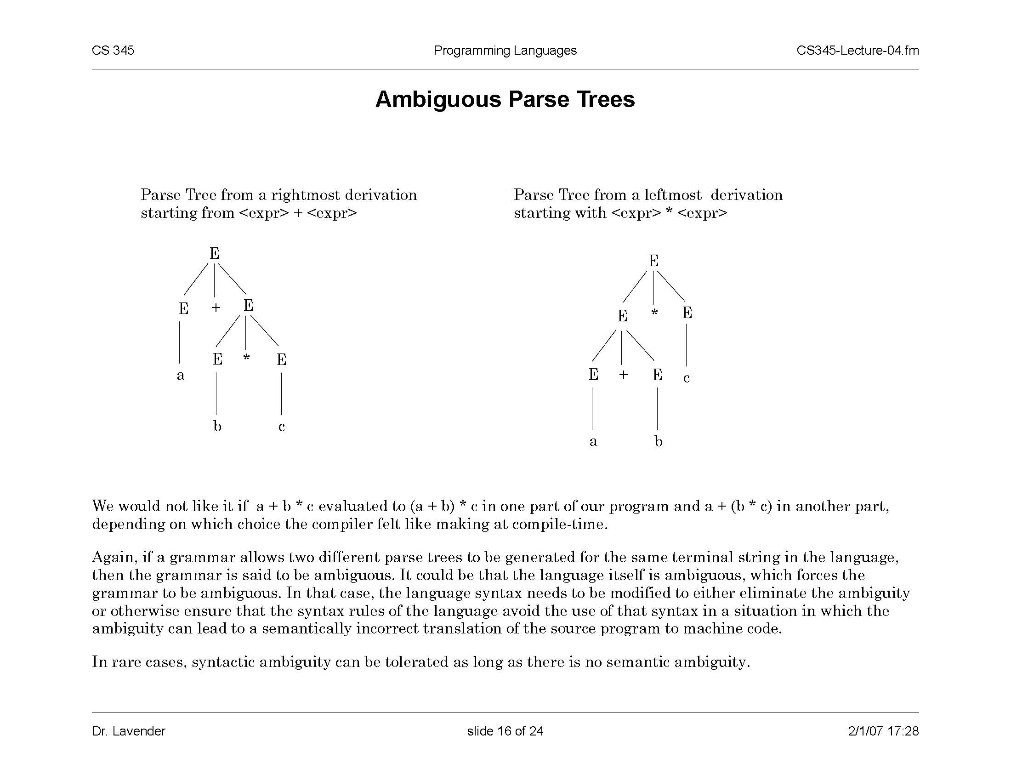
Syntactic Ambiguity
How to parse a+b*c using this grammar?
This grammar is
ambiguous
Both parse trees are
syntactically valid
Only this tree is semantically correct
(operator precedence and associativity
are semantic, not syntactic rules)
Problem: this tree is syntactically correct, but semantically incorrect
slide <number>

Slide 30
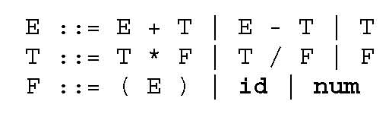
Removing Ambiguity
Not always possible to
remove ambiguity this way!
Define a distinct non-terminal symbol for each operator precedence level
Define RHS of production rule to enforce proper associativity
Extra non-terminal for smallest subexpressions
slide <number>

Slide 31
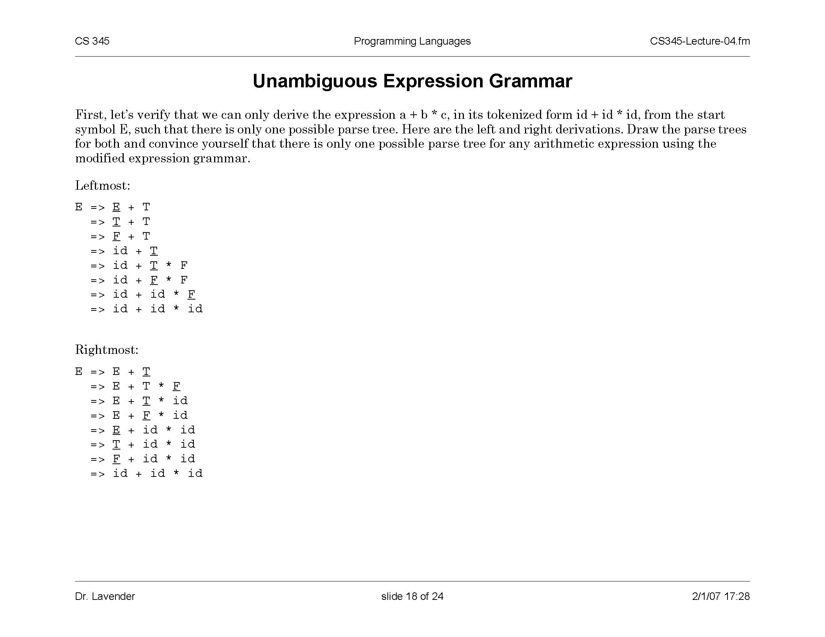
This Grammar Is Unambiguous
slide <number>

Slide 32
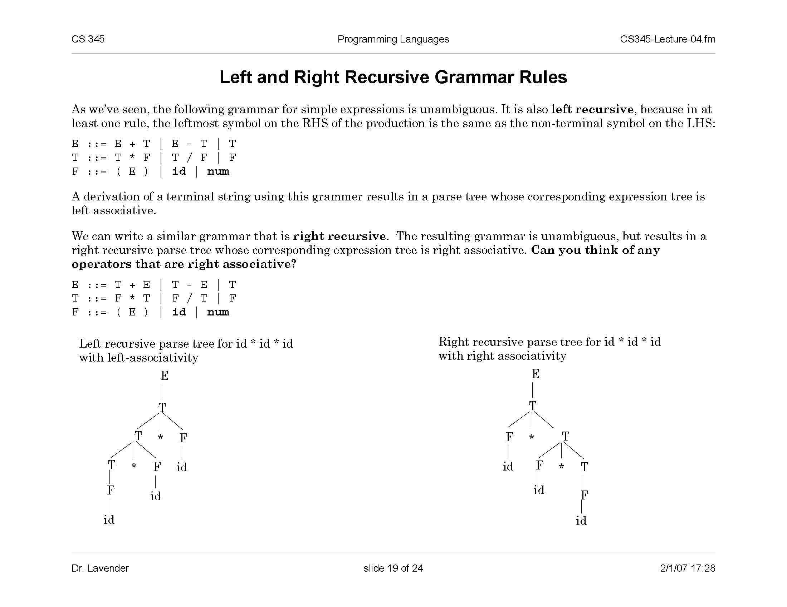
Left- and Right-Recursive Grammars
Leftmost non-terminal on the RHS of
production is the same as the LHS
Right-recursive grammar
Can you think of any
operators that are
right-associative?
slide <number>

Slide 33
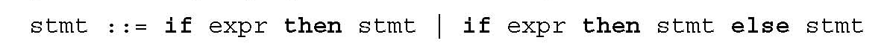
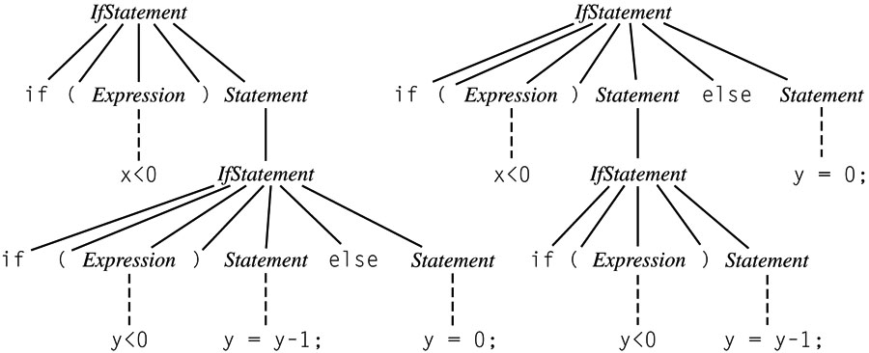
“Dangling Else” Ambiguity
(
)
(
)
if (x < 0)
if (y < 0) y = y - 1;
else y = 0;
Classic example of a
shift-reduce conflict
With which if does
this else associate?
slide <number>

Slide 34
Solving the Dangling Else Ambiguity
Algol 60, C, C++: associate each else with closest if; use { … } or begin … end to override
  Does this prefer “shift” to “reduce” or vice versa?
Algol 68, Modula, Ada: use an explicit delimiter to end every conditional (e.g., if … endif)
Java: rewrite the grammar and restrict what can appear inside a nested if statement
  IfThenStmt → if ( Expr ) Stmt
  IfThenElseStmt → if ( Expr ) StmtNoShortIf else Stmt
    The category StmtNoShortIf includes all except IfThenStmt
slide <number>

Slide 35
More Powerful Grammars
Context-sensitive: production rules have the form αAβ → αωβ
  A is a non-terminal symbol, α,β,ω are strings of terminal and non-terminal symbols
  Deciding whether a string belongs to a language generated by a context-sensitive grammar is PSPACE-complete
  Emptiness of a language is undecidable
    What does this mean?
Unrestricted: equivalent to Turing machine
slide <number>

