Slide 1
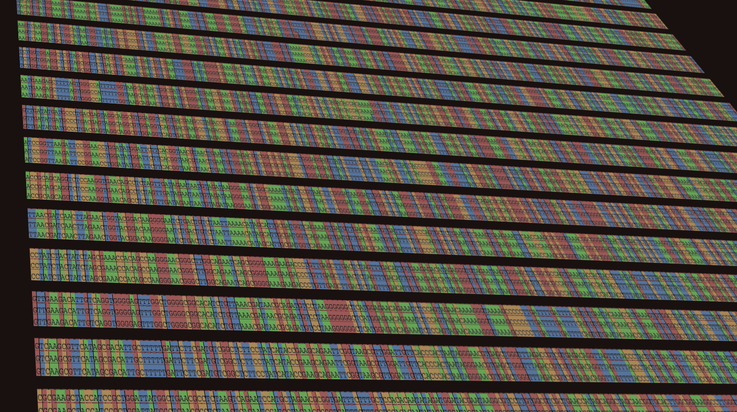
h a c k s e q
G e n o m i c s H a c k a t h o n
60 hours of *omics hacking
O c t o b e r 15 – 17 ^{th} 2016
V a n c o u v e r, B C, C a n a d a
www.hackseq.com
@hackseq

Slide 2

What is hackseq?
Vancouver's first Genomics Hackathon, supported by the Society for Canadian Women in Science and Technology (SCWIST), and a satellite event of the American Society of Human Genetics (ASHG) meeting.
When & where is it?
October 15 – 17th, 2016 (60 hours of omics hacking)
Life Science Institute, UBC, Vancouver, BC, Canada
What is our goal?
To contribute to the advancement of diverse research fields, including personalized medicine and machine learning, by providing an inclusive space for scientists with diverse backgrounds to catalyze open and innovative solutions for today's biggest omics problems.
Who are we?
A group of researchers that believe science works best when passionate individuals come together and collaborate in inclusive spaces.
Why sponsor?
By sponsoring hackseq, your company/organization will initiate relationships with untapped talent from Vancouver and beyond. hackseq also provides sponsors the opportunity to obtain brand exposure, generating publicity and increasing product popularity.
Interested in sponsoring hackseq?
E-mail us: director-events@scwist.ca

Slide 3

S p o n s o r s h i p T i e r s
 | GigaBase | MegaBase | KiloBase | BasePair
Sponsorship Amount (CAN) | $6000 | $4000 | $2000 | Please Contact Us
Prizes | ✓
Host a Workshop | ✓
Mentors at the Event | ✓ | ✓ | ✓ | ✓
Speak at Closing Ceremony | 4 min | 2 min
Banners | ✓ | ✓
Allowed to Recruit | ✓ | ✓ | ✓
Free Giveaways | ✓ | ✓ | ✓ | ✓
Booth | ✓
Logo on Website | ✓ | ✓ | ✓ | ✓

Slide 4

Interested?
Please contact us at
director-events@scwist.ca
If these sponsorship levels are not suitable, please let us know what we can do for you!
All sponsorship contributions will be used to cover the costs of running hackseq.

