Slide 1
Adelaide Suburb Housing Prices: Pre and Post COVID-19 Analysis
By Group 3:
Jordan Kane
Van Hoang
Isha Sharma
Magdalene Singh

Slide 2


Group Question: “Has the price of housing in the Adelaide suburbs changed since before and after COVID?”

Slide 3
Group Data Source
Our data source was the Metro median house sales data from data.sa.gov.au.
Reliable government data source.
Contains the quarterly median house prices for metropolitan Adelaide by suburb from 2015-2023.
REFERENCE:
Department of Planning, T. and I. (2023). Metro median house sales. data.sa.gov.au. [online] Available at: https://data.sa.gov.au/data/dataset/metro-median-house-sales.

Slide 4
Group Roles
Each member focuses on a small selection of 2-5 suburbs from each direction of the city.
The combination of all directions from the CBD provides a full range of suburbs within Adelaide.
Different directions may provide different outcomes and results from one another.
Jordan: Eastern Suburbs (Norwood & Burnside)
Isha: Northern Suburbs (Modbury, Salisbury, North Adelaide & Enfield)
Magdalene: Western Suburbs (Findon, Grange & Seaton)
Van: Southern Suburbs (Flagstaff Hill, Goodwood, Edwardstown, Pasadena & Adelaide CBD)

Slide 5
Eastern Suburbs (Norwood & Burnside)
Jordan Kane

Slide 6
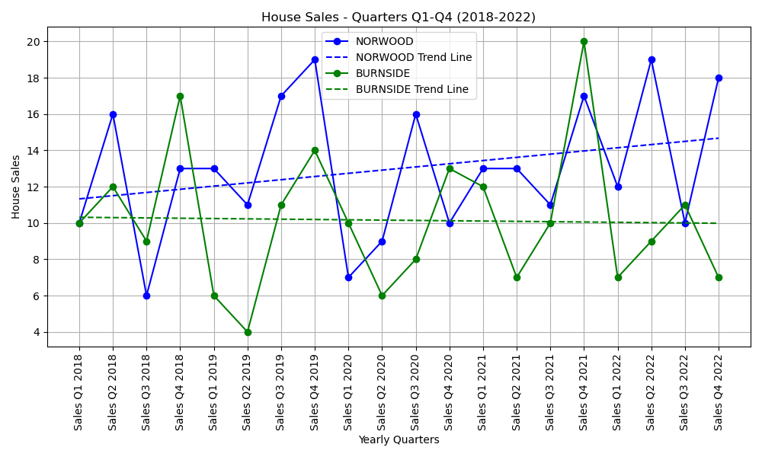
Eastern Suburbs: “Has the number of house sales in Norwood and Burnside changed from 2018-2022?”

Slide 7
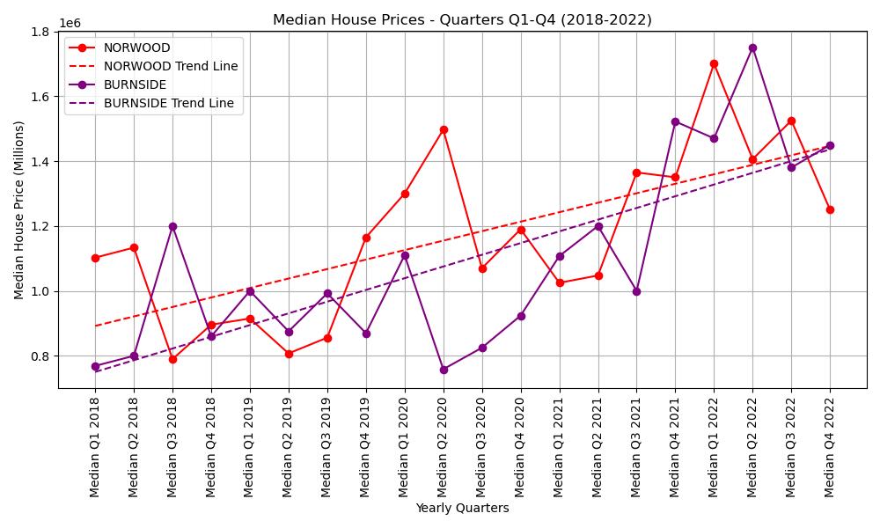
Eastern Suburbs: “Has the median house price in Norwood and Burnside changed from 2018-2022?”

Slide 8
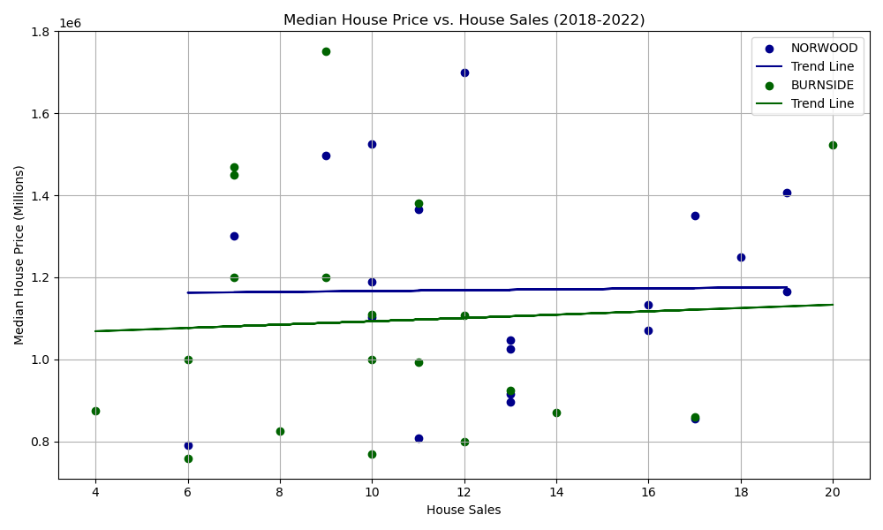
Eastern Suburbs: “Has the number of house sales impacted the median house price in Norwood and Burnside from 2018-2022?”

Slide 9
Western Suburbs (Greenacres, Grange & Seaton)
Magdalene Singh

Slide 10
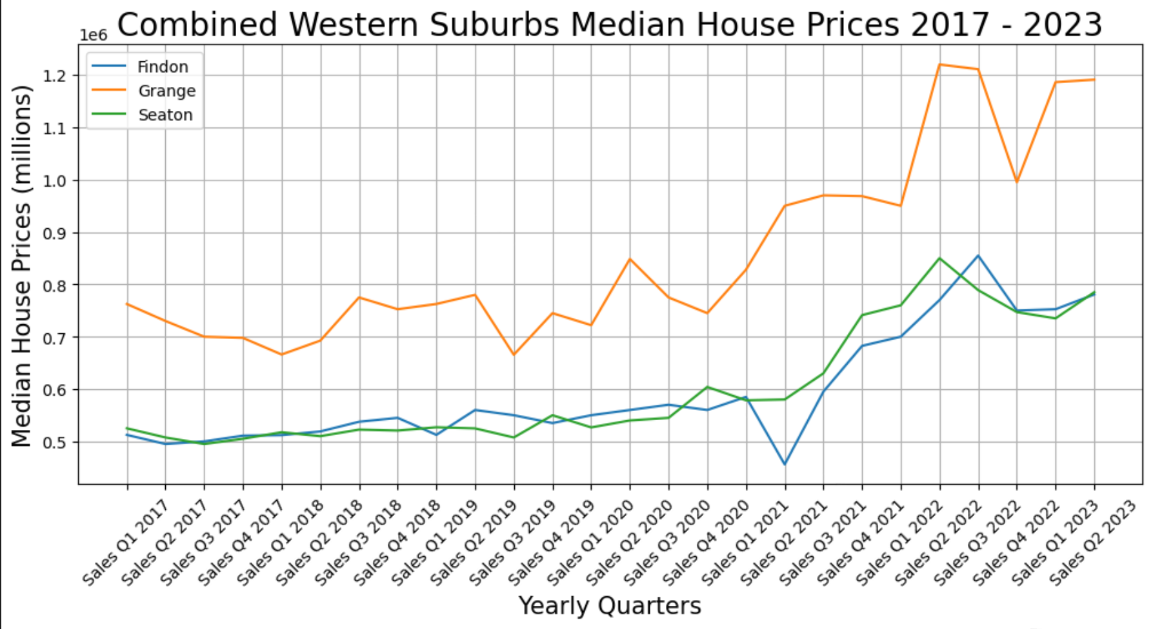
Out of the 3 selected suburbs, Grange has experienced the highest price appreciation over the past 6½ years. There was a significant increase in the median price for this suburb, starting off at $762.5k in 2017 and ending off in the 2nd quarter of 2023 at almost $1.2m. Findon and Seaton maintained steady and consistent price increases, starting off in 2017 at $512.5k and $525k respectively and ending off at $780.7k and $785k respectively. Both suburbs were almost on par, increasing gradually.

Slide 11
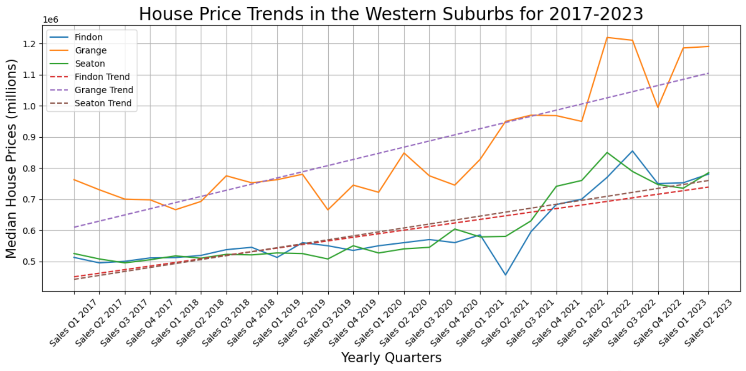
The trend lines in the graph below, indicate that median house prices for all 3 suburbs are increasing on average.

Slide 12
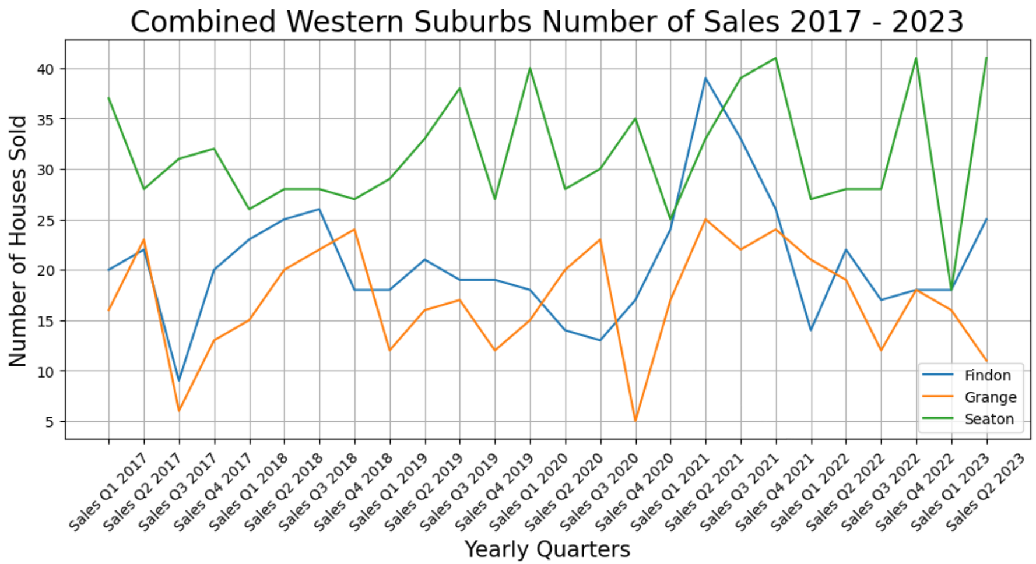
Sales appear to have been unimpacted by COVID lockdowns. The graph shows that there are numerous peaks and troughs in the number of houses sold in the last 6½ years.

Slide 13
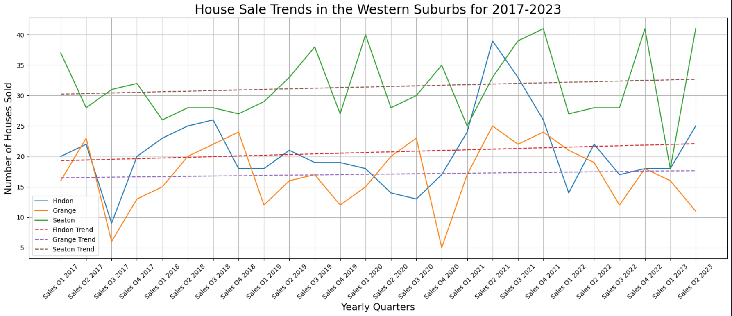
The trend lines are showing a gradual increase in the number of houses sold. An increase in the number of houses sold would drive an increase in the price of houses as demand increases and supply falls short. A point to consider here would be new housing developments e.g. larger blocks of land being subdivided; this would increase the number of house sales. Without more relevant data, we are unable to determine the causes for the peaks and troughs in the number of houses sold.

Slide 14
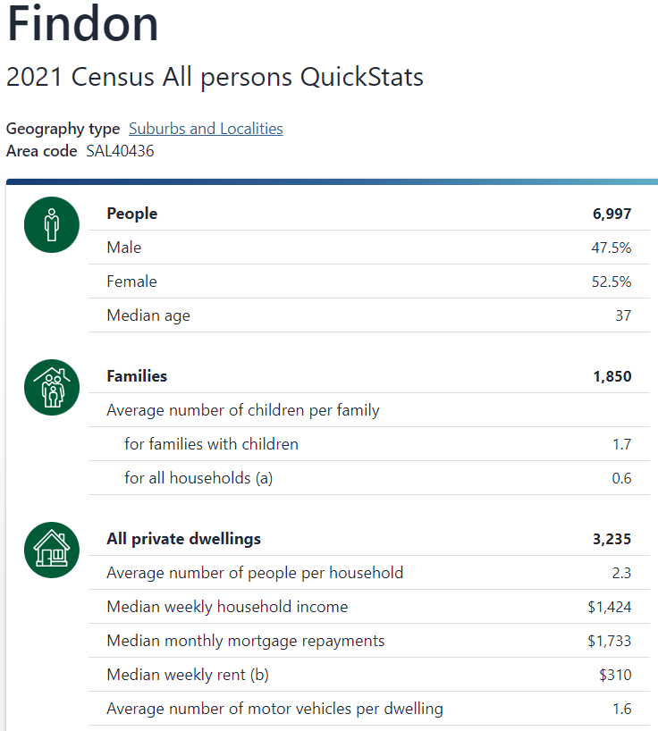
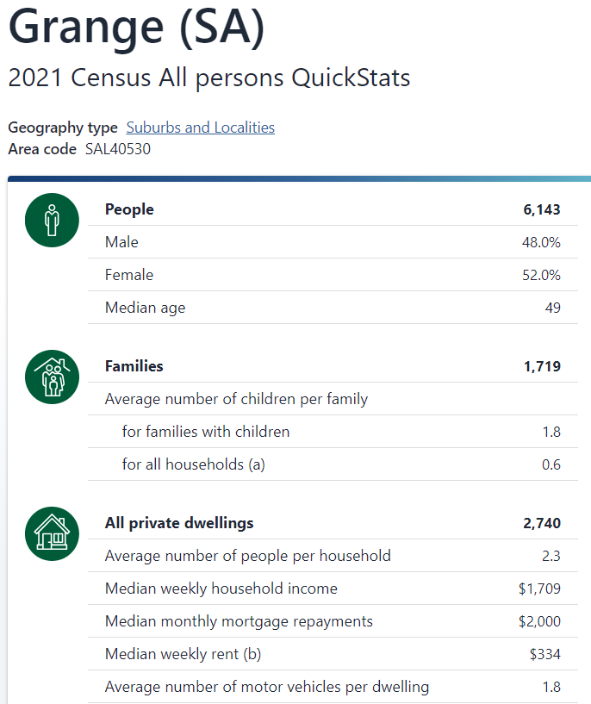
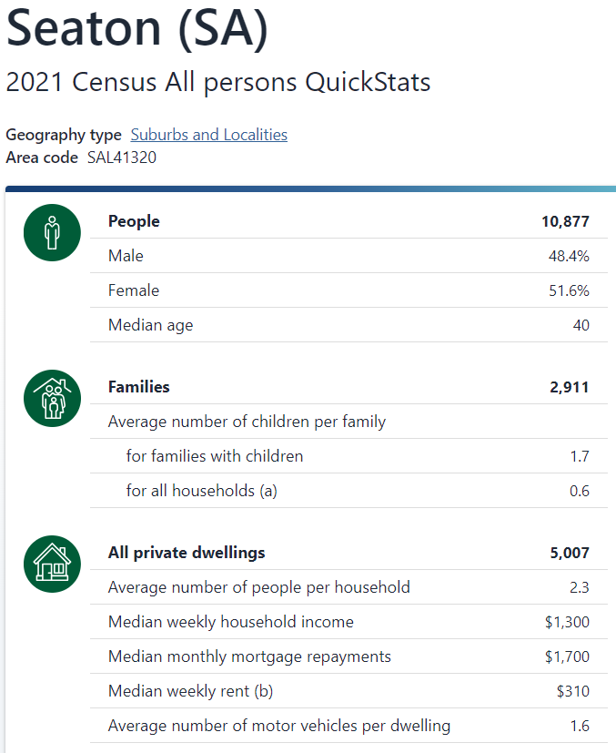
The 3 snapshots appended below, of the census run in 2021, were obtained from the Australian Bureau of Statistics, to determine the density of each suburb. Seaton had the highest number of dwellings. The graphs indicate that Seaton also had the most number of sales between the 3 suburbs.

Slide 15
Northern Suburbs (Modbury, Salisbury, North Adelaide & Enfield)
Isha Sharma

Slide 16
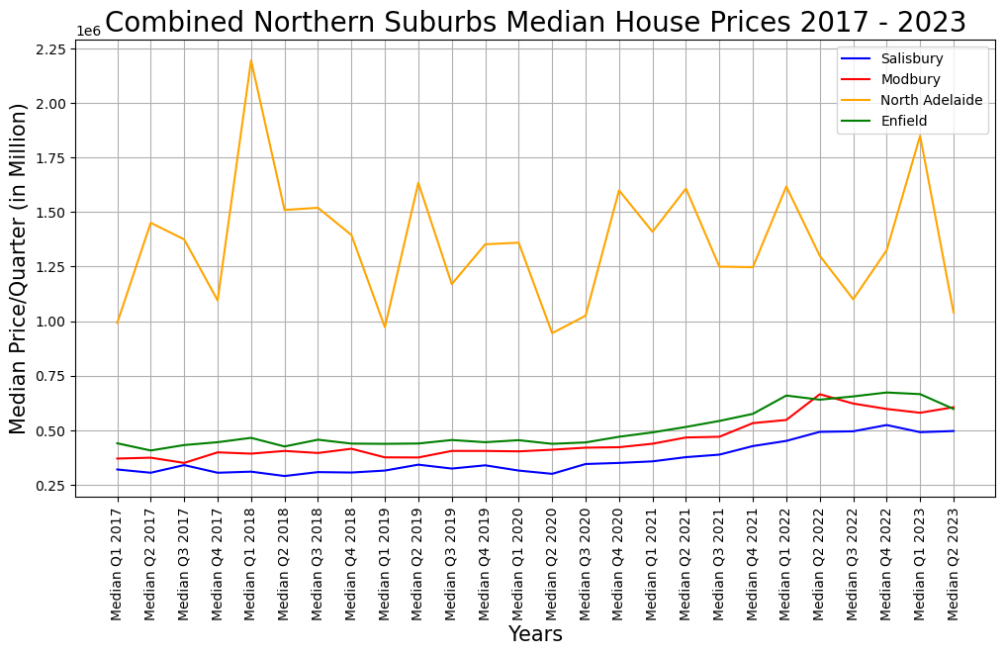
Distance from Adelaide CBD impacts the Median house price as can be seen in the picture. Closer the suburb to the city, higher the median house price. Although, mass can have accessibility to all the amenities, still most population chose to reside in distant suburbs

Slide 17
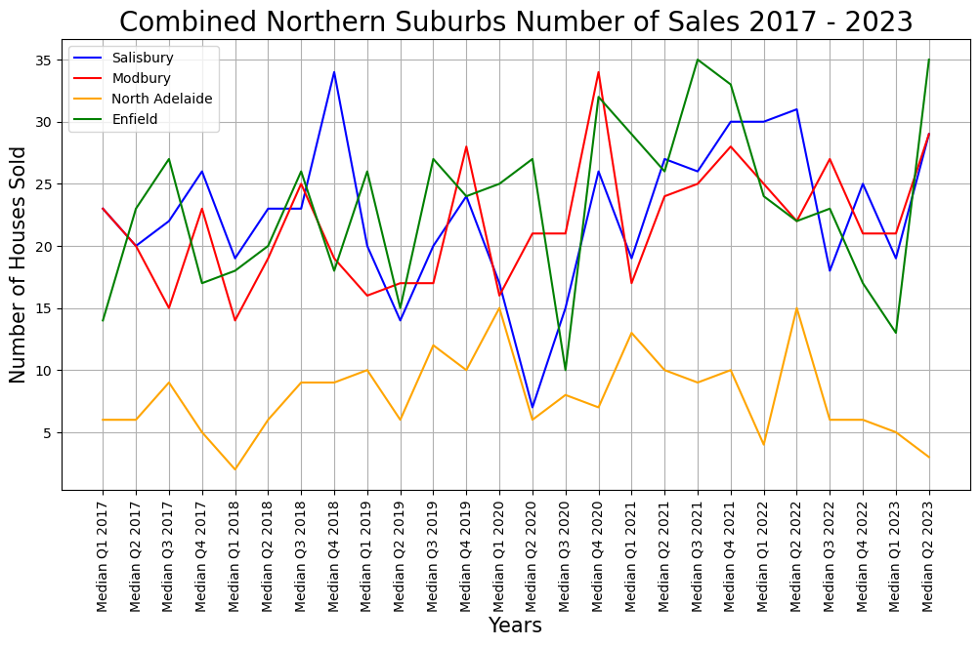
Does proximity to the city center has any impact on number of sales?

Slide 18
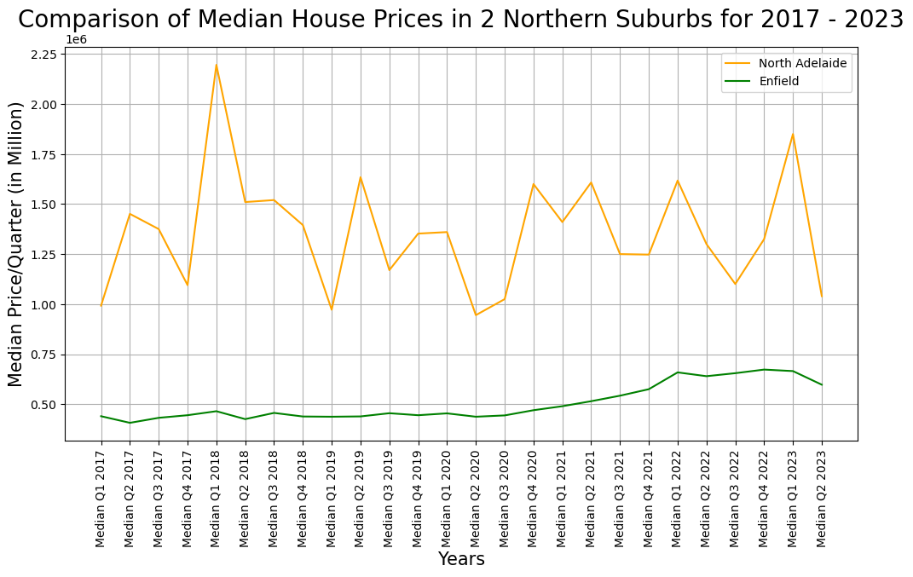

Slide 19
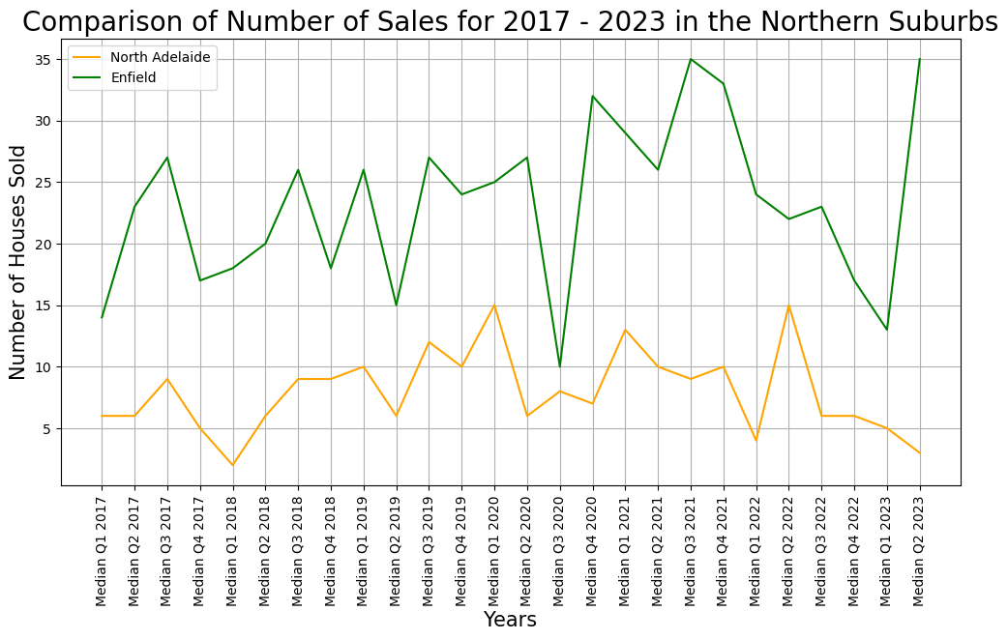
Comparison of impact on sales

Slide 20
Southern Suburbs (Adelaide CBD, Goodwood, Edwardstown, Pasadena & Flagstaff Hill)
Van Hoang

Slide 21
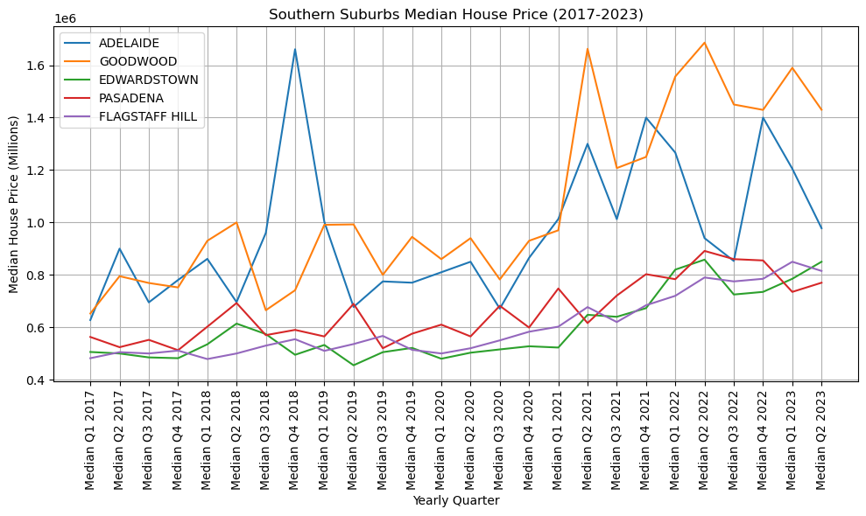
How the median house price in selected Southern Suburbs changed from 2017 to quarter 2 2023?

Slide 22
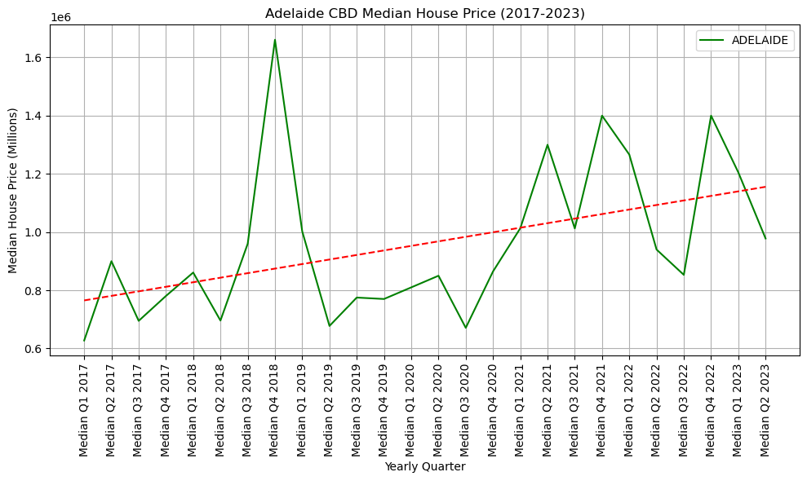
Adelaide Trend Line

Slide 23
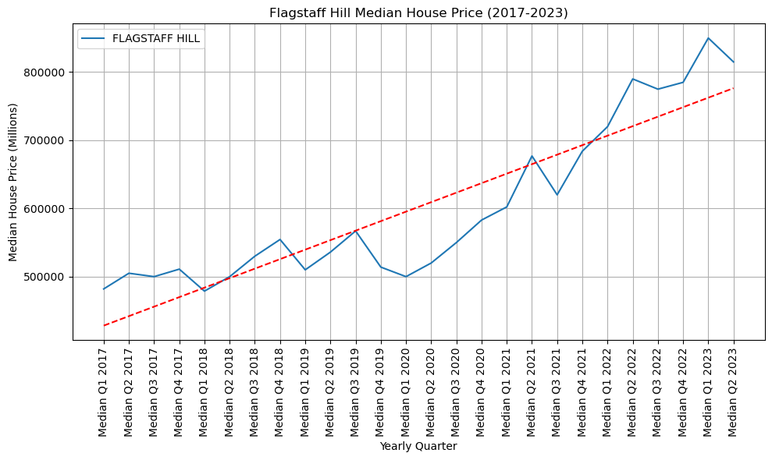
Flagstaff Hill Trend Line

Slide 24
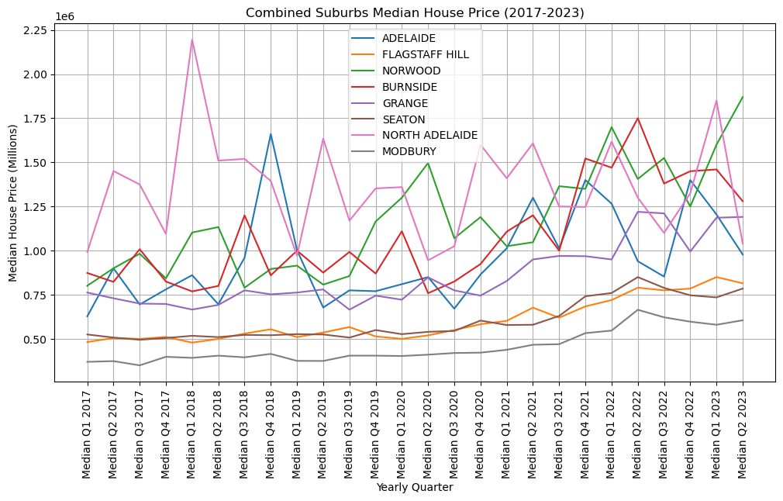
Suburb Combinations from Four Directions: South, North, East, and West of Adelaide CBD

Slide 25
THANK YOU

