Slide 1
MIlk Tea APps
Nhóm 2

Slide 2
General
1. PRODUCT SCOPE
II. STACEHOLDERS
III.FUNCTIONAL REQUIREMENTS
IV. NON- FUNCTIONAL REQUIREMENTS
V. RELEASE METHOD

Slide 3
1. PRODUCT SCOPE
75% of staff in the field of restaurants - food and beverage are asked to "pocket" their money when given the opportunity (According to Brain Research Institute). A strict management system will help you completely eliminate employee fraud.
Sales process is not optimized.
To sell milk tea, you both have to sell to customers sitting at the shop, and sell to customers to take-away just received online orders (If any)... Quick sales solution, centralized sales data, continuously reported sales data will help you solve these problems

Slide 4
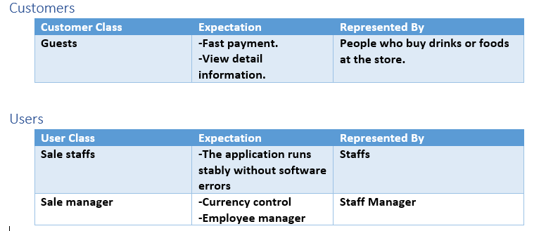
II. STACEHOLDERS

Slide 5
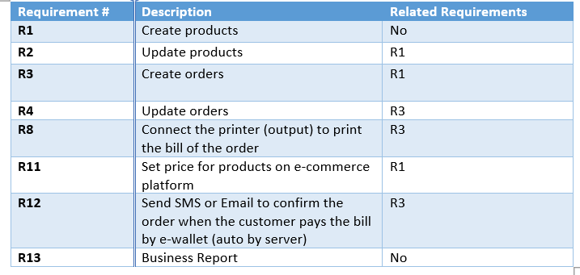
III. FUNCTIONAL REQUIREMENTS
1.User Functional Requirements

Slide 6
III. FUNCTIONAL REQUIREMENTS
2.Customer Functional Requirements

Slide 7
IV. NON- FUNCTIONAL REQUIREMENTS
1. Targeted Platforms
We build apps for Windows XP operating system based on current programming language C# with NetBeans support tool. Along with that, we built a database system with SQL server to make the management easier.
2. Performance
We wish to “create orders” and “check memberships” functions finish into 0.5 second.
The maximum delays of other function about 2 second.

Slide 8
IV. RELEASE METHOD
We use Agile/ Scrum

