Slide 2
Index
structural organization
Implementation

Slide 3
Structural Organization
Overall Structure:
-> Raw Data
-> Data processing with / without HDFS
-> Store data into Database Server
-> Building Connection between Database server and Web server with php / sql
-> Organize Web with PHP / Java Script / HTML
-> Implementing functions with PHP / Java Script / Python
-> Available Web page for people
Flow Chart
Raw Data
HDFS
Data Processing
Database Server
Construct Connection
Webpage Server
Visualizing Service
Webpage

Slide 4
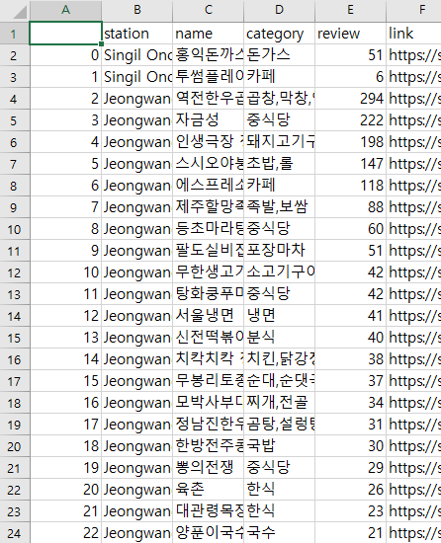
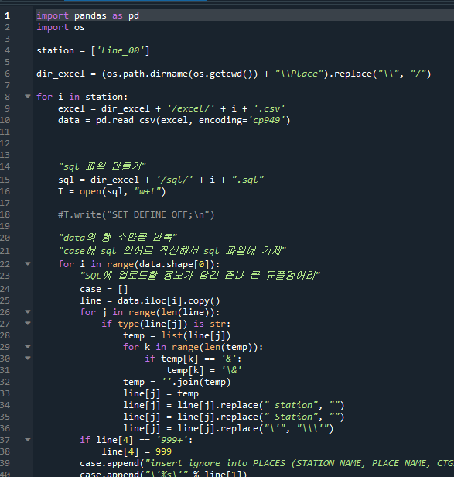
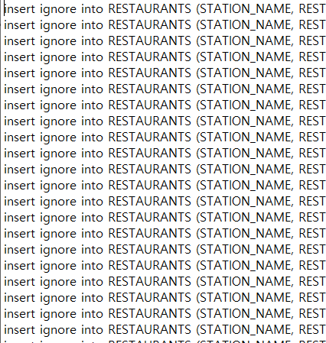
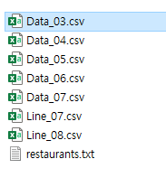
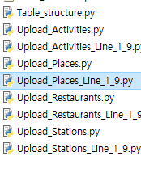
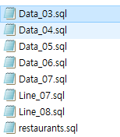
Structural Organization
Raw Data:
- Stores by category:
- by Crawling by Python
- for measuring scale of infrastructure
- info:
- Name of station; Name of store; Type of store;
- Category of store; Number of reviews; Link;
- Number of mentions
- by Crawling by Python
- for measuring degree of activation
- info:
- ???? 여기는 내가 모름 ㅜ퓨ㅠ
Database Server:
- MySQL:
- as form of table
- by big categories
- Stations; Activities; Places; Restaurants;
- Hadoop:
- 여기도
- 나는 모르는 부분
- 너희가 넘겨준 데이터 설명
- ???? 여기는 내가 모름 ㅜ퓨ㅠ
Data Processing:
- Trim raw data for database:
- by using Python
- csv -> sql
- for each tables
- Stations; Activities; Places; Restaurants;

Slide 5
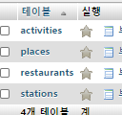
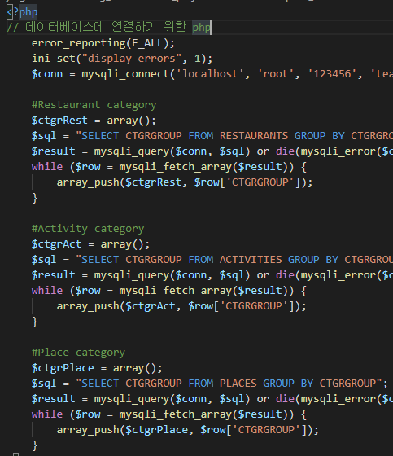
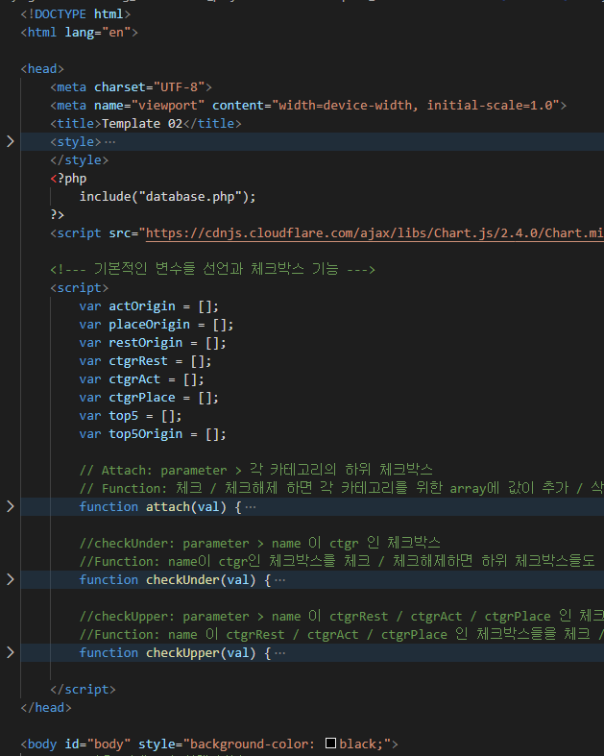
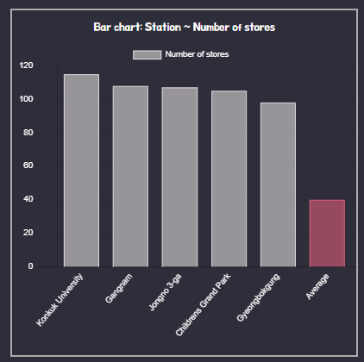
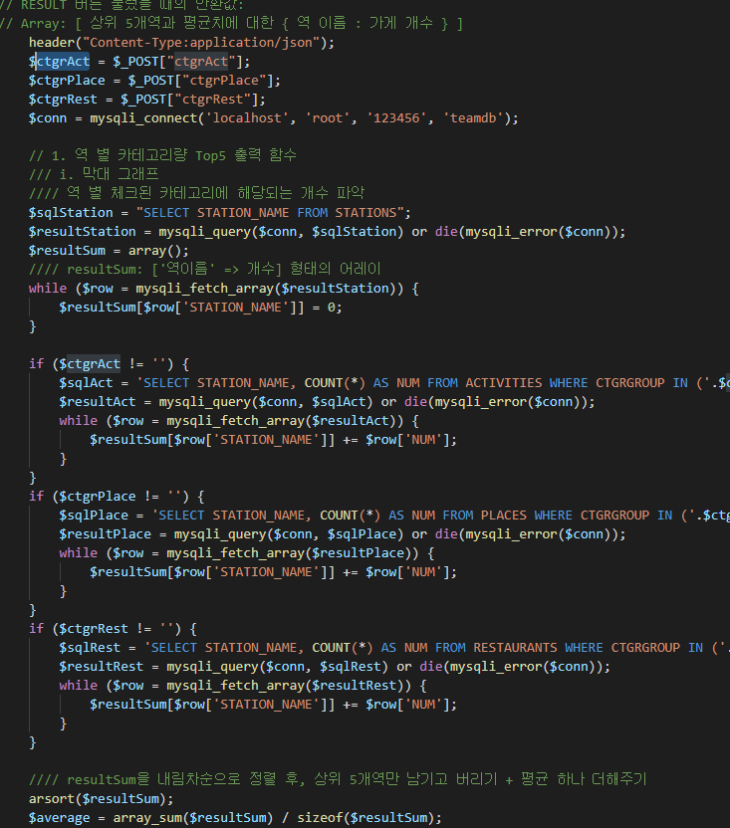
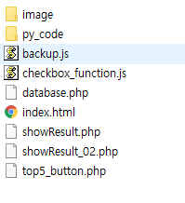
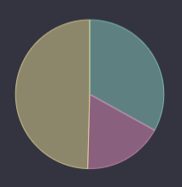
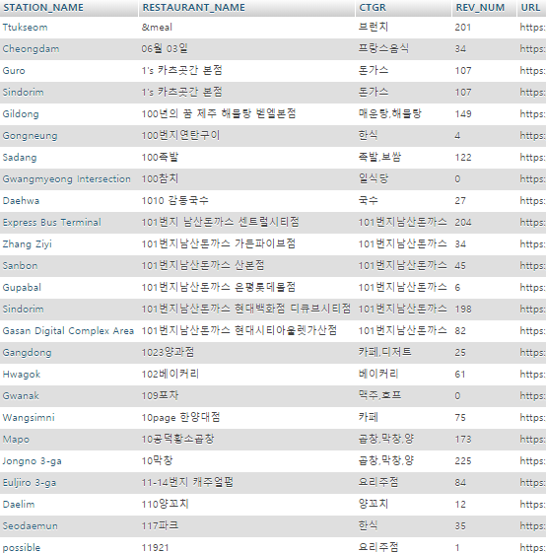
Structural Organization
Construct Connection:
- Building connection for transmission:
- by using PHP and sql
Visualizing Service:
- by Java Script / PHP / Python:
- Organizing codes / import packages(chart.js)
Webpage Server:
- Apache:
- based on HTML with many languages
- Enable external connection

Slide 6


Structural Organization
Directory: py_code
Files & Directories Structure:
Storage for data about Python
Directory: part
Storage for raw data through HDFS
users
database.php
Index.html
graph.py
Database: MySQL
Essential data for UI
UI / Interaction
Function for data processing
showResult.php
Top5_button.php
Functions / Changes for user’s behaviors
Directory: image
Functions / Changes for user’s behaviors
Storage for processed image through HDFS
showResult_02.php
Created input(<button>, etc)
Functions / Changes for user’s behaviors
UI / Interaction

Slide 7
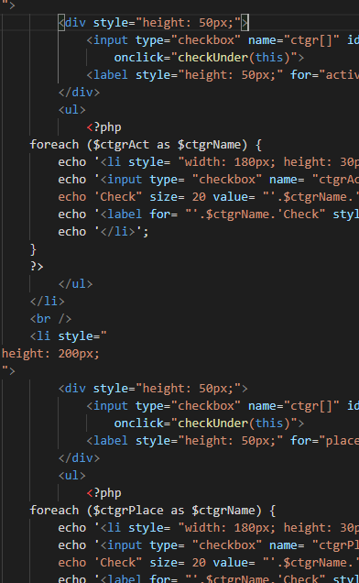
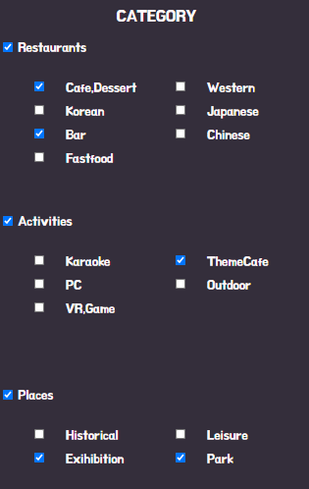
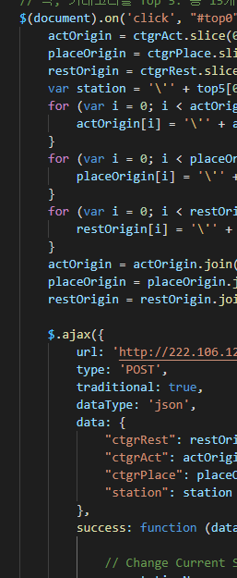
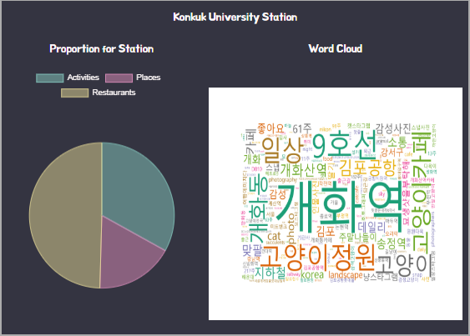
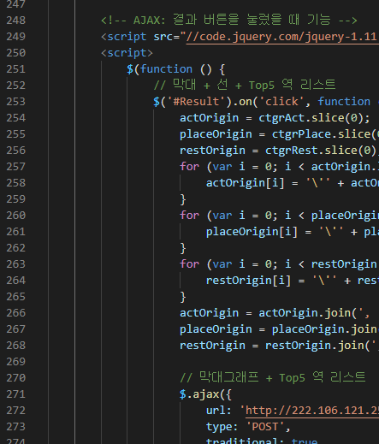
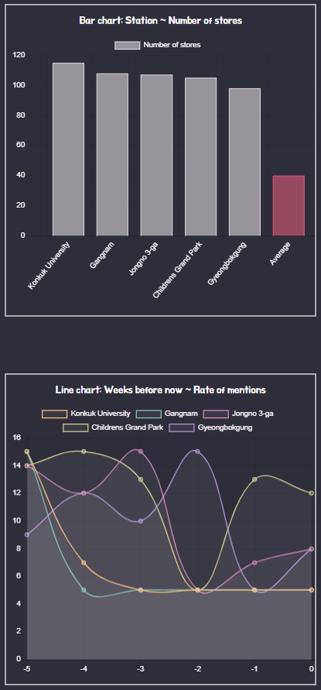
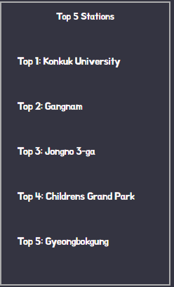
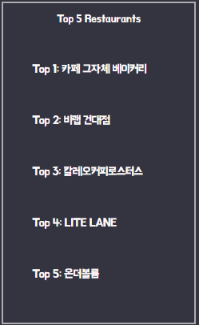
Implementation
Category checkboxes
- Enable users to choose their interests
- Get ‘category’ data from database
- Functions for checkbox-to-checkbox association
- Used Languages: PHP / HTML / Java Script
Button for result
- Show result about user’s choice
- Get data from database / directory
- Draw Bar chart / Line chart
- Bar chart for {station, number of stores}
- Line chart for {weeks, rate of mention}
- List top 5 stations
- as button
- Functions for buttons
- Used Languages: PHP / HTML / Java Script
Top 5 Stations as Button
- Show result about user’s choice
- Get data from database / directory
- Draw Pie chart / load Word cloud
- Pie chart for {category, number of stores}
- Line chart for {weeks, rate of mention}
- List top 5 stores for each categories
- as image / chart / list
- Used Languages: PHP / HTML / Java Script / Python

Slide 8
Problem and Debugging
Problem: Error 400, 404, 500, etc
- Some scripts became wrong
Debugging
- Using <script> console.log(); </script>
- Break suspicious points and check if it printed
- Follow the logical procedure
Error from html / Java Script / sql / Python
- Possibility of syntax error or extra
Debugging
- Click the line that occur error
- Check for grammatical error
- Using <script>alert();</script>
- Follow logical procedure
Error without any return
- 99% php error
- Unable to specify the fault point
Debugging
- Check the latest modified line
- Using echo”<script>alert();</script>”;
- Using echo $variable;
- Repeat until finding the fault point

