Slide 1

Good Team
A D D O N
15146311 Jun, Nyeongnam
15146314 Yang, Seunghyuck

Slide 2


Description
Description
Develop
Environment
Server Architecture
implementation
Result
Conclusion
Part-time necessary function
Provide the necessary features for both part-timers and bosses
monthly/weekly/daily salary calculations
+
Personal schedule management
+
Human Resource management
Boss necessary function
A D D O N

Slide 3
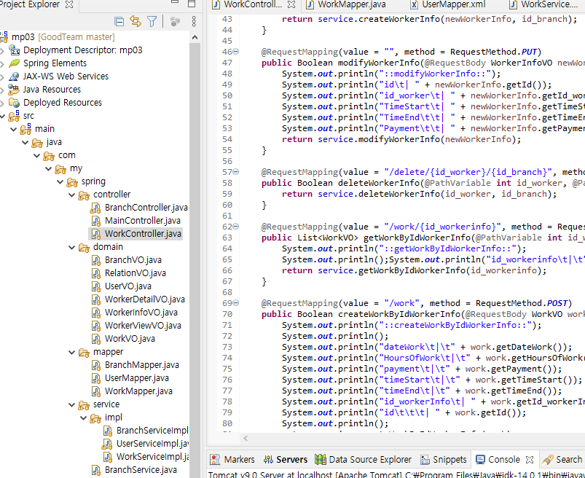
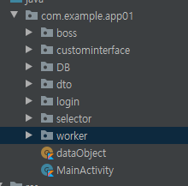


Develop
Environment
Description
Develop
Environment
Server Architecture
implementation
Result
Conclusion
Module
Server
Client
APP
Spring Boot
Android Studio
Three Module + a
Main
Boss
Worker
For each type of data(VO)
Categorized By its function
Necessary of module division
Efficient management
Software with experience(partial parts)
Hope to develop Spring-based rest API
Learning Kotlin
Optimal solution for making android app

Slide 4
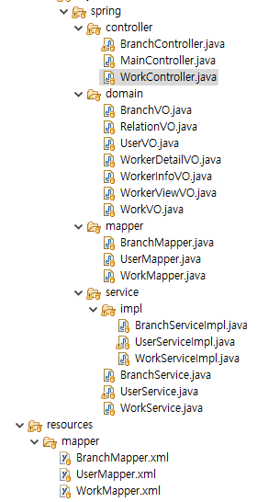
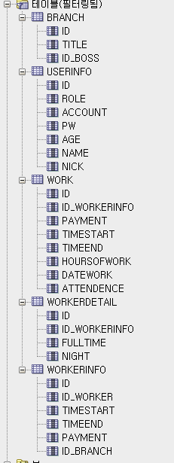
Server
Architecture
Description
Develop
Environment
Server Architecture
implementation
Result
Conclusion
Server : Spring Boot
Building components for each VO
Controller .java
Domain .java
Mapper .java
Service .java
Service implementation .java
Mapper .xml + sql
Data
Data Objects which defined in advance
Branch
UserInfo
Work
WorkerInfo
WorkerDetail

Slide 5
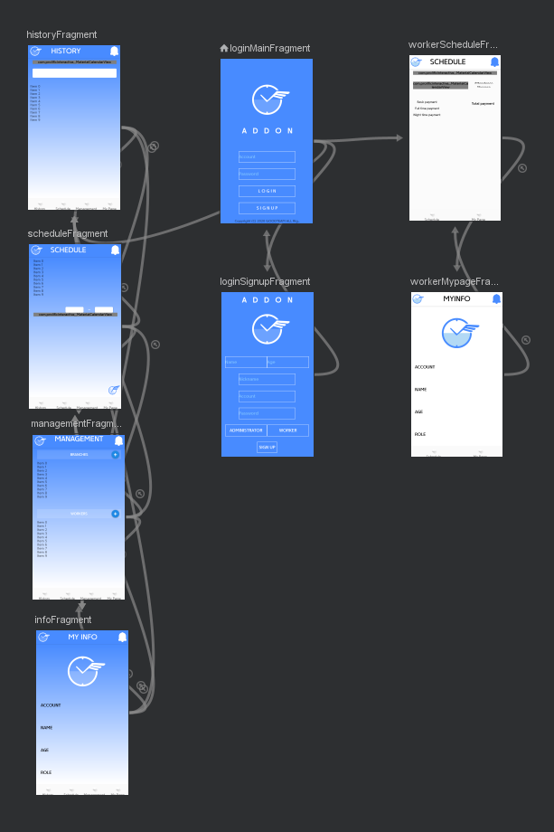
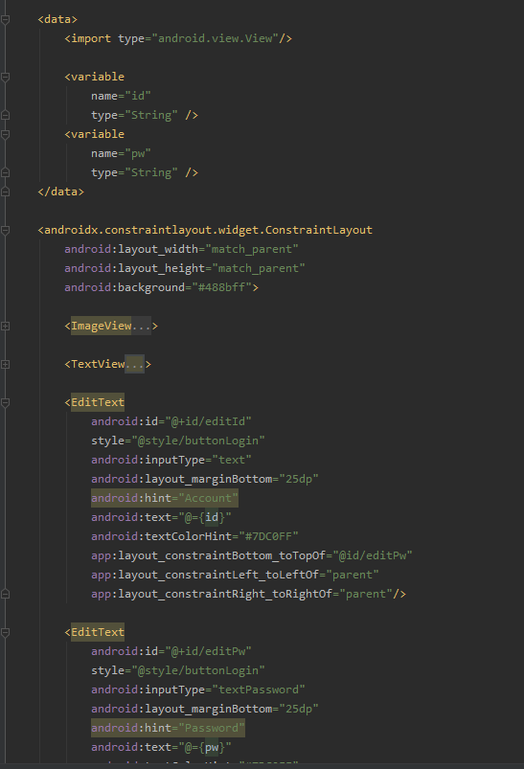
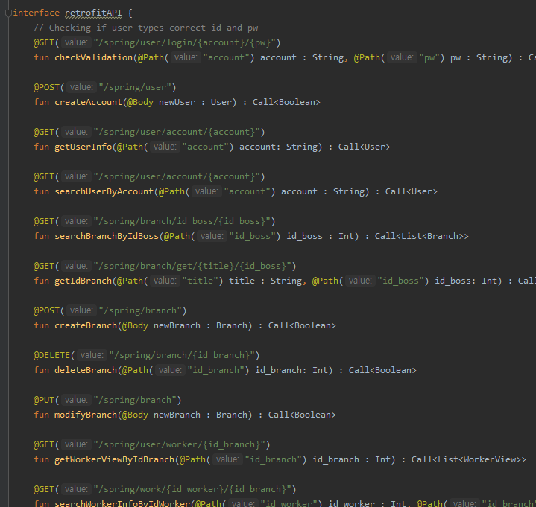
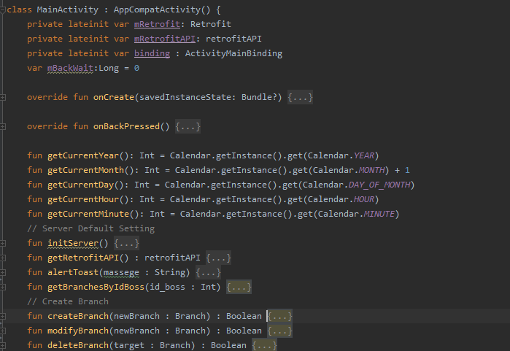
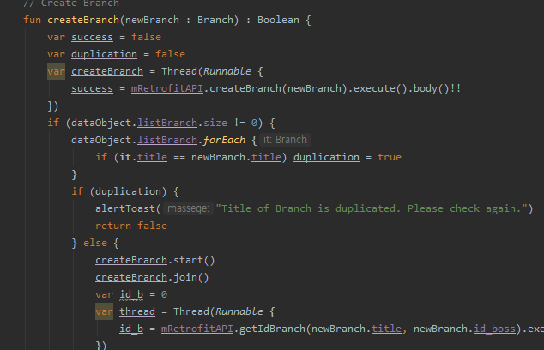
Implementation
Description
Develop
Environment
Server Architecture
implementation
Result
Conclusion
Navigation & DataBinding
Retrofit API & Server Connection
Navigation to designate movement between fragments
DataBinding to handle variables and layouts actively
Create Interface for Retrofit API to interact with server connection
Assignment of various function for mapping to server
Initialization of functions from Activity with threads
Handling variables with server more clearly
Usage: Overall fragments, All layouts
Usage: Across all services

Slide 6
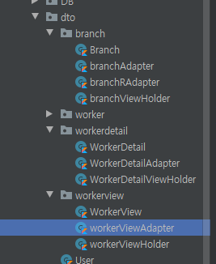
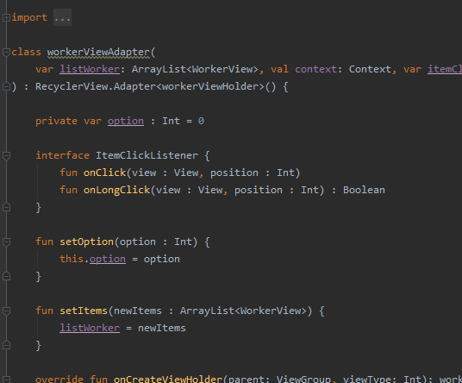
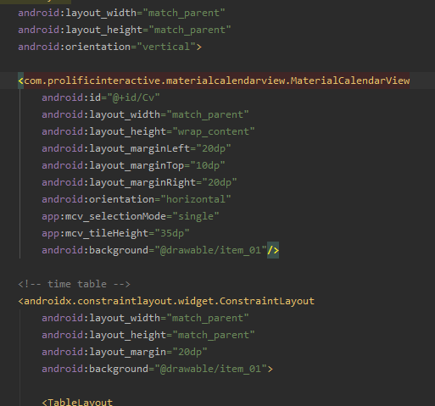
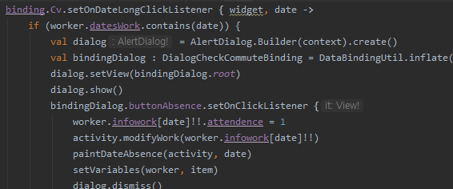
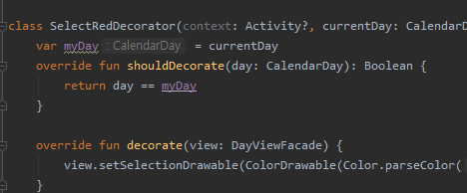
Implementation
Description
Develop
Environment
Server Architecture
implementation
Result
Conclusion
RecyclerView & ListView
CalendarView
RecyclerView and ListView to show list of data
such as branches, workers with each given conditions
Assignment of Adapter and ViewHolder
for each RecyclerViews and ListViews
Additional assignment of interface for implementing events
Implementation of customized CalendarView for required functions
which cannot be acquired by normal CalendarView
Customization for additional functions:
Differentiating dates with color, click events, etc.
Usage: List for branches, workers and worker information
Usage: Showing Schedule with timetable. Checking Attendance

Slide 7
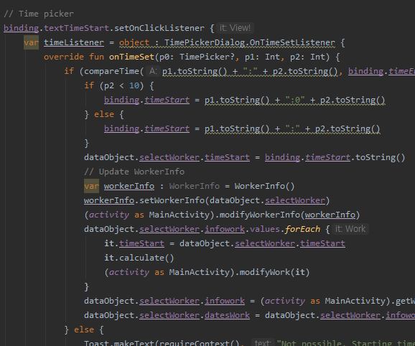
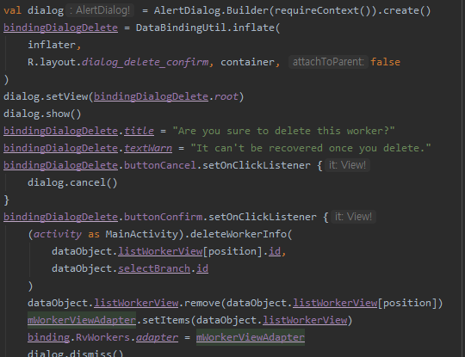
Implementation
Description
Develop
Environment
Server Architecture
implementation
Result
Conclusion
TimePicker
Dialog
Creating new window for various settings for requirements
Using with designated layouts by DataBinding
Implementation of other components such as
RecyclerView, CalendarView
Enable user to select commitment time and left time
Usage: Commitment time and left time selection
Usage: Detail modification of data, Non-main functions

Slide 8
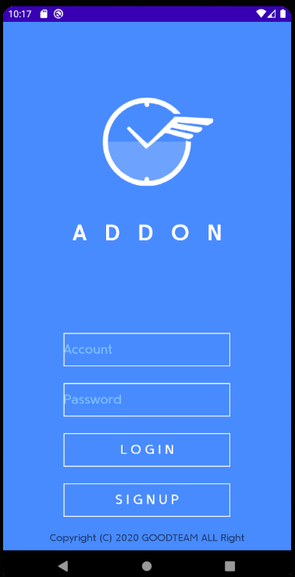
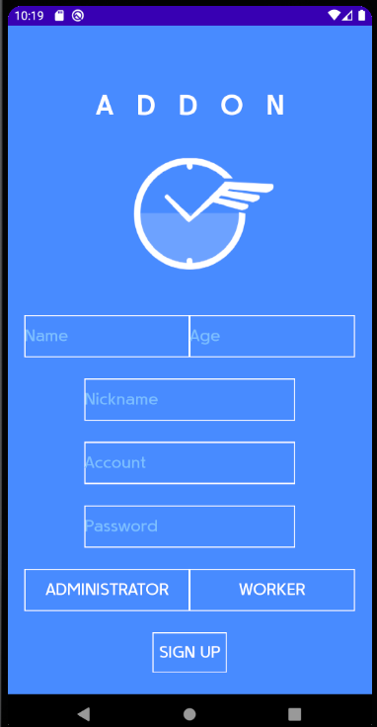
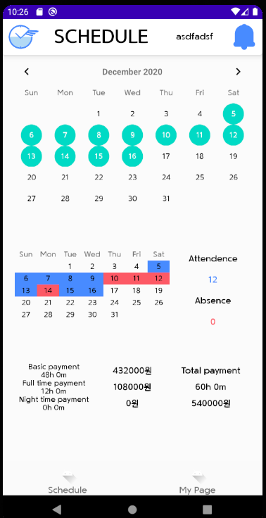
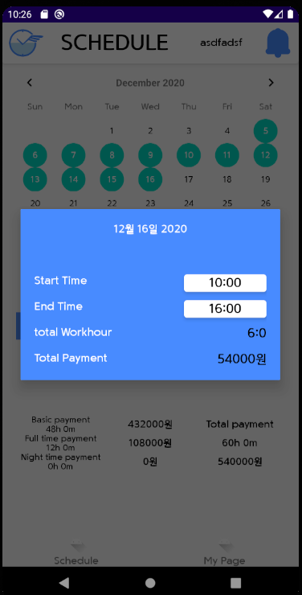
Result
Description
Develop
Environment
Server Architecture
implementation
Result
Conclusion
Main sides & Worker sides
Main page
Logo and title of application
Represents simplicity
Choose to Login or Signup
Navigate user to each fragments
which fits in their role
Signup page
Simple form for minimal requirements
Check constraints for each variables
duplication, prohibited letters
Schedule page
Brief summary of work for each branches
Check schedule selected by manager
Attendance checked by manager

Slide 9
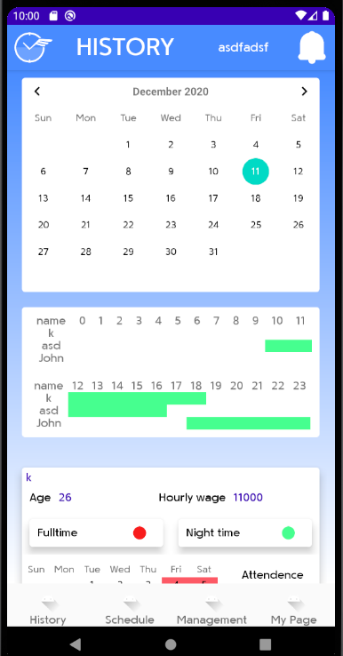
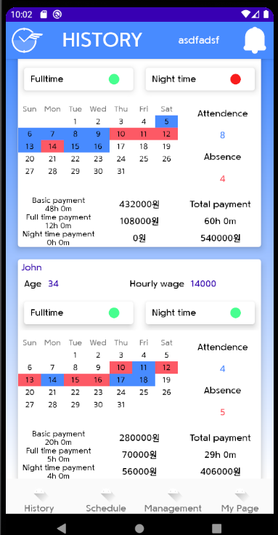
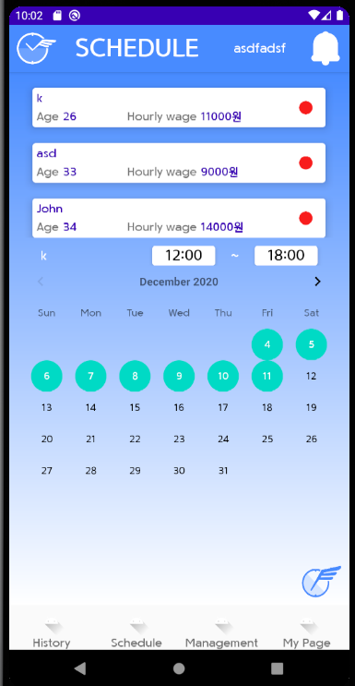
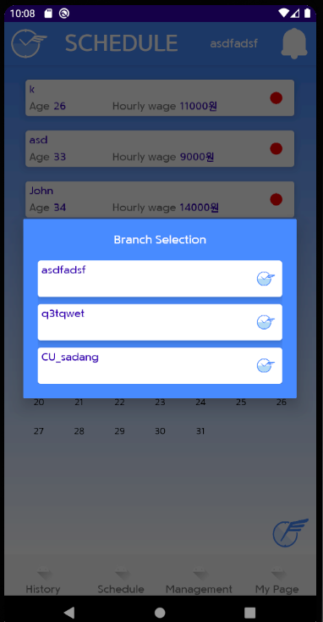
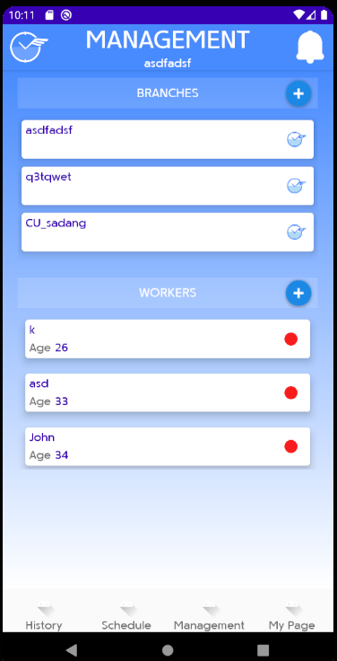
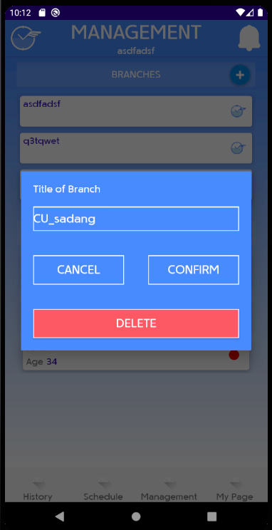
Result
Description
Develop
Environment
Server Architecture
implementation
Result
Conclusion
Boss sides
History page
Each date’s timetable for each branch
Each worker’s monthly summary
including checking attendance
and checking detail condition
Schedule page
Branch selection for boss user
Date selection for each workers
Detail modification for
wage, time for each/all dates
Management page
Management for branch
addition, modification, deletion
Worker management for each branch
addition, modification, deletion

Slide 10
Conclusion
Description
Develop
Environment
Server Architecture
implementation
Result
Conclusion
Achievement
Feedback
Experiencing Kotlin
Applying newly learnt functions
Implementation of most functions aimed for
Lack of designing stage
Lack of understanding structure
Limitation of implementation
caused by proficiency level

